Slide 1
Size Structure Dynamics
Recruitment
Natural Mortality
Population
Biomass
Fishing Mortality
Immigration
Emigration
Growth

Slide 2
Size Structure Methods
Length frequencies
Proportional Size Distribution (PSD)
was “Proportional Stock Density”
Proportional Size Distribution (PSD-X)
was “Relative Stock Density”

Slide 3
Length Frequency
Use “common” breaks depending on fish size and sample size
2, 5, 10, or 25 mm
0.1, 0.25,0.5,or 1 in

Slide 4
Size Structure Concept
Recruitment controls … numbers in smaller length bins.
Growth controls … fish “moving” into larger length bins.
Fishing mortality controls … fish removal from larger length bins.
Natural Mortality
Natural mortality controls …
fish removal from smaller length bins
and, without compensatory mortality, larger length bins.
Natural Mortality
Thus, size structure analysis provides insight on many aspects of population dynamics!
Frequency
Recruitment
Growth
Fishing Mortality
5
10
15
20
25
Length

Slide 5
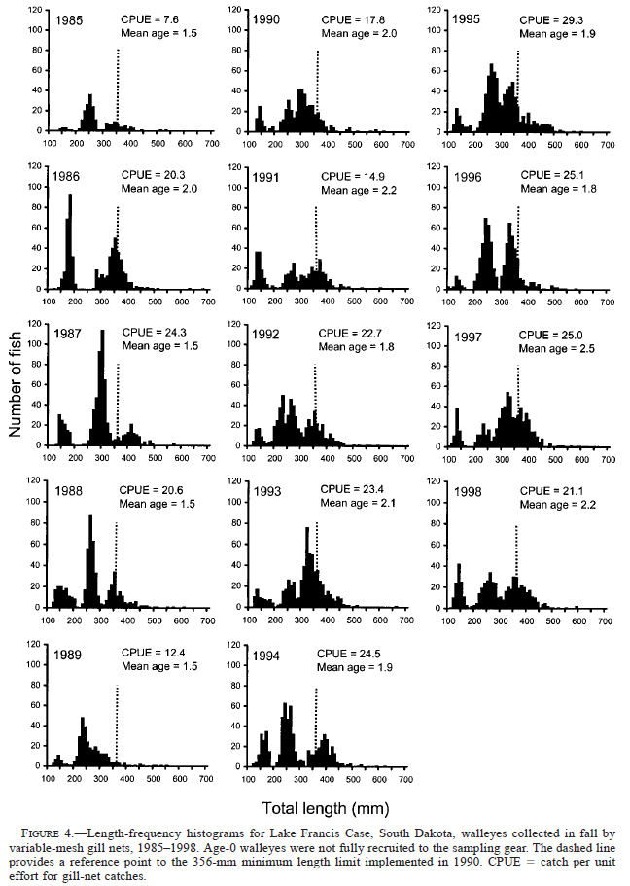
Length Frequency -- Example
From Stone and Lott. 2002. North American Journal of Fisheries Management 22:975–984

Slide 6
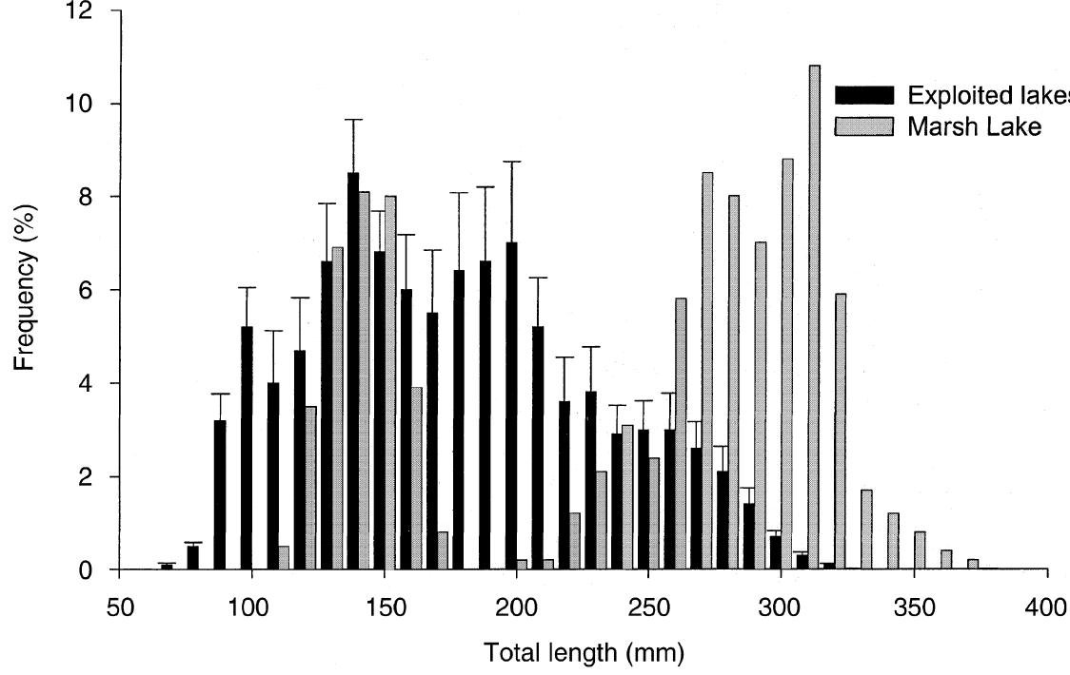
Length Frequency -- Example
From Paukert and Willis. 2001. Fisheries Management and Ecology 8:533-542

Slide 7
Length Frequency in R
Do Class Exercise I

Slide 8
Why fewer 6” than 10” fish?
Size structure summaries are heavily influenced by the relative selectivity of the gear used.
Frequency
5
10
15
20
25
Length

Slide 9
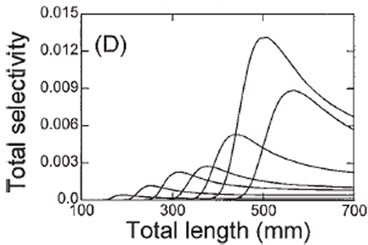
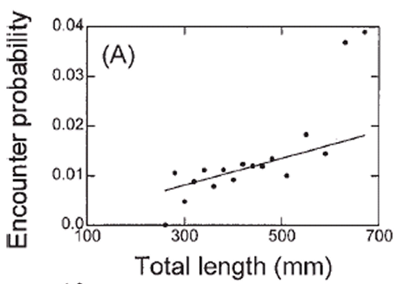
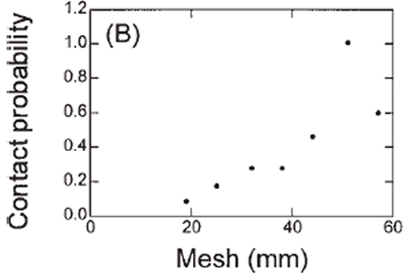
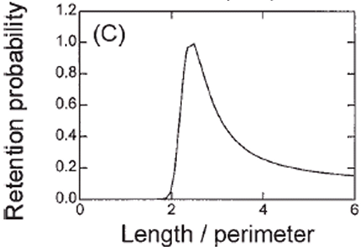
Gillnet -- Selectivity
Total selectivity is related to three parts of catch process
encounter
contact
retention
from Anderson, C.S. 1998. Partitioning total size selectivity of gill nets for walleye (Stizostedion vitreum) into encounter, contact, and retention components. Can. J. Fish. Aquat. Sci. 55: 1854–1863.

Slide 10
Gear Selectivity
Do Class Exercise II

