Slide 1
Abundance Estimates
Recruitment
Natural Mortality
Population
Numbers
Fishing Mortality
Immigration
Emigration

Slide 2
Common Abundance Estimates
CPE/CPUE (relative density)
Depletion/Removal (estimate of N₀)
Mark-Recapture (estimate of N₀)

Slide 3
Catch-Per-Unit-Effort
Consider two situations …
Lake A – 4 nets, 40 total fish
Lake B – 2 nets, 30 total fish
Which lake has a higher density of fish?
Consider another two situations …
Stream A – 50 fish in 25 minutes of shocking
Stream B – 60 fish in 35 minutes of shocking
Which stream has a higher density of fish?

Slide 4
Catch-Per-Unit-Effort
CPUE or CPE
Calculated as
(Catch / Effort)*scaling factor
Examples
50 lake trout in 1600 m of gillnet set for 2 nights
50 brook trout in 1600 s of electrofishing

Slide 5
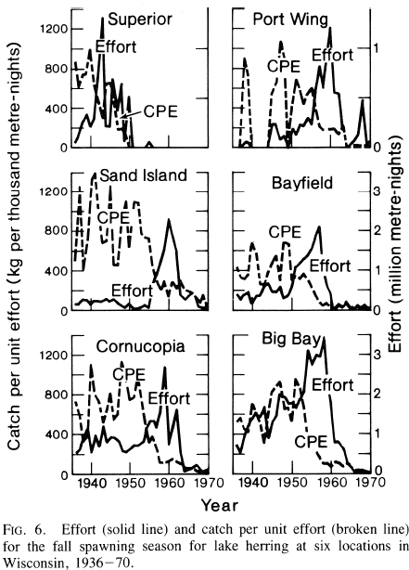
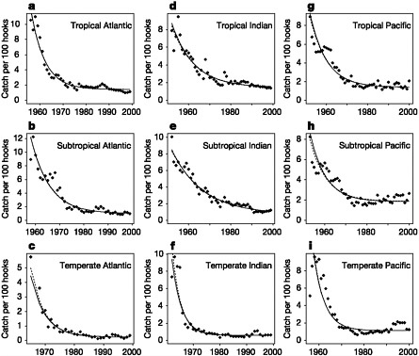
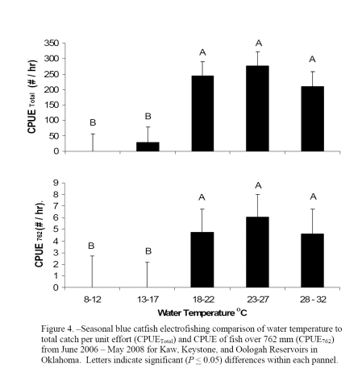
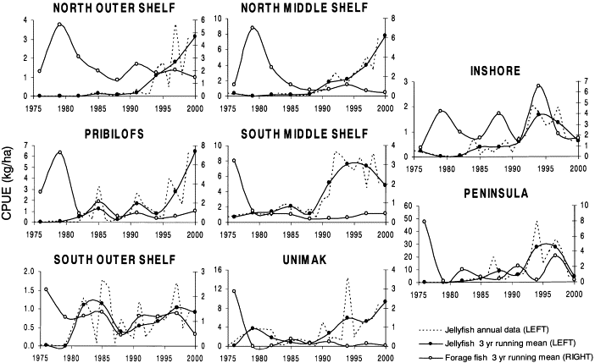
Catch-Per-Unit-Effort
Electrofishing
Longlines
Gillnet
Trawling

Slide 6
Catch-Per-Unit-Effort
Define
C_{t} = catch at time t
f_{t} = fishing effort at time t
q = catchability coefficient
proportion of population captured w/ one unit of effort
What is …
q*f_{t}
q*f_{t}*N_{t}
q*N_{t}
Thus, CPE measures relative abundance

Slide 7
Common Abundance Estimates
CPE/CPUE (relative density)
Depletion/Removal (estimate of N₀)
Mark-Recapture (estimate of N₀)

Slide 8
Concept – Depletion Estimate
Consider this situation …
Sampling a pond with three fyke nets
No limit on number of sampling events (days)
Fish are removed from pond when captured
Compute CPE as … total fish/day
Compute cumulative catch prior to each day
What would the following graph look like?

Slide 9
Concept – Depletion Estimate

Slide 10
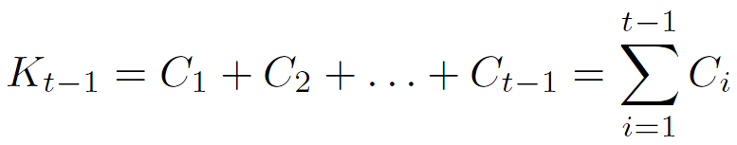

Development – Depletion Estimate
Define (along with N₀, N_{t}, C_{t}, and q)
K_{t-1} = cumulative catch prior to time t
i.e.,
Key relationship
Substitute CPE equation for N_{t} and simplify
What type of function is this?
Notes:
(Ct/ft)=qNt, solve for Nt and substitute into Nt=N0-Kt-1 to get
(Ct/ft) = qN0 – qKt-1

Slide 11
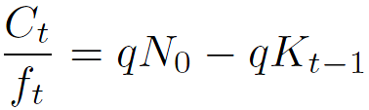
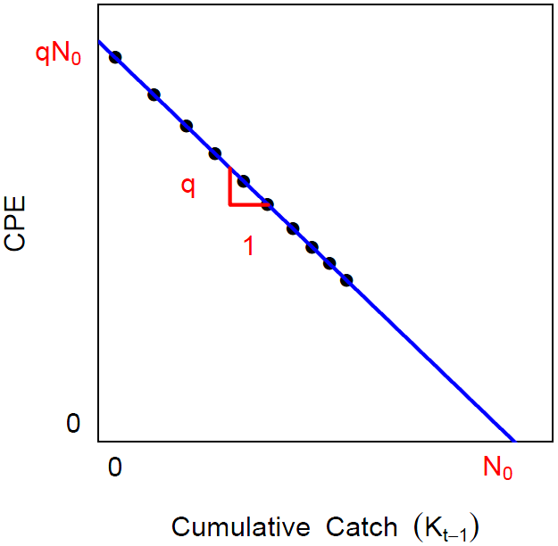
Development – Depletion Estimate
Use regression to fit linear model
q = -slope
N₀ = intercept/q

Slide 12
Leslie Model Assumptions
The population is closed.
Catchability (q) is constant.
All fish are equally vulnerable to capture method.
CPE is substantially reduced by fish removal.
Catches remove more than 2% of population.
Units of effort are independent - i.e., the individual units of capture method do not compete with each other.

Slide 13
Leslie Model HO
Examine HO
depletion()
plot()
coef()
summary()
confint()

Slide 14
K-pass Removal
Common in stream work
Several “passes” through an area are made
Number of fish captured are counted
Captured fish are physically removed
Derivation of estimates is complex.
Zippin and Carle-Strub methods are common
Carle-Strub somewhat more general

Slide 15
Common Abundance Estimates
CPE/CPUE (relative density)
Depletion/Removal (estimate of N₀)
Mark-Recapture (estimate of N₀)

Slide 16
Mark-Recapture Methods
Marking/Tagging
Batch
Cheaper, but has limitations
Individual
Expensive, but also allows estimates of mortality / survival, recruitment, movement
Recapture information recorded in “capture history” format.

Slide 17
Concept – Single-Census M/R
i=1
i=2
First sample is called the “marking run”
Second sample is called the “recapture run”

Slide 18
Parameter / Statistics Definitions
N = population size
M = number marked in popn
n = recapture sample size
m = number marked in recapture sample
m=7
n=19
M=16
N=50
i=1
N=50
i=2

Slide 19
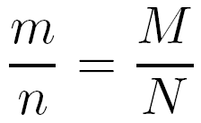
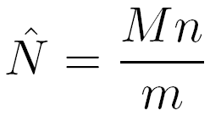
Estimation Concept
Central concept ...
… which is immediately rewritten as
Explore with mrClosed1Sim()
Use defaults, re-randomize several times

Slide 20
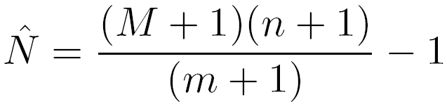
Chapman Modification
Chapman modified the Petersen method
Bias is negligible if m>7
Explore with mrClosed1Sim(type=“C”)
Use defaults, re-randomize several times

Slide 21
Estimation Example
Hand Calculation
Examine handout
mrClosed()
summary()
confint()
n=19
m=7
M=16
N=50
i=1
N=50
i=2

Slide 22
Estimation Confidence Intervals
Seber (1982) suggests using …
… the binomial distribution of m/n > 0.10
… the normal approximation if m > 50
… the Poisson approximation otherwise

Slide 23
Assumptions – Petersen Methods
The population is closed.
no losses due to emigration or mortality.
no gains due to immigration or recruitment.
All fish have the same chance of being caught.
Tagging fish does not affect their catchability.
Fish do not lose their tags.
All tagged fish are observed/reported when recaptured.

Slide 24
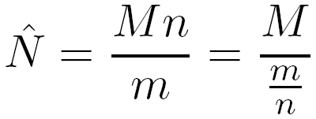
Assumptions – Effect of Violations
The Petersen estimate can be rewritten as
where the denominator can be thought of as the probability of capturing a marked fish.
If probability of capturing a marked fish is lower after the violation then N is overestimated.
If … higher … then N is underestimated.
Examine M/R Bias Simulation Case

Slide 25
Concept – Multiple-Census M/R
i=1
i=2
i=3

Slide 26
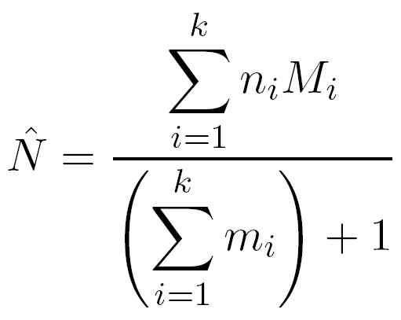
Schnabel Method (Chapman Modification)
Very similar to
Basically a weighted version of individual Petersen estimates

Slide 27
Capture History Format
A matrix
rows are individual fish
columns are capture events.
Each cell contains a …
“1” if the fish was captured
“0” if the fish was not captured (but was captured sometime)

Slide 28
Capture History – Example #1
Suppose that a researcher captured and individually marked 75 fish on day 1. Two days later, a total of 100 fish were captured of which 25 were marked.
How many columns in the capture history matrix?
How many rows in the capture history matrix?
What does a row look like for …
… a fish captured in both samples?
… a fish captured in the first but not the second?
… a fish captured in the second but not the first?
… a fish captured in neither sample?

Slide 29
Capture History – Example #2
A researcher samples a stream weekly for 8 weeks. What is the capture history row for a fish …
marked in week 2 and re-captured in weeks 7 & 8?
marked in week 3 and then not seen again?
marked in the first week, captured again in week 3, and captured again in week 5 but not again?

Slide 30
Capture History – Example #3
Suppose the following summary of capture histories.
CH 001 010 011 100 101 110 111
Fish 17 20 4 19 5 8 2
How many capture events? Captured fish?
How many fish captured in first sample and then not seen again?
How many fish captured in first sample and seen again?
How many fish were captured twice?
How many fish were never captured?

Slide 31
Capture History
Examine HO
capHistSum()
mrClosed()
summary()
confint()
plot()

