Slide 1
Population Ecology

Slide 2
Unit Stock
“A unit stock can be theoretically described as a group of individuals of the same species whose gains by immigration and whose losses by emigration, if any, are negligible in relation to the rates of growth and mortality.

Slide 3
Unit Stock
“A unit stock can be theoretically described as a group of individuals of the same species whose gains by immigration and whose losses by emigration, if any, are negligible in relation to the rates of growth and mortality. A unit stock is essentially a self-contained population with its own spawning area.

Slide 4
Unit Stock
“A unit stock can be theoretically described as a group of individuals of the same species whose gains by immigration and whose losses by emigration, if any, are negligible in relation to the rates of growth and mortality. A unit stock is essentially a self-contained population with its own spawning area. It is isolated and fishing upon one unit stock has no effect upon the individuals of other stocks.” -- Holden and Raitt, 1974

Slide 5
Unit Stock
Closed, confined.
Identifies specific unit for management and unit of analysis (i.e., statistical population).
Difficult to define in some instances.
Too confined!? (what about watershed or system-level management)

Slide 6
Conceptual Model of a Stock
Recruitment
Natural Mortality
Population
Numbers
Population
Biomass
Fishing Mortality
Immigration
Emigration
Growth
Notes:
Measure things (size, age strux) on population box, make inferences about processes leading in and out.

Slide 7
Environments of a Stock
Socio-Cultural Environment
Economics
Politics
Physical Environment
Habitat
Biotic Environment
Competition
Recruitment
Natural Mortality
Population
Biomass
Fishing Mortality
Immigration
Emigration
Growth
Predation
Behavior
Beliefs
Behavior
Traditions

Slide 8
Simple Population Model
Consider a very simple population
Closed (no emigration, no immigration)
No fishing (no fishing mortality)
Only examine numbers (i.e., growth not examined)
Recruitment
Natural Mortality
Population
Numbers
Fishing Mortality
Immigration
Emigration
Growth

Slide 9
Simple Population Model
Define the following:
N_{t} = Population size (numbers) at time t
N₀ = Initial (time=0) population size
b = Per capita recruitment (birth) rate
d = Per capita mortality (death) rate
Population
Numbers
Recruitment
Natural Mortality
b
d
N_{t}

Slide 10
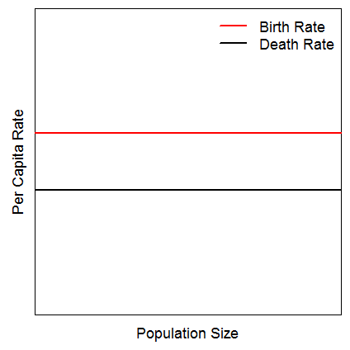
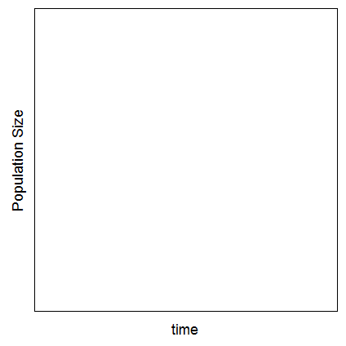
Simple Population Model
Population
Numbers
Recruitment
Natural Mortality
b
d
Consider this …
Draw this …

Slide 11
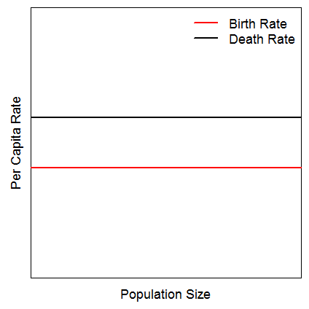
Simple Population Model
Population
Numbers
Recruitment
Natural Mortality
b
d
Now consider this …
And draw this …

Slide 12
Simple Population Model
Population
Numbers
Recruitment
Natural Mortality
b
d
N_{t}
Define the following:
bN_{t}
dN_{t}
Construct a model for estimating N_{t+1} from N_{t}
Construct a model for estimating N_{t} from N₀

Slide 13
Simple Population Model
What is r?
What are the population dynamics if …
… r = 0
… r > 0
… r < 0
Are these dynamics realistic? Why?

Slide 14
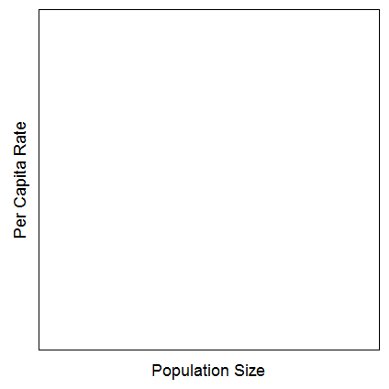
More Complex Population Model
If not realistic …
Then what is …

Slide 15
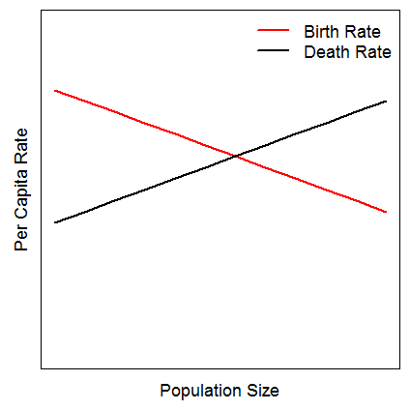
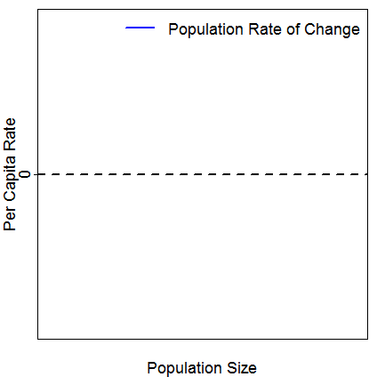
More Complex Population Model
Consider this …
Draw this …

Slide 16
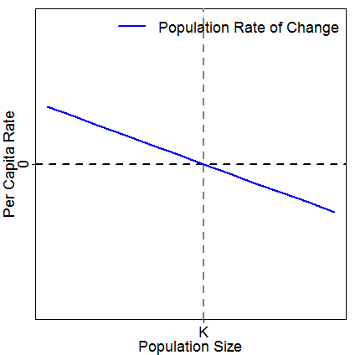
More Complex Population Model
Consider this …
Sketch this (assume low N₀) …

Slide 17
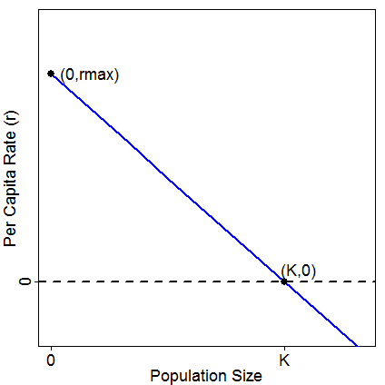
More Complex Population Model
Define equation for r
Substitute into exponential growth model and simplify
Notes:
r=rmax-(rmax/K)*Nt
Nt+1=[1+rmax(1-(Nt/K)]*Nt

Slide 18
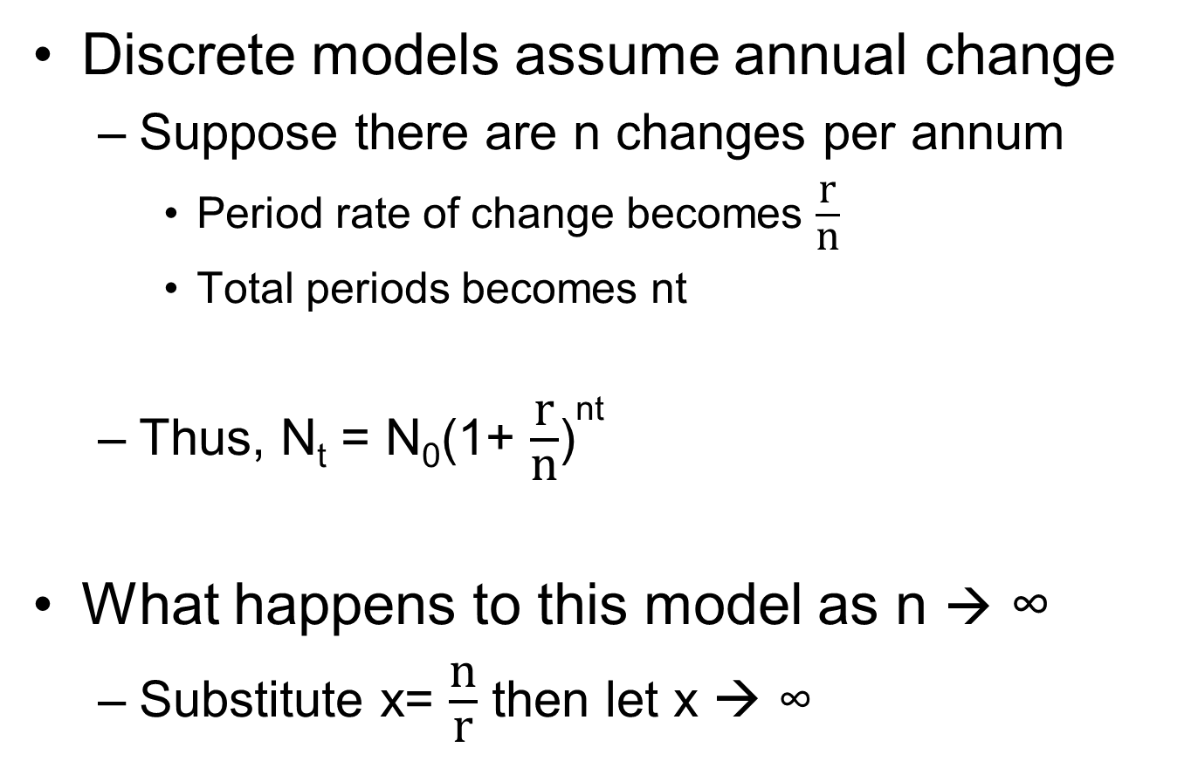
Continuous Models
Discrete models assume annual change
Suppose there are n changes per annum
Period rate of change becomes $\frac{\text{r}}{\text{n}}$
Total periods becomes nt
Thus, N_{t} = N₀(1+ $\frac{\text{r}}{\text{n}}$)^{nt}
What happens to this model as n → ∞
Substitute x= $\frac{\text{n}}{\text{r}}$ then let x → ∞
Notes:
N0(1+1/x)^(xrt)

Slide 19
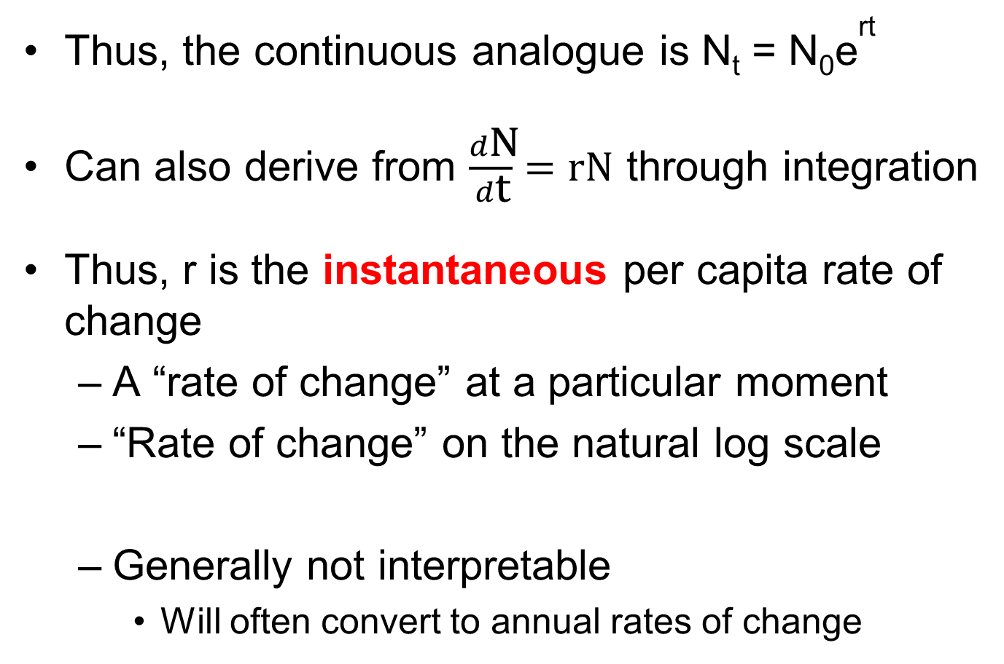
Continuous Models
Thus, the continuous analogue is N_{t} = N₀e^{rt}
Can also derive from $\frac{d\text{N}}{d\text{t}}=\text{rN}$ through integration
Thus, r is the instantaneous per capita rate of change
A “rate of change” at a particular moment
“Rate of change” on the natural log scale
Generally not interpretable
Will often convert to annual rates of change

Slide 20
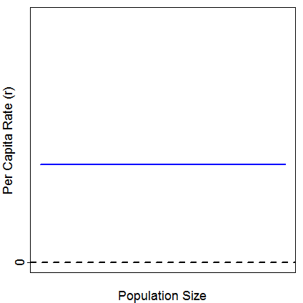
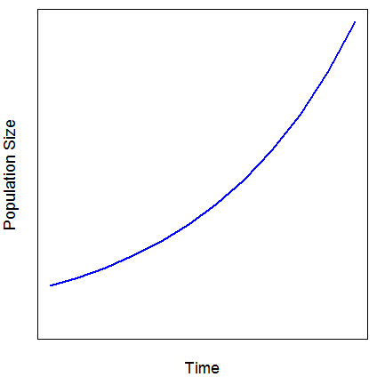
Density Independent Popn Growth
Rate of change does not depend on population size (i.e., density)

Slide 21
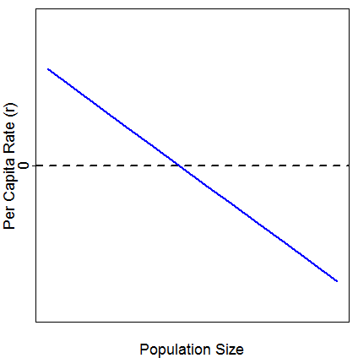
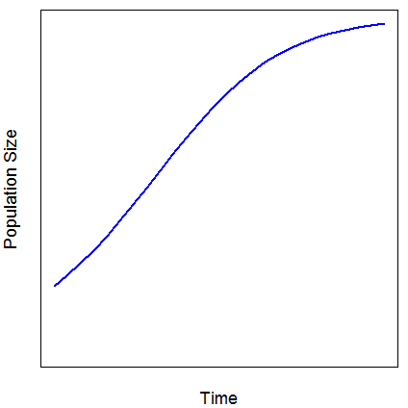
Density Dependent Popn Growth
Rate of change does depend on population size (i.e., density)

Slide 22
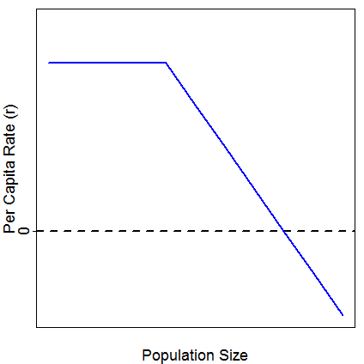
Density Dependent Popn Growth
Rate of change does depend on population size (i.e., density) …
… but not always in a linear fashion

