Slide 1
Abundance Estimates
Recruitment
Natural Mortality
Population
Numbers
Fishing Mortality
Immigration
Emigration

Slide 2
Common Abundance Estimates
CPE/CPUE (relative density)
Depletion/Removal (estimate of N₀)
Mark-Recapture (estimate of N₀)

Slide 3
Catch-Per-Unit-Effort
Consider …
Lake A – 4 nets, 40 total fish
Lake B – 2 nets, 30 total fish
Which lake has a higher density of fish?
Consider …
Stream A – 50 fish in 25 minutes of shocking
Stream B – 60 fish in 35 minutes of shocking
Which stream has a higher density of fish?

Slide 4
Catch-Per-Unit-Effort
CPUE or CPE
Calculated as
(Catch / Effort)*scaling factor
Examples
50 Lake Trout in 1600 m of gillnet set for 2 nights
50 Brook Trout in 1600 s of electrofishing

Slide 5
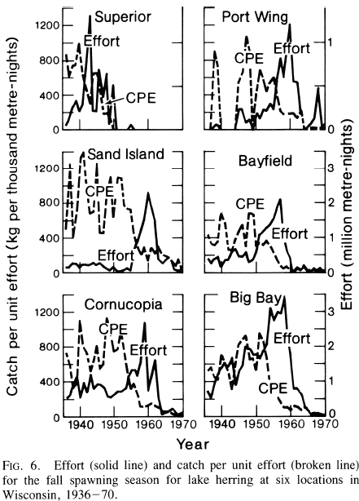
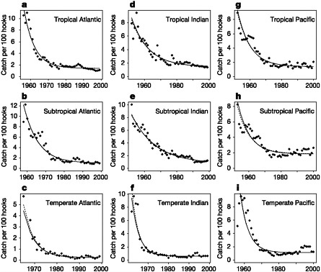
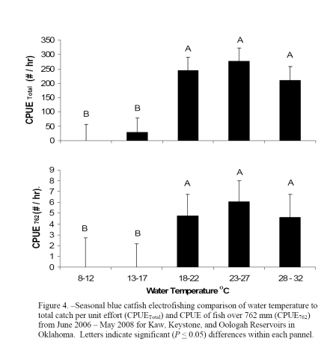
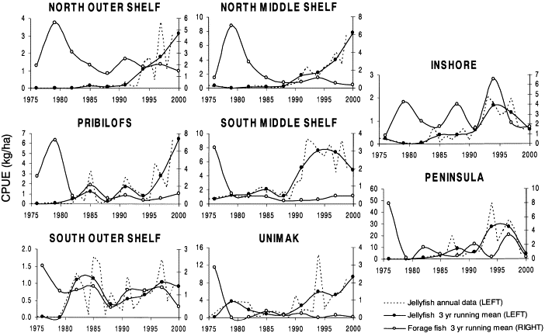
Catch-Per-Unit-Effort
Electrofishing
Longlines
Gillnet
Trawling

Slide 6
Catch-Per-Unit-Effort
Define
C_{t} = catch at time t
f_{t} = fishing effort at time t
q = catchability coefficient
proportion of population captured w/ one unit of effort
What is …
q*f_{t}
q*f_{t}*N_{t}
q*N_{t}
Thus, CPE measures relative abundance

Slide 7
CPE Measures Relative Abundance
ONLY …
of portion of stock vulnerable to the gear
if q is constant (see readings)

Slide 8
