Slide 1
Size Structure Dynamics
Recruitment
Natural Mortality
Population
Biomass
Fishing Mortality
Immigration
Emigration
Growth

Slide 2
Size Structure Methods
Length frequencies
Proportional Size Distribution (PSD)
Proportional Size Distribution (PSD-X)

Slide 3
Proportional Size Distribution (PSD)
Stock length
mature length; fully vulnerable length; or minimum size acceptable to anglers.
Quality length
minimum size anglers like to harvest.

Slide 4
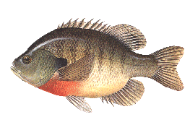
PSD
Stock
(37)
Quality
(17)
Preferred
(5)
17
PSD =
= 0.46
37
5
PSD-PQ =
= 0.29
17

Slide 5
PSD

Slide 6
PSD
Quality
253
Stock
= 0.327
100
773
80
60
Number of LMB
40
20
0
8
12
5
10
15
20
Total Length (inches)

Slide 7
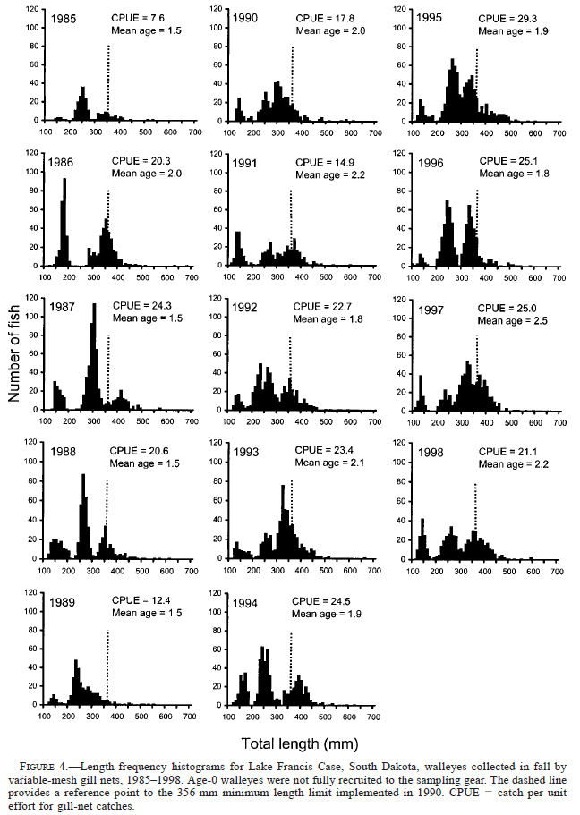
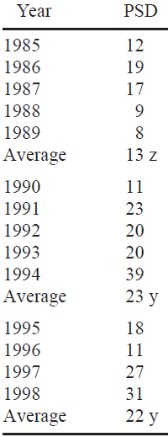
PSD -- Example
From Stone and Lott. 2002. North American Journal of Fisheries Management 22:975–984

Slide 8
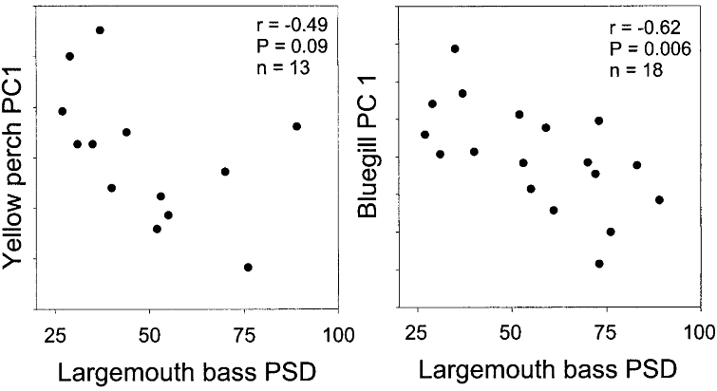

PSD -- Example
From Paukert et al. 2002. North American Journal of Fisheries Management 22:86–95.

Slide 9
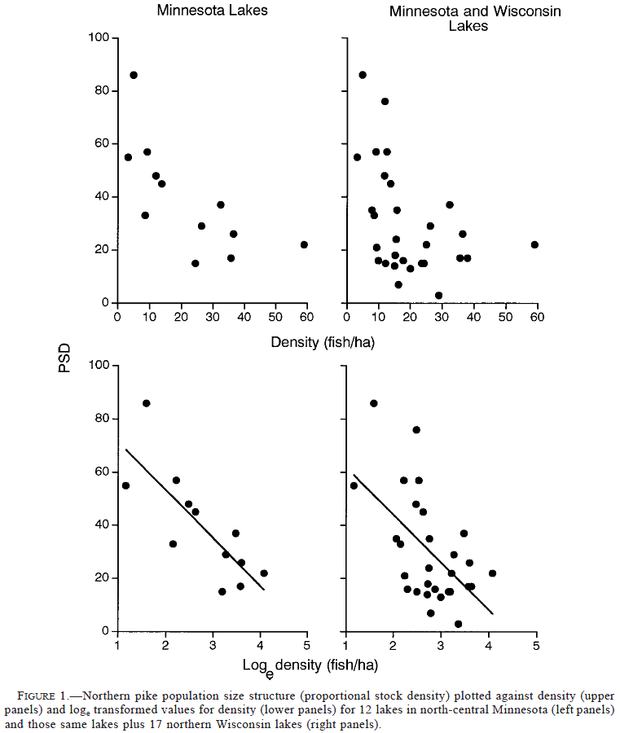
PSD -- Example
From Pierce et al. 2003. North American Journal of Fisheries Management 23:331–339.

Slide 10
Size Structure Methods
Length frequencies
Proportional Size Distribution (PSD)
Proportional Size Distribution (PSD-X)

Slide 11
Size Structure – Summary Measure
Proportional Size Distribution (PSD):
Examples
PSD-P → numerator is “preferred” fish.
PSD-15 → numerator is >15 fish.

Slide 12
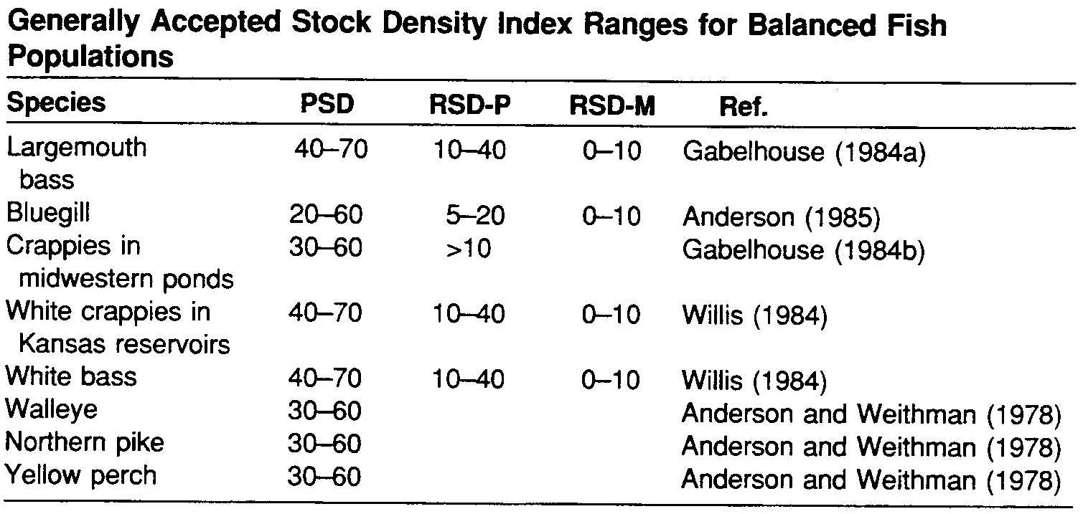
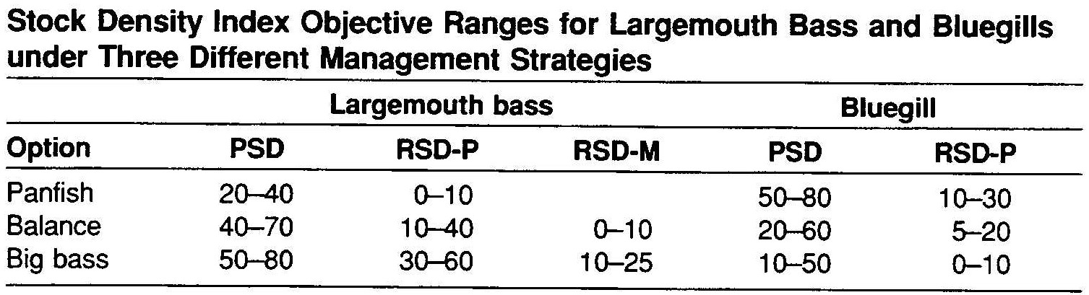
PSD – Interpretation
Many authors suggest that values of 40-60 or 30-70 represent “balanced” populations.
May depend on management goals.

Slide 13
Size Structure – Interpretation
To strengthen conclusions of PSD analysis:
Evaluate condition, growth, and mortality of target species and other species.
Determine if PSD, condition, growth, and mortality of all species are consistent with a single interpretation.
Evaluate PSD of other prey or predator species in the fish community.

Slide 14
Size Structure – Interpreting PSD
100
80
60
(lmb,bg)
Prey PSD
40
20
(wae,yep)
0
0
20
40
60
80
100
Predator PSD

