Slide 1
Adaptive Management

Slide 2
Conceptual Model
Input
Controls
Growth
Stock or
Biomass
Natural
Effort
Recruitment
Harvest
Catch
Output
Controls
Stock
Assessment
CPUE
Monitoring
Management
Objectives
Management
Actions
Harvest
Regulations
Economics
Sociocultural
Political/Legal
Risk
Assessment
Two Sources of “Data”
From Dr. Mike Hansen, UW-Stevens Point
Notes:
output control – quotas, etc.
input controls – monitoring effort – more important to control this then output controls
CPUE is very much different than stock assessment
CPUE is meant to be efficient (it’s a business)
stock assessment is not (its statistics, sampling)
Need to monitor both – CPUE and stock assessment

Slide 3
Fisheries Management: Art & Science
Science
Estimate parameters of the stock to be managed.
Statistics and model based.
Generally “well-known.”
Art
Forming management decision from science information and knowledge of stakeholders, society, etc.
Incorporates a wide array of information.
Incorporates uncertainty, precautionary principle.
May be specific to situation.
May rely on experience.

Slide 4
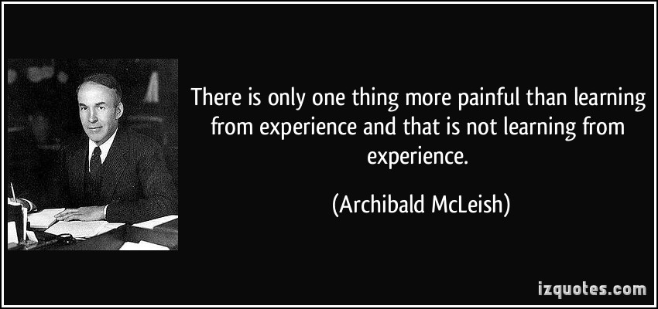
What is Adaptive Management?
Structured, iterative process of decision making
Experimentation with management decisions

Slide 5
Goals of Adaptive Management
Primary (from Allen et al. (2011) & Walters (2007))
Reduce uncertainty over time
What are four sources of uncertainty?
Secondary
Meet management objective(s)
Accrue information to inform future decisions
Notes:
Environmental variation
Partial observability (due to sampling variability)
Partial controllability (using indirect means (i.e., regulations) to implement an action (harvest regulation))
Structural or process uncertainty (lack of understanding of complex dynamics)

Slide 6
Challenges to Adaptive Management
What are five challenges to implementing AM according to Allen et al. (2011)?
Notes:
a lack of clarity in definition and approach
a paucity of success stories on which to build,
management, policy, and funding paradigms that favor reactive rather than proactive approaches to natural resource management,
failure to recognize the potential for shifting objectives, and
failure to acknowledge the social source of uncertainty, and hence increased risk of surprise

Slide 7
Challenges to Adaptive Management
What are three challenges to implementing AM according to Walters (2007)?
Notes:
Lack of resources for the expanded monitoring required to carry-out large-scale experiments.
Unwillingness to acknowledge uncertainty in decision-making
Lack of leadership (lack of an individual to shoulder the major burden to plan and implement)

Slide 8
Example: Black Bass and Walleye
Bass >8 inches (statewide)
LMB
SMB
LMB: R²=0.46, p=0.0006
SMB: R²=0.19, p=0.05
LN(CPUE)- annual mean +/- SE
YOY Walleye (Ceded Territory)
R²=0.28, p=0.01
From Gretchen Hansen (UW)

Slide 9
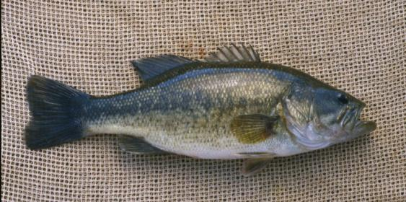
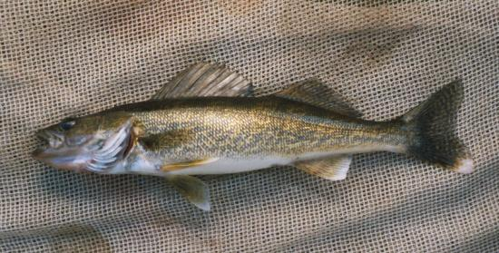
Black Bass & Walleye: Complex & Uncertain Interactions
?
Can we manage in such a way as to better understand these interactions?
Exploitation
Shoreline development
Macrophytes
Other fishes
Invasive species
Stocking
Lower water levels
Warming temperatures
From Gretchen Hansen (UW)
Notes:
It is possible that changes in the abundance of both species are indicators of other changes in the environment: that both bass and walleye are simply passengers of other changes, rather than bass driving changes in walleye. So this is an example of uncertainty in interactions that it might be possible to do something about. If we manage in a way that allows us to learn about which of these interactions are important, we will be better to able to manage in the future. This is where adaptive management comes in.

Slide 10
Adaptive Management Process
Goal
Objective
Identify uncertainties
Form hypotheses
Problem
Identification
Evaluation
Information
Base
Actions
Implemented as an experiment with controls, replication, etc.

Slide 11
Adaptive Management: Planning
Objective
Improve walleye fishing
YOY walleye catch rate of >30/mile in 75% of lakes within 10 yrs
Uncertainties
Effects of largemouth bass (LMB) on walleye
Role of harvest regulations in determining LMB abundance
Hypotheses
LMB are causing declines in walleye reproduction
Liberalized harvest regulations will decrease LMB population
Action option
Remove length and bag limits on LMB on SOME lakes
Notes:
Let’s go through an example. As with any type of good management, it is important to start with specific objectives. For example,… The next step is more specific to AM – identify sources of uncertainty and hypotheses. These hypotheses could come from previous studies, modeling, or just your gut feeling, the important part is that they are articulated as hypotheses rather than known facts. For example,… Finally, the management intervention is chosen. This could be designed to explicitly test hypotheses and promote learning, or they could be chosen for other reasons. Sometimes management actions are designed for political or social reasons, and that is fine. The important thing is that they are implemented in a way that allows us to learn whether they work as intended, no matter what the reason.

Slide 12
Adaptive Management: Implementation
2013
2018
From Gretchen Hansen (UW)
Notes:
Identify environmental/biological gradient in your lakes, implement regulation on SOME lakes in 2013 but leave others as a control, implement regulation on more lakes in 2018 to provide replication across time. Monitor lakes with regard to objectives. Document results for future use, make conclusions about actions taken.

Slide 13
Red Snapper Case Study
Briefly explain this case study.
What point was the author trying to make with it?
Notes:
Bycatch reduction devices intuitively will save Snappers, however models suggest that compensatory mortality may mitigate the young saved
People must acknowledge the complexity and that intuitive answers may not be correct.

Slide 14
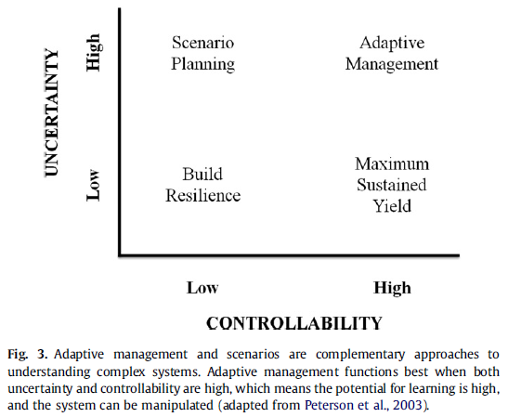
Explain
Notes:
Controllability --- resources will react to management (i.e., management can control populations)
If little control then AM will have little impact. If there is little uncertainty, then little is gained by AM.

Slide 15
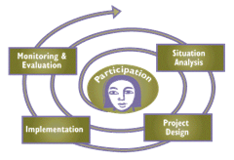
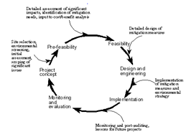
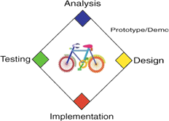
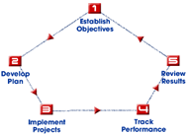
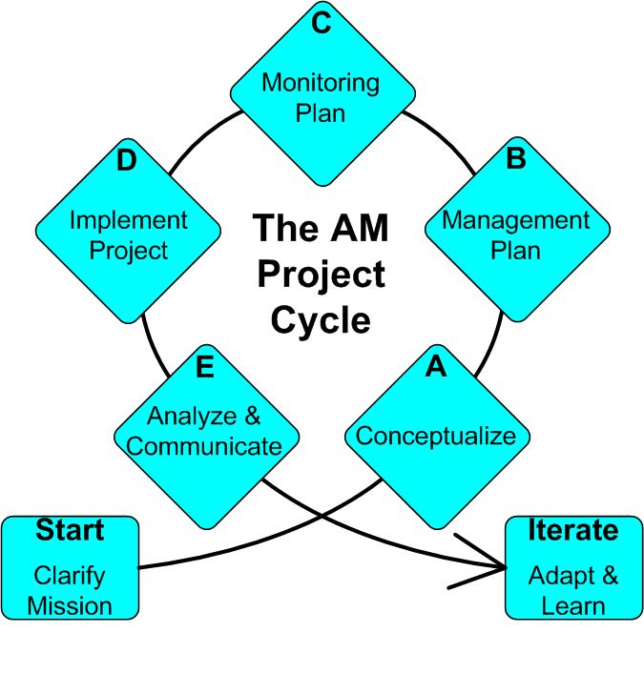
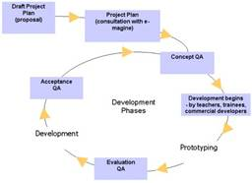
Adaptive Management Cycle
Notes:
Point is – there are a lot of different cycles out there, but if you really look closely at them, they are conceptually very similar. Once you learn one cycle, you probably know 90% of what you would see in any other cycle.
It doesn’t matter which cycle you use – what’s important is that you follow a systematic process

