Slide 1
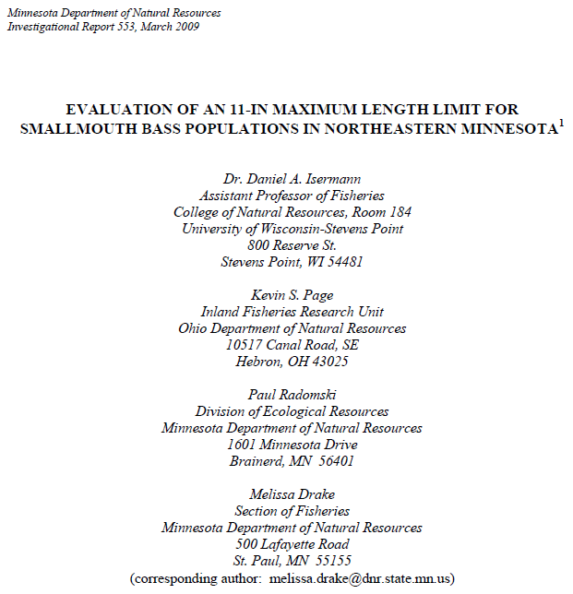

Isermann et al. (2009) SMB Maximum Length Limit Minnesota

Slide 2
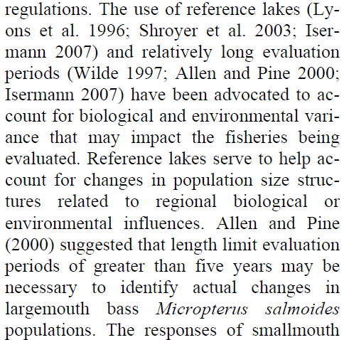
Background
Why are reference lakes and long evaluation periods needed to address the effects of regulation changes?

Slide 3

Background
What management “tool” was used in this evaluation?

Slide 4
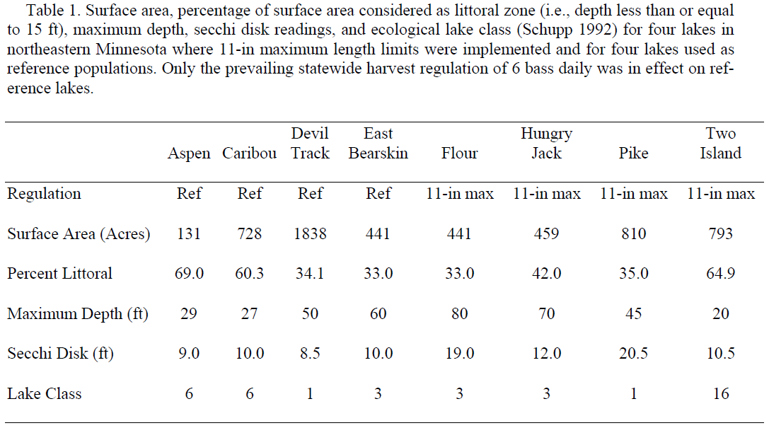

Slide 5
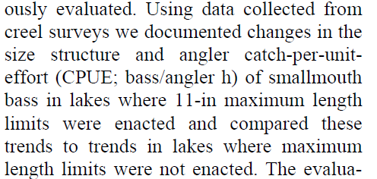
Methods
What is/are the response variable(s)?

Slide 6
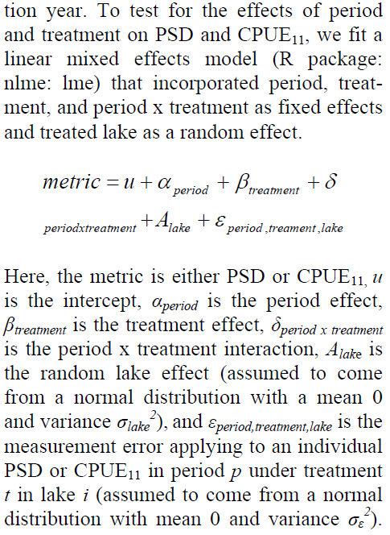
Methods
Describe the statistical model used in this evaluation?
Explain why the authors chose the effect of interest to identify that the regulation had an impact.

Slide 7
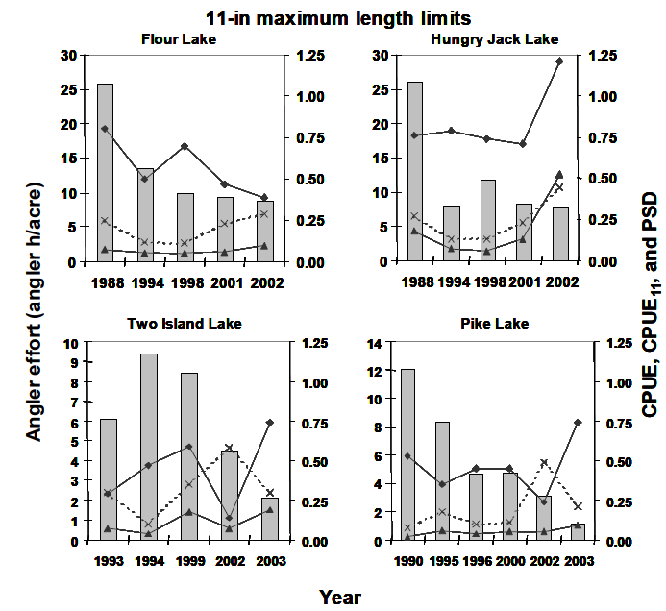



Slide 8
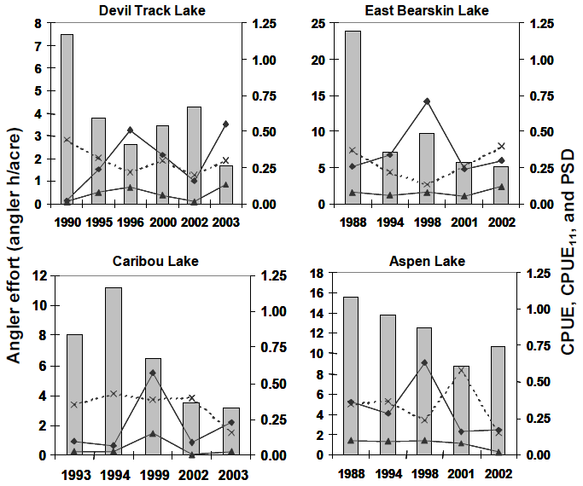


Slide 9
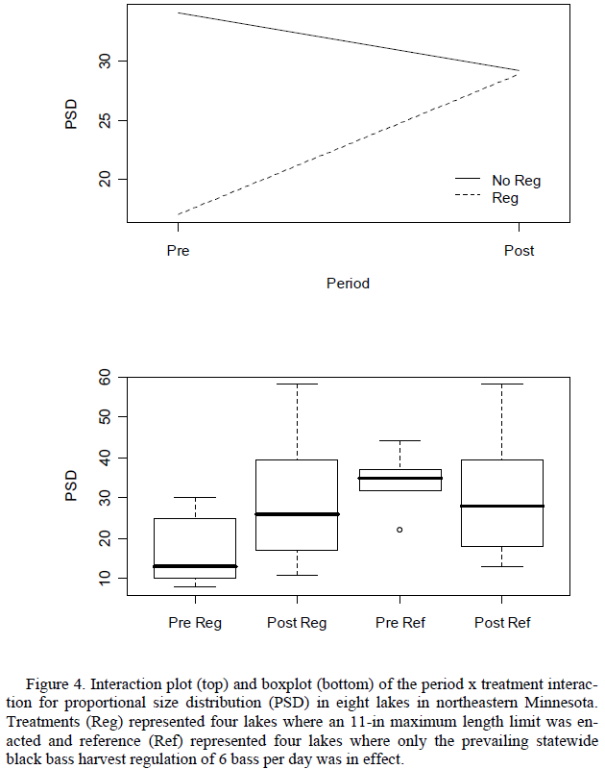

Slide 10
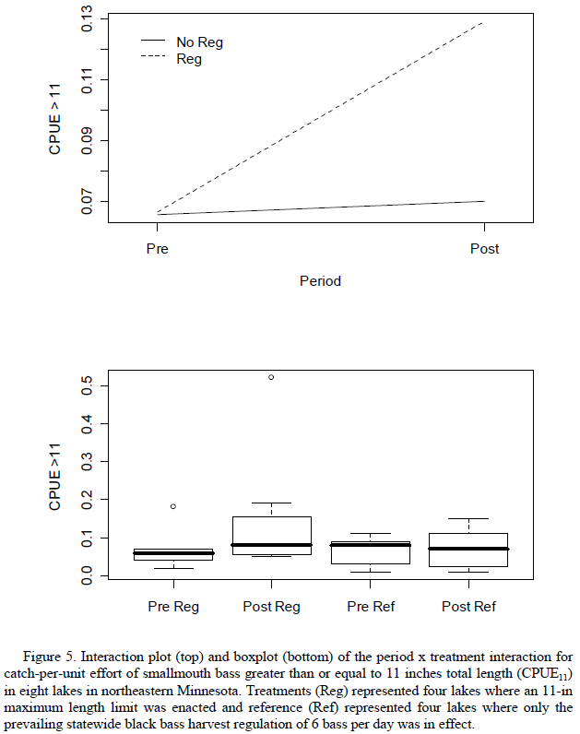

Slide 11
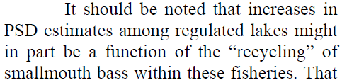
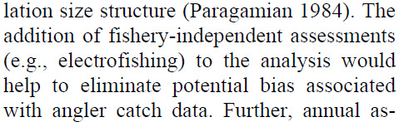
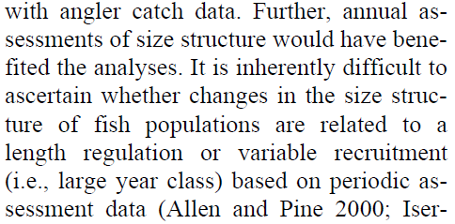
Discussion
What were three problems with this study as noted by the authors?

Slide 12
Discussion
How do you think anglers “felt” about this regulation? What evidence do you have to support your contention?

Slide 13
Conclusions
What are take home messages?

