Slide 1
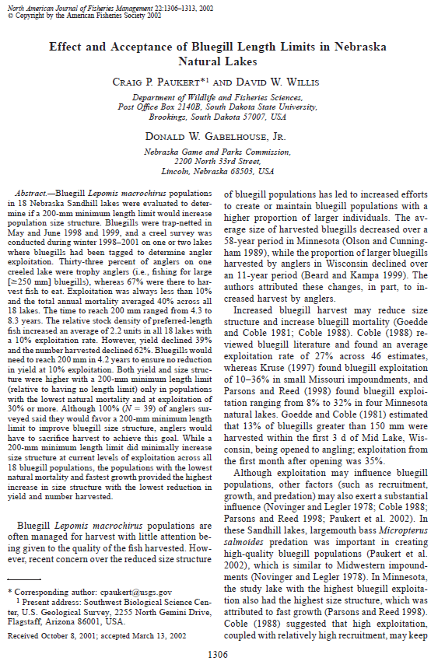
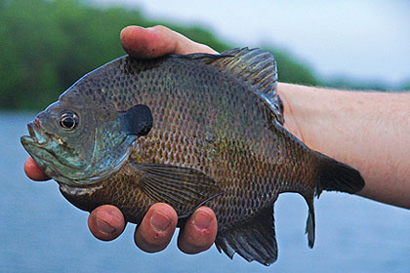
Paukert et al. (2002) Bluegill Length Limit Nebraska

Slide 2
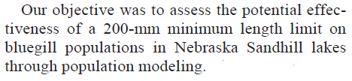
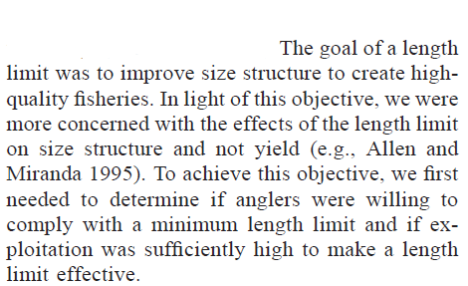
Introduction
What management “tools” were used in this study?
What were the objectives of the regulation change?

Slide 3
Background – Minimum Lengths
Under what conditions should a minimum length limit be considered?
Why is it important to consider L∞ when setting a minimum length limit?

Slide 4
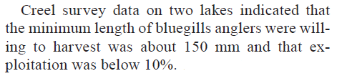
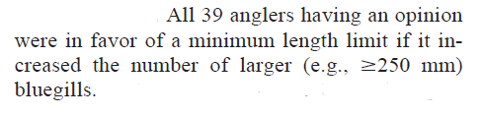
Results – Creel Survey
What did the authors learn from the creel survey?

Slide 5
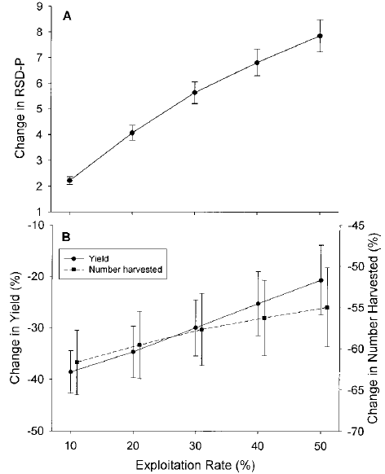
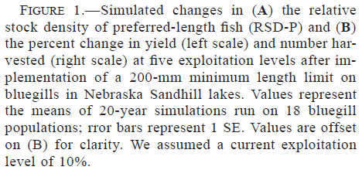
Results

Slide 6
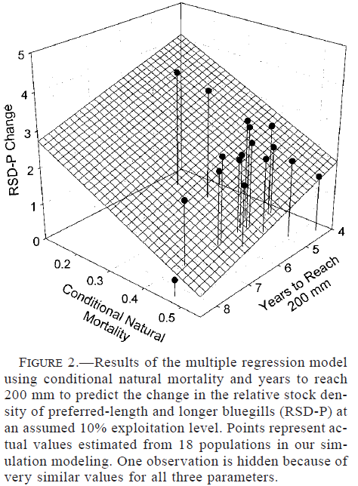
Results

Slide 7
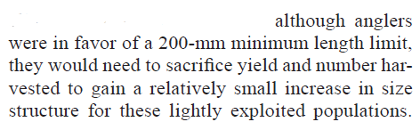
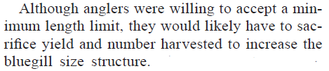
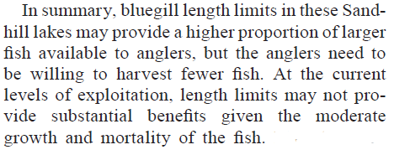
Conclusions
What are take home messages?

