Slide 1
Introduction

Slide 2
Environments of a Stock
Socio-Cultural Environment
Economics
Politics
Physical Environment
Habitat
Biotic Environment
Competition
Recruitment
Natural Mortality
Population
Biomass
Fishing Mortality
Immigration
Emigration
Growth
Predation
Behavior
Beliefs
Behavior
Traditions

Slide 3
Management Environment
Space
Sociocultural
Economic
Political
Ecological
Time

Slide 4
Management Environment
Ecological (Biotic and Physical)
Habitat, predation, forage base, genetics, etc.
Economic
Market forces, license fees, budgets, etc.
Political
Laws, treaties, etc.
Social / Cultural
Traditions, values, perceptions, philosophies, etc.
Sets bounds on productivity
Provides motivation
Sets limits on actions

Slide 5
Walleye War – Mgmt Environment
Ecological
Economic
Political
Sociocultural
Notes:
Ecological
Walleye abundance, spawning behavior, etc.
Economic
Impact on recreational fishing (license sales), tourism, enforcement costs, etc.
Political
Treaties, federal vs. state, racism
Sociocultural
Native traditions, tourist expectations, racism

Slide 6
Management Environment
Space
Sociocultural
Management
Process
Economic
Political
Ecological
Time

Slide 7
Management Process
Where do we want to be?
Broad, long-term, sets direction
Goal
Objective
Specific, Measurable, Achievable, Related to Goal, Time-specific
What will prevent us?
What to do next?
Measure
Compare
Assess
Revise
Problem
Identification
Evaluation
Information
Base
Obstructions to objectives
Actions
Did we make it?
How do we get there?

Slide 8
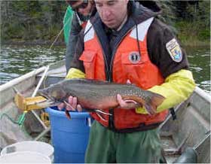
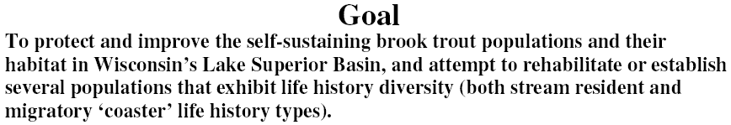
Management Process - Coaster BKT
Goal
Objective

Slide 9
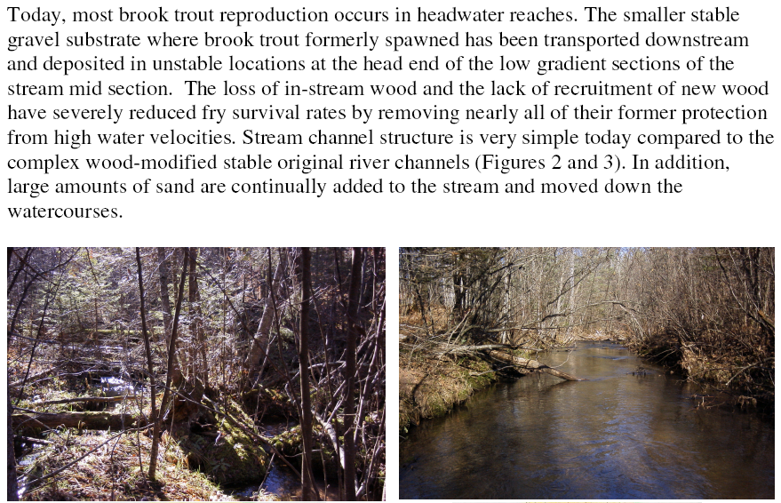
Management Process - Coaster BKT
Problem Identification

Slide 10
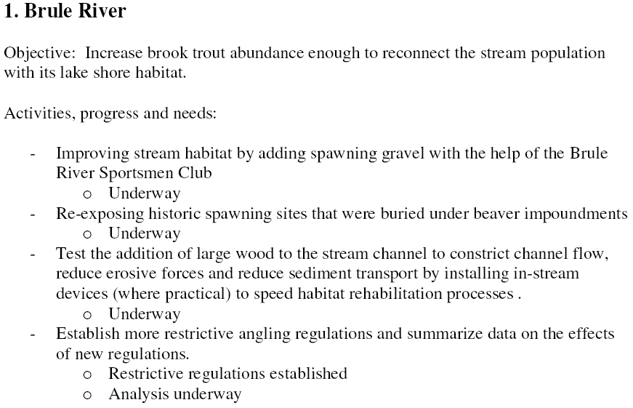
Management Process - Coaster BKT
Information Base
Action
Evaluation
Action

Slide 11
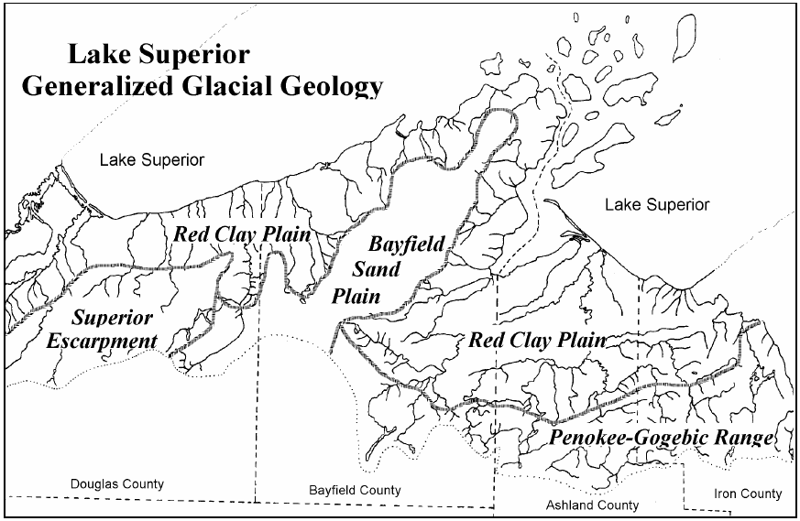
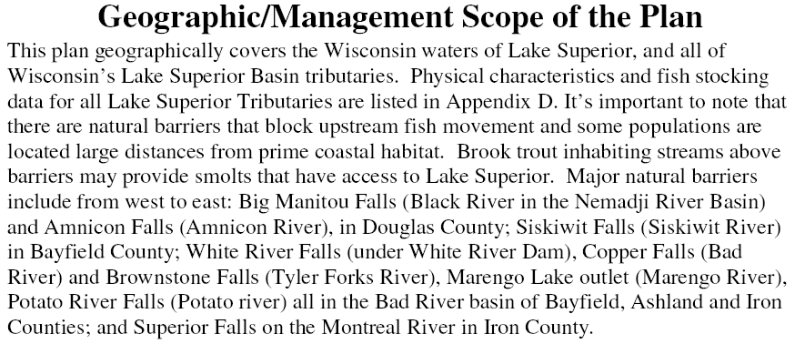
Management Process - Coaster BKT

