Slide 1
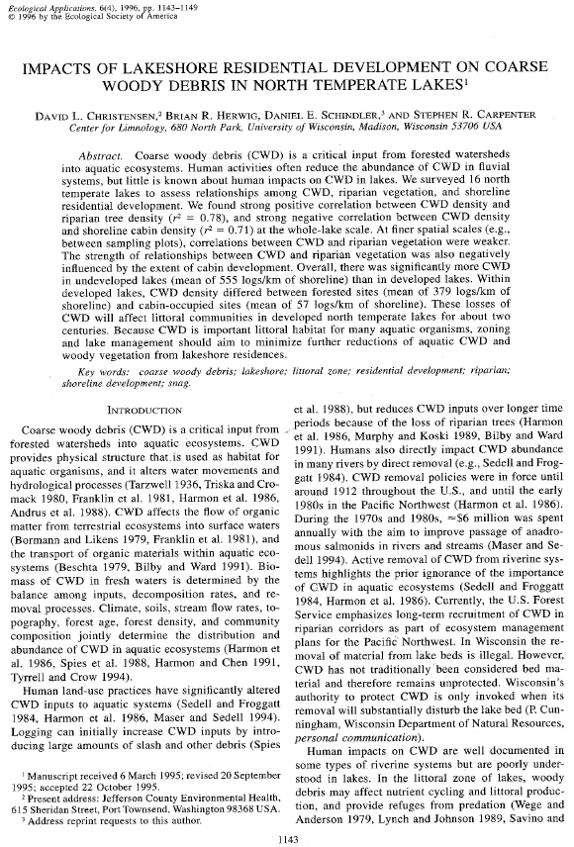
Christensent et al. (1996) Coarse Woody Debris and Lakeshore Development Wisconsin

Slide 2
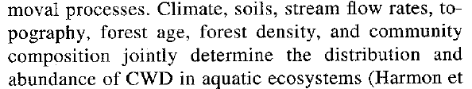

CWH -- Background
What factors determine the density of CWH in aquatic systems?

Slide 3

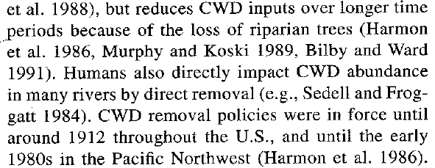
CWH -- Background
How have humans impacted the density of CWH in aquatic systems?

Slide 4
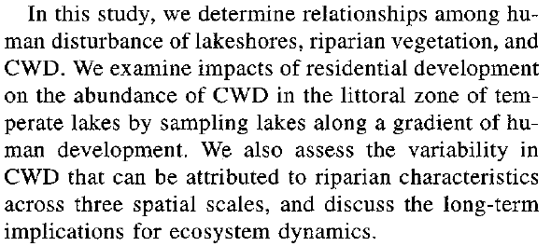
Objective
What was the primary objective of this research?

Slide 5

Experimental Setup
How were the lakes chosen?
What was/were the response variable(s)?
CWD Density (“Abundance”)
CWD Basal Area (“Size”)
What were some of the explanatory variables?
Cabin density, riparian tree density, riparian tree basal area

Slide 6
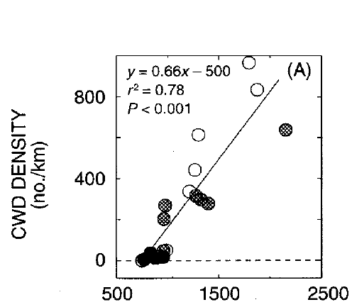
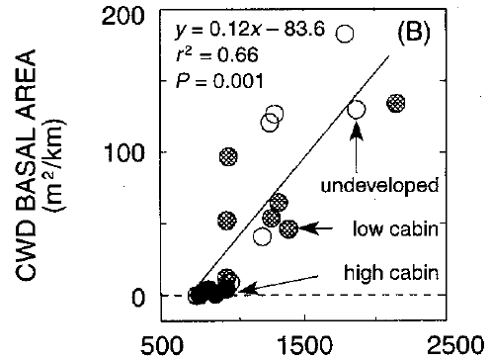

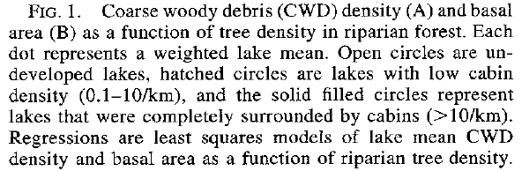
Results – Figure 1

Slide 7
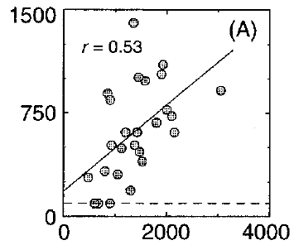
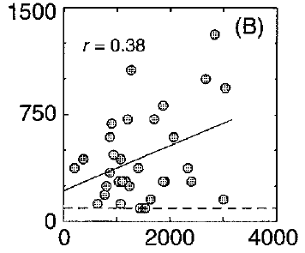
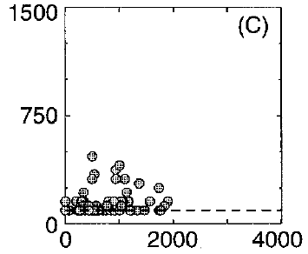

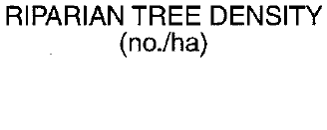
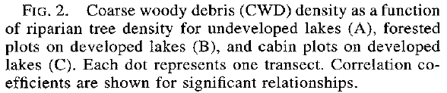
Results – Figure 2
Undeveloped
Devlpd – Forested Plots
Devlpd – Cabin Plots

Slide 8
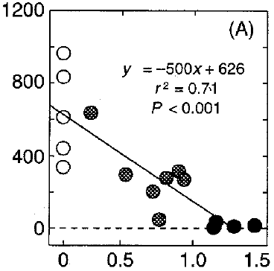
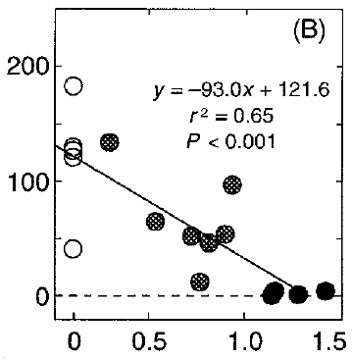



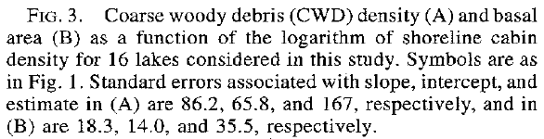
Results – Figure 3

Slide 9
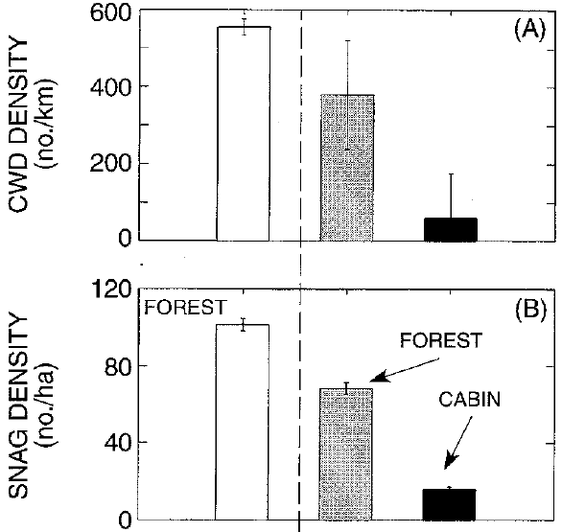
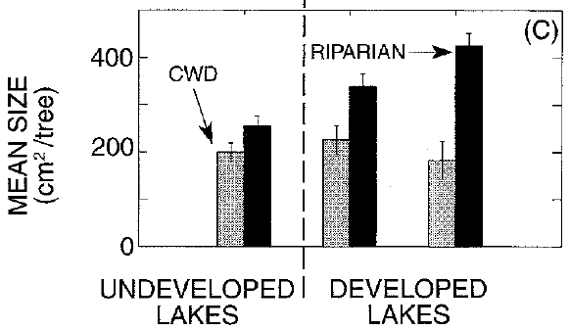


Results – Figure 4
Forest
Forest
Cabin

Slide 10
Conclusions
What are take home messages?

