Slide 1
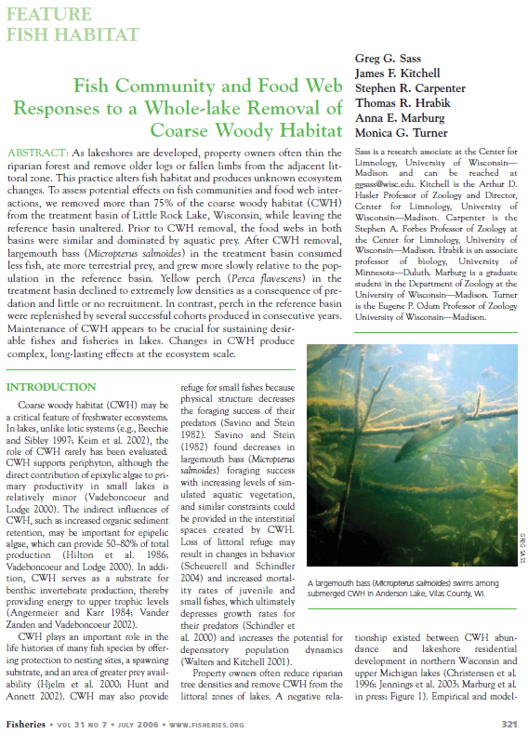
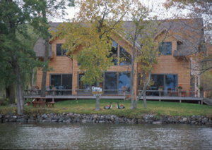
Sass et al. (2002) Coarse Woody Debris Wisconsin

Slide 2
Background – CWH
What are the positive aspects of CWH?
Increased primary production (through algae and increased sediment retention)
Increased benthic production
“Large” fish – protection for nests, spawning substrate, greater prey availability
“Small” fish – protection from predators, increased prey availability
What is the primary driver of CWH loss?
Riparian land owners

Slide 3
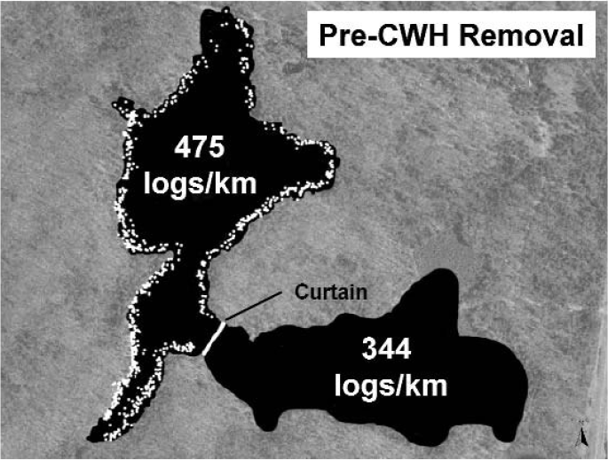
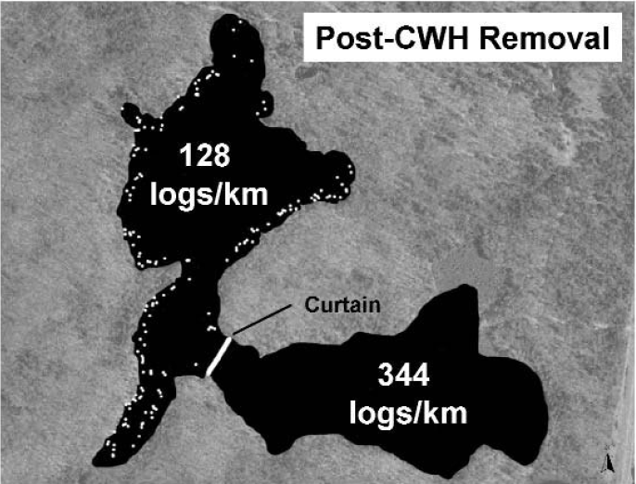
Methods – Experiment
What did the authors do?

Slide 4
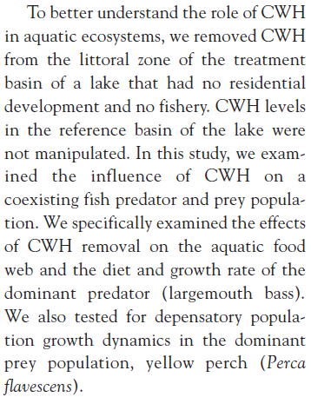
Methods – Experiment
What did the authors do?

Slide 5
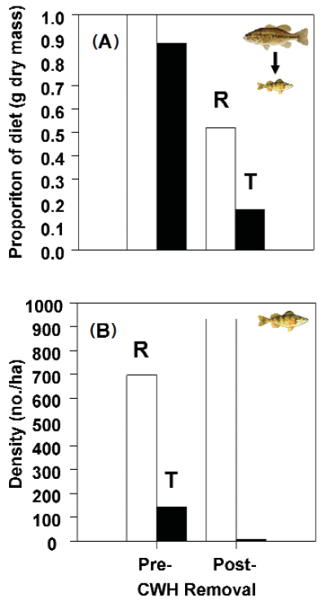
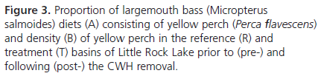
Results

Slide 6
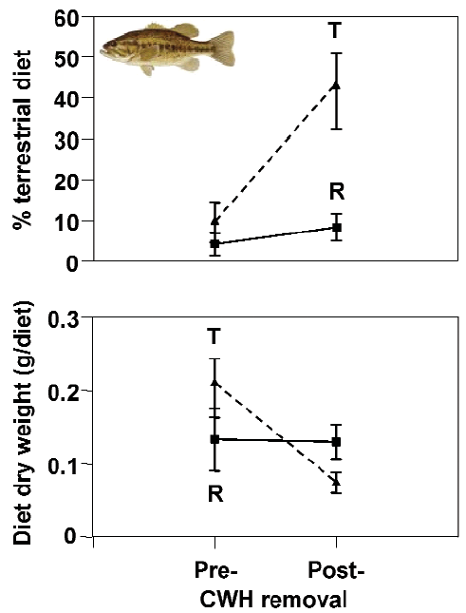
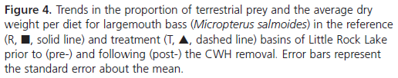
Results

Slide 7
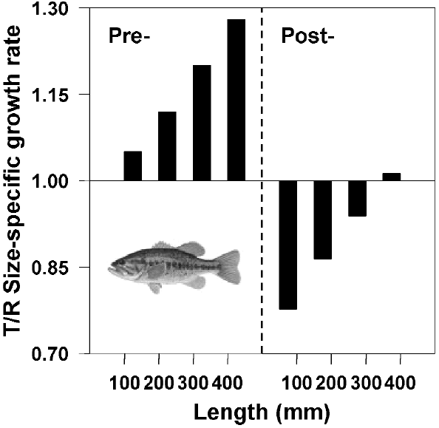

Results

Slide 8
Conclusions
What are take home messages?

