Slide 1
Closures
Notes:
IUCN --the International Union for Conservation of Nature
Ecosystem services – provisioning (“products”roduction of food and water), regulating (control of climate and disease), supporting (nutrient cycles and crop pollination), cultural (spiritual and recreational benefits)

Slide 2
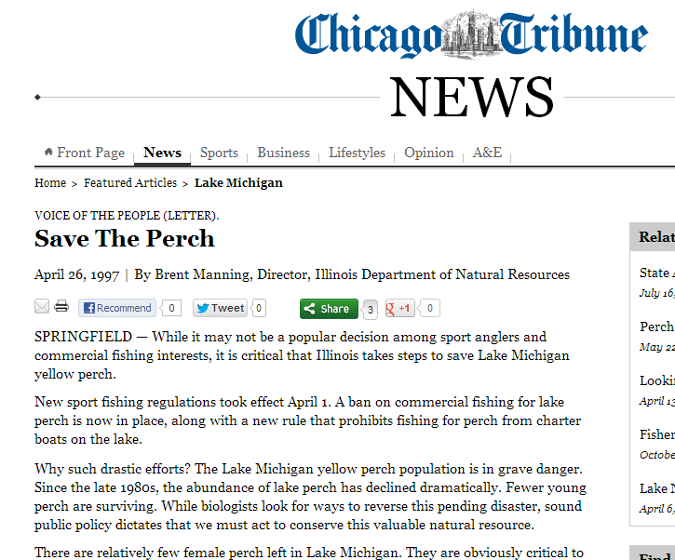
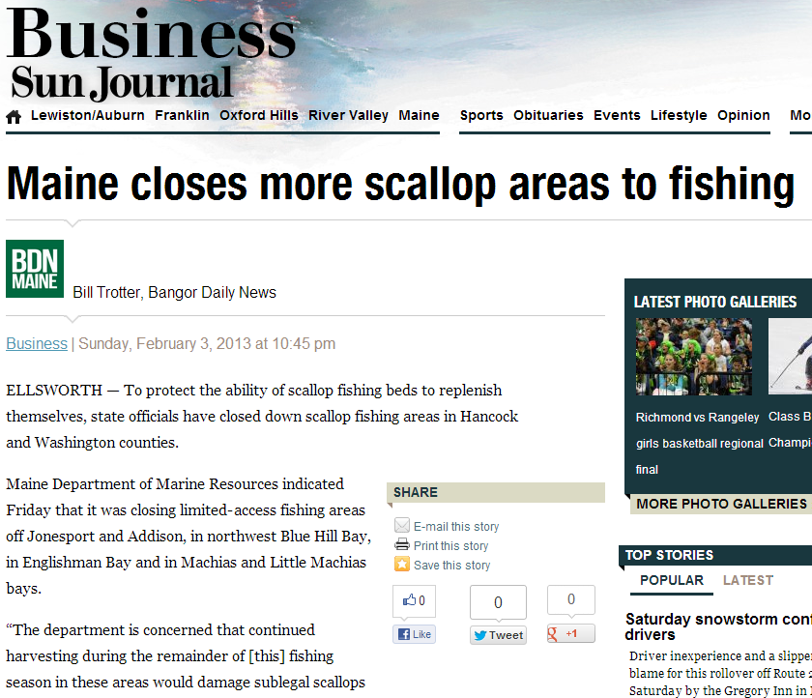
Closures
Seasons
Can fish only at certain times.
Areas
Fishing restricted in specific locations.
Fisheries
Fishing is completely prohibited.

Slide 3
Marine Protected Areas (MPAs)
“A clearly defined geographical space, recognized, dedicated and managed, through legal or other effective means, to achieve the long-term conservation of nature with associated ecosystem services and cultural values” – IUCN
Notes:
IUCN – International Union for the Conservation of Nature
Ecosystem Services
--Supporting (other services) … primary production, nutrient cycling
-- Provisioning (production) … food, water, energy
-- Regulating … carbon sequestration, purification of water/air, pest/disease control
-- Cultural … spiritual, recreational, aesthetic benefits

Slide 4
Marine Protected Areas (MPAs)
Many types
Can have ecological, cultural, or both objectives.
We will primarily discuss ecological (i.e., fishery) objectives

Slide 5
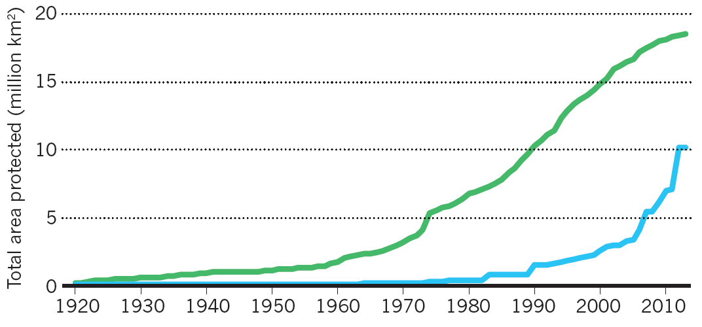
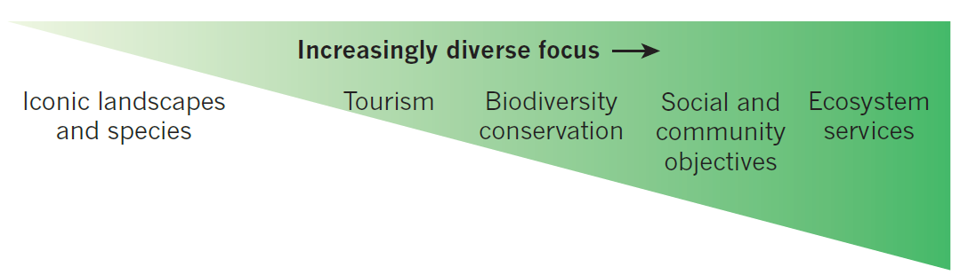
Marine Protected Areas (MPAs)

Slide 6
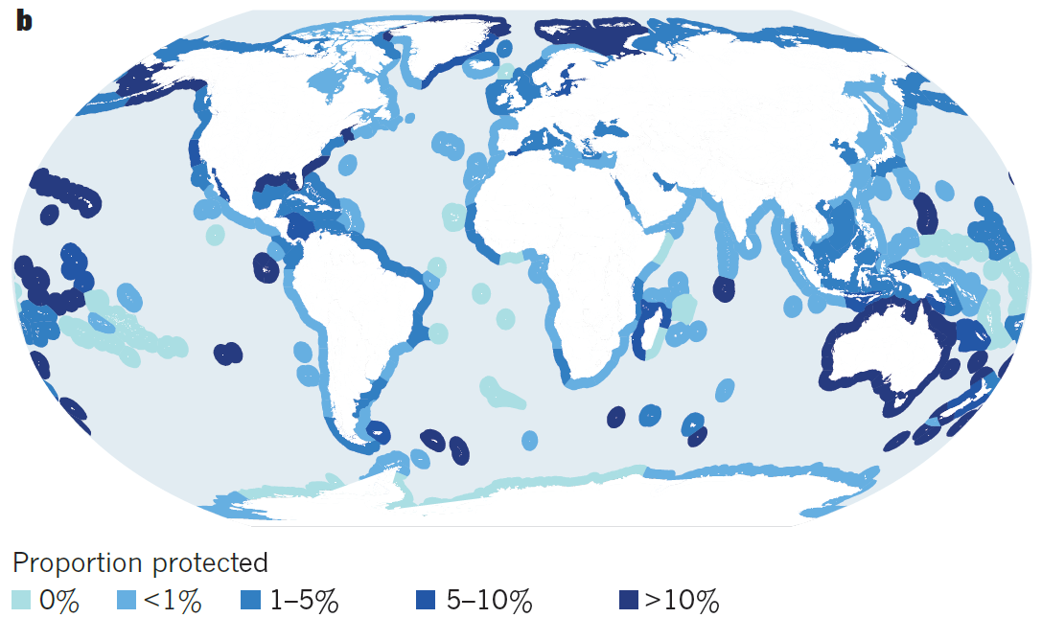
Marine Protected Areas (MPAs)
Notes:
From Watson et al. 2014. The performance and potential of protected ares. Nature 515:67-73.

Slide 7
MPAs – Objectives
“Harvest Refugia” (for exploited species)
Increase fish stocks within boundaries
Provide adult spill-over into fished areas
Provide a source of recruits to fished areas
“Conservation of Biodiversity”
Maximize numbers of species and habitats
Protect threatened species and habitats
Provide resilience to habitat degradation

Slide 8
MPAs – Case Studies
Great Barrier Reef
Papua New Guinea

Slide 9
MPA – Needs for Success
According to Edgar et al. 2014. Global conservation outcomes depend on marine protected areas with five key features. Nature 506:216-220.
“No Take” – low fishing mortality
“Strong Enforcement”
“Old Age of MPA”
“Large Size of MPA”
“Isolated Habitat” – different habitats within the MPA and immediately surrounding areas

Slide 10

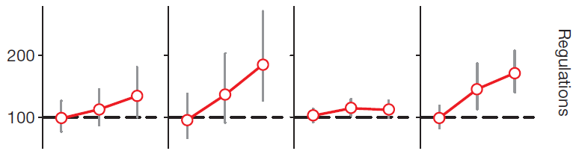
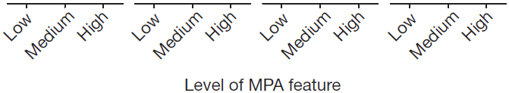
MPA – Needs for Success
Notes:
100% is same as fished area (i.e., non-MPA)

Slide 11
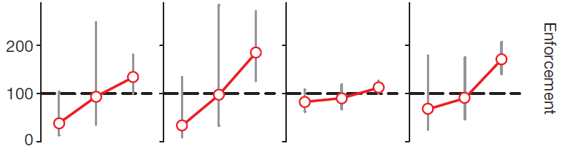
MPA – Needs for Success

Slide 12
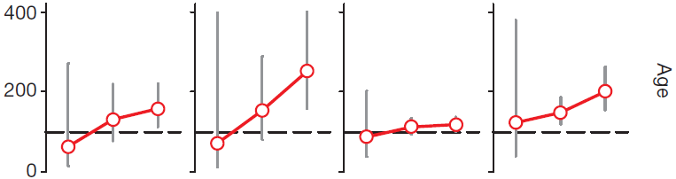
MPA – Needs for Success

Slide 13
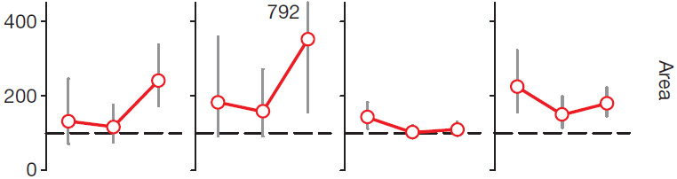
MPA – Needs for Success

Slide 14
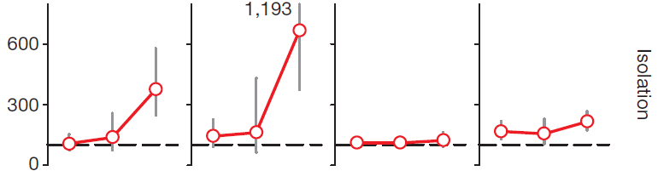
MPA – Needs for Success

Slide 15
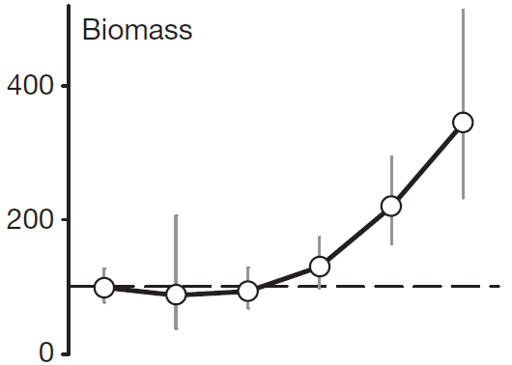



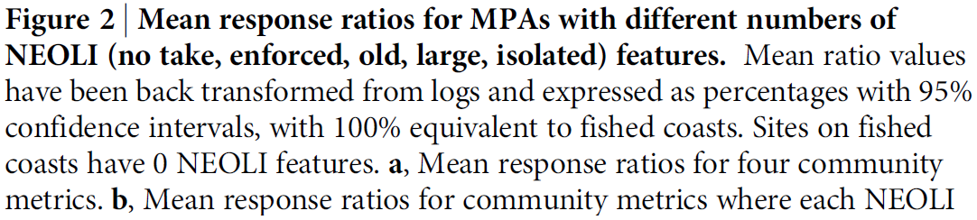
MPA – Needs for Success

Slide 16
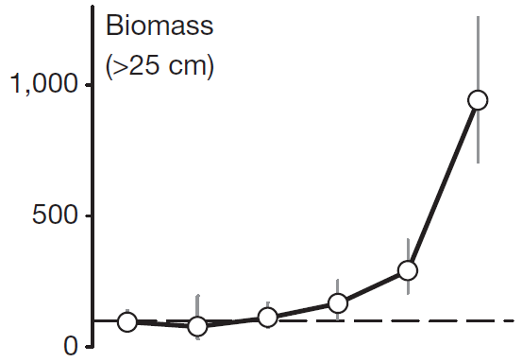
MPA – Needs for Success

Slide 17
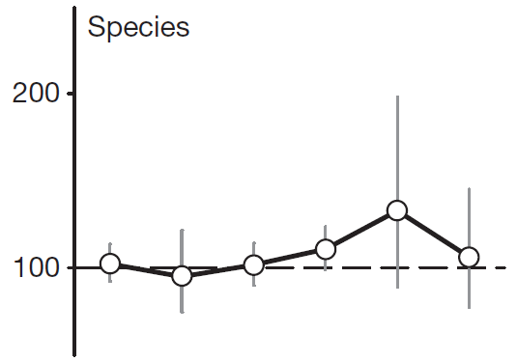
MPA – Needs for Success

Slide 18
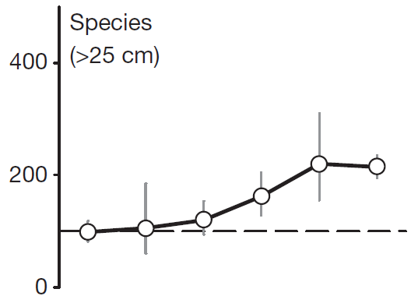
MPA – Needs for Success

Slide 19
MPA -- Critiques
Displaced fishers.
Shift fishing pressure to other locations (usually poorer areas).
Attracts fishers (net increase in fishing mortality if enforcement is weak).
High costs (of maintenance and enforcement).

