Slide 1
Components of Z
Recruitment
Natural Mortality
Population
Numbers
Fishing Mortality
Immigration
Emigration
F = instantaneous fishing mortality.
M = instantaneous natural mortality.
Components are additive; Thus, Z = F+M
Controlling F is a major goal of many fisheries management strategies.

Slide 2
Estimating M
Assume a constant value for M
Typically use M=0.2
Is this realistic?
Notes:
Realistic? Varies by age, bathtub model

Slide 3

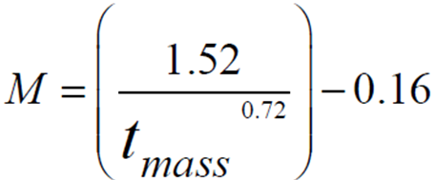

Estimating M
Assume a constant value for M
Relationship of M to life history traits
Hewitt and Hoenig (2005)
Richter and Efanov (1977)
Pauly (1980)
Notes:
Tmass is age at 50% maturity

Slide 4
Estimating M
Assume a constant value for M
Relationship of M to life history traits
From f and Z
Recall that Z = F+M and F=qf
Thus, Z = qf+M
If Z is estimated at different f, then …
M is the intercept from the Z on f regression.
Same as asking what is Z when f = 0.
f and Z estimated over a five year period.
See handout for estimate of M
Notes:
Tmass is age at 50% maturity

Slide 5



Estimating F with Marked Fish
Consider –
The number of fish caught is the proportion of dying fish due to fishing mortality
This proportion is F/Z
Therefore …
Consider --
Where the asterisks represent only marked fish

Slide 6
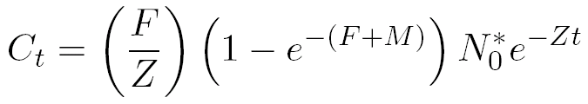
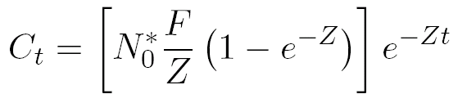
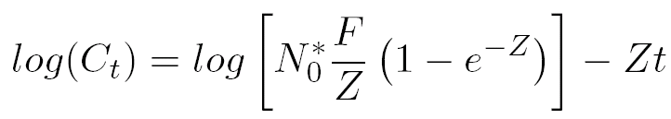
Estimating F with Marked Fish
Substitute N_{t}* equation into catch equation
and rearrange for simplicity
and take natural logs of both sides

Slide 7
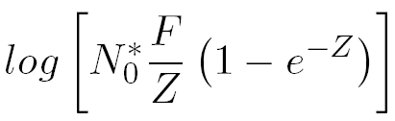
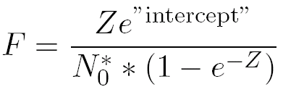
Estimating F with Marked Fish
Examine this model closely …
Slope is an estimate of –Z
Intercept is an estimate of …
Which can be solved for F

Slide 8
Example
400 fish were initially tagged
Tags were returned from the fishery over the next four years
Consider the time period to be the midpoints of the years.
Use these data to estimate Z & F (see HO).

