Slide 1
Estimation of Mortality
Recruitment
Natural Mortality
Population
Numbers
Fishing Mortality
Immigration
Emigration

Slide 2
Recall
Discrete Population Growth Model
N_{t+1} = (1+r)N_{t}
where r = b-d+i-e
Suppose that …
… population is closed
… following the same group of fish
Thus, r = -d but d is usually replaced with A
A is the annual mortality rate
Solve for A
Notes:
Solve N_{t+1} = (1-A)N_{t} for A

Slide 3
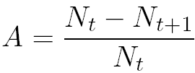
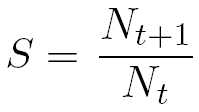
Mortality Rate Concept
For example, N₁ = 1000 and N₂ = 850.
What is the mortality rate?
What is the survival rate?
S is an annual survival rate
Note that A+S = 1
Such that S=1-A or A=1-S

Slide 4
Instantaneous Mortality Rate (Z)
Similarly examine continuous model …
r = -d but replace d with Z such that N_{t+1} = N_{t}e^{-Z}
solve for Z
thus, Z is an instantaneous mortality rate
Note that S=e^{-Z} and A = 1-e^{-Z}

Slide 5
Two Problems
Population sizes are not usually “seen.”
Z can be computed from CPEs
Recall that C_{t} = qf_{t}N_{t}
Algebraically show that Z=log(CPE_{t})-log(CPE_{t+1})
Catches or CPEs are subject to variability
Catches are samples; Z is, thus, a statistic.
If a cohort is followed over time, individual estimates of Z can be made and averaged.
Notes:
Solve catch equation for Nt, plug into continuous popn growth model, solve for z

Slide 6
Example Calculations
IDEAL REAL
t Nt Ct Ct*
0 1000 200 211
1 800 160 159
2 640 128 126
3 512 102 104
4 410 82 81
5 328 66 64
Calculate Z from each time step of …
population sizes.
idealistic catches.
realistic catches.
composite (average) of realistic catches.

Slide 7
Catch Curve
Longitudinal
Catch-at-age for a single cohort of fish.
Cross-sectional
Catch-at-age in a single year (across many cohorts of fish).

Slide 8
Longitudinal vs. Cross-Sectional
Catch-at-age across several capture years.
Capture Year
Age 2001 2002 2003 2004 2005 2006 2007 2008
0 200 200 200 200 200 200 200 200
1 160 160 160 160 160 160 160 160
2 128 128 128 128 128 128 128 128
3 102 102 102 102 102 102 102 102
4 82 82 82 82 82 82 82 82
5 66 66 66 66 66 66 66 66
What is the cross-sectional catch-at-age for 2004?
What is the longitudinal catch-at-age for the 2002 year-class?
Longitudinal=cross-sectional if Z and N₀ are constant across time and cohorts.

Slide 9
Catch Curve Model
Recall: CPE_{t} = qN_{t} and N_{t} = N₀e^{-Zt}
Substitute second into first … CPE_{t} = qN₀e^{-Zt}
Can this be
linearized?
What is estimate
of Z?
200
160
CPE
120
80
0
1
2
3
4
5
Age / Time

Slide 10
Catch Curve Characteristics
4.0
3.5
3.0
2.5
log(CPE)
2.0
-Z
1.5
1
1.0
-Z
0.5
Asc
Dome
Descending
1
0
2
4
6
8
10
Age / Time
Fit regression of log(CPE) on age only for ages on descending limb.

Slide 11
Catch Curve Analysis in R
Examine Handout
catchCurve()
summary()
confint()

Slide 12
Catch Curve Assumptions
Population closed to immigration and emigration.
Z is constant.
q is constant
“Sample” is unbiased regarding any age-group (i.e., be careful of selective gears)
Accurate ages
Follow a cohort (if longitudinal CC used)
No recruitment on descending limb (if cross-sectional CC used)

Slide 13
Components of Z
Recruitment
Natural Mortality
Population
Numbers
Fishing Mortality
Immigration
Emigration
F = instantaneous fishing mortality.
M = instantaneous natural mortality.
Components are additive; Thus, Z = F+M
Controlling F is a major goal of many fisheries management strategies.

Slide 14
Estimating M
Assume a constant value for M
Typically use M=0.2
Is this realistic?
Notes:
Realistic? Varies by age, bathtub model

Slide 15

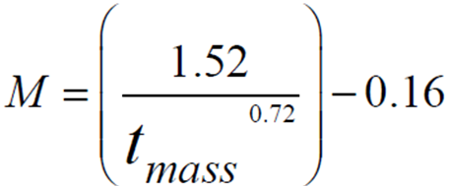

Estimating M
Assume a constant value for M
Relationship of M to life history traits
Hewitt and Hoenig (2005)
Richter and Efanov (1977)
Pauly (1980)
Notes:
Tmass is age at 50% maturity

Slide 16
Estimating M
Assume a constant value for M
Relationship of M to life history traits
From f and Z
Recall that Z = F+M and F=qf
Thus, Z = qf+M
If Z is estimated at different f, then …
M is the intercept from the Z on f regression.
Same as asking what is Z when f = 0.
f and Z estimated over a five year period.
See handout for estimate of M
Notes:
Tmass is age at 50% maturity

Slide 17



Estimating F with Marked Fish
Consider –
The number of fish caught is the proportion of dying fish due to fishing mortality
This proportion is F/Z
Therefore …
Consider --
Where the asterisks represent only marked fish

Slide 18
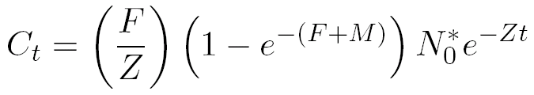
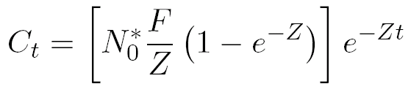
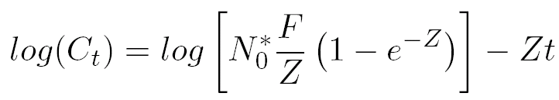
Estimating F with Marked Fish
Substitute N_{t}* equation into catch equation
and rearrange for simplicity
and take natural logs of both sides

Slide 19
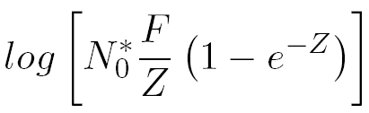
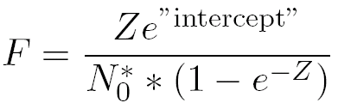
Estimating F with Marked Fish
Examine this model closely …
Slope is an estimate of –Z
Intercept is an estimate of …
Which can be solved for F

Slide 20
Example
400 fish were initially tagged
Tags were returned from the fishery over the next four years
Consider the time period to be the midpoints of the years.
Use these data to estimate Z & F (see HO).

