Slide 1
Stock-Recruitment
Recruitment
Natural Mortality
Population
Numbers
Fishing Mortality
Immigration
Emigration

Slide 2
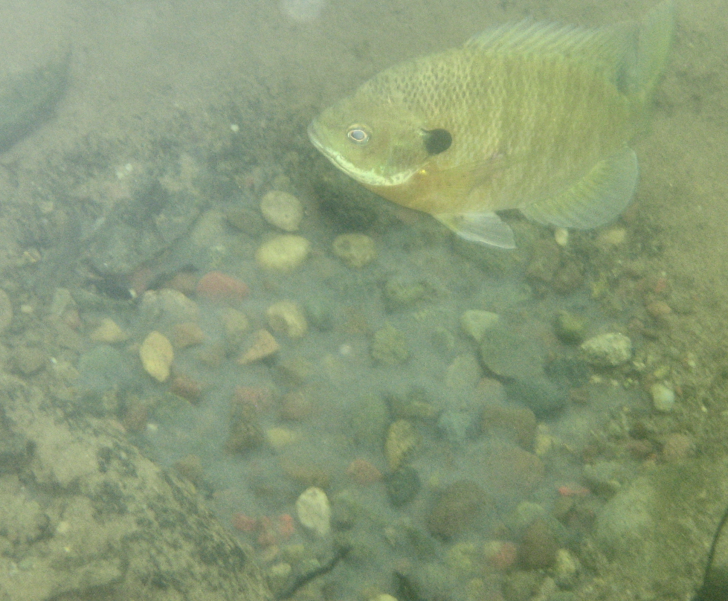
Overall Concept
How many “recruits” are produced for X number of “adults”?

Slide 3

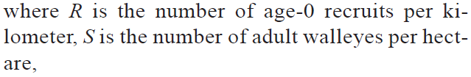
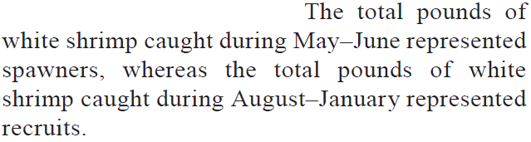
“Stock” & “Recruits” Definitions
Froese (2004) – Coho salmon, OR
Beard et al. (2003) – Walleye, WI
Belcher & Jennings (2004) – White shrimp, GA

Slide 4
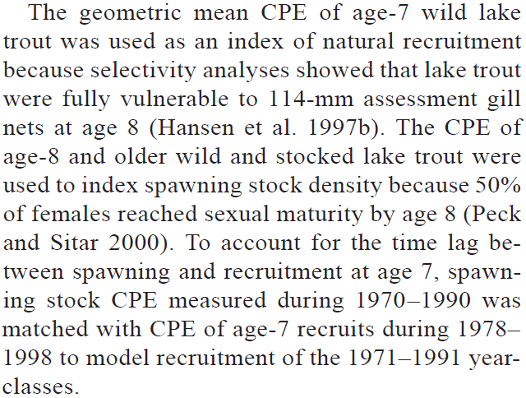
“Stock” & “Recruits” Definitions
Allen & Miranda (2001) – Black crappie, MS
Richards et al. (2004) – Lake Trout, MI

Slide 5
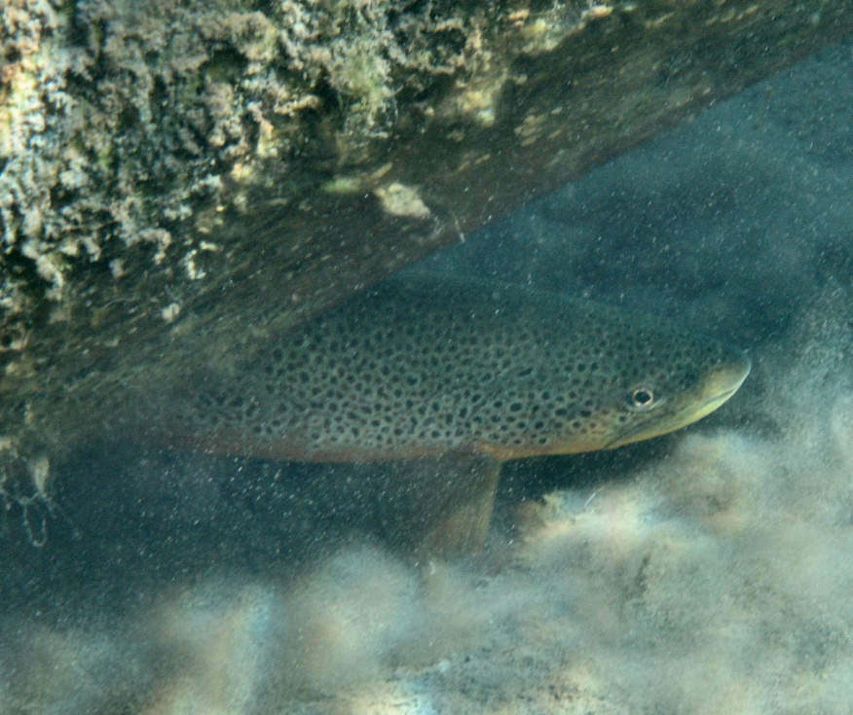


“Stock” & “Recruits” Definitions

Slide 6
Overall Concept
What do you expect this relationship to look like?
Recruits
Spawners or Stock

Slide 7
Overall Concept
What do you expect this relationship to look like?
Recruits / Spawner
Spawners or Stock

Slide 8
Density Dependence
S-R relationship is density-independent if recruits-per-spawner is constant for all numbers of spawners.
alt., number of recruits increases at a constant rate
S-R relationship is density-dependent if recruits-per-spawner decreases with increasing number of spawners.
alt., number of recruits does not increase at a constant rate

Slide 9
Density Dependence
Stock-recruit relationship is density-independent if the number of recruits-per-spawner is constant
Stock-recruit relationship is density-dependent if the number of recruits-per-spawner is decreasing
Recruits-per-Spawner
Spawning Stock
Notes:
S <- 0:1000
R.di <- 2*S
R.bh1 <- bh1(S,a=2,b=0.005)
R.r1 <- r1(S,a=2,b=0.004)
par(mar=c(3,3,1,1),mgp=c(1,0,0),cex.lab=1.5)
plot(R.di~S,type="l",lwd=4,ylim=c(0,1000),xlab="Spawning Stock",ylab="Recruits",xaxt="n",yaxt="n")
lines(R.bh1~S,type="l",lwd=4,col="red")
lines(R.r1~S,type="l",lwd=4,col="blue")

Slide 10
Density Dependence
Stock-recruit relationship is density-independent if the number of recruits increases at a constant rate with increasing number of spawners.
Stock-recruit relationship is density-dependent if the number of recruits does NOT increase at a constant rate with increasing number of spawners.
Recruits
Spawning Stock
Notes:
S <- 0:1000
R.di <- 2*S
R.bh1 <- bh1(S,a=2,b=0.005)
R.r1 <- r1(S,a=2,b=0.004)
par(mar=c(3,3,1,1),mgp=c(1,0,0),cex.lab=1.5)
plot(R.di~S,type="l",lwd=4,ylim=c(0,1000),xlab="Spawning Stock",ylab="Recruits",xaxt="n",yaxt="n")
lines(R.bh1~S,type="l",lwd=4,col="red")
lines(R.r1~S,type="l",lwd=4,col="blue")

Slide 11


Stock-Recruit Models
Density-Independent Model
Recruits
Recruits-per-Spawner
Spawning Stock
Spawning Stock

Slide 12
Stock-Recruit Models
Density-Independent Model
R/S is a constant of S
a is the “density independent” parameter
Units are “recruits per spawner”
Is this model realistic?
Recruits
Recruits-per-Spawner
Spawning Stock
Spawning Stock

Slide 13

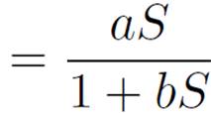
Stock-Recruit Models
Beverton-Holt Model
Recruits
Recruits-per-Spawner
Spawning Stock
Spawning Stock

Slide 14
Stock-Recruit Models
Beverton-Holt Model
a parameter has same meaning
b is “density-dependent” parameter
What happens if b=0?
Peak recruitment (R_{p}) is at asymptote
R_{p} equals a/b
What does “more density dependence” do to R_{p}?
What does “more density independence” do to R_{p}?

Slide 15
Stock-Recruit Models
Beverton-Holt Model
Model basis
juvenile competition results in a mortality rate that is linearly dependent upon the number of fish alive in the cohort at any time
predators are always present
Appropriate “if there is a maximum abundance imposed by food availability or space, or if the predator can adjust its predatory activity immediately to changes in prey abundance" (Wootton 1990, p. 264).

Slide 16


Stock-Recruit Models
Ricker Model
Recruits
Recruits-per-Spawner
Spawning Stock
Spawning Stock

Slide 17
Stock-Recruit Models
Ricker Model
a, b parameters have same meaning
What happens if b=0?
Peak recruitment (R_{p}) is a/be, occurs at S_{p}=1/b
What does “more density dependence” do to R_{p}? S_{p}?
What does “more density independence” do to R_{p}? S_{p}?

Slide 18
Stock-Recruit Models
Ricker Model
Model based on mortality rate of the eggs and juveniles is proportional to the initial cohort size.
cannibalism of the juveniles by the adults
disease transmission
damage by adults of one another’s spawning sites (e.g., redd superimposition)
density-dependent growth coupled with size-dependent predation (e.g., increase in the time it takes for the young fish to grow through a size range vulnerable to predation)
a time-lag in the response of a predator or parasite to the abundance of the fish

Slide 19
Stock-Recruit Models
Do first Class Exercise.

Slide 20
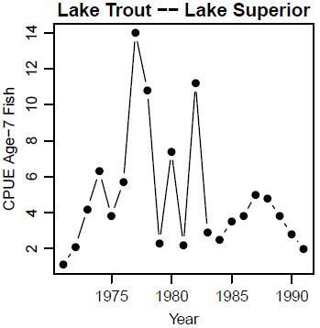
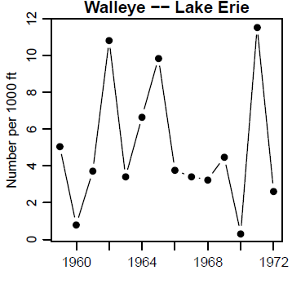
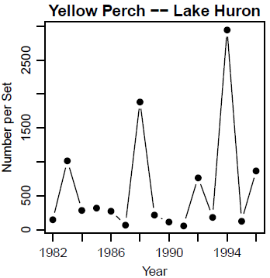
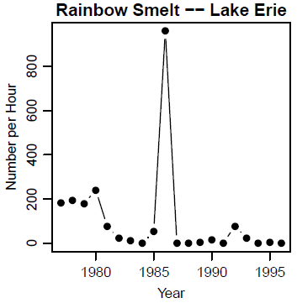
Recruitment Variability -- Annual

Slide 21
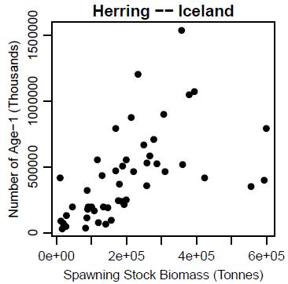
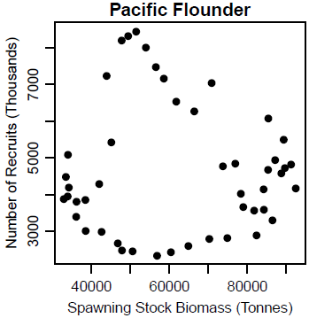
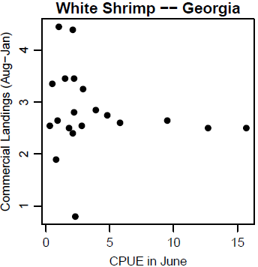
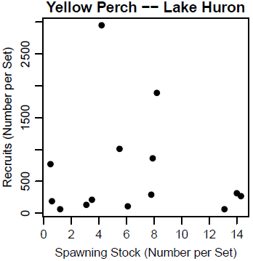
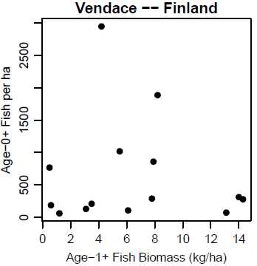
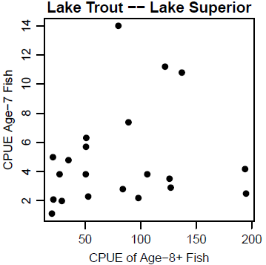
Recruitment Variability – S-R Model

Slide 22
Recruitment Variability
Empirical relationships between spawning stock and recruitment show extreme annual variability – Quinn II and Deriso (1999, p. 86)
Much ingenuity has been spent in fitting these curves to data sets and to developing the basic models. All this effort has largely foundered in the face of the variability in the relationships between stock and recruitment shown by most natural populations. The curves can be fitted, but it takes an act of faith to take the resulting curves seriously – Wootton (1990, p. 264)
Analysis of stock-recruitment data provides an enormous number of traps for the unwary – good luck – Hilborn and Waters (1992)

