Slide 1
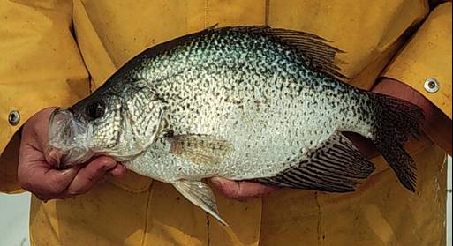
Application of a Minimum Length Limit for Crappie Populations
Modified from Case 9 in Murphy et al. (2010)
Notes:
Image courtesy of Craig Paukert.

Slide 2
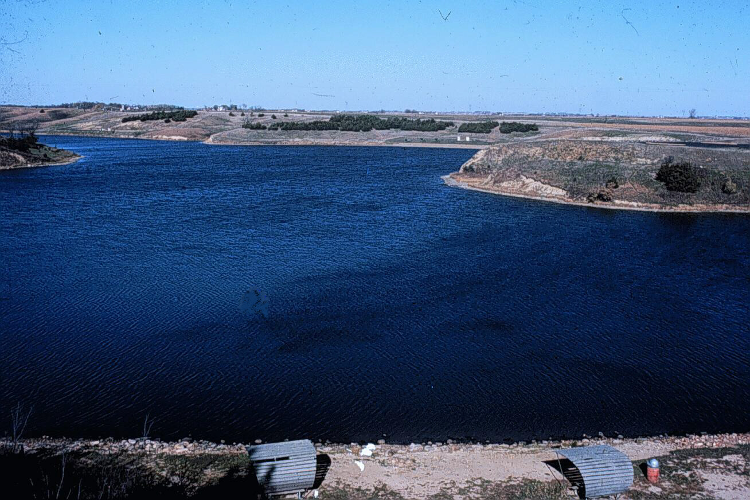
Lake Alvin, SD
36.4 ha impoundment
Eutrophic, though little vegetation
Primary – LMB, BKC, WHC, BG, CC
Secondary – WAE, YEP, NOP, BBH
10 km from Sioux Falls
High angling effort

Slide 3
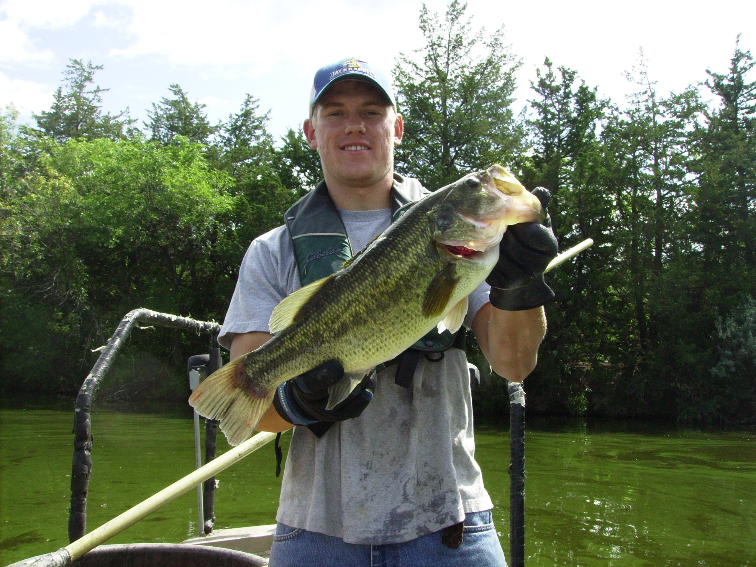
Notes:
The photo is of one of my undergraduate researchers at South Dakota State, Nick Peterson (now a fisheries specialist with MN DNR in Duluth). Note the “split pea soup” water in the background. We did a bunch of research on bluegill in that system and when we would be electrofishing I would literally run into giant rocks because you could not see them through the green water. Very eutrophic with little to no aquatic plants due to high nutrient runoff (both urban and agricultural). They also have installed a sediment trap on this system to reduce sedimentation (post this case study). Interestingly, the portion of the impoundment next to the dam often stratifies and becomes hypoxic in the summer. This further restricts habitat within the system.

Slide 4
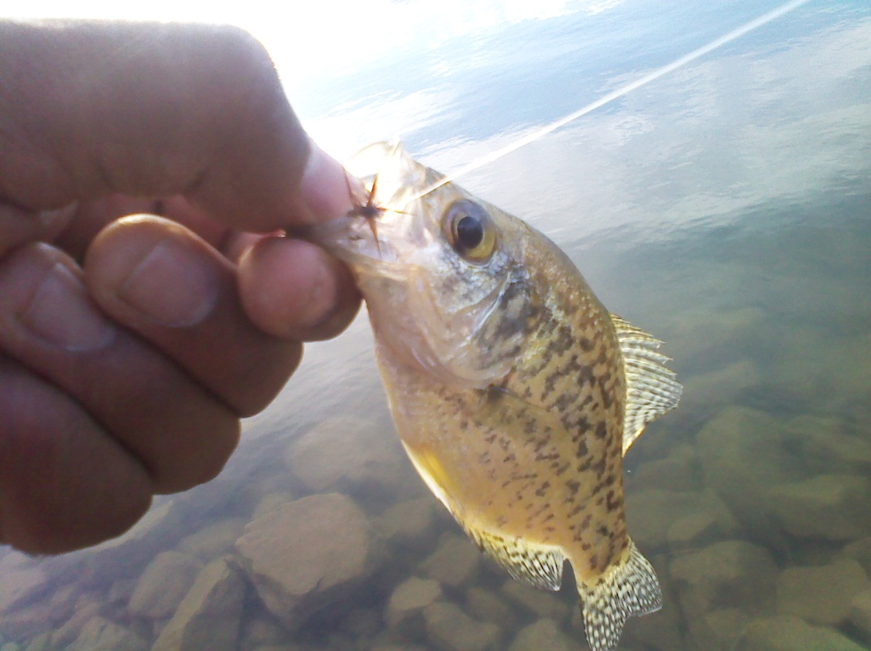
Angler Opinions
Complaints of small average size of harvested fish.
91% favor a 20-cm minimum length limit.
93% favor a 23-cm minimum length limit.

Slide 5

Group Think
23-cm minimum length limit implemented on 1-Jan-96.
What characteristics of a fish population typically lead a manager to consider use of a minimum length limit regulation? Explain!
What metrics would you want to look at before implementing a minimum length limit regulation?

Slide 6
Group Think
What does this pre-implementation data suggest about the success of this regulation?
High CPE, slow growth SD lakes exceed 100 fish/net-night
 | Black Crappie |  |  |  | White Crappie
Year | CPE | PSD-23 | Mean TL Age-3 |  | CPE | PSD-23 | Mean TL Age-3
1992 | 63 ± 16 | 0 | -- |  | 63 ± 23 | 3 | --
1993 | 11 ± 3 | 0 | -- |  | 37 ± 12 | 1 | --
1994 | 5 ± 1 | 3 | -- |  | 10 ± 3 | 15 | --
1995 | 7 ± 1 | 3 | 207 ± 9.0 |  | 6 ± 2 | 13 | 220 ± 9.3
Mean | 22 ± 5 | 2 | 207 ± 9.0 |  | 29 ± 10 | 8 | 220 ± 9.3
Wr
 | Black Crappie |  |  |  |  | White Crappie
Year | SS | S-Q | Q-P | P-M |  | SS | S-Q | Q-P | P-M
1992 | 138 (8) | 110 (6) | 86 | -- |  | 101 (11) | 100 (3) | 78 (5) | 77 (7)
1993 | -- | 102 (1) | 88 (2) | -- |  | -- | 88 (1) | 81 (2) | --
1994 | 103 (6) | 96 (4) | 88 (2) | -- |  | 104 (5) | 89 (3) | 81 (2) | 81 (2)
1995 | 134 (7) | 106 (2) | 81 (3) | -- |  | 100 (7) | 97 (3) | 71 (2) | 77
Notes:
CPE fairly low … does not suggest that min length will not work
Few “large” fish
Condition always declined with increasing length category … probably prey limited

Slide 7
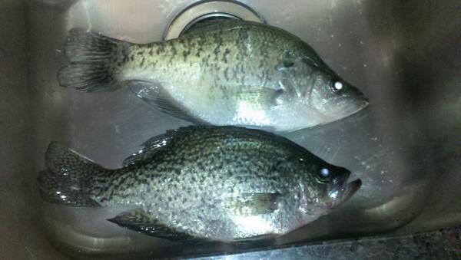
BKC and WHC Populations
Relative abundance relatively lower
Growth near state-wide average
Size structure below balanced objectives
Few fish older than age-2
Suggested overharvest of BKC and WHC

Slide 8
Post-Implementation Data
 | Black Crappie |  |  |  | White Crappie
Year | CPE | PSD-23 | Mean TL Age-3 |  | CPE | PSD-23 | Mean TL Age-3
1992 | 63 ± 16 | 0 | -- |  | 63 ± 23 | 3 | --
1993 | 11 ± 3 | 0 | -- |  | 37 ± 12 | 1 | --
1994 | 5 ± 1 | 3 |  |  | 10 ± 3 | 15
1995 | 7 ± 1 | 3 | 207 ± 9.0 |  | 6 ± 2 | 13 | 220 ± 9.3
Mean | 22 ± 5 | 2 | 207 ± 9.0 |  | 29 ± 10 | 8 | 220 ± 9.3
1996 | 35 ± 11 | 0 | 199 ± 3.1 |  | 43 ± 8 | 2 | 215 ± 2.2
1997 | 13 ± 5 | 2 | 209 ± 1.5 |  | 40 ± 10 | 4 | 212 ± 3.6
1998 | 41 ± 7 | 1 | 211 ± 2.5 |  | 27 ± 9 | 3 | 213 ± 0.7
1999 | 66 ± 10 | 2 | 202 ± 2.4 |  | 44 ± 15 | 3 | 205 ± 2.6
Mean | 39 ± 8 | 1 | 205 ± 2.4 |  | 39 ± 11 | 3 | 211 ± 2.3
Notes:
CPE variable … increased slightly post-implementation
Growth to age-3 did not change much (perhaps slightly decreased)
No increase in proportion of 23cm and larger fish
Table 9.3. Mean catch per unit effort (CPUE, number of fish >age 1/net night) ± SE, proportional size distribution of 23-cm fish (PSD-23; percent of 13-cm and longer fish that also exceeded 23 cm; Guy et al. 2007), and mean length (mm) ± SE at time of capture for age-3 black and white crappies collected with trap (modified fyke) nets during late June-early July 1992-1999 from Lake Alvin, South Dakota. Means are presented for pre- (1992-1995) and post-regulation (1996-1999) periods. Age-and-growth analysis was not conducted prior to 1995.

Slide 9
Post-Implementation Data
Wr
 | Black Crappie |  |  |  |  | White Crappie
Year | SS | S-Q | Q-P | P-M |  | SS | S-Q | Q-P | P-M
1992 | 138 (8) | 110 (6) | 86 | -- |  | 101 (11) | 100 (3) | 78 (5) | 77 (7)
1993 | -- | 102 (1) | 88 (2) | -- |  | -- | 88 (1) | 81 (2) | --
1994 | 103 (6) | 96 (4) | 88 (2) | -- |  | 104 (5) | 89 (3) | 81 (2) | 81 (2)
1995 | 134 (7) | 106 (2) | 81 (3) | -- |  | 100 (7) | 97 (3) | 71 (2) | 77
1996 | 126 (12) | 89 (1) | 88 (4) | -- |  | -- | 107 (1) | 99 (2) | --
1997 | 129 (2) | 116 (3) | 100 (2) | -- |  | 112 (4) | 102 (4) | 89 (1) | 82
1998 | 108 (7) | 107 (1) | 105 (3) | -- |  | 108 | 106 (2) | 87 (3) | 87 (3)
1999 | 107 (3) | 101 (1) | 89 (2) | -- |  | -- | 89 (1) | 81 | 83
Notes:
Wr decrease with increasing length category did not change post-implementation
Wr generally did not change post-implementation
Table 9.4. Mean relative weight (Wr) by length category (SE in parentheses) for black and white crappies collected with trap nets during late June/early July 1992 to 1999 from Lake Alvin, South Dakota. SS = substock (<13 cm); S = stock (13 cm), Q = quality (20 cm), P = preferred (25 cm), M= memorable (30 cm).

Slide 10
Post-Implementation Data
140
Black crappie
130
120
110
100
1992
90
1993
80
1994
70
1995
Relative weight
1996
140
White crappie
1997
130
1998
120
1999
110
100
90
80
70
SS
S-Q
Q-P
P-M
Length category
Notes:
Wr decrease with increasing length category did not change post-implementation
Wr generally did not change post-implementation
Figure 9.2. Mean relative weight (Wr) by length category for black and white crappies collected with trap nets during late June/early July, 1992–1999 from Lake Alvin, South Dakota. SS=sub-stock (<13 cm); S–Q = stock to quality (13–19 cm); Q–P = quality to preferred (20–24 cm); P–M = preferred to memorable (25–29 cm).

Slide 11
Post-Implementation Data
Black Crappie
White Crappie
100
100
1995
80
80
60
60
40
40
20
20
0
0
50
100
150
200
250
50
100
150
200
250
Length Increment (mm)
100
100
1999
80
80
60
60
40
40
20
20
0
0
50
100
150
200
250
50
100
150
200
250
Initial Length (mm)
Initial Length (mm)
Notes:
Growth of small fish stayed the same or slightly increased (for BKC)
However, growth of large fish declined.
Figure 9.3. Incremental growth analysis (i.e., growth increment for the last full growing season plotted as a function of initial length at the start of that growing season) for black crappies (BLC) collected with trap nets from Lake Alvin, South Dakota in 1995 and 1999. Each symbol represents the growth of an individual fish. A 23-cm minimum length limit was implemented for crappies in 1996. The regression line for 1995 data is replicated on the 1999 plot to allow comparison between the two years.

Slide 12
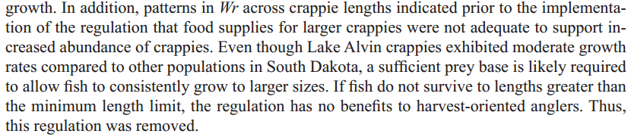
Manager’s Notes

