Slide 1
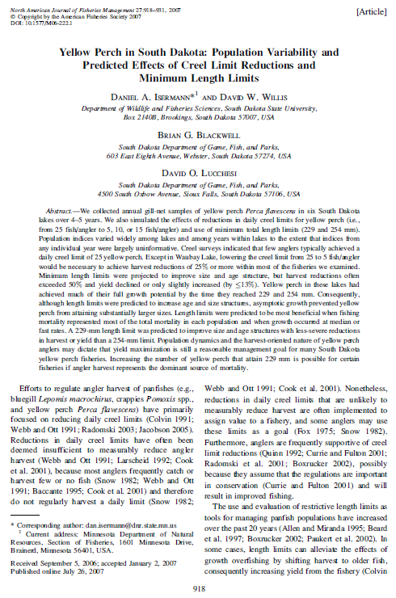
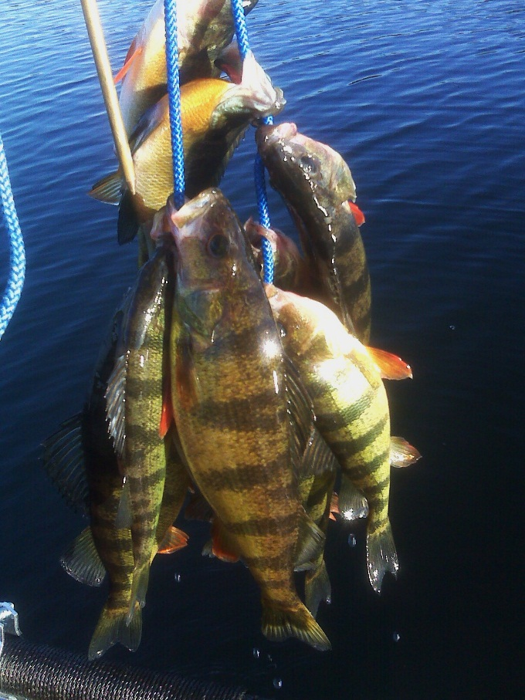
Isermann et al. (2007) YEP Bag/Length Limits South Dakota

Slide 2
Definitions / Distinctions
PSS
CV
Harvest
Yield
Growth overfishing

Slide 3
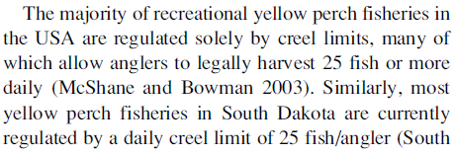
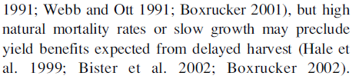
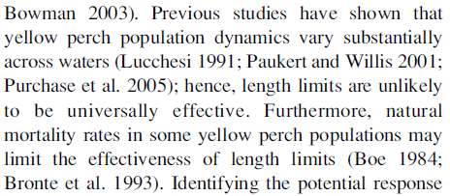
Introduction – Background
How are most YEP fisheries managed?
What two characteristics of YEP populations impact management options?
Page 919, Col 1, Par 2
Page 919, Col 1, top
Page 919, Col 2

Slide 4
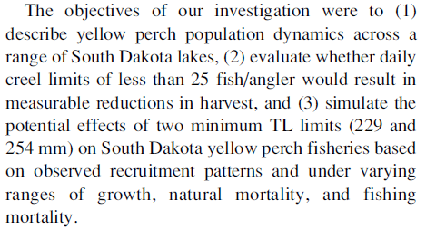
Introduction – Objectives
What are the stated objectives of this study?
Page 919, Col 2, Par 1

Slide 5
Methods
What did the authors do in this study?
Simulated (harvest truncation) bag limit reductions from 25 to 15, 10, and 5.
Simulated minimum length limits (9 and 10 in) compared to 7 in.
What are the response variables?
Examined changes (from no min length and 25 bag) in harvest, yield, PSD-P, and percent of fish age-5+

Slide 6
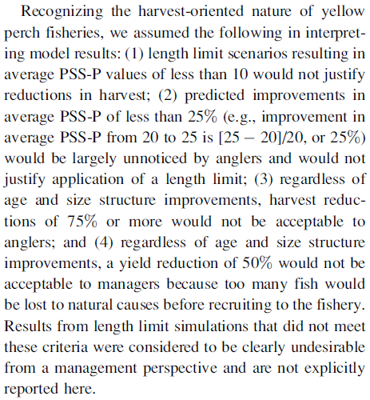
Methods – “Success” Criterion
Explain, in lay terms, the following four criterion
Explain, in lay terms, what these four items mean.
Not enough interesting fish for anglers
If the interesting fish don’t change enough, then anglers won’t notice
Anglers won’t accept major harvest reductions
Managers would rather have fish in the creel than dead on the bottom of the lake

Slide 7
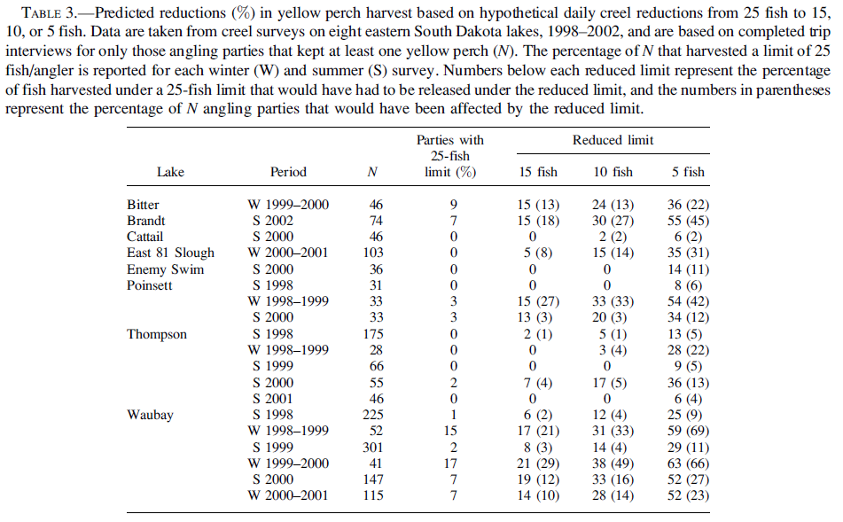

Slide 8
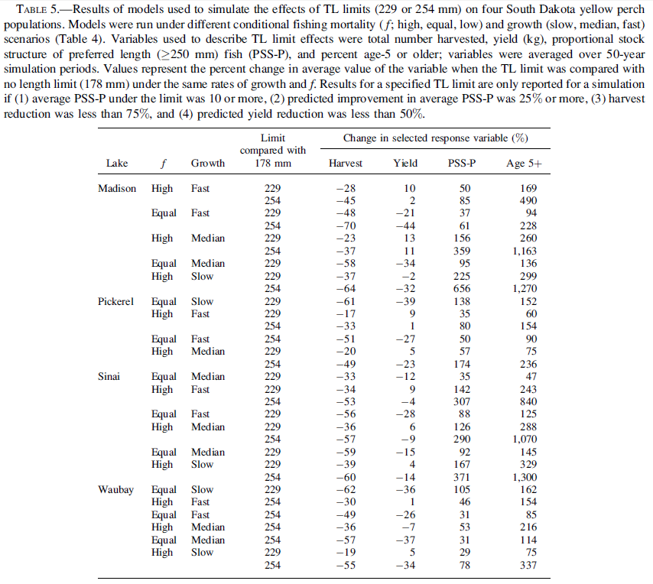

Slide 9
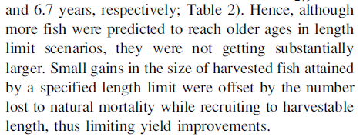
Discussion
Why did minimum length limits result in improved age- and size-structures but not in increased yields and harvests?
Page 928, Col 1, Par 1

Slide 10
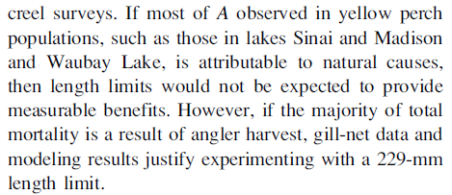
Discussion
How does the relative proportional contribution to A impact the probability of success for minimum length limits?
Page 928, Col 1, Par 1

Slide 11
Conclusions
What are take home messages?
High variability in YEP populations (between populations and years) make management recommendations and evaluations difficult.
Minimum length limits may improve age- and size-structures of YEP populations (if fishing mortality and growth rates are high), but result in declines in harvest and yields.
Bag limits had no real impact on YEP population metrics.

Slide 13
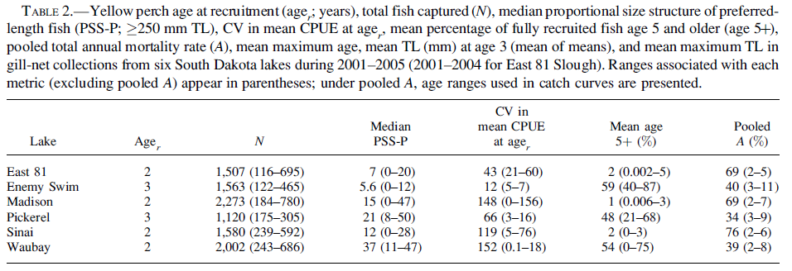
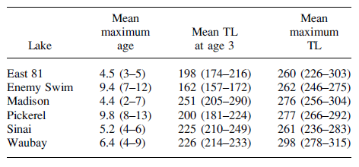

Slide 14
