Slide 1
Management Regulations

Slide 2
Length Limits
Minimum – no harvest below minimum size.
Maximum – no harvest above maximum size.
Protected Slot – no harvest within slot sizes.
Harvest Slot – no harvest outside of slot sizes.
6 | 7 | 8 | 9 | 10 | 11 | 12 | 13 | 14 | 15 | 16 | 17 | 18 | 19 | 20 | 21 | 22
6 | 7 | 8 | 9 | 10 | 11 | 12 | 13 | 14 | 15 | 16 | 17 | 18 | 19 | 20 | 21 | 22
6 | 7 | 8 | 9 | 10 | 11 | 12 | 13 | 14 | 15 | 16 | 17 | 18 | 19 | 20 | 21 | 22
6 | 7 | 8 | 9 | 10 | 11 | 12 | 13 | 14 | 15 | 16 | 17 | 18 | 19 | 20 | 21 | 22

Slide 3
Length Limits – Minimum
6 | 7 | 8 | 9 | 10 | 11 | 12 | 13 | 14 | 15 | 16 | 17 | 18 | 19 | 20 | 21 | 22
Possible reasons to use.
Lower mortality (fishing and total) in highly vulnerable populations.
Prevent overexploitation.
Protect reproductive potential of population.
Allow at least one spawning.
Increase catch (but not necessarily harvest) rates.
Increase abundance of quality fishes.
Promote predation on prey fishes.

Slide 4
Length Limits – Minimum
6 | 7 | 8 | 9 | 10 | 11 | 12 | 13 | 14 | 15 | 16 | 17 | 18 | 19 | 20 | 21 | 22
Recommended when …
Low rates of recruitment.
Low rates of natural mortality.
High fishing mortality.
“Good” growth rates.
“Late” maturing populations.

Slide 5
Length Limits – Minimum
Examine Class Exercise
Discuss Nebraska Reading

Slide 6
Length Limits – Protected Slot
6 | 7 | 8 | 9 | 10 | 11 | 12 | 13 | 14 | 15 | 16 | 17 | 18 | 19 | 20 | 21 | 22
Possible reasons to use.
Increase abundance of protected-size fish.
Increase abundance of trophy fish.
Promote growth of smaller-size fish.
Increase catch rates.
Promote predation on prey fishes.

Slide 7
Length Limits – Protected Slot
6 | 7 | 8 | 9 | 10 | 11 | 12 | 13 | 14 | 15 | 16 | 17 | 18 | 19 | 20 | 21 | 22
Recommended when …
High rates of recruitment.
Low rates of growth.
Desire more quality fish.
Notes:
Stop video at 3:30

Slide 8
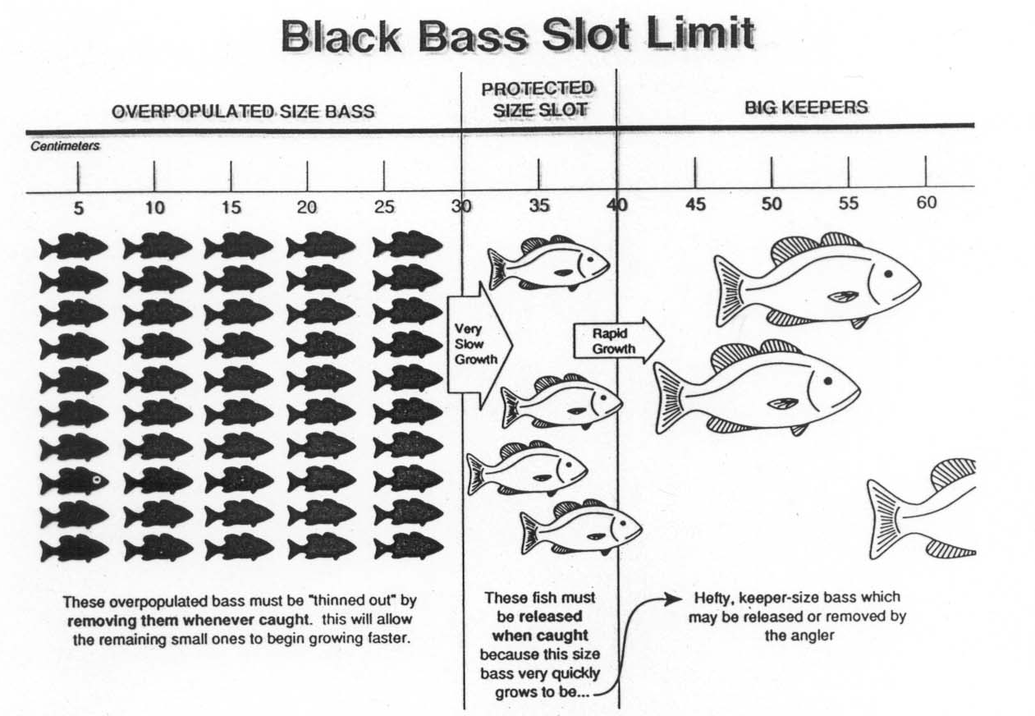
Length Limits – Protected Slot

Slide 9
Length Limits – Protected Slot
6 | 7 | 8 | 9 | 10 | 11 | 12 | 13 | 14 | 15 | 16 | 17 | 18 | 19 | 20 | 21 | 22
Recommended when …
High rates of recruitment.
Low rates of growth.
Desire more quality fish.
Check this out! (0:31-2:18)
And note this! (0:45-3:30)
Notes:
Stop video at 3:30

Slide 10
Length Limits – Protected Slot
Examine Class Exercise
Discuss South Dakota Reading

Slide 11
Length Limits – Harvest Slot
6 | 7 | 8 | 9 | 10 | 11 | 12 | 13 | 14 | 15 | 16 | 17 | 18 | 19 | 20 | 21 | 22
Possible reasons to use.
Protect small fish for recruitment.
Protect large fish for spawning and attainment of trophy size.
Recommended when …
Low recruitment.
Good growth.
Check this out! (0:35-3:37)

Slide 12
Length Limits – Maximum
6 | 7 | 8 | 9 | 10 | 11 | 12 | 13 | 14 | 15 | 16 | 17 | 18 | 19 | 20 | 21 | 22
Possible reasons to use.
Protect relatively few sexually mature adults.
Protect important large spawners.
Reduce numbers of small fish (and potentially increase growth rates).

