Slide 1
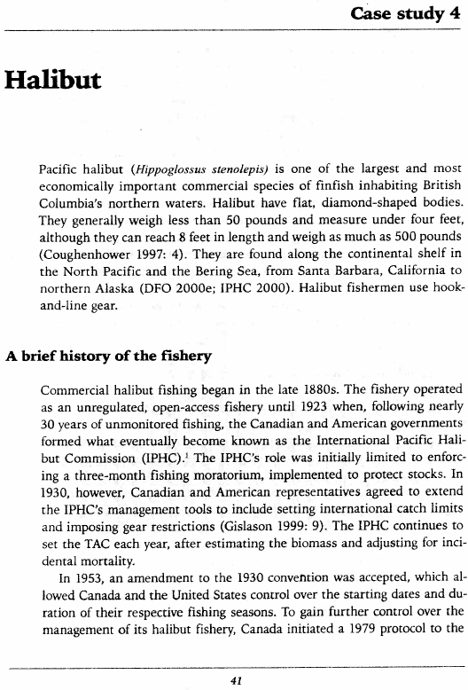
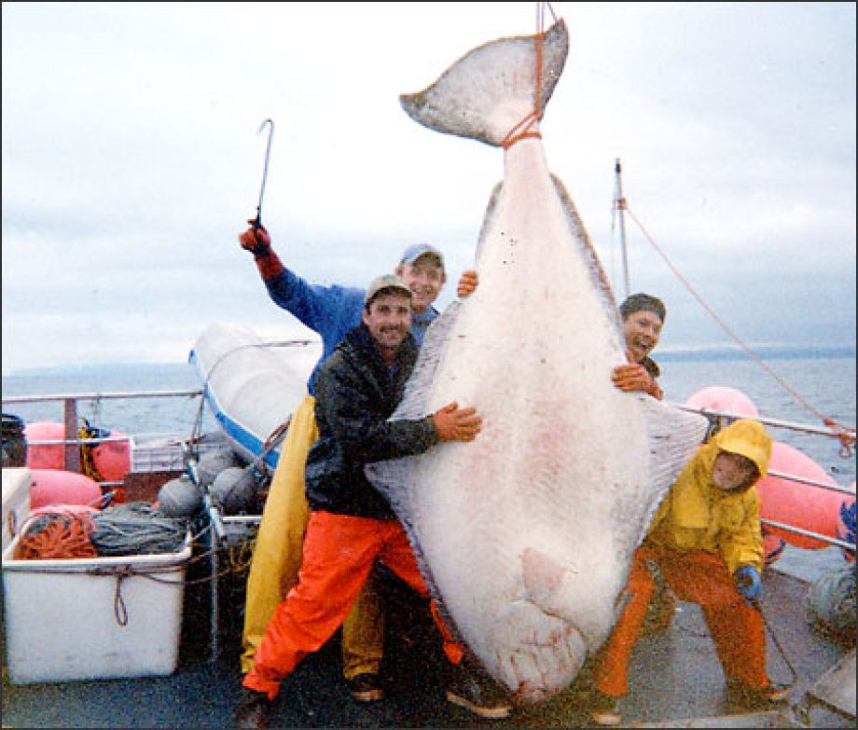
Individual Vessel Quotas Canadian Pacific Halibut

Slide 2
Definitions / Distinctions
Open Access
Limited Entry
IQ, IFQ, IVQ, ITQ, catch-shares
TAC

Slide 3
History of Canadian Halibut Fishery
Describe specific events in the fishery
1923
Changed from open access to 3-month fishing moratorium
1930
Set catch limits and gear restrictions
1953
US and Canada separate control of starting dates and duration
1979
US and Canada fisheries independently managed
Canada imposed limited entry (435 licenses)
1980s
Fishery grew (additional crew, better gear, more fish harvested)
Seasons got shorter to try to limit catch and exceedance of TAC
1988
Fishers approached DFO about implementing IVQs

Slide 4
History of Canadian Halibut Fishery
What were the characteristics of the fishery in 1988 that prompted industry to ask for IQs?
Short season (6 days)
Decreased safety
Reduced revenue
Longer periods of unemployment
Harvests exceed the TAC, fear of collapse
Lost gear leading to mortality
Unreported bycatch
Concerns over illegal fishing

Slide 5
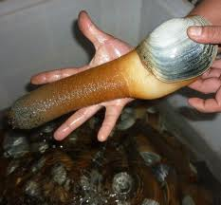
History of Canadian Halibut Fishery
Describe specific events in the fishery
1991-1993
IVQs were temporary
91% support for continuation
1999-current
Allows transfer of quotas (individuals <1% of TAC)
Industry pays for monitoring
Industry helps pay for management

Slide 6
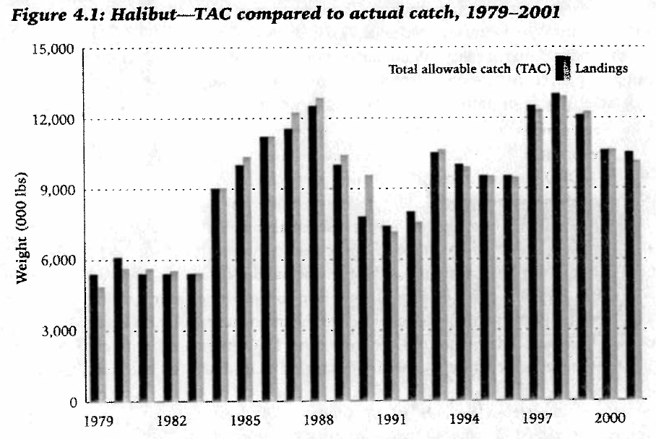
Canadian Halibut Fishery – Results
Limited Entry
IVQs

Slide 7
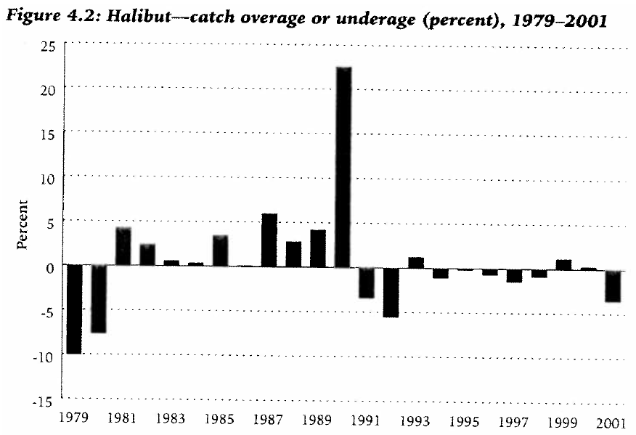
Canadian Halibut Fishery – Results
Limited Entry
IVQs

Slide 8
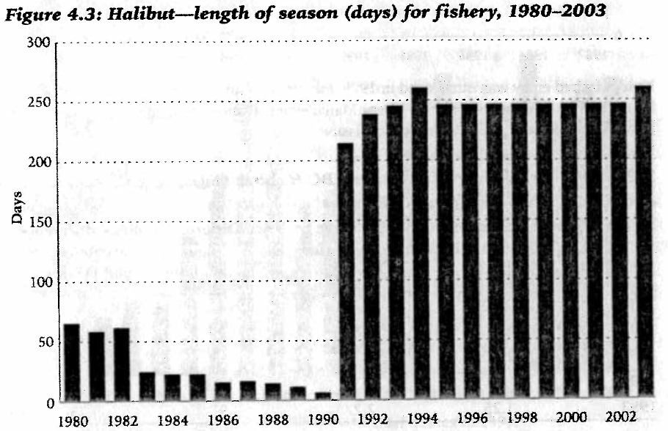
Canadian Halibut Fishery – Results
Limited Entry
IVQs

Slide 9
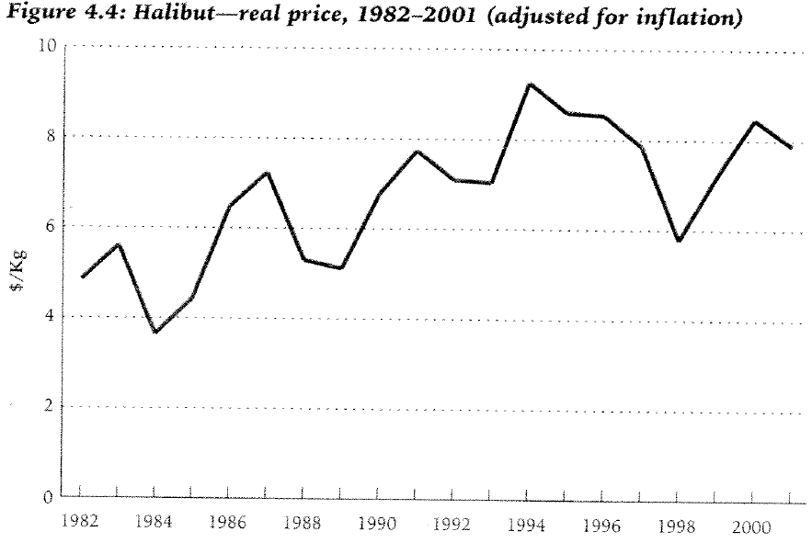
Canadian Halibut Fishery – Results
Limited Entry
IVQs

Slide 10
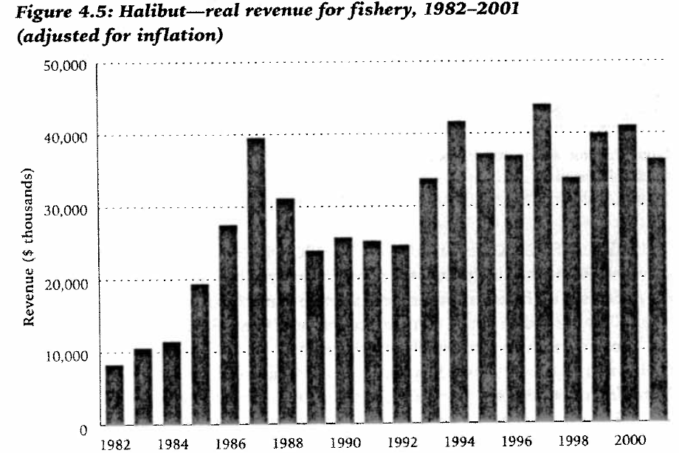
Canadian Halibut Fishery – Results
Limited Entry
IVQs

Slide 11
Canadian Halibut Fishery – Summary
TAC has been exceeded less (often and percentage)
Longer season, better product
$/kg increased, total revenues increased
Working conditions generally safer
Fewer workers, but jobs more stable

