Slide 1
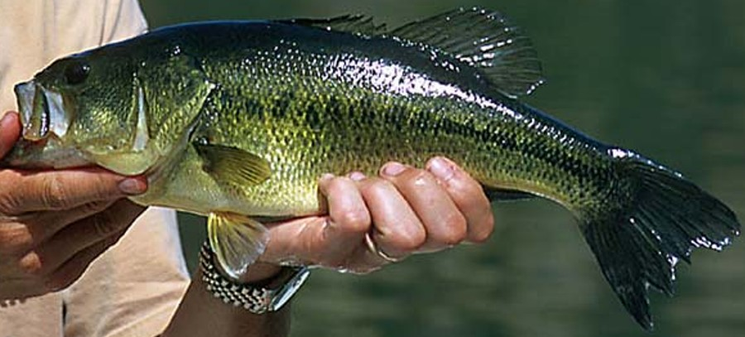
A Protected Slot Length Limit for Largemouth Bass in a Small Impoundment
Modified from Case 12 in Murphy et al. (2010)

Slide 2
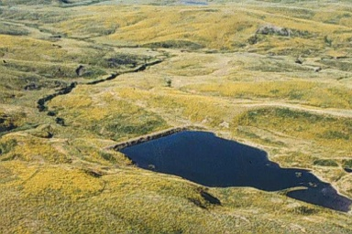
Knox Pond, SD
2.9 ha
private impoundment
Very remote
60% vegetation
Only LMB and BBH
BBH very low density

Slide 3
Knox Pond, SD
Year 1 (none >30 cm)
Marked 386 (in 4-h efishing)
Caught 221, 74 were marked
Typical biomasses
Midwestern lakes -- 43 kg/ha
SD small ponds – 73 kg/ha
 | Year 1
Density (number)
Biomass (kg/ha) | 112
CPUE (stock/hr) | 306
PSD | 0
RSD-P | 0
Mean Wr (S-Q) | 77
Mean Wr (Q-P) | --
1153
Notes:
Use M/R to fill-in Density (1153)

Slide 4

Group Think
Describe the population in Year 1.
Should a protected slot effectively re-structure this population?
 | Year 1
Density (number) | 1,153
Biomass (kg/ha) | 112
CPUE (stock/hr) | 306
PSD | 0
RSD-P | 0
Mean Wr (S-Q) | 77
Mean Wr (Q-P) | --

Slide 5
Experiment
Years 1-4
Night-time electrofishing
Annually removed <30 cm fish
Goal – 40% of 20-cm long population
Actual – 48%, 40%, 40%, 21%
Simulated a 30-38 cm protected slot length limit

Slide 6
Group Think
What do you think the population will look like in Years 2 and 5?.
 | Year 1 | Year 2 | Year 3 | Year 4 | Year 5
Density (number) | 1,153
Biomass (kg/ha) | 112
CPUE (stock/hr) | 306
PSD | 0
RSD-P | 0
Mean Wr (S-Q) | 77
Mean Wr (Q-P) | --

Slide 7
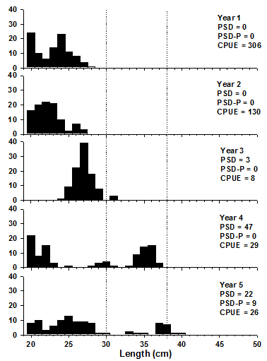
Length Frequencies

Slide 8
Group Think
 | Year 1 | Year 2 | Year 3 | Year 4 | Year 5
Density (number) | 1,153 | 458 | 167 | 191 | --
Biomass (kg/ha) | 112 | 52 | 16 | 31 | --
CPUE | 306 | 130 | 8 | 28 | 26
PSD | 0 | 0 | 3 | 47 | 22
PSD-P | 0 | 0 | 0 | 0 | 9
Mean Wr (S-Q) | 77 | 87 | 82 | 109 | 100
Mean Wr (Q-P) | -- | -- | 73 | 106 | 91
Describe how the population changed from Year 1.
Was the protected slot effective in re-structuring this population?
Notes:
Table 12.1. Spring nighttime electrofishing data for Knox Pond, South Dakota. Density and biomass were based on Peterson mark-and-recapture population estimates. Confidence intervals and/or standard errors of the mean can be found in Neumann et al. (1994). CPUE = number of stock-length fish/hr of night electrofishing; PSD = proportional size distribution (percentage of 20-cm and longer largemouth bass that also were 30 cm or longer); PSD-P = proportional size distribution of preferred-length fish (percentage of 20-cm and longer bass that also were 38 cm or longer); S = stock length (20 cm for largemouth bass); Q = quality (30 cm); P = preferred (38 cm)(Gabelhouse 1984).

Slide 9
Group Think/Analysis
110
Year 4
100
Year 5
90
Mean Wr (S-Q)
Year 2
80
Year 3
Year 1
70
0
20
40
60
80
100
LMB PSD

Slide 10
Group Think
Experiment concluded after five years.
Seven years later the pond was sold & an opportunity to return for two years of analysis was offered.
 | Year 1 | Year 2 | Year 3 | Year 4 | Year 5 | Year 12 | Year 13
Density (number) | 1,153 | 458 | 167 | 191 | -- | -- | --
Biomass (kg/ha) | 112 | 52 | 16 | 31 | -- | -- | --
CPUE | 306 | 130 | 8 | 28 | 26
PSD | 0 | 0 | 3 | 47 | 22
PSD-P | 0 | 0 | 0 | 0 | 9
Mean Wr (S-Q) | 77 | 87 | 82 | 109 | 100
Mean Wr (Q-P) | -- | -- | 73 | 106 | 91

Slide 11
Follow-Up Analysis
 | Year 1 | Year 2 | Year 3 | Year 4 | Year 5 | Year 12 | Year 13
Density (number) | 1,153 | 458 | 167 | 191 | -- | -- | --
Biomass (kg/ha) | 112 | 52 | 16 | 31 | -- | -- | --
CPUE | 306 | 130 | 8 | 28 | 26 | 88 | 91
PSD | 0 | 0 | 3 | 47 | 22 | 36 | 13
PSD-P | 0 | 0 | 0 | 0 | 9 | 27 | 12
Mean Wr (S-Q) | 77 | 87 | 82 | 109 | 100 | 87 | 87
Mean Wr (Q-P) | -- | -- | 73 | 106 | 91 | 90 | 75

Slide 12
Follow-Up Analysis

Slide 13
Follow-Up Analysis
110
100
Year 5
90
Year 13
Mean Wr (S-Q)
Year 12
80
Year 1
70
0
20
40
60
80
100
LMB PSD

Slide 14
Follow-Up Analysis
Notes:
Figure 12.5. Changes in incremental growth (length increment for the last full growing season plotted as a function of initial length at the start of that growing season) for largemouth in Knox Pond, South Dakota, over a 13-year period. The regression line fitted to the Year 1 data was replicated on each sub- sequent figure.

Slide 16
 | Year 1 | Year 2 | Year 3 | Year 4 | Year 5 | Year 12 | Year 13
Density (number) | 1,153
Biomass (kg/ha) | 112
CPUE | 306
PSD | 0
PSD-P | 0
Mean Wr (S-Q) | 77
Mean Wr (Q-P) | --

Slide 17
Follow-Up Analysis
110
100
90
Mean Wr (S-Q)
80
70
0
20
40
60
80
100
LMB PSD

