Slide 1
Abundance Estimates
Recruitment
Natural Mortality
Population
Numbers
Fishing Mortality
Immigration
Emigration

Slide 2
Common Abundance Estimates
CPE/CPUE (relative density)
Depletion/Removal (estimate of N₀)
Mark-Recapture (estimate of N₀)

Slide 3
Mark-Recapture Methods
Marking/Tagging
Batch
Cheaper, but has limitations
Individual
Expensive, but also allows estimates of mortality / survival, recruitment, movement
Recapture information recorded in “capture history” format.

Slide 4
Concept – Single-Census M/R
i=1
i=2
First sample is called the “marking run”
Second sample is called the “recapture run”

Slide 5
Parameter / Statistics Definitions
N = population size
M = number marked in popn
n = recapture sample size
m = number marked in recapture sample
m=7
n=19
M=16
N=50
i=1
N=50
i=2

Slide 6
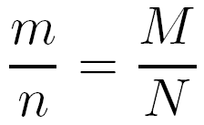
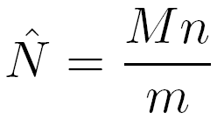
Estimation Concept
Central concept ...
… which is immediately rewritten as
Explore with mrClosed1Sim()
Use defaults, re-randomize several times

Slide 7
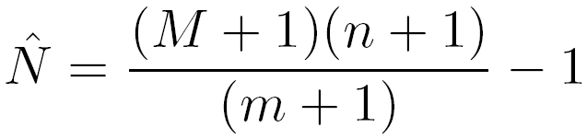
Chapman Modification
Chapman modified the Petersen method
Bias is negligible if m>7
Explore with mrClosed1Sim(type=“C”)
Use defaults, re-randomize several times

Slide 8
Estimation Example
Hand Calculation
Examine handout
mrClosed()
summary()
confint()
n=19
m=7
M=16
N=50
i=1
N=50
i=2

Slide 9
Estimation Confidence Intervals
Seber (1982) suggests using …
… the binomial distribution of m/n > 0.10
… the normal approximation if m > 50
… the Poisson approximation otherwise

Slide 10
Assumptions – Petersen Methods
The population is closed.
no losses due to emigration or mortality.
no gains due to immigration or recruitment.
All fish have the same chance of being caught.
Tagging fish does not affect their catchability.
Fish do not lose their tags.
All tagged fish are observed/reported when recaptured.

Slide 11
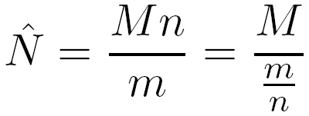
Assumptions – Effect of Violations
The Petersen estimate can be rewritten as
where the denominator can be thought of as the probability of capturing a marked fish.
If probability of capturing a marked fish is lower after the violation then N is overestimated.
If … higher … then N is underestimated.
Examine M/R Bias Simulation Case

Slide 12
Concept – Multiple-Census M/R
i=1
i=2
i=3

Slide 13
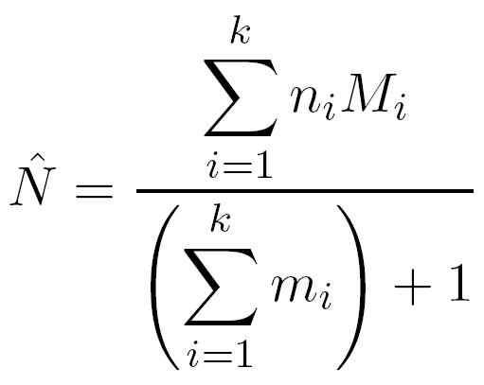
Schnabel Method (Chapman Modification)
Very similar to
Basically a weighted version of individual Petersen estimates

