Slide 1
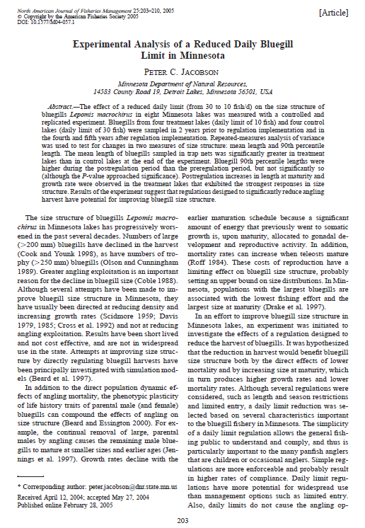
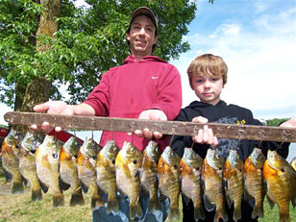
Jacobson (2005) Bluegill Bag Limit Minnesota

Slide 2
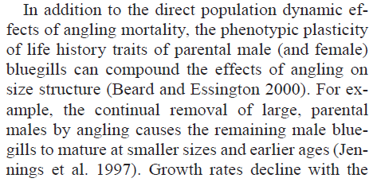
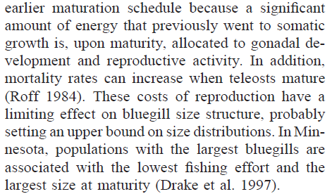
Introduction – Background
What is the described relationship between fishing effort and size-at-maturity and size of Bluegills?
Page 203, Col 1-2

Slide 3
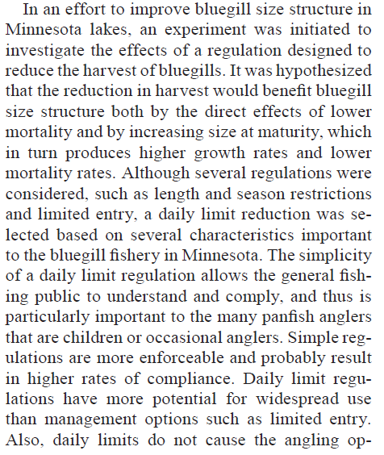
Introduction – Hypothesis
What hypothesis led to this study?
Page 203, Col 2, Par 1

Slide 4
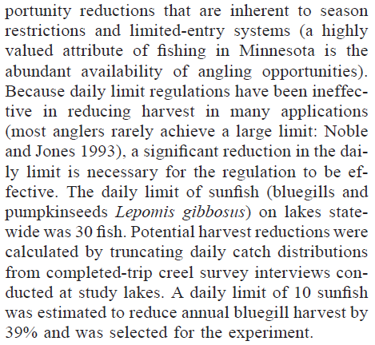
Methodology – Treatment
What bag limit was used? How did the author arrive at this value?
Page 204, Col 1

Slide 5
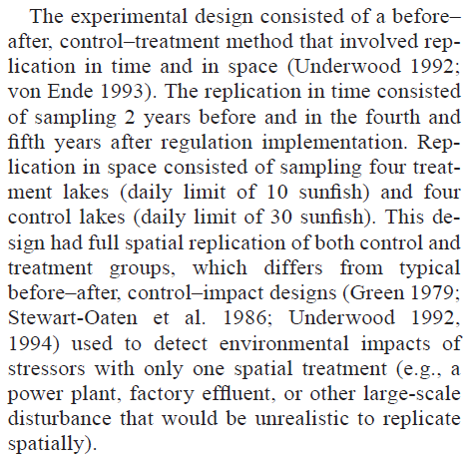
Methodology – Treatment Design
Describe the experimental setup?
What are the response variables?
Length, length-at maturity, age-at-maturity
Page 204, Col 2, Par 1

Slide 6
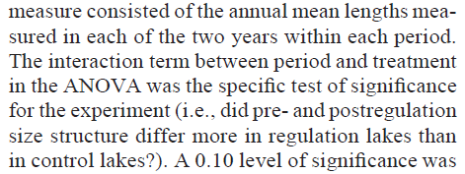
Methodology – Statistics
What does this mean? Draw a graphic that represents what the authors expect to see.

Slide 7
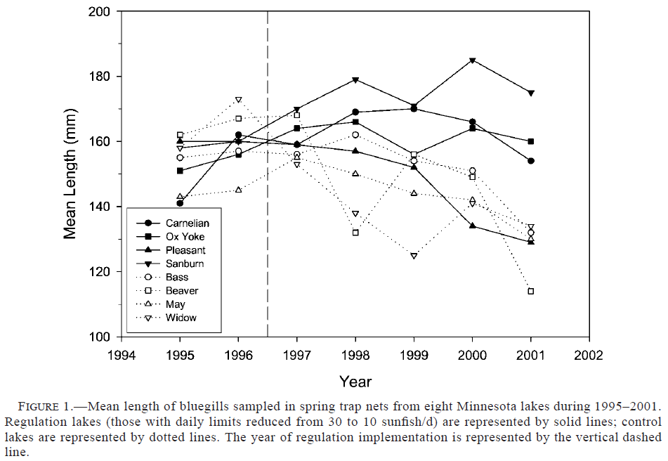
Results

Slide 8
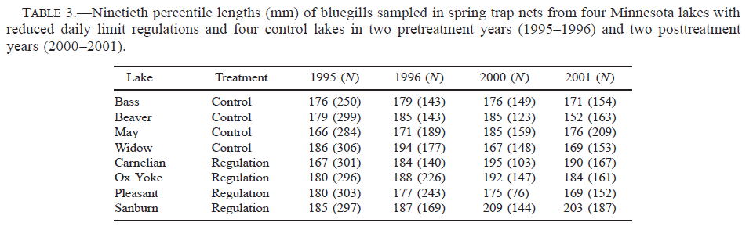
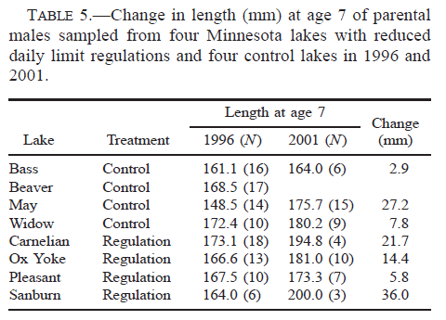

Slide 9
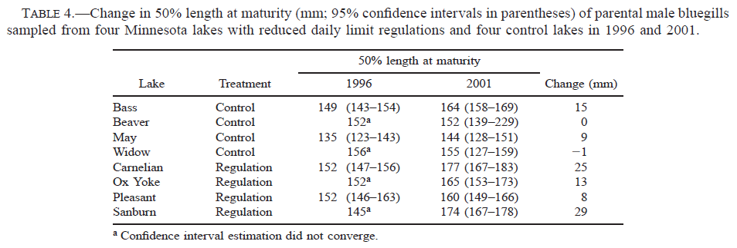
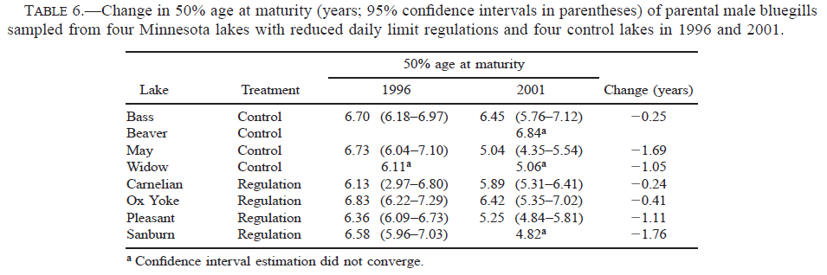

Slide 10
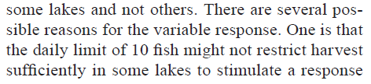

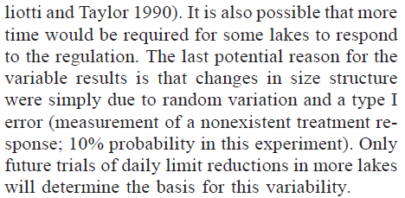
Discussion
Why did the bag limits “work” in some lakes but not others?
Page 207, Col 2, bottom
…
…

Slide 11
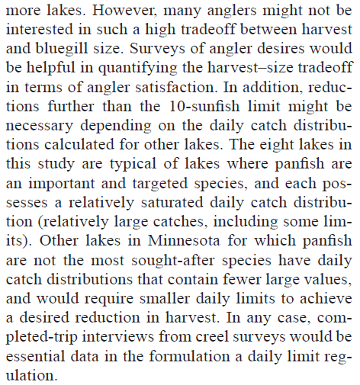
Discussion
What else does the author want to know about anglers to set more reduced bag limits?

Slide 12
Conclusions
What are take home messages?
Heavily reduced daily bag limits have the potential to increase the size structure of Bluegills.
Reducing bag limits may result in a significant increase in male Bluegill length-at-maturity, which may effect size structure.
Meeting statistical assumptions for experiments on real populations is difficult.

