Slide 1
Bag / Creel Limits
Maximum number (sometimes weight) of fish that can be removed from a water.
Daily
maximum per day.
Possession
maximum in your possession.
Season
limited number (usually 1) per season.
Typically referred to as a quota.

Slide 2
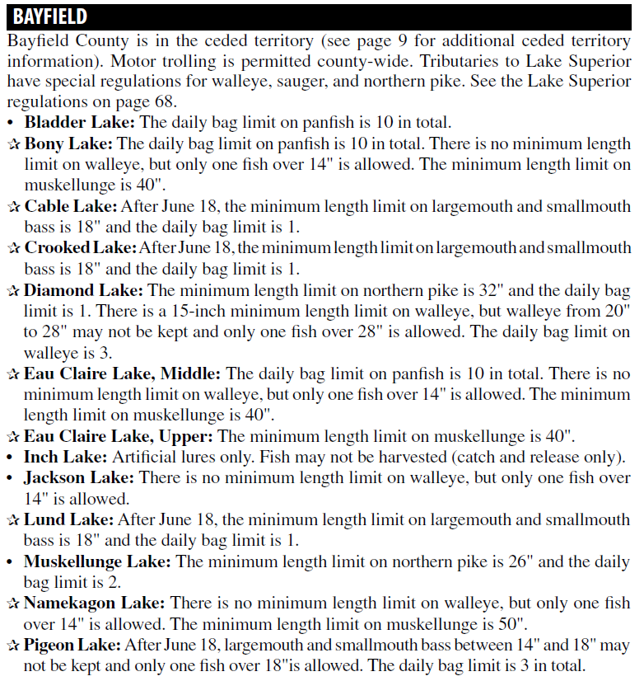
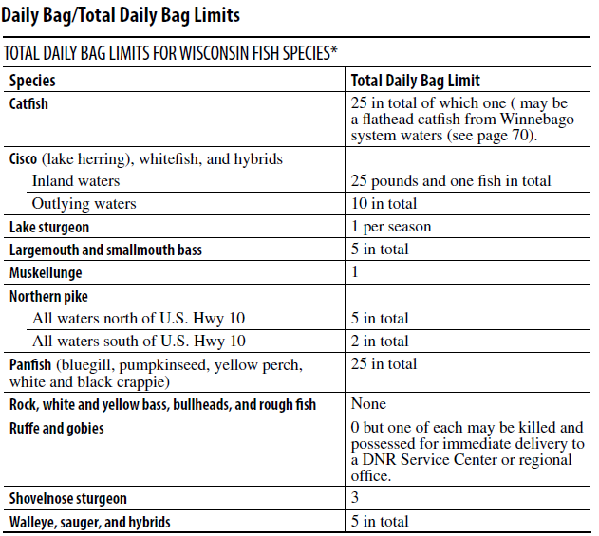
Bag / Creel Limits

Slide 3
Bag / Creel Limits
Possible reasons to restrict (be conservative).
Reduce harvest / prevent over-exploitation.
Equitable distribution of harvest.
Provide the satisfaction of reaching a goal.
Remind anglers of finite resource.
Possible reasons to liberalize
Encourage removal (of undesirable fish).
Recommend lower limits when …
High rates of fishing mortality.

