Slide 1
Components of Z
Recruitment
Natural Mortality
Population
Numbers
Fishing Mortality
Immigration
Emigration
M = instantaneous natural mortality.
F = instantaneous fishing mortality.

Slide 2
Definitions
Instantaneous Models
F = instantaneous fishing mortality
M = instantaneous natural mortality
Z = F + M

Slide 3
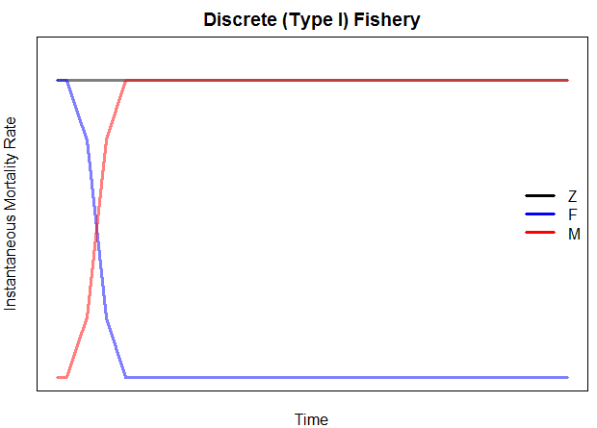
Definitions
Discrete (Type I) Fishery
F and M operate separately (different times)
Realistic for a highly seasonal fishery

Slide 4
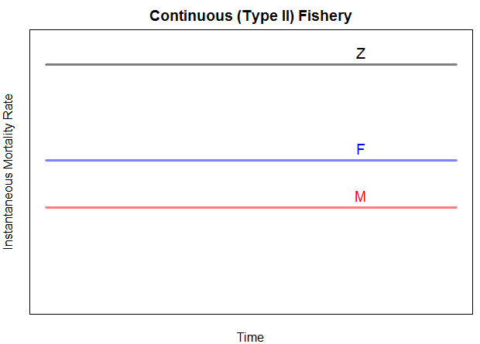
Definitions
Contionuous (Type II) Fishery
F and M operate at same time
We will assume constant F & M through year

Slide 5
Definitions
Discrete (Annual) Models
u = annual exploitation rate
expectation of death due to fishing
proportion of population that dies due to fishing
v = annual natural mortality rate
m = annual conditional mortality rate
expectation of death due to fishing IF no other source of mortality existed
proportion of population that dies due to fishing IF no other source of mortality existed
n = annual conditional natural mortality rate

Slide 6
Definitions
A = m + n – mn
mn is that some fish that died from one cause may have ultimately died of the other cause
Discrete (Type I) Fishery
mn=0 …. A = m + n = u + v
Continuous (Type II) Fishery
A ≠ u + v
Thus, most work on instantaneous scale

Slide 7
Mortality Components
As a manager, which of natural or fishing mortality can you control and, thus, want to know?
Controlling F, u, m is a major goal of most fisheries management strategies.
Very difficult to estimate precisely

Slide 8
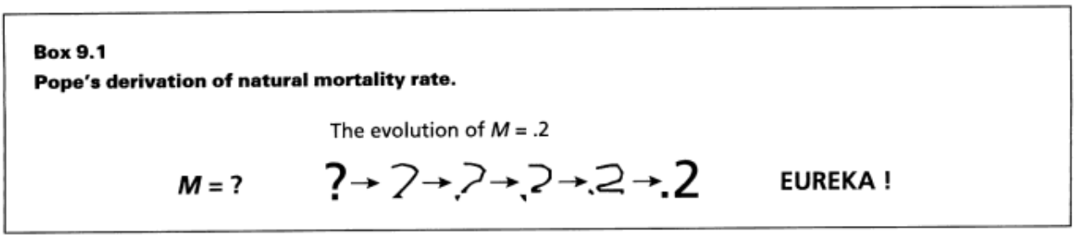
Estimating M
Assume a constant value for M
Typically use M=0.2
Is this realistic?
Notes:
Realistic? Varies by age, bathtub model

Slide 9
Estimating M
Assume a constant value for M
Relationship of M to life history traits
See page 217 in IFAR

Slide 10
Estimating M
Assume a constant value for M
Relationship of M to life history traits
From f and Z
Recall that Z = F+M and F=qf
Thus, Z = qf+M
If Z is estimated at different f, then …
M is the intercept from the Z on f regression.
Same as asking what is Z when f = 0.
Notes:
Draw the graphic

Slide 11
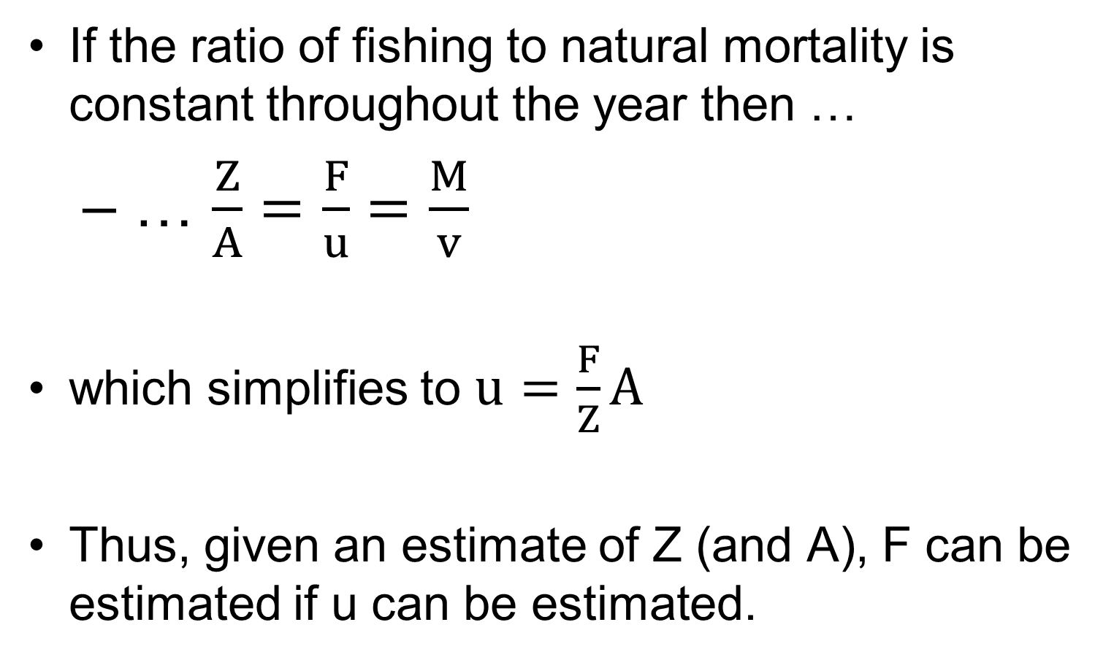
Estimating F from Expoitation Rate
If the ratio of fishing to natural mortality is constant throughout the year then …
… $\frac{Z}{A}=\frac{F}{u}=\frac{M}{v}$
which simplifies to $u=\frac{F}{Z}A$
Thus, given an estimate of Z (and A), F can be estimated if u can be estimated.

Slide 12
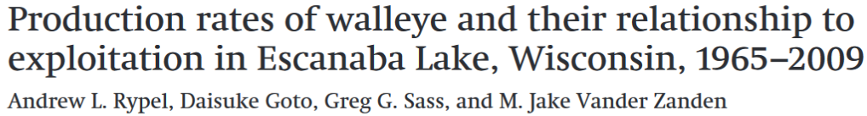
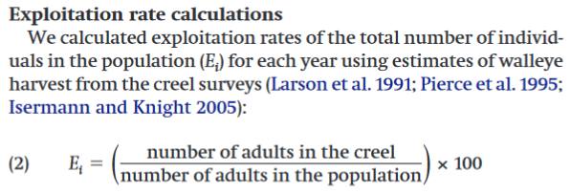
Estimating u
Divide annual harvest by estimate of N.

Slide 13

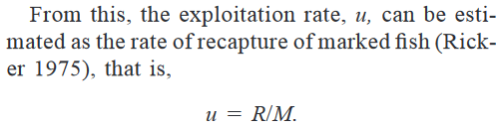
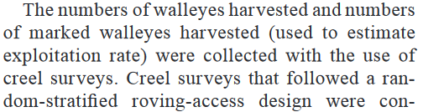
Estimating u
Divide harvested tagged fish by number of tagged fish released.

Slide 14
Estimating u
Divide annual harvest by estimate of N.
Divide harvested tagged fish by number of tagged fish released.
Recall that these estimates are only valid if ratios of fishing and natural mortality are constant throughout the year.

Slide 16



Estimating F with Marked Fish
Consider –
The number of fish caught is the proportion of dying fish due to fishing mortality
This proportion is F/Z
Therefore …
Consider --
Where the asterisks represent only marked fish

Slide 17
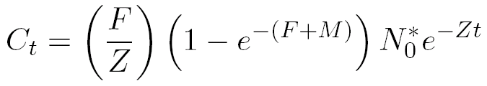
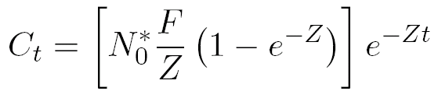
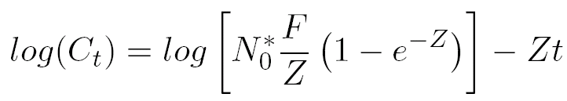
Estimating F with Marked Fish
Substitute N_{t}* equation into catch equation
and rearrange for simplicity
and take natural logs of both sides

Slide 18
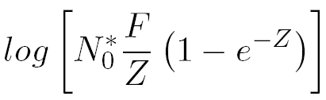
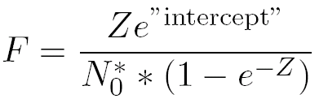
Estimating F with Marked Fish
Examine this model closely …
Slope is an estimate of –Z
Intercept is an estimate of …
Which can be solved for F

Slide 19
Example
400 fish were initially tagged
Tags were returned from the fishery over the next four years
Consider the time period to be the midpoints of the years.
Use these data to estimate Z & F (see HO).

