Slide 1
Stock
A group of individuals of the same species where immigration and emigration are negligible in relation to growth and mortality. A stock is a self-contained population with its own spawning area. Fishing upon one stock has no effect upon other stocks.” – paraphrased from Holden and Raitt, 1974
Subpopulations of a species for which intrinsic factors (growth, recruitment, mortality) are significant factors determining the stock's dynamics, while extrinsic factors (immigration and emigration) are traditionally ignored.” – paraphrased from Wikipedia
Notes:
Key concepts … (1) Closed (simplifies) and (2) Identifies unit for management and analysis (i.e., statistical population).

Slide 2
Conceptual Model of a Stock
Recruitment
Natural Mortality
Population
Numbers
Population
Biomass
Fishing Mortality
Immigration
Emigration
Growth
Notes:
Measure things (size, age strux) on population box, make inferences about processes leading in and out.

Slide 3
Environments of a Stock
Socio-Cultural Environment
Economics
Politics
Physical Environment
Habitat
Biotic Environment
Competition
Recruitment
Natural Mortality
Population
Biomass
Fishing Mortality
Immigration
Emigration
Growth
Predation
Behavior
Beliefs
Behavior
Traditions

Slide 4
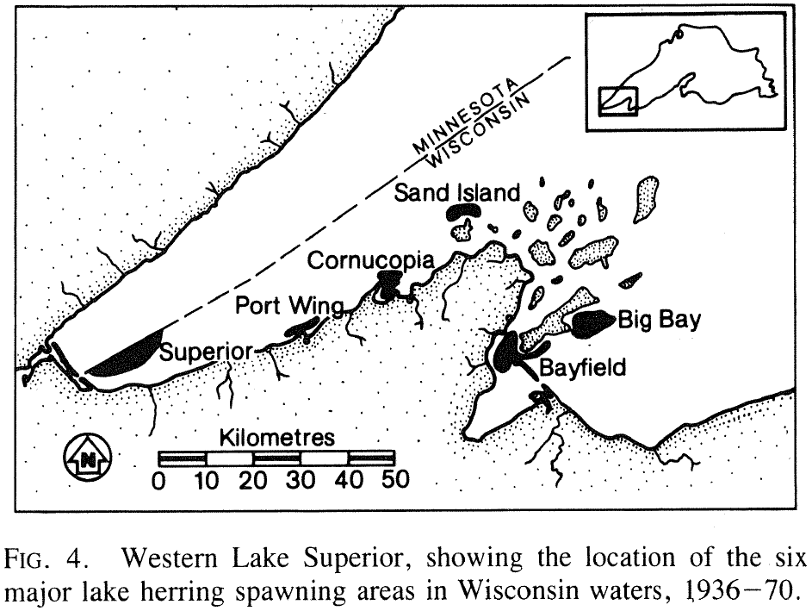
Stock Concept Example

Slide 5
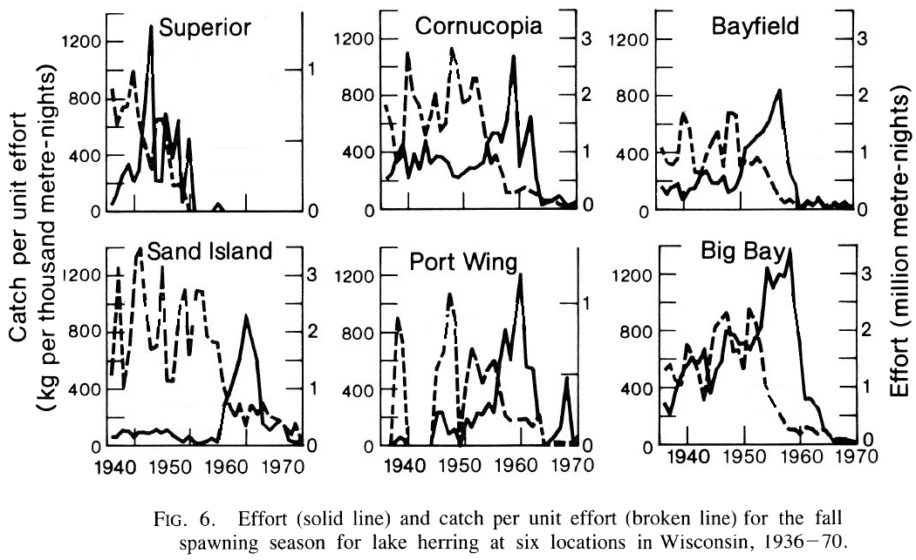
Stock Concept Example

Slide 6
Critique of Stock Concept
Too narrowly focuses management
move towards ecosystem-based approach that considers other species, habitat, etc.
but some debate about what this means.

