Slide 1
Introduction

Slide 2
Environments of a Stock
Socio-Cultural Environment
Economics
Politics
Physical Environment
Habitat
Biotic Environment
Competition
Recruitment
Natural Mortality
Population
Biomass
Fishing Mortality
Immigration
Emigration
Growth
Predation
Behavior
Beliefs
Behavior
Traditions

Slide 3
Management Environment
Ecological (Biotic and Physical)
Habitat, predation, forage base, genetics, etc.
Economic
Market forces, license fees, budgets, etc.
Political
Laws, treaties, etc.
Social / Cultural
Traditions, values, perceptions, philosophies, etc.
Sets bounds on productivity
Provides motivation
Sets limits on actions

Slide 4
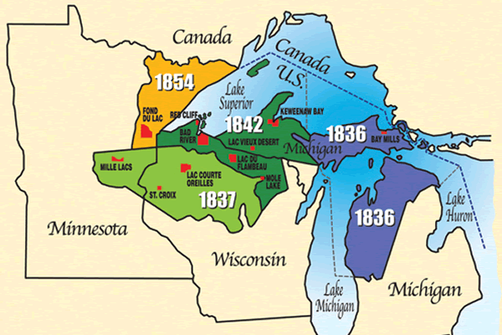
Walleye War – Background (brief)
1836, 1837, 1842, and 1854 Treaties
Ojibwe reserved right to hunt and fish in (off-reservation) ceded lands.

Slide 5
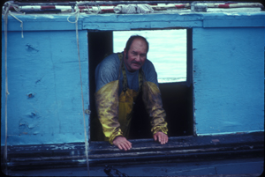
Walleye War – Background (brief)
1972 -- Gurnoe decision
Bad R. and Red Cliff rights on Lake Superior upheld

Slide 6
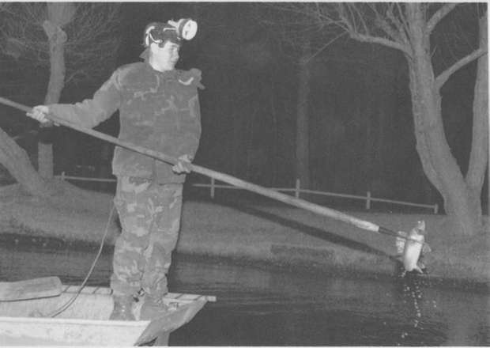
Walleye War – Background (brief)
Early 1980s
LCO and then LDF members reasserted this right by harvesting deer and walleye off-reservation.
Upheld in court 1983 – Voigt decision

Slide 7
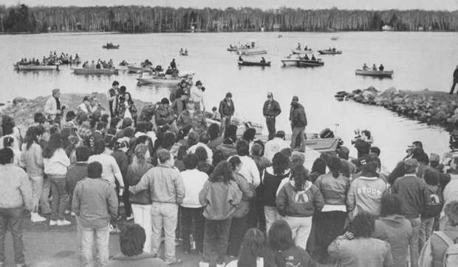
Walleye War – Background (brief)
Late 1980s through early 1990s
Continued harvest, very large demonstrations
Rights upheld numerous times (Crabb decision in 1987, Mille Lacs decision in 1997, Supreme Court in 1999)
http://www.glifwc.org/TreatyRights/protest.html
http://www.wisconsinoutdoorfun.com/apps/pbcs.dll/gallery?Avis=U0&Dato=20110519&Kategori=WOF071&Lopenr=105190807&Ref=PH

Slide 8
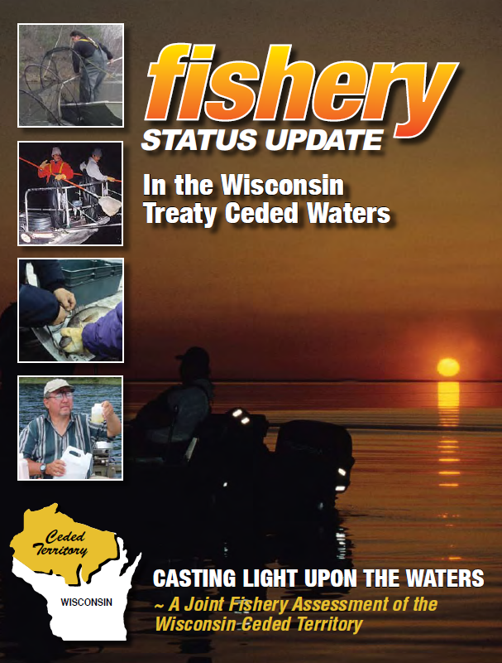
Walleye War – Background (brief)
Today
Rights maintained
Strict and thorough management
http://www.glifwc.org/publications/pdf/FisheryStatus2010.pdf

Slide 9
Walleye War – Mgmt Environment
Ecological
Walleye abundance, spawning behavior, etc.
Economic
Impact on recreational fishing (license sales), tourism, enforcement costs, etc.
Political
Treaties, federal vs. state, racism
Sociocultural
Native traditions, tourist expectations, racism

Slide 10
Management Environment
Space
Sociocultural
Management
Process
Economic
Political
Ecological
Time

Slide 11
Management Process
Where do we want to be?
Broad, long-tem, sets direction
Goal
Objective
Specific, Measurable, Achievable, Related to Goal, Time-specific
What will prevent us?
Measure
Compare
Assess
Revise
Problem
Identification
Evaluation
Information
Base
Obstructions to objectives
Actions
Did we make it?
What to do next?
How do we get there?

Slide 12
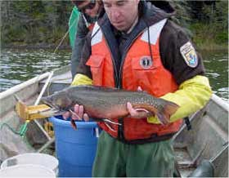
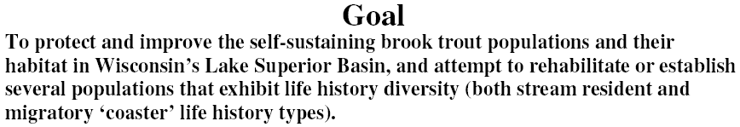
Management Process - Coaster BKT
Goal
Objective

Slide 13
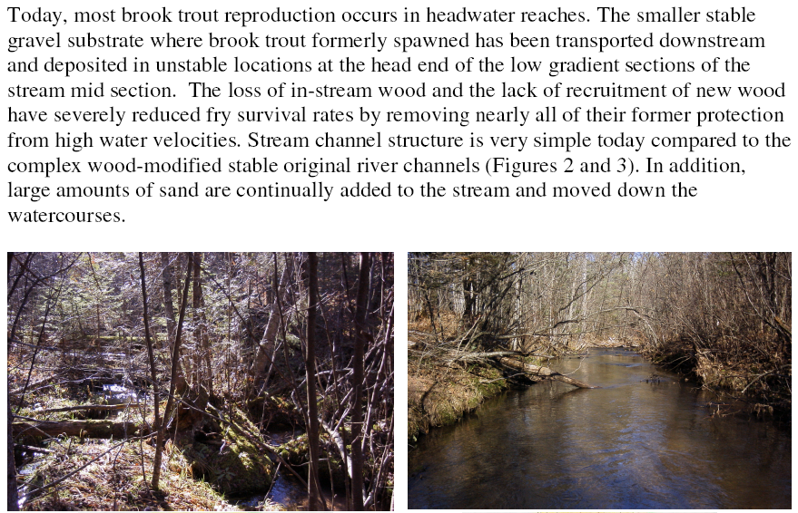
Management Process - Coaster BKT
Problem Identification

Slide 14
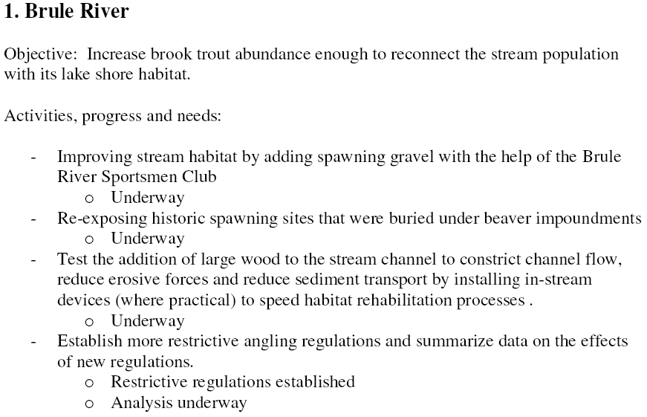
Management Process - Coaster BKT
Information Base
Action
Evaluation
Action

Slide 15
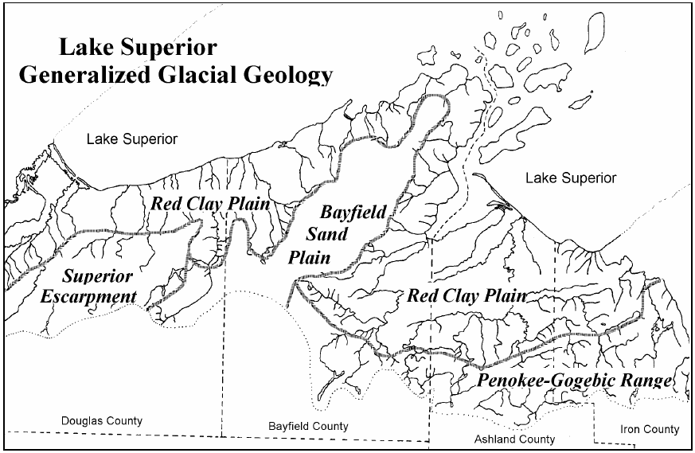
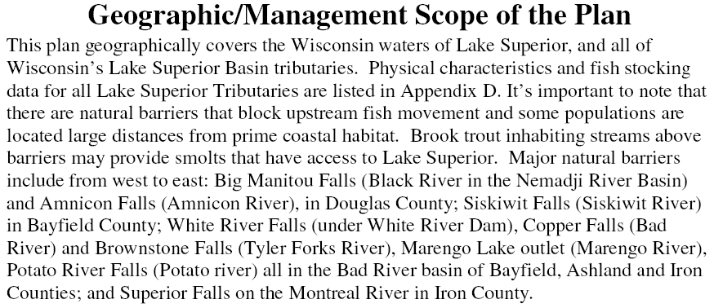
Management Process - Coaster BKT

Slide 16
Fisheries Management: Art & Science
Science
Estimate parameters of the stock to be managed.
Statistics and model based.
Generally “well-known.”
Art
Forming management decision from science information and knowledge of stakeholders, society, etc.
Incorporates a wide array of information.
Incorporates uncertainty, precautionary principle.
May be specific to situation.
May rely on experience.

Slide 17
Adaptive Management
Structured, iterative process of decision making
Experimentation with management decisions
Aims
Meet management objective(s)
Accrue information to inform future decisions
Reduce uncertainty over time
Challenges
Balance short-term management outcome with long-term increase in knowledge

Slide 18
Example: Black bass and walleye
Bass >8 inches (statewide)
LMB
SMB
LMB: R²=0.46, p=0.0006
SMB: R²=0.19, p=0.05
LN(CPUE)- annual mean +/- SE
YOY Walleye (Ceded Territory)
R²=0.28, p=0.01
From Gretchen Hansen (UW)

Slide 19
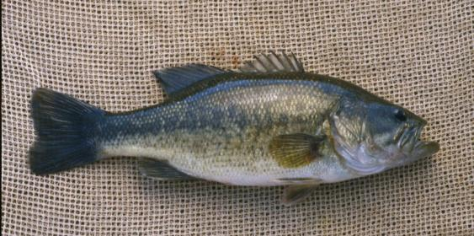
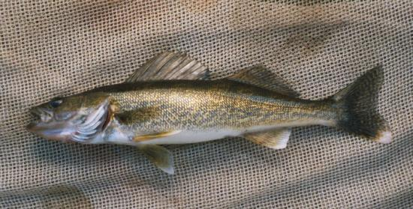
Black Bass & Walleye: Complex & Uncertain Interactions
?
Can we manage in such a way as to better understand these interactions?
Exploitation
Shoreline development
Macrophytes
Other fishes
Invasive species
Stocking
Lower water levels
Warming temperatures
From Gretchen Hansen (UW)
Notes:
It is possible that changes in the abundance of both species are indicators of other changes in the environment: that both bass and walleye are simply passengers of other changes, rather than bass driving changes in walleye. So this is an example of uncertainty in interactions that it might be possible to do something about. If we manage in a way that allows us to learn about which of these interactions are important, we will be better to able to manage in the future. This is where adaptive management comes in.

Slide 20
Adaptive Management Process
Goal
Objective
Identify uncertainties
Form hypotheses
Problem
Identification
Evaluation
Information
Base
Actions
Implemented as an experiment with controls, replication, etc.

Slide 21
Adaptive Management: Planning
Objective
Improve walleye fishing
YOY walleye catch rate of >30/mile in 75% of lakes within 10 yrs
Uncertainties
Effects of largemouth bass (LMB) on walleye
Role of harvest regulations in determining LMB abundance
Hypotheses
LMB are causing declines in walleye reproduction
Liberalized harvest regulations will decrease LMB population
Action option
Remove length and bag limits on LMB on SOME lakes
Notes:
Let’s go through an example. As with any type of good management, it is important to start with specific objectives. For example,… The next step is more specific to AM – identify sources of uncertainty and hypotheses. These hypotheses could come from previous studies, modeling, or just your gut feeling, the important part is that they are articulated as hypotheses rather than known facts. For example,… Finally, the management intervention is chosen. This could be designed to explicitly test hypotheses and promote learning, or they could be chosen for other reasons. Sometimes management actions are designed for political or social reasons, and that is fine. The important thing is that they are implemented in a way that allows us to learn whether they work as intended, no matter what the reason.

Slide 22
Adaptive Management: Implementation
2013
2018
Notes:
Identify environmental/biological gradient in your lakes, implement regulation on SOME lakes in 2013 but leave others as a control, implement regulation on more lakes in 2018 to provide replication across time. Monitor lakes with regard to objectives. Document results for future use, make conclusions about actions taken.

