Slide 1
Introduction

Slide 2
Management Environment
Traditions, Values, Philosophies, Perceptions
Market forces, License Fees, Budgets
Space
Sociocultural
Sets limits on types of actions
Sets limits on types of actions
Provides motivation
Management
Process
Economic
Political
Laws,
Treaties
Sets bounds on productivity
Ecological
Time
Sets limits on types of actions
Habitat, Predators, Forage, Genetics, Behavior
Introduction

Slide 3
Walleye War – Background (brief)
1837 & 1842 Treaties
  Ojibwe reserved right to hunt and fish in (off-reservation) ceded lands.
Early 1980s
  LCO and then LDF members reasserted this right by harvesting deer and walleye off-reservation.
Mid- to late-1980s
  Continued harvest, very large demonstrations
1987
  Rights affirmed in U.S. Court by Judge Crabb
Today
  Rights maintained, strict and thorough management
Introduction

Slide 4
Walleye War – Mgmt Environment
Ecological
  Walleye abundance, spawning behavior, etc.
Economic
  Impact on recreational fishing (license sales), tourism, enforcement costs, etc.
Sociocultural
  Native traditions, tourist expectations, racism
Political
  Treaties, federal vs. state, racism
Introduction

Slide 5
Management Environment
Space
Sociocultural
Management
Process
Economic
Political
Ecological
Time
Introduction

Slide 6
Management Process
Where do we want to be?
Broad, long-tem, sets direction
Goal
Objective
Specific, Measurable, Achievable, Related to Goal, Time-specific
What will prevent us?
Measure
Compare
Assess
Revise
Problem
Identification
Evaluation
Information
Base
Obstructions to objectives
Actions
Did we make it?
What to do next?
How do we get there?
Introduction

Slide 7
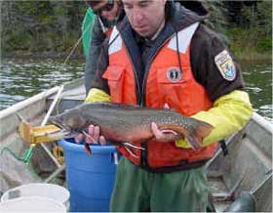
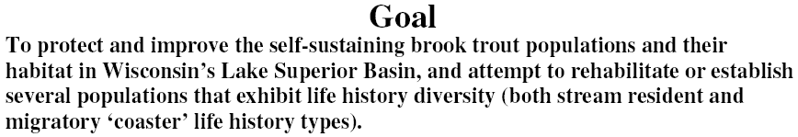
Coaster Brook Trout Management
Goal
Objective
Introduction

Slide 8
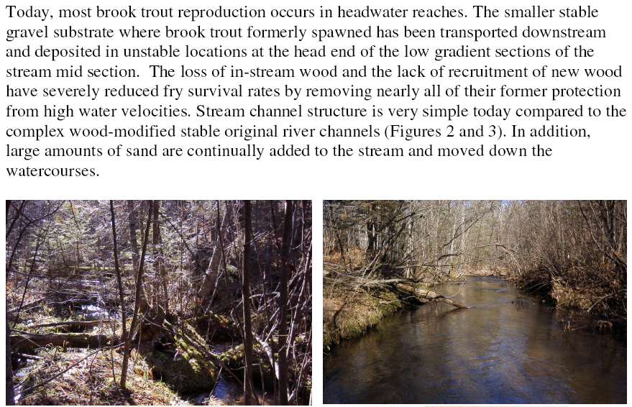
Coaster Brook Trout Management
Problem Identification
Introduction

Slide 9
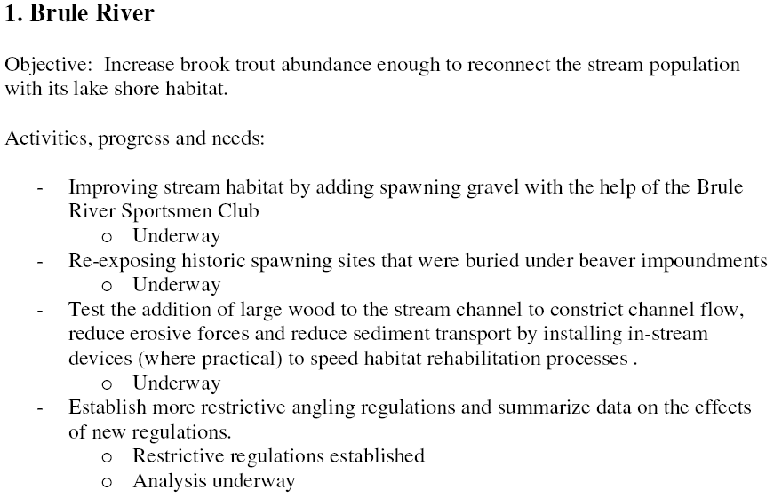
Coaster Brook Trout Management
Information Base
Action
Evaluation
Action
Introduction

Slide 10
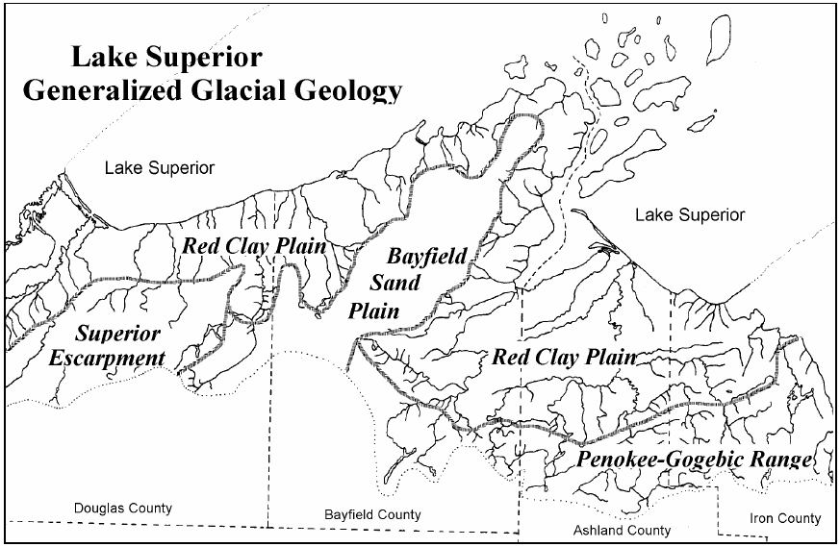
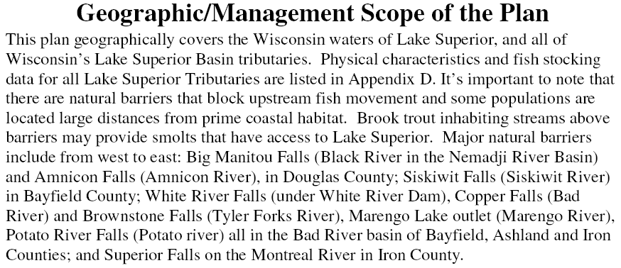
Coaster Brook Trout Management
Introduction

Slide 11
Unit Stock
“A unit stock can be theoretically described as a group of individuals of the same species whose gains by immigration and whose losses by emigration, if any, are negligible in relation to the rates of growth and mortality. A unit stock is essentially a self-contained population with its own spawning area. It is isolated and fishing upon one unit stock has no effect upon the individuals of other stocks.” -- Holden and Raitt, 1974
Introduction

Slide 12
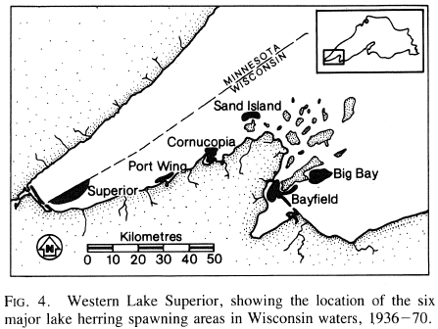
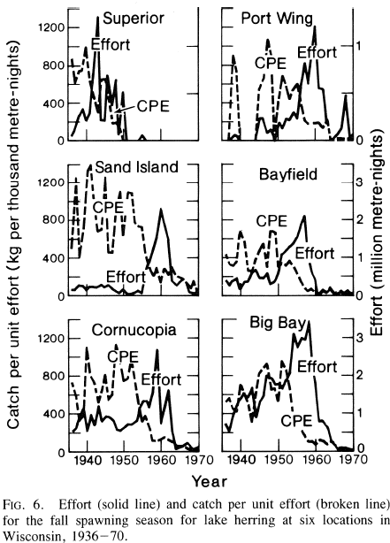
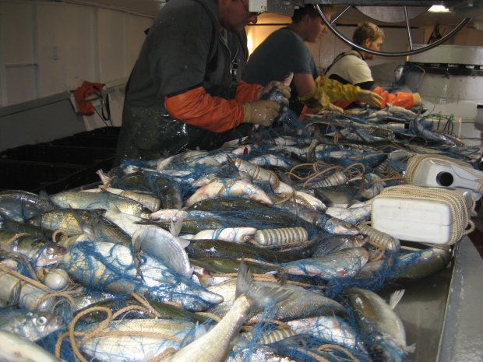
Unit Stock Example -- Herring
Introduction

Slide 13
Unit Stock
Closed, confined.
Identifies specific unit for management and unit of analysis (i.e., statistical population).
Difficult to define in some instances.
Too confined!? (what about watershed or system-level management)
Introduction

Slide 14
Key Parameters of Stock
Suppose that you have been asked to “manage” a lake.
  What characteristics of the lake do you want to “know?”
Suppose that you have decided to focus on a particular fish in the lake.
  What characteristics of the stock of fish do you want to “know?”
Introduction

Slide 15
Conceptual Model
Biotic Environment
Recruitment
Fishing
Mortality
Population
Biomass
Natural
Mortality
Individual
Growth
Physical
Environment
From Dr. Mike Hansen, UW-Stevens Point
Introduction
Notes:
Measure things (size, age strux) on population box, make inferences about processes leading in and out.

Slide 16
Conceptual Model
Input
Controls
Growth
Stock or
Biomass
Natural
Effort
Recruitment
Harvest
Catch
Output
Controls
Stock
Assessment
CPUE
Monitoring
Management
Objectives
Management
Actions
Harvest
Regulations
Economics
Sociology
Risk
Assessment
Two Sources of “Data”
From Dr. Mike Hansen, UW-Stevens Point
Introduction
Notes:
output control – quotas, etc.
input controls – monitoring effort – more important to control this then output controls
CPUE is very much different than stock assessment
CPUE is meant to be efficient (it’s a business)
stock assessment is not (its statistics, sampling)
Need to monitor both – CPUE and stock assessment

Slide 17
Data Sources
“Experimental” sampling
  Directed by resource managers for the sole purpose of collecting information for managing the fishery.
Sampling the Fishery
  Commercial Fishery
    Sampling the behavior (e.g., effort) and catch of the fishery.
  Recreational Fishery
    Sampling the behavior and catch of fisherpeople.
Introduction

Slide 18
Fisheries Management: Art & Science
Science
  Estimate parameters of the stock to be managed.
  Statistics and model based.
  Generally “well-known.”
Art
  Forming a management decision based on interpretations from the information gained from the science and application of knowledge of stakeholders, society, etc.
  Incorporates a wide array of information.
  Incorporates uncertainty, precautionary principle.
  Generally, use experience & specific to situation.
Introduction

