Slide 1
Common Abundance Estimates
CPE/CPUE (relative density)
Depletion/Removal (estimate of N₀)
Mark-Recapture (estimate of N₀)

Slide 2
Concept – Depletion Estimate
Consider this situation …
Sampling a pond with three fyke nets
No limit on number of sampling events (days)
Fish are removed from pond when captured
Compute CPE as … total fish/day
Compute cumulative catch prior to each day
What would the following graph look like?

Slide 3
Concept – Depletion Estimate

Slide 4
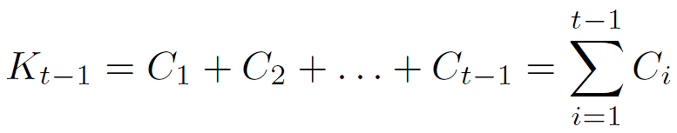

Development – Depletion Estimate
Define (along with N₀, N_{t}, C_{t}, and q)
K_{t-1} = cumulative catch prior to time t
i.e.,
Key relationship
Substitute CPE equation for N_{t} and simplify
What type of function is this?
Notes:
(Ct/ft)=qNt, solve for Nt and substitute into Nt=N0-Kt-1 to get
(Ct/ft) = qN0 – qKt-1

Slide 5
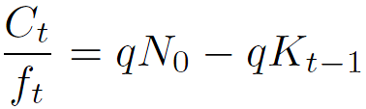
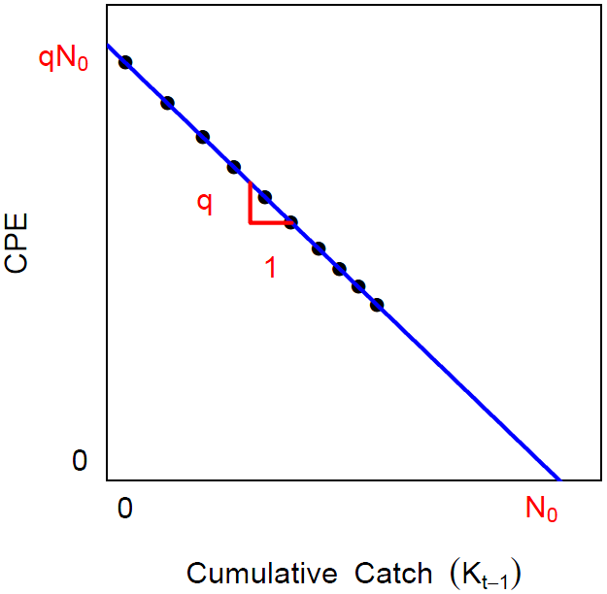
Development – Depletion Estimate
Use regression to fit linear model
q = -slope
N₀ = intercept/q

Slide 6
Proportion Caught
As noted in CPUE module, q is proportion of population caught with one unit of effort but only if effort is small (and then it is only an approximation).
q is an instantaneous rate that must be converted to an actual rate with 1-e^{-q}
If q=0.02 then 1-e^{-0.02} = 0.0198
If q=1.00 then 1-e^{-1.00} = 0.0632

Slide 7
Class Exercise
Do First Question

Slide 8
Leslie Model Assumptions
The population is closed.
Catchability (q) is constant.
All fish are equally vulnerable to capture method.
CPE is substantially reduced by fish removal.
Catches remove more than 2% of population.
Units of effort are independent - i.e., the individual units of capture method do not compete with each other.

Slide 9
K-pass Removal
Common in stream work
Several “passes” through an area are made
Number of fish captured are counted
Captured fish are physically removed
Derivation of estimates is complex.
Zippin and Carle-Strub methods are common
Carle-Strub somewhat more general

Slide 10
Class Exercise
Do Second Question

