Slide 1
Stock-Recruitment
Recruitment
Natural Mortality
Population
Numbers
Fishing Mortality
Immigration
Emigration

Slide 2
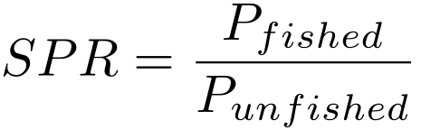
Spawning Potential Ratio (SPR)
Number of lifetime eggs produced by an average recruit when fished divided by the number of lifetime eggs produced by an average recruit when unfished.
Compares the spawning ability of a fished stock to the spawning ability of the unfished stock.

Slide 3
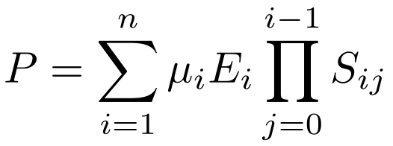
Spawning Potential Ratio (SPR)
Proportion mature
Mean fecundity
Survival to age i
Examine Excel spreadsheet

Slide 4
Spawning Potential Ratio (SPR)
Use in management
Principle: enough fish have to survive to spawn and replenish the stock.
Benchmark: not well-defined for most species
Marine pelagic -- >20% (Goodyear 1993)
Marine pelagic -- >30% (Mace & Sissenwine 1993)
Channel catfish -- >10% (Slipke et al. 2002)
Shovelnose sturgeon -- >40-50% (Quist et al. 2002)
Examine Excel Spreadsheet

