Slide 1
Introduction to R Using Basic Fisheries Methods
Dr. Derek H. Ogle, Northland College
Midwest Fish & Wildlife Conference
Wichita, KS
9 December 2012

Slide 2

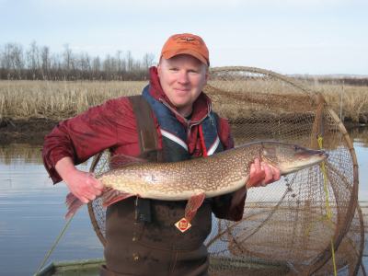
Who Am I?
Derek
Professor of Mathematical Sciences and Natural Resources at Northland College
M.S. and Ph.D. in Fisheries with minor in Statistics from University of Minnesota

Slide 3
Course Assumptions
Focus on R (not statistics or fisheries science)
Use fisheries data/analyses
Attendees have little experience with R
Integrate “lecture”, discussion, and hands-on experience with R

Slide 4
Course Outcomes
Have a feeling for the general philosophies underlying the use of R
Describe the differences among and uses of various types of R objects
Understand the use of constructor and extractor functions in R
Understand and appreciate how R can be used to form reproducible analyses

Slide 5
Course Outcomes
Read data into R from common formats
Perform simple data manipulations and preparations and construct simple graphics and summary tables in R
Perform simple linear and non-linear regressions in R

Slide 6
R: What is it?
R is a system for statistical computation and graphics. It consists of a language plus a run-time environment with graphics, … and the ability to run programs stored in script files.
from www.r-project.org

Slide 7
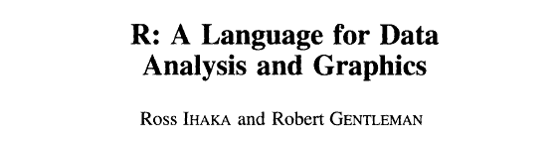

R: The Name
Journal of Computational and Graphical Statistics, 5:299-314. 1996

Slide 8
R: Strengths (in my eyes)
Extremely powerful
Can do nearly “anything”
Open-source
No “black boxes”
Can be modified
Free
Must ask or build results
Must think about analyses
Script authoring
Collaboration
Reproducibility
Connects to other software (Excel, Access, SAS, SPSS, SQL, et al.)
Extensible
Special purpose
Cutting edge

Slide 9
R: Extensibility with Packages
Automatic Packages
base splines
datasets stats
grDevices stats4
graphics tcltk
grid tools
methods utils
R Core
CRAN Packages
alr3
boot
Design
.
~4200 more (on 7Dec12)
.
Local Packages
FSA
FSAdata
NCStats
.
(your package here)
.
Other Repositories
rforge
rforge.net
github
Google Code
.
.

Slide 10
R: Weaknesses (in the eyes of some)
Minimal GUI – you must type commands
Must spell/capitalize correctly
Must remember (can’t search through menus)

Slide 11
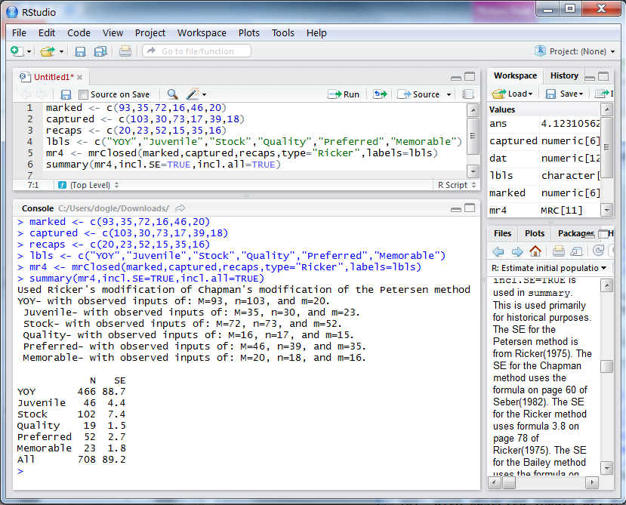
R: You Type Commands

Slide 12
R: Weaknesses (in the eyes of some)
Minimal GUI – you must type commands
Must spell/capitalize correctly
Must remember (can’t search through menus)
No formal or commercial support
Help pages are often terse
Error messages are even more terse
Some “user errors” do not produce warnings
i.e., can make mistakes and not know it (if not careful)
Some limitations with extremely large datasets
You must invest time to learn & become proficient

Slide 13
R: Workflow Environment
Script Editor
Input R commands.
Built-in, Rstudio, Tinn-R, Notepad, word processor, et al.
R Core
The analytical engine.
Produce results & graphs.
Report
Output results.
Word processor, HTML, PDF, et al.
Data
An external text (.txt), CSV, Excel, Access, or other database file.

Slide 14
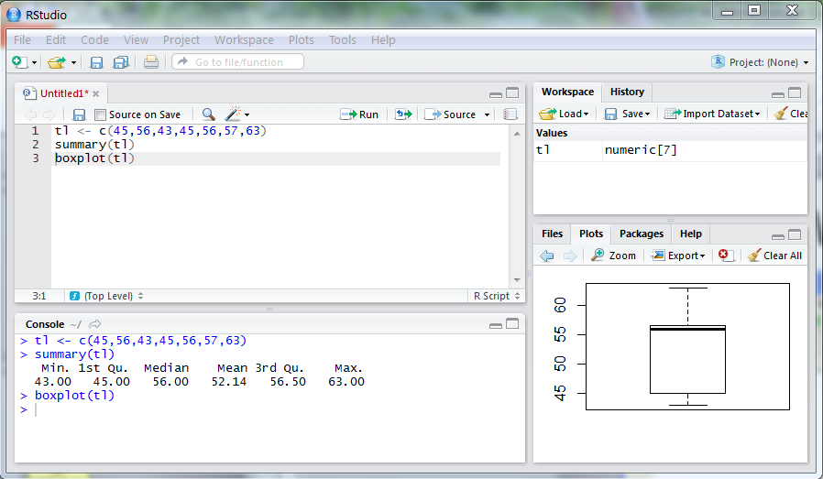
R: Workflow Environment
Script Editor
Input R commands.
Edit R commands.
R Console
Produce results & graphs.
Plot Pane
See graphs.

Slide 15
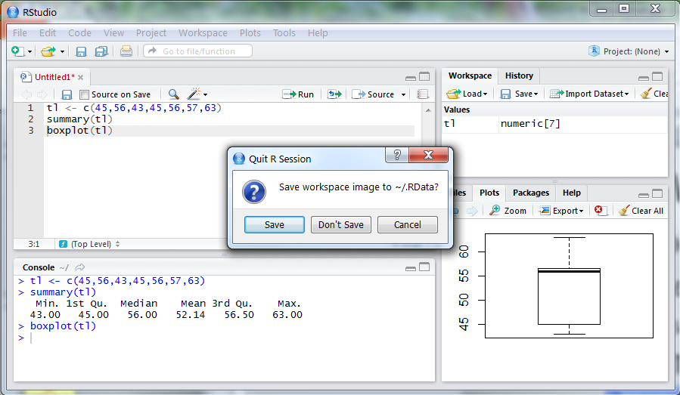
R: Workflow Environment
Recommendations for “Beginners”:
Do save “good” commands in a text editor.
Like saving a script that allows repeating
Do NOT save workspace image when exiting.

Slide 16
Fisheries Analyses in R
fishR Website
http://www.ncfaculty.net/fishR/.
Several example fisheries analyses.
Links to packages devoted to fisheries analyses.

