Slide 1
Simple Linear Regression Review
Dr. Derek H. Ogle, Northland College
Iqaluit, Nunavut, Canada
6-9 August 2016

Slide 2
Types of Questions
Are weight and length related?
Is there a relationship between CPE and discharge?
Can the number of eggs be predicted from the weight of the female?
Identify relationship between two quantitative variables.

Slide 3
Hypotheses
H₀: “the two variables are not related”
H₀: “a flat line (no slope) fits the data”
H_{A}: “the two variables are related”
H_{A}: “a non-flat (a slope) fits the data”

Slide 4
Hypotheses
H₀: “the two variables are not related”
H_{A}: “the two variables are related”

Slide 5
Assumptions
Independence of individuals between and among groups.
A line adequately represents the relationship.
Consistent vertical scatter around the line (i.e., homoscedastic).
Normality of residuals.
No outliers.

Slide 6
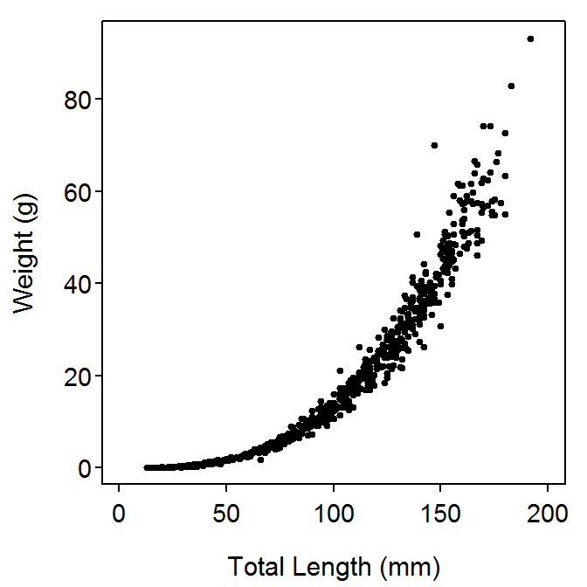
Weight-Length Relationship
Usually non-linear (in shape) and heteroscedastic

Slide 7
Weight-Length Relationship
Usually non-linear (in shape) and heteroscedastic
Can be represented by a power function with multiplicative errors
Examine natural logarithm of this function

Slide 8
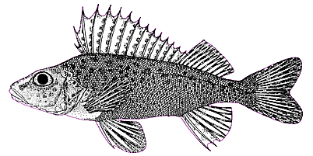
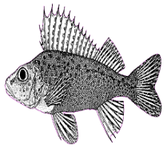
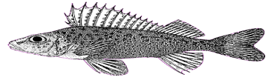
Weight-Length Relationship
if b≠3 then fish growth is allometric
if b<3 then fish gets more fusiform with time
if b>3 then fish gets more plump with time

