Slide 1
Non-Linear Regression / von Bertalanffy Growth Review
Dr. Derek H. Ogle, Northland College
Iqaluit, Nunavut, Canada
6-9 August 2016

Slide 2
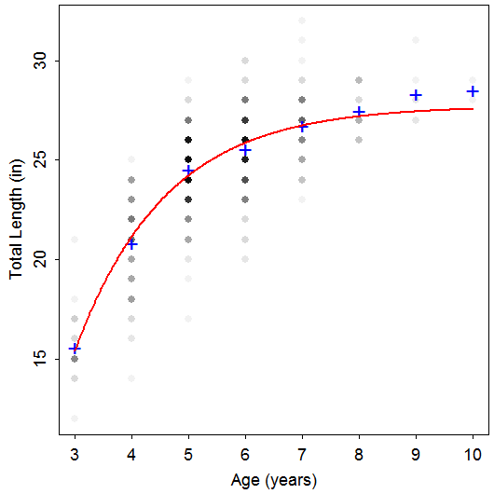
Length-At-Age Data
TL Age Species
24 6 Rainbow
26 8 Rainbow
23 5 Rainbow
25 5 Rainbow
24 4 Rainbow
24 5 Rainbow
23 4 Rainbow
25 5 Rainbow
20 4 Rainbow
23 4 Rainbow
26 6 Rainbow
29 10 Rainbow
20 4 Rainbow
29 8 Rainbow
24 6 Rainbow
26 6 Rainbow
23 5 Rainbow
24 4 Rainbow
Notes:
data(TroutBR)
rbt <- TroutBR[TroutBR$Species=="Rainbow",]
attach(rbt)
plot(jitter(TL,1)~jitter(Age,0.5),xlab="Age [jittered]",ylab="Total Length (in) [jittered]")

Slide 3
Length-At-Age Models
Purposes
Summarize growth with few parameters.
Compare growth parameters among populations.
Use results in key fisheries models, such as Beverton-Holt yield models.
Main models
Von Bertalanffy
Gompertz
Logistic
Schnute

Slide 4
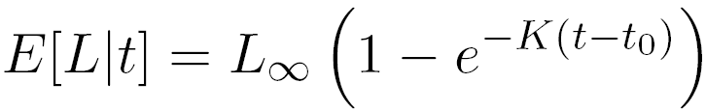
Von Bertalanffy – Typical
L∞ = asymptotic mean length
t_{o} = time when mean length is 0 (artifact)

Slide 5
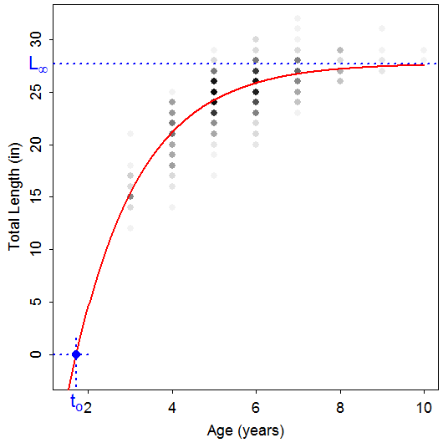
Von Bertalanffy – Typical

Slide 6
Von Bertalanffy – Typical
L∞ = asymptotic mean length
t_{o} = time when mean length is 0 (artifact)
K = Brody “growth” coefficient
Controls “curvature” of the model
How “fast” mean length approaches L∞
log(2)/K is “half-life”

Slide 7
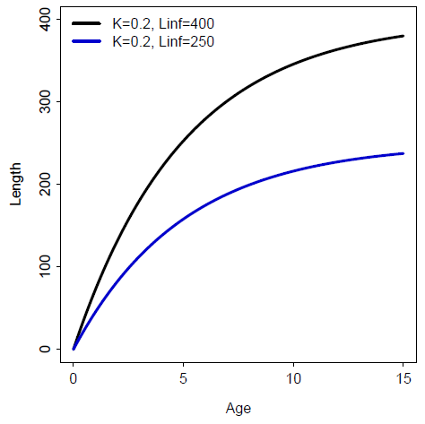
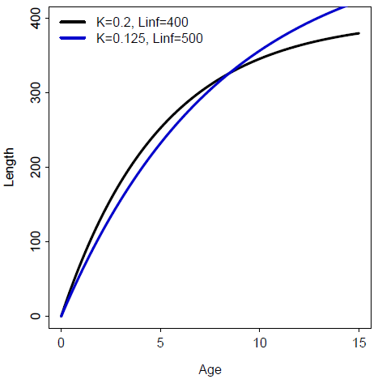
Von Bertalanffy – Typical

Slide 8
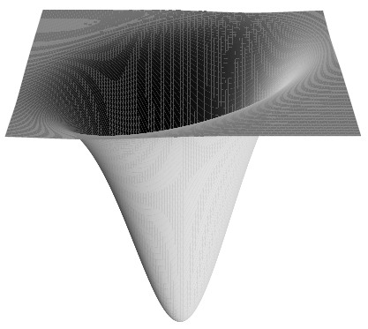
Non-Linear Modeling
VBGF is non-linear, in shape and parameters
Non-linear least-squares minimizes RSS
However, no closed-form solution
Algorithms require starting values
Iteratively search for minimum RSS

Slide 9
Non-Linear Modeling
Sampling distributions of parameter estimates tend NOT to be normally distributed.
Alternative CI #1 – Profile Likelihood Method
Use χ² and shape of likelihood function

Slide 10
Non-Linear Modeling
Sampling distributions of parameter estimates tend NOT to be normally distributed.
Alternative CI #2 – Bootstrapping
Construct a random sample (with replacement) of n “cases" of observed data.
Extract parameters from model fit to this (re)sample.
Repeat first two steps B times.
95% CI is values of ordered parameter estimates with 2.5% of values lesser and 2.5% of values greater.

Slide 11
Von Bertalanffy – Typical
Common Problems
Misinterpreted meanings
Difficulty modeling L∞
Few old fish
Difficulty modeling K
Few young fish
Model won’t converge, Poor parameter estimates
Much variability in length at each age
Highly correlated parameters
“Scale” of L∞ much different than K or t_{o}
Type of error structure (additive or multiplicative)

