Slide 1
Introduction to R (and Statistics) Using Fisheries Examples
Dr. Derek H. Ogle, Northland College
Iqaluit, Nunavut, Canada
6-9 August 2016

Slide 2


Who Am I?
Professor of Mathematical Sciences and Natural Resources at Northland College
Ph.D. in Fisheries with minor in Statistics from University of Minnesota

Slide 3


Who Am I?
Author of Introductory Fisheries Analyses with R
Maintainer of fishR webpage
Derek

Slide 4
Workshop Assumptions
You
Have little experience with R
Want to learn R
Understand basic statistical concepts
We will
Focus on R (some statistics and fisheries science)
Use fisheries data/analyses
Integrate “lecture” and “hands-on” experience

Slide 5
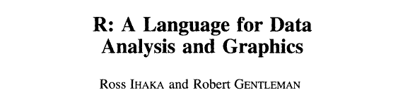

R: What is it?
R is a system for statistical computation and graphics. It consists of a language plus a run-time environment with graphics, … and the ability to run programs stored in script files.
from www.r-project.org
Journal of Computational and Graphical Statistics, 5:299-314. 1996

Slide 6
R Environment
CRAN Packages
FSA, dplyr, nlstools, …
~9750 more (on 20Jul16)
Other Repositories
Rforge, rforge.net,
github, Google Code, …
R Core
The analytical engine.
Produce results & graphs.

Slide 7
R Workflow
CRAN Packages
FSA, dplyr, nlstools, …
~9750 more (on 20Jul16)
Other Repositories
Rforge, rforge.net,
github, Google Code, …
Data
An external text (TSV, CSV), Excel, Access, or other database file.
R Core
The analytical engine.
Produce results & graphs.
Report Results
Cut-n-Paste to …
Report Results
PDF, HTML, Word
Script Editor
Input/Save R commands.
RStudio, Notepad, Tinn-R, word processor, et al.
Reproducibility
Markdown, LaTeX
knitr, Sweave

Slide 8
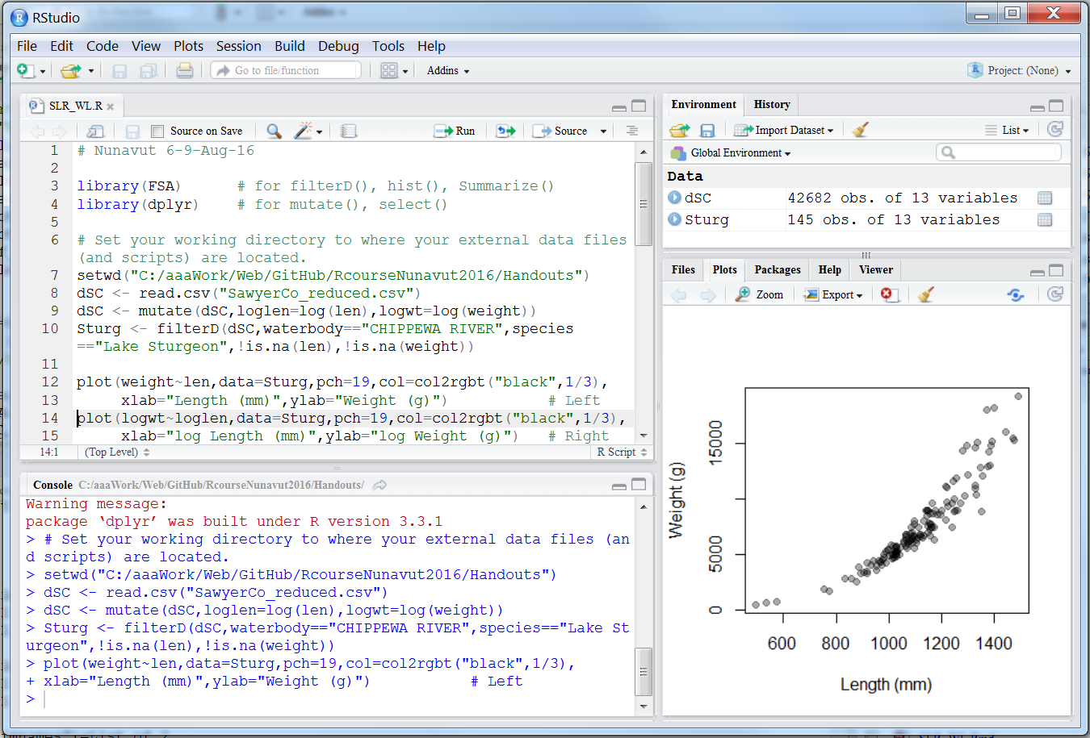
RStudio: Workflow Environment
Script Editor
Input R commands.
Edit R commands.
Plot Pane
See graphs.
R Console
Run commands.
See non-graphical results.

Slide 9
Type Commands … No Menus/GUI
Advantages
Reproducibility
Collaboration
Crib code from analysis to analysis
Getting help
Increase thoughtfulness in analyses
(Semi-)Automate repetitive tasks

Slide 10
Type Commands … No Menus/GUI
Challenges
Spelling matters
Must recall / Can’t search menus for analysis
Must ask for specific results

Slide 11
Some Workflow Suggestions
Original (clean) data file (extracted from a database) should not be modified by other than R code.
All data wrangling is done with R code.
Script should be edited (i.e., produces no errors).
Script should be commented (where function purpose is not obvious).
Repetitive code should be saved in a separate script and source()d.

Slide 12
Tentative Workshop Agenda
See webpage.

