Slide 1
Introduction to R Using Fisheries Examples
Dr. Derek H. Ogle, Northland College
Vermont Cooperative Fish & Wildlife Research Unit
University of Vermont, Burlington, VT
5-7 March 2014

Slide 2

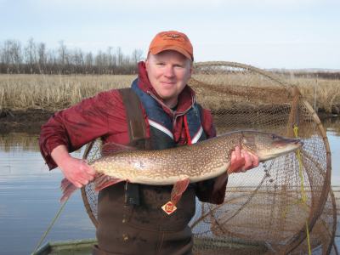
Who Am I?
Derek
Professor of Mathematical Sciences and Natural Resources at Northland College
Ph.D. in Fisheries with minor in Statistics from University of Minnesota

Slide 3
Workshop Assumptions
Focus on R (not statistics or fisheries science)
Use fisheries data/analyses
Integrate “lecture” and hands-on experience
You have little experience with R
You want to learn R

Slide 4
Workshop Agenda
Day 1 – Introduction (First Principles in R)
Day 2 – Intermediate Statistical Models
Day 3 – Fisheries-Specific Applications

Slide 5
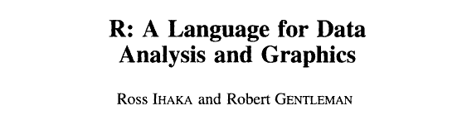

R: What is it?
R is a system for statistical computation and graphics. It consists of a language plus a run-time environment with graphics, … and the ability to run programs stored in script files.
from www.r-project.org
Journal of Computational and Graphical Statistics, 5:299-314. 1996

Slide 6
R: Workflow Environment
Packages
Add-on functionality.
R Core
The analytical engine.
Produce results & graphs.

Slide 7
R: Extensibility with Packages
Automatic Packages
base splines
datasets stats
grDevices stats4
graphics tcltk
grid tools
methods utils
R Core
CRAN Packages
alr3
boot
Design
.
~4200 more (on 7Dec12)
.
Local Packages
FSA
FSAdata
NCStats
.
(your package here)
.
Other Repositories
rforge
rforge.net
github
Google Code
.
.

Slide 8
R: Workflow Environment
Script Editor
Input/Save R commands.
Built-in, RStudio, Tinn-R, Notepad, word processor, et al.
Packages
Add-on functionality.
R Core
The analytical engine.
Produce results & graphs.
Report
Output results.
Word processor, HTML, PDF, et al.
Data
An external text (.txt), CSV, Excel, Access, or other database file.
Reproducibility
LaTeX, Markdown
knitr, Sweave

Slide 9
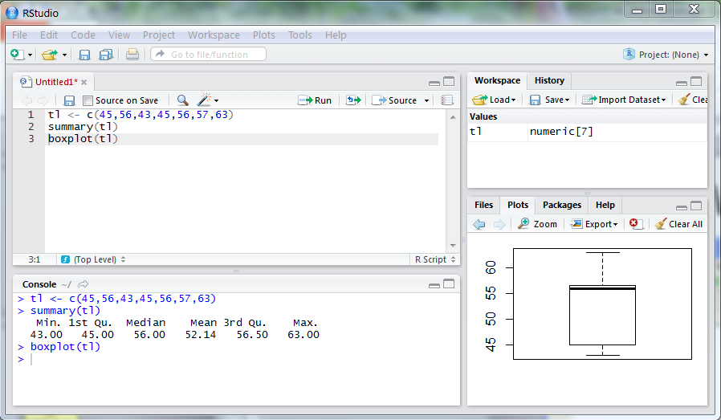
R: Workflow Environment
Script Editor
Input R commands.
Edit R commands.
R Console
Produce results & graphs.
Plot Pane
See graphs.

Slide 10
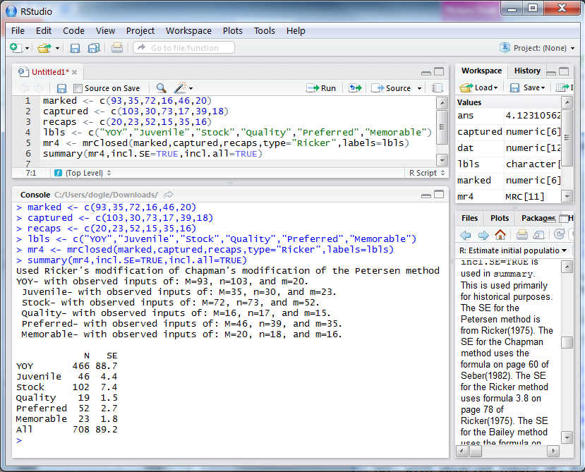
R: You Type Commands

Slide 11
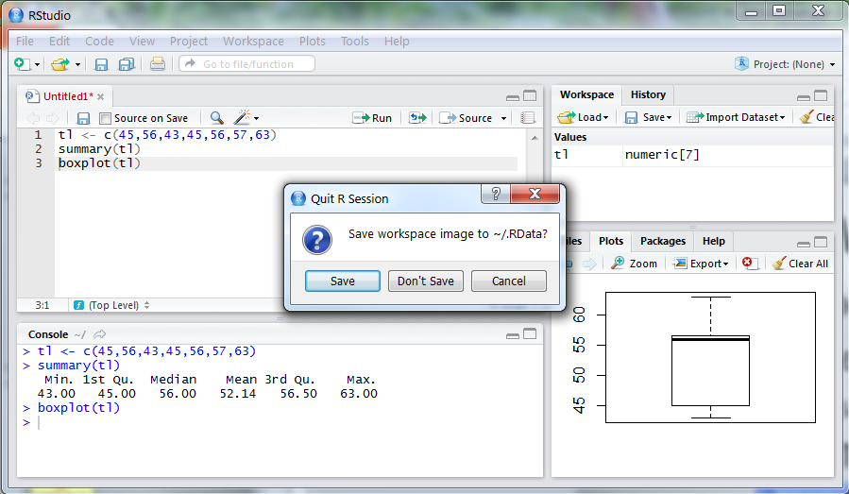
R: Workflow Environment
Recommendations for “Beginners”:
Do save “good” commands in a text editor.
Like saving a script that allows repeating
Do NOT save workspace image when exiting.

Slide 12
Fisheries Analyses in R
fishR Website
fishr.wordpress.com.
Several example fisheries analyses.
Links to packages devoted to fisheries analyses.

Slide 13
Workshop Agenda
Day 1 – Introduction (First Principles in R)
Day 2 – Intermediate Statistical Models
Day 3 – Fisheries-Specific Applications

