Slide 1
Introduction to R Using the FM Database
Derek H. Ogle, Northland College
Gretchen Hansen, WDNR
Zach Lawson, WDNR
Lori Tate, WDNR
Ted Treska, USFWS
Max Wolter, WDNR

Slide 2

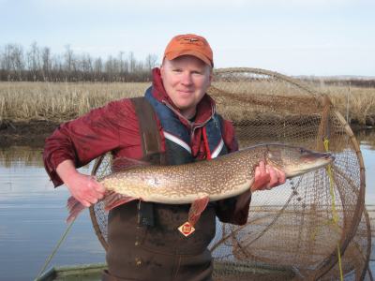
Derek
Professor of Mathematical Sciences and Natural Resources at Northland College
M.S. and Ph.D. in Fisheries with minor in Statistics from University of Minnesota

Slide 3
Workshop Assumptions
You have little to no experience with R
You have individual fish data from FM database
You want to efficiently summarize data for each waterbody
Best to use “demonstrate and apply” pedagogy
You will continue with R after the workshop

Slide 4
Workshop Outcomes
Understand basic philosophy, terminology, strengths, and weaknesses of R
Load your individual fish data into R
Perform data manipulations
Construct basic summary tables and graphs
Understand how to re-use R scripts for efficiency

Slide 5
R: What is it?
R is a system for statistical computation and graphics. It consists of a language … and the ability to run programs stored in script files.
from www.r-project.org

Slide 6
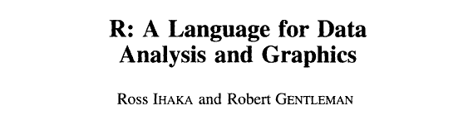

R: The Name
Journal of Computational and Graphical Statistics, 5:299-314. 1996

Slide 7
R: Strengths
Powerful
Does nearly “anything”
Open-source
No “black boxes”
Can be modified
Free
Must ask or build results
Must think about analyses
Script authoring
Collaboration
Reproducibility
Re-Use
Extensible
Special purpose
Cutting edge

Slide 8
R: Extensibility with Packages
Automatic Packages
base splines
datasets stats
grDevices stats4
graphics tcltk
grid tools
methods utils
R Core
CRAN Packages
alr3
boot
Design
…
~6000 more (on 1Nov14)
Local Packages
FSA
fishWiDNR
…
(your package here)
Other Repositories
rforge
rforge.net
github
Google Code
…

Slide 9
R: Weaknesses (for some)
Minimal GUI – you must type commands
Must spell/capitalize correctly
Must remember (can’t search through menus)

Slide 10
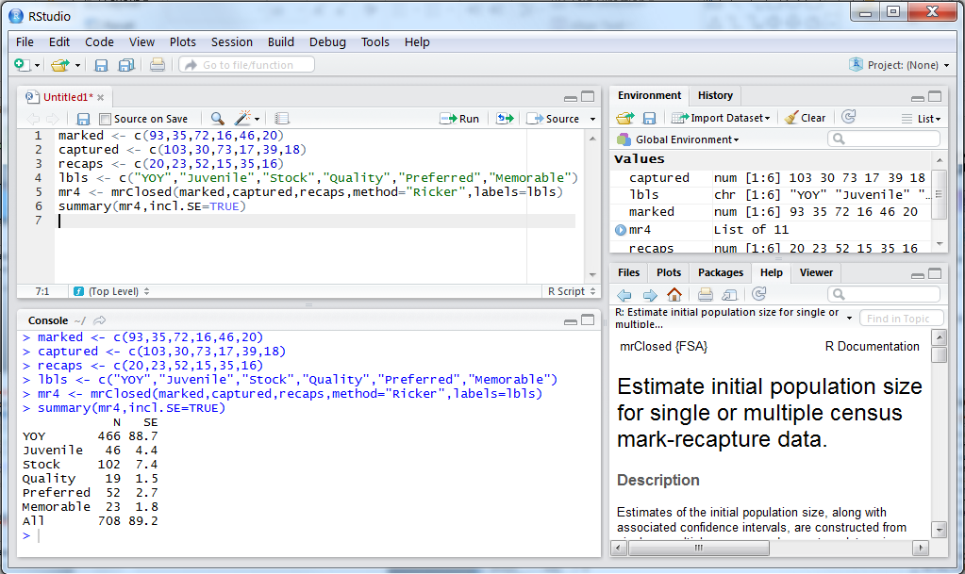
R: You Type Commands

Slide 11
R: Weaknesses (for some)
Minimal GUI – you must type commands
Must spell/capitalize correctly
Must remember (can’t search through menus)
No formal or commercial support
Help pages and error messages are often terse
Somewhat mitigated by web resources (e.g., Stack Exchange)
Some “user errors” do not produce warnings
i.e., can make mistakes and not know it (if not careful)
Some limitations with extremely large datasets
You must invest time to learn & become proficient

Slide 12
R: Workflow Environment
Script Editor
Input R commands.
Rstudio, Built-in, Tinn-R, Notepad, word processor, et al.
R Core
The analytical engine.
Produce results & graphs.
Report
Output results.
Word processor, HTML, PDF, et al.
Data
An external text (.txt), CSV, Excel, Access, or other database file.

Slide 13
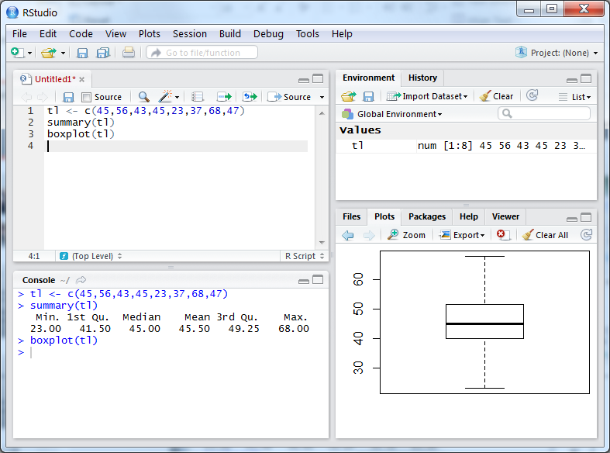
R: Workflow Environment
Script Editor
Input R commands.
Edit R commands.
R Console
Produce results & graphs.
Plot Pane
See graphs.

Slide 14
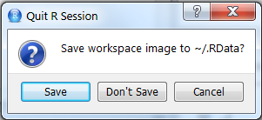
R: Workflow Environment
Save “good” commands in a text editor
A script that allows repeating
Do NOT save workspace image when exiting

Slide 15
Fisheries Analyses in R
fishR Website
fishR.wordpress.com.
Several example fisheries analyses.
Links to packages devoted to fisheries analyses.

