Slide 1
MANOHARAN.S
Final Project

Slide 2
PROJECT TITLE
Dog and Cat Convolution Neural Network Image Classifier

Slide 3
AGENDA
Convolutional Neural Networks (CNNs):
Specialized neural networks for processing grid-like data, such as images.
Utilize convolutional layers to detect patterns and features within images.
Widely used in computer vision tasks, including image classification, object detection, and segmentation.
Image Classification:
Task of categorizing an image into predefined classes or categories.
Example: distinguishing between images of dogs and cats.
CNNs excel at image classification due to their ability to automatically learn hierarchical features from raw pixel data.

Slide 4

PROBLEM STATEMENT
Classifying images of dogs and cats using Convolutional Neural Networks (CNNs).
Given a dataset of labeled images, the task is to develop a model that can accurately differentiate between pictures of dogs and cats.
The objective is to create a robust image classifier capable of generalizing well to unseen data.

Slide 5

PROJECT OVERVIEW
What We Aim to Achieve:
Create a model that accurately distinguishes between images of dogs and cats.
Demonstrate the practical application of CNNs in image classification tasks.
Enhance understanding of fundamental concepts in deep learning and computer vision.
Approach:
Utilize a dataset of labeled images containing pictures of dogs and cats.
Train a CNN model to learn patterns and features indicative of each class.
Evaluate the model's performance on unseen data to assess its accuracy and generalization capability.

Slide 6
OBJECTIVE:
The main objective of this project is to develop a Convolutional Neural Network (CNN) image classifier capable of accurately distinguishing between images of dogs and cats.
Key Goals:
Train a CNN model using a labeled dataset of images containing pictures of dogs and cats.
Achieve high accuracy in classifying images into the correct categories.
Validate the model's performance on unseen data to ensure robustness and generalization.
Provide insights into the practical application of CNNs in image classification tasks and deepen understanding of deep learning concepts.
Expected Outcomes:
A trained CNN model that accurately identifies whether an image contains a dog or a cat.
Increased proficiency in building and training CNNs for image classification.
Potential for further exploration and utilization of CNNs in various real-world applications beyond this project.

Slide 7
YOUR SOLUTION AND ITS VALUE PROPOSITION
The model's value proposition lies in several key areas:
Accurate Classification:
The model offers precise classification of images, distinguishing between dogs and cats with high accuracy.
Efficient Image Processing:
Utilizing Convolutional Neural Networks (CNNs), the model efficiently processes image data, enabling rapid classification even with large datasets.
Robustness to Variability:
The model demonstrates robustness to variations in poses, backgrounds, and appearances of dogs and cats, ensuring reliable performance across diverse scenarios.
Scalability and Adaptability:
Designed with scalability in mind, the model can be adapted and fine-tuned to accommodate additional classes or categories beyond dogs and cats.
User-Friendly Integration:
The model's architecture facilitates seamless integration into various applications, providing users with a user-friendly interface for image classification tasks.

Slide 8
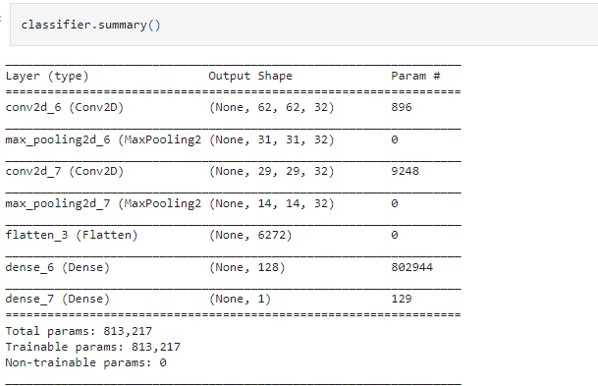
RESULTS

Slide 9
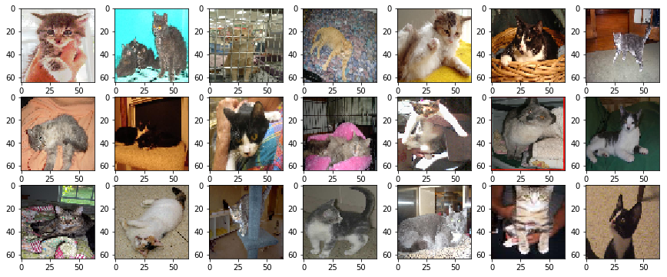
Results
GITHUB LINK:
https://github.com/droid96/NM_SEM_6_PROJECT.git

Slide 10
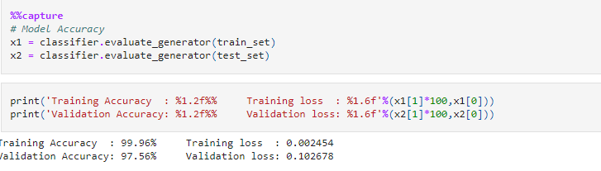
Accuracy of the model

