Slide 1
Captain America Volume: 5 An analysis of color and perspective
ART 112
Braden Licastro

Slide 2
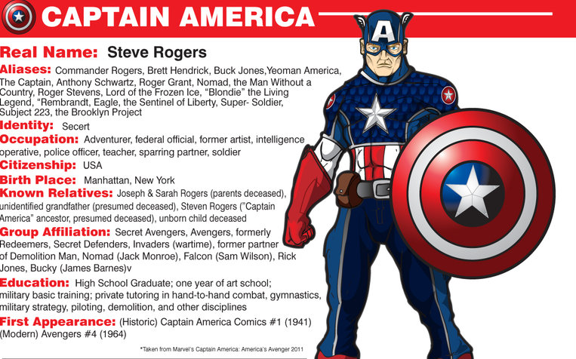
Biography
Master text styles
Second level
Third level
Fourth level
Fifth level

Slide 3
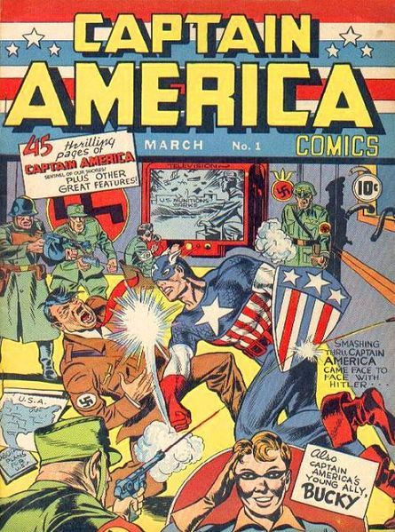
Early History
Started out a frail, sickly child
Denied by military but accepted into military performance-enhancing experiment
“New” Steve Rogers fights for US
Primary concern and early motivation is fighting Nazis

Slide 4
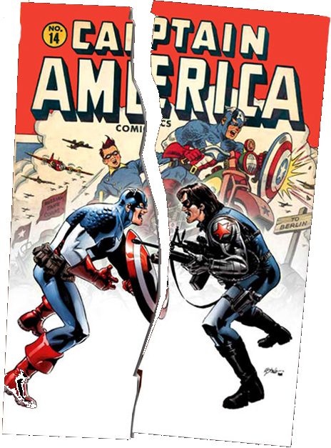
Fall of Captain America
Originally written by Joe Simon and Jack Kirby
Massively popular during the second World War
Following the war, Captain America lost popularity.
Discontinued by 1950 and attempts failed to revitalize a following

Slide 5
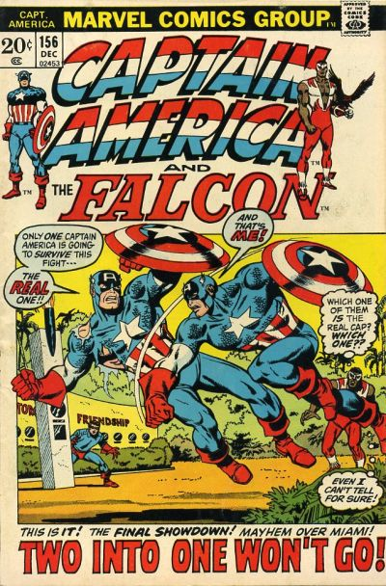
Rebirth of Captain America
Brought back in the Silver Age (Mid to late 1950s)
Begins as MIA soldier
Rescued from iceberg by Avengers
Storyline continued through 1950s until 1960s

Slide 6
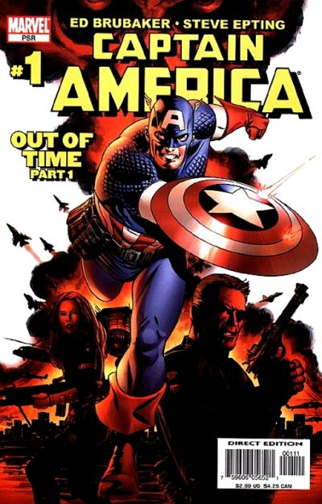
Present Day
Volume 5 brings back sidekick “Bucky” as Winter Soldier
Continuation of Volumes dating back to 1960s
Written by Ed Brubaker and Steve Epting

Slide 7
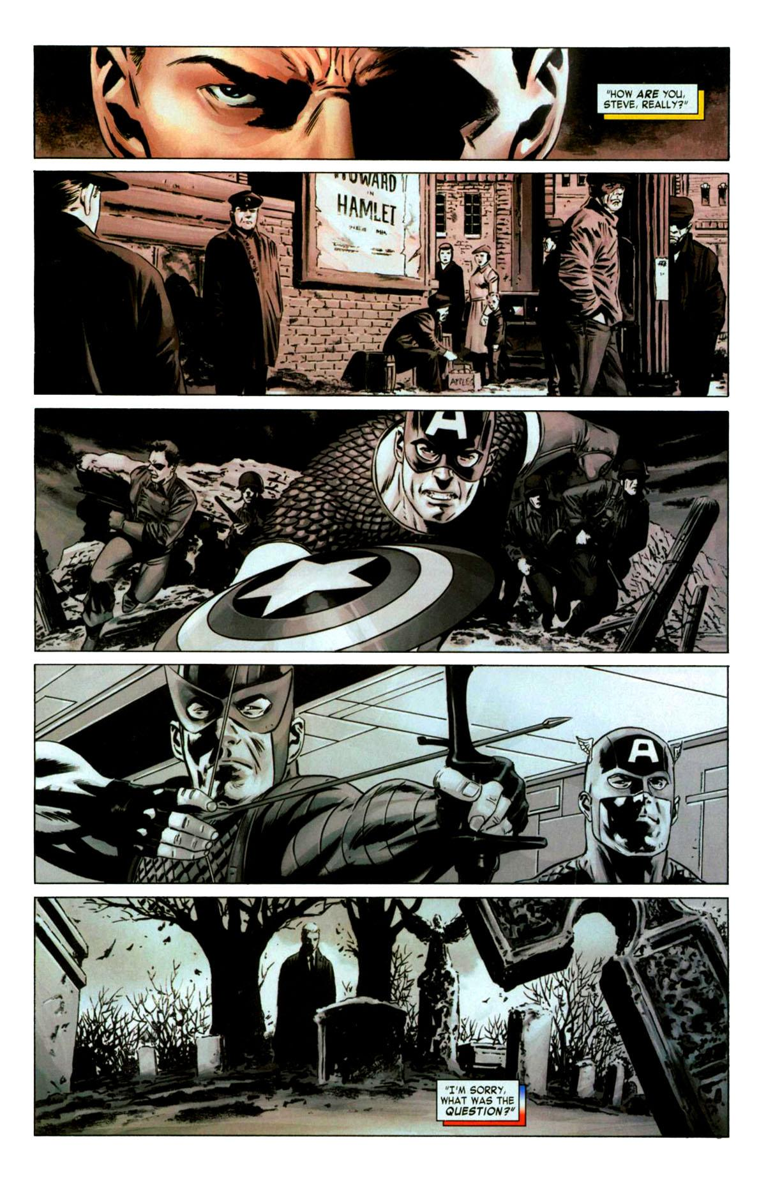
Usage of Color
Emphasis of emotion
Sets the mood, accompanying text
Used to give conversational context
Helps develop weight of events
Altered to portray a change in time

Slide 8
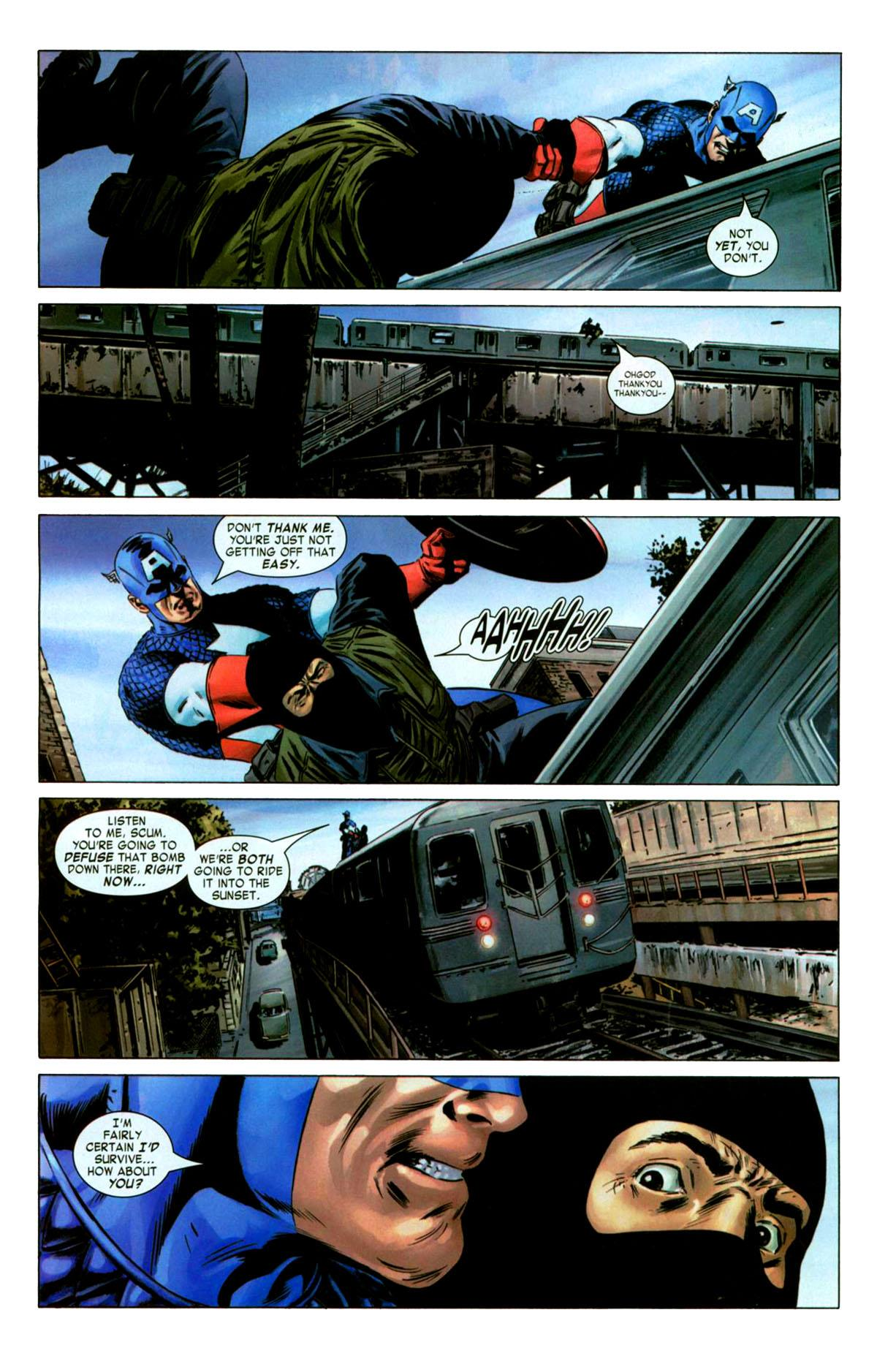
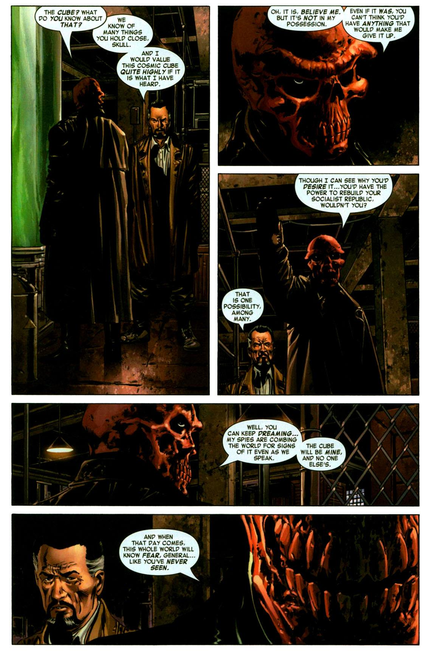
Usage of Color
Discussion involving protagonist
Discussion involving antagonist

Slide 9
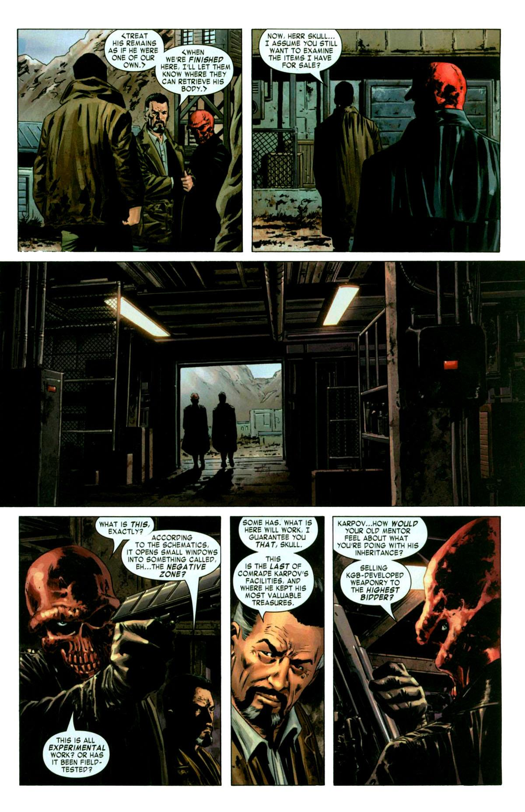
Usage of Perspective
Used to give idea of surrounding expanses of space
Often signifies lack of conversation or events
Allows for out-of-frame interactions
Provides focus and emphasizes intensity

Slide 10
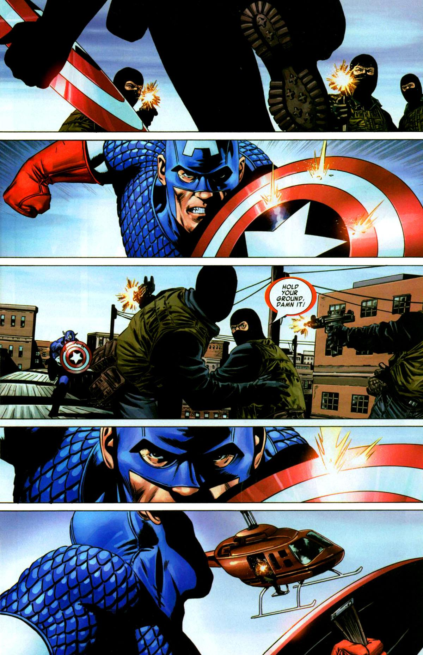
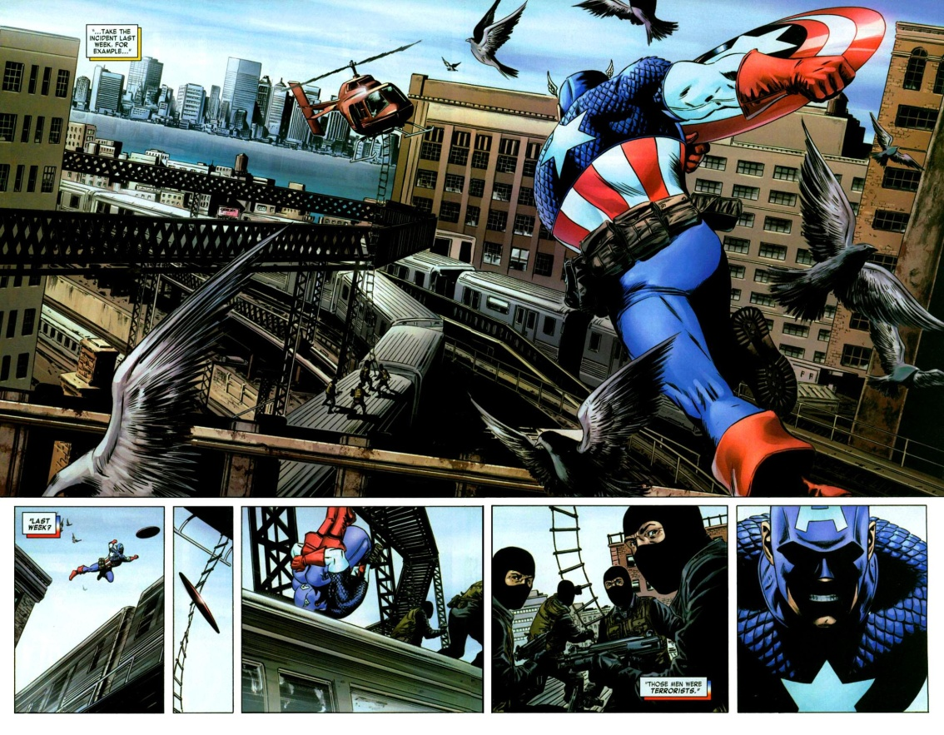
Usage of Perspective

