Slide 1

Using TextField and TextEditingController Widgets
Simone Alessandria
linkedin.com/in/simone-alessandria

Slide 2
Section Overview
Building the User Interface of the app
Main life cycle events of a Stateful Widget
Using a TextEditingController
Updating the UI with setState()

Slide 3
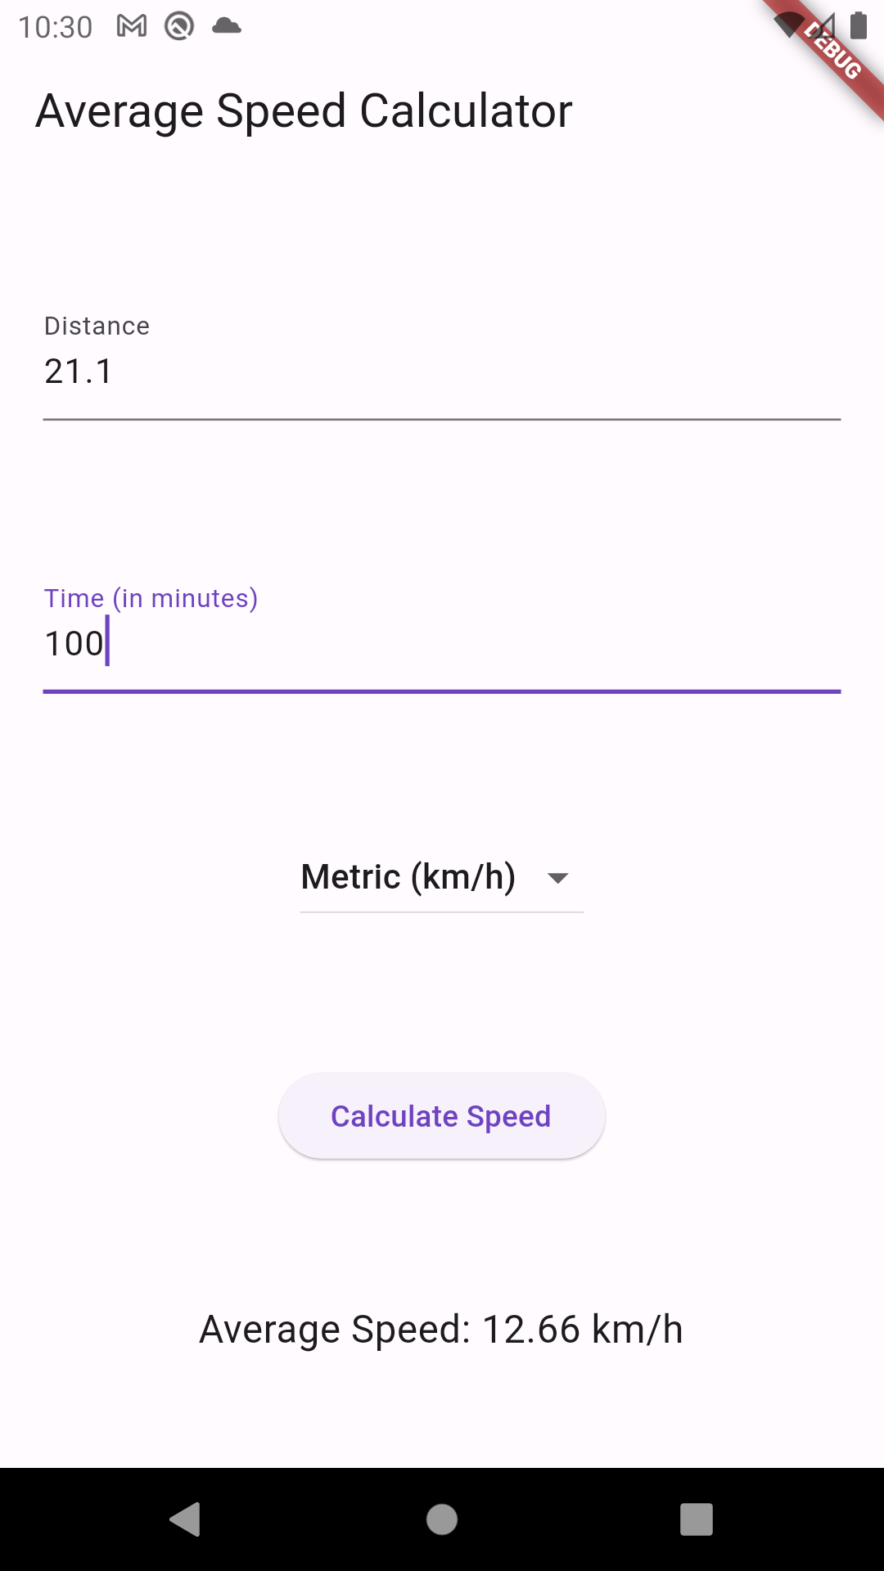
Speed Calculator UI
TextField →
TextField →
DropdownButton →
ElevatedButton →
Text →

Slide 4
TextField
TextField(
controller: [A TextEditingController],
keyboardType: [Choose your keyboard]
decoration: InputDecoration( //actions )
)
Create instance
Set controller
Set keyboardType
Apply a decoration

Slide 5
Section Summary
Building the User Interface
setState()
TextEditingController
onChanged vs controller
Life cycle events:
initState
build
dispose

Slide 6
Using DropdownButton Widgets

