Slide 1

Flutter Widgets Fundamental
Shrihriday Bhagwat
@shreebhagwat94
in/shrihriday

Slide 2


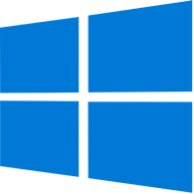

Flutter
Flutter is an Open Source Framework by Google for building beautiful, natively complied, multi platform application from a Single Code Base

Slide 3
Everything is a Widget

Slide 4
What are we going to build?
Build a Widget Bank application, which will showcase most of the important widgets.
Not only Widgets but also their properties and uses cases.
These widgets will help you fast track your flutter development journey.

Slide 5
What is a widget?
Widget in Flutter is a way to declare and construct UI.
Everything on screen is a Widget

Slide 6
Classification of Widgets
A Widget can be classified in multiple Ways.
State Widgets: Based on weather the widget has a State or no.
Stateless Widgets
Stateful Widgets
UI Widgets: Widgets used to create UI of the application.
Layout Widgets
Interface Widgets
UI Widgets are also classified as,
Single Child Widget
Multiple Child Widget

Slide 7
Stateless Widgets
Do not have a mutable state
The state is the information that can be read synchronously when the widget is built.
In stateless widget this state (information) is read only at the time of rendering the Widget.
The state of a stateless widget do not change.
Stateless Widgets are also called as static widget, as the they do not change.
Used to showcase information that will not change.

Slide 8
Stateful Widgets
Have a mutable state
In stateful widget this state (information) is read at the time of rendering the Widget and can be changed during the lifetime of the widget
Stateful Widgets are also called as dynamic widget, as the they do change.
Used to showcase the information which will change when operations takes place In app, like changing button color, fetching users data etc.
setState is the function used to notify the widget to update the state of the widget

Slide 9
Layout Widgets
Layout Widgets used to create the UI Layout of the application
Layout Widgets help to arrange the UI of the application.
Helps to arrange widgets top to bottom, left to right, on top of other as stack.
Add padding, create containers and transparent boxes and a lot.
Row, Column, Stack, SizedBox, Expanded.

Slide 10
Interface Widgets
Widgets which interacts with users.
User can tap, scroll, swipe, type. Any type of interaction.

Slide 11
Single Child Widget
Widgets which can have ONE child widget.
Container, Center etc.
Multi Child Widget
Widgets which can have MORE THAN ONE child (Children) widget.
Row, Column, Grid etc.

Slide 12
Setting Up Project

Slide 13
Download Starter Project
Head over to github and clone or download the starter project.
Open the project in your favorite IDE.

Slide 14
Let’s check the starter project.

Slide 15
Understanding Layout Widgets

Slide 16
Container
Is a common painting, positioning and sizing widget.

Slide 17
Container
Can create container of any size shape, colour, decoration.
Is a single child widget.
If no size is given, takes the size of child widget.
Decoration property to,
Colour
Image
Border
Border Radius
Shadow

Slide 18
Lets check Container.

Slide 19
Padding
A widget that gives padding to its child widget.

Slide 20
Lets check Padding.

Slide 21
Padding
Give padding to any child widget. Also a single child widget.
Types of Paddiing
all: equal padding from all sides
only: Only for a specific mentioned side.
fromLTBR: In sequence – Left, Top, Bottom Right.
Symmetric: horizontal and vertical

Slide 22
Row and Column

Slide 23
Multi Child Widget
Widgets which can more than one children as their child.
Use to create UI layout.
Row, Column etc.
Rows: Align horizontal
Columns: Align Vertical

Slide 24

Column
Multi-Child Layout Widget.
Arranges Widget from top to Bottom or Vertical direction.

Slide 25
Lets check Column.

Slide 26
Axis Alignment
Axis Alignment helps in arranging the child widgets.
MainAxisAlignment: Axis parallel to the alignment.
CrossAxisAlignment: Axis perpendicular to the alignment.
For Column
Main axis alignment runs vertically and cross axis alignment runs horizontally.
For Row
Main axis alignment runs horizontally and cross axis alignment runs vertically.

Slide 27
Row
Multi-Child Layout Widget.
Arranges Widget from left to right or horizontal direction.

Slide 28
Lets check Row.

Slide 29
Wrap Widget

Slide 30
Wrap Widget
Widgets to display its children in multiple horizontal and vertical manner.
Wraps the widget to screen size , so that they do not go beyond the limited screen space.
Important properties
Axis: (Direction) Decides if children are arranged horizontally or vertically.
Spacing: Gap between adjacent widgets.
runSpacing: Gap between lines.

Slide 31
Wrap
Multi-Child Layout Widget.
Arranges Widget from top to Bottom or Vertical direction.
Row
Wrap

Slide 32
Lets check Wrap.

Slide 33
FractionallySizedBox Widget
A sized box widgets which sizes according to the available space.
If given a child, restricts the child to the provided size.
Have to provide width / height factor
Percentage according to available space.

Slide 34
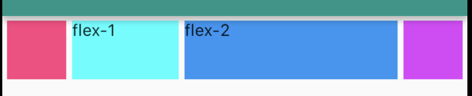
Expanded Widget
A widgets that expands a child of Row, Column or Flex to fill the available space.
If multiple children are expanded, the available space is divided among them according to the flex factor.
Must be a descendant of Row, Column or Flex

Slide 35
SizedBox Widget
SizedBox Widgets creates a Box of given size
Used to create blank space between two widgets.

Slide 36
Lets check
Expanded and SizedBox Widget

Slide 37
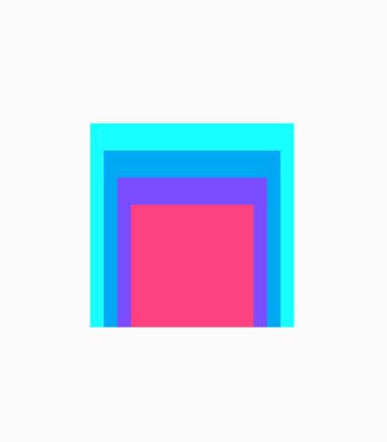
Stack
Creates a Stack of layout Widgets.
Arranges widgets on top.
Alignment helps in aligning the child widgets with reference points.
Position Widget can be used to give position for child widgets.
Position Widget woks as absolute positioning.

Slide 38
Lets check Stack Widget

Slide 39
Basic Widget

Slide 40
Basic Widget
Basic Widget are used inside layout widget to create UI of the application, for example Text, Button, Icon etc.
In this section we will cover mostly used basic widgets.

Slide 41
Icon
Icon Widgets creates Icons in the UI.
We can pass Material Icons to display icons in UI.
We can pass colour, size to change the colour and size of Icons.
SemanticLabel is announced in accessibility mode.

Slide 42
IconButton
A widget which is an Icon and acts as a button as well.
We onPressed() function will run when pressed on the Icon

Slide 43
Lets check Icon Widget

Slide 44
Text
Most basic widget in Flutter development is the Text Widget.
It is used to display Text.
Text Widget has a style property which can be used to style the widget.
Give font size, font weight, colour, font style, decoration etc.

Slide 45
RichText
RichText widget displays text that uses multiple different styles.
RichText takes multiple TreeSpan widgets and its children
TreeSpan is used to display multiple text with multiple different styles

Slide 46
Lets check Text Widget

Slide 47
Button
A button is a user interface widget that is used to perform some action when tapped.
It has a dedicated onPressed() function which will get called when the user taps on the button.
Buttons have other properties as long pressed, onHover etc.
Different kinds of Buttons.
TextButton
ElevatedButton
OutlinedButton
IconButton
LikeButton

Slide 48
All Buttons
TextButton
Takes a Text widget as a child widget
ElevatedButton
Elevated button is like a normal button, it give look and feel of a Button Press.
Can take any widget as a child widget
OutlinedButton
OutlinedButton has an outline border and can take any widget as a child widget
IconButton
Need to pass icon as a property of the Button.
LikeButton
LikeButton stores a Boolean value and helps to decide according to the condition.

Slide 49
Lets check Button Widgets

Slide 50
TextField
A TextField Widget lets the user enter text, with onscreen or hardware keyboard.
It is a basic widget used get input from users.
Keyboard type can be set for the text field.
Decoration property can be used to add decoration to the TextField.
Borders
Hint Text
Text Syle
Icons

Slide 51
Lets check TextField Widgets

Slide 52
Image Widget
An Image Widget displays an image on the screen.
Height, width can be passed to set the size of the Image.
BoxFit helps in filling the image accordingly to box.
fill, contain, cover, fitWidth, fitHeight, none, scaleDown
Assets Image: displays images from assets of the project
Image path needs to be passed
Network Image: displays images from network.
Image url need to be passed.

Slide 53
Lets check Image Widgets

Slide 54
Card Widget
Creates a material design card.
Takes any widget as a child widget.
Has predefined border radius and shadow, which can be changed
Decoration properties
Background colour
Elevation
Shape
margin
This is a basic Card

Slide 55
Lets check Card Widgets

Slide 56
InkWell Widget
Creates a rectangular area which has material properties that responds to touch
Must have Material widget as an ancestor.
Touch response results into material effects animation.
InkWell has material effects likes
Ripple
Splash

Slide 57
Lets check Inkwell Widgets

Slide 58
Other Basic Widgets

Slide 59
Exploring Appbar Widget

Slide 60
Appbar
Toolbars in an application are called as Appbar.
Generally located on the top of the screen which consists of multiple widgets, TabBar, IconButton etc.
Appbar is used to showcase the name of the app or the current screen.
It has decoration properties which helps to change the colour, shadow and other properties of the appbar.
Appbars are used for navigation in app.

Slide 61
Types of Appbar
Flutter has multiple type of appbar.
Top Appbar: Appbar located at the top of the screen.
Bottom AppBar: App bar location at the bottom of the screen.
Sliver Appbar: Are appbars that vary in height according to scroll offset or float above the content.
Search Bar: Appbar with search option.

Slide 62

Top Appbar
Appbar located on the top of the screen which consists of multiple widgets, TabBar, IconButton etc.
Used to showcase the name of the app or the current screen.
Appbars are used for navigation in app.
Generally to go back to previous screen.
Navigation drawer is called form appbar.

Slide 63
Lets check Top Appbar Widgets

Slide 64

Bottom Appbar
Appbar located on the Bottom of the screen.
Used navigate to multiple screens.
Can have Icon and Text to indicate

Slide 65
Bottom Appbar
Appbar located on the Bottom of the screen.
Use to navigate to multiple screens.
Can have Icon and Text to indicate

Slide 66
Lets check Bottom Appbar Widgets

Slide 67
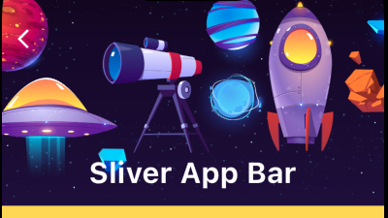

Sliver Appbar
Appbars that vary in height according to scroll offset or float above the content.
It can be pinned, or you can scroll the app bar with content

Slide 68
Lets check Sliver Appbar Widgets

Slide 69
Working With List

Slide 70
ListView
In mobile application its common to display items in manner of List.
This is done by ListView Widget.
A ListView is most commonly used scrolling widget.
It displays its children one after another in the scroll direction.
Each Child of the listview can be called as a Cell.
Its important to pass ItemCount to know the limit of the list.

Slide 71
Type of List View
ListView: The most basic LiveView offered by Flutter
ListView.builder: The builder in the ListView helps to build and reuse the ListView Tile.
ListTile and ExpandableListTile: A listTile is a Widget to display content in the ListView. ExpandableListTile, expands on tap to show more content.
ReoderableList: A list where we can reorder the cells in the list.
GrideView: Helps in arranging the item in form of Gride.
SwipeToDissmiss: List where we can swipe to delete the cell in the list.
DataTable: A Widget to display the data in TableForm.
DraggableScrollView: A scrollView which can be dragged and bring up and minimised

Slide 72
Lets check ListView Widgets

Slide 73
Navigation In Flutter

Slide 74
Navigation
Apps are made up of Multiple screens.
User needs to navigate from one screen to other screen.
Flutter Navigator helps in that.
There are Different ways to navigate and show different screen in a App
Routes
Tabs
Navigation Drawer
BottomNavigationBar
PageSelector

Slide 75
Tabs
Tabs are a way to create multiple screens which can be swiped to change.
TabBar needs a controller to control the TabView.
TabViews are single page view per each Tab.
TabController needs length , which decides the number of pages.
TabBarView takes multiple children which will be displayed per Tab.
The Length of Tab and the Children in TabBarView must be same

Slide 76
Lets check Tab Widgets

Slide 77
Routes
Navigation in Flutter is like Stack. First In Last Out.
Push adds a new screen on top of the Navigation Stack. Navigates to new screen
Pop removes the top most screen. Navigate to previous screen.
Routes help in navigating from one screen to other.
Flutter uses MaterialRoute to push or pop screen.

Slide 78
Lets check Routes Widgets

Slide 79
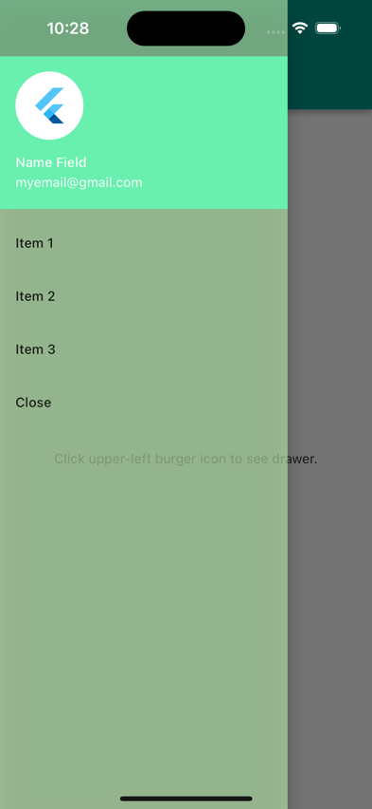
Drawer
A drawer is a Navigation pane which slides on the screen from left or right side of the screen.
It has menu which helps in navigation between screens

Slide 80
Lets check Drawer Widgets

Slide 81

Bottom Navigation Bar
A BottomNavigationBar is like a TabBar but just located at the bottom of the screen.
We pass the BottomNavigationBar as a property on Scaffold.
It needs currentIndex which decides which screen is currently selected.
Each tab is treated like a separate Page or screen
BottomNavigationBarItem is used to show the icons on the screen
The List of Widgets and the Length must match.

Slide 82
Lets check BottomNavigationBar Widgets

Slide 83
Futures and Streams

Slide 84
Dart Execution
Dart has a single threaded execution model.
Only one flow of Code execution and control exists.
Functions are executed in a synchronous way. One after another.
Some function might require some extra time like
Fetching data from network
Uploading some files
Using image picker etc.
Other functions will have to wait unless these functions are executed.
Might stop loading UI or executing important functions.
Asynchronous execution helps to solve this issue.

Slide 85
Asynchronous Execution
Time consuming functions are made asynchronous.
Removed from main thread – so other functions can be executed.
Event loop to stage functions.
Back on main thread when its empty – so it can be executed.
Make function asynchronous by using async keyword.

Slide 86
Future
Futures are objects that are returned in the future.
Future are not value, but promise to get value in future.
FutureBuilder to used to show Future value
FutureBuilder
A widget that builds itself on the latest data obtained in Future.
FutureBuilder needs a future value.
ConnectionState is used to decide what widget to build by builder.

Slide 87
Lets check FutureBuilder

Slide 88
Streams
Provides a continuous stream or sequence of data.
Create a stream using async* keyword
StreamController to control the stream.
Listen to the stream by using listen keyword on the stream
StreamBuilder
A widget that builds itself on the latest data obtained from stream
Continuous listens to the stream value.
Need a stream value to be passed to the widget.
ConnectionState is used to decide what widget to build by builder.

Slide 89
Lets check StreamBuilder

Slide 90
Lets Recap What We Learned

