Slide 1
Comprehensive Analysis on YouTube Videos
Panel Review - 2
Guide: Mrs Ramya G R Assistant Professor(Sr Gr)
SL NO. | Name | Roll No
1 | Dineshsuriya D | CB.EN.U4CSE20616
2 | Karishram B | CB.EN.U4CSE20626
3 | Nishaanth K N | CB.EN.U4CSE20642
4 | Rajkumar M | CB.EN.U4CSE20650

Slide 2
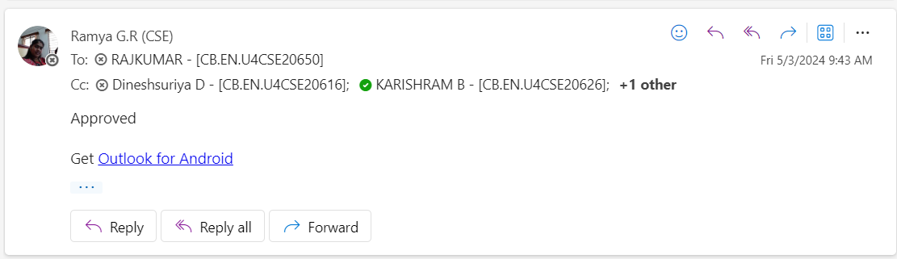
Guide Approval

Slide 3
Motivation
In the era of digital media, YouTube has emerged as a significant platform for content creation and consumption.
Every minute, hundreds of hours of video are uploaded to YouTube, generating billions of views and comments.
As video content continues to grow, ensuring a safe and positive online environment becomes crucial.
The integration of Automatic Speech Recognition (ASR), Hate Speech Detection, Spam Detection, and Sentiment Analysis aims to provide a comprehensive solution to address these challenges.

Slide 4
Introduction
In an era dominated by dynamic digital content, our project sets out to revolutionize the analysis and understanding of YouTube videos through a multifaceted approach. Our core objectives are meticulously designed to address critical aspects of content moderation, sentiment evaluation, and user engagement:
Automatic Speech Recognition (ASR)
Hate Speech Detection
Spam Detection
Sentiment Analysis
Summarizer

Slide 5
Expected output
The expected output is a robust system that can automatically transcribe YouTube audio, identify hate speech, filter out spam comments, and analyze sentiment.
The system aims to contribute to a safer and more positive online environment by automating content moderation tasks.

Slide 6
Literature Survey – Speech to text recognition
Year | Title | Problem Statement | Dataset & Sensors | Methodology | Performance Metrics
2022 | Long Short-Term Memory Recurrent Neural Network for Automatic Speech Recognition | Automatic Speech Recognition (ASR) involves converting speech signals to text, particularly challenging for transcribing spoken English digits due to speech pattern variability. | The authors used a well-established publicly available dataset comprising isolated spoken English digits. The dataset contains 2400 audio files, with each of the 15 speakers uttering each digit 16 times. | The authors used a well-established publicly available dataset comprising isolated spoken English digits. The dataset contains 2400 audio files, with each of the 15 speakers uttering each digit 16 times. | The enhanced LSTM-RNN model's performance was assessed using accuracy as the main metric. Additionally, precision, recall, and F1-score were calculated using a confusion matrix for a comprehensive classification evaluation.

Slide 7
Literature Survey – Hate speech detection
Year | Title | Problem Statement | Dataset & Sensors | Methodology | Performance Metrics
2020 | A Framework for Hate Speech Detection Using Deep Convolutional Neural Network | To improve hate speech detection on Twitter using deep learning while addressing imbalanced dataset issues. | Twitter hate speech dataset from Kaggle. | Utilizing a deep convolutional neural network (DCNN) and implementing 10-fold cross-validation to tackle the problem of hate speech detection on Twitter. The study employs GloVe pre-trained word embeddings and various n-gram filters to extract features from text data | Achieving improved results in hate speech detection on Twitter through the proposed deep convolutional neural network (DCNN) model with 10-fold cross-validation. The model attained a recall of 0.88 for hate speech tweets and 0.99 for non-hate speech tweets, demonstrating its effectiveness in handling imbalanced datasets

Slide 8
Literature Survey – Sentiment Analysis
Year | Title | Problem Statement | Dataset & Sensors | Methodology | Performance Metrics
2022 | Sentiment Analysis and Emotion Detection on Cryptocurrency Related Tweets Using Ensemble LSTM-GRU Model | The study aims to analyze the cryptocurrency market through social media data by performing sentiment analysis and emotion detection on tweets related to cryptocurrency | Cryptocurrency Tweets with Sentiment Analysis | The authors have proposed an ensemble model that combines the advantages of long short-term memory (LSTM) and gated recurrent unit (GRU) for sentiment analysis and emotion detection. They have also studied the performance of three feature engineering approaches, including term frequency-inverse document frequency (TF-IDF), bag of words (BoW), and Word2Vec, using several well-known machine learning models such as support vector machine (SVM), logistic regression (LR), Gaussian Naive Bayes (GNB), extra tree classifier (ETC), decision tree (DT), and k nearest neighbor (KNN) | The proposed ensemble model achieved an accuracy of 87.5% for sentiment analysis and an accuracy of 80.5% for emotion detection. The best performing feature engineering approach was found to be TF-IDF, and the best performing machine learning model was SVM. The study also found that the LSTM-GRU model outperformed other machine learning models in terms of accuracy, precision, recall, and F1 score.

Slide 9
Research Gap
Existing content moderation systems often lack integration and fail to comprehensively address hate speech, spam, and sentiment analysis in the context of YouTube comments.

Slide 10
Novelty of our solution
The project's novelty lies in its integrated approach, incorporating ASR and advanced NLP techniques to comprehensively address content moderation challenges in YouTube comments, ultimately contributing to a more effective and user-friendly platform.
Our project bridges this gap by providing an integrated solution leveraging ASR and advanced natural language processing techniques.

Slide 11
Project Problem Research Objectives
Objective 1: To develop an integrated system that converts speech from YouTube videos into text using an Automatic Speech Recognition (ASR) system, specifically leveraging the wav2vec fine-tuned model. (Completed in phase 1)
Objective 2: Apply hate speech detection algorithms to the transcribed text to identify potential hate speech elements. (Completed)
Objective 3: Perform spam detection on YouTube comments to filter out irrelevant or malicious content. (Completed)
Objective 4: Conduct sentiment analysis on YouTube comments to gauge the overall sentiment and reactions of the audience.(Completed)
Objective 5: Summarize the content of the YouTube Video.

Slide 12
System Design: Architecture
Architecture Overview: The system consists of three primary modules: ASR, Hate Speech Detection, Spam & Sentiment Analysis and Video Summarization. The ASR module uses the wav2vec model to convert audio to text. The text is then fed into the Hate Speech Detection module. Simultaneously, YouTube comments are extracted and passed through the Spam Detection and Sentiment Analysis modules.

Slide 13
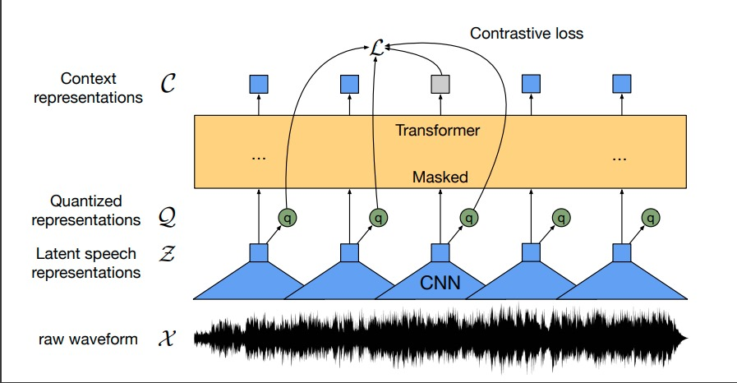
Wav2Vec Architecture

Slide 14
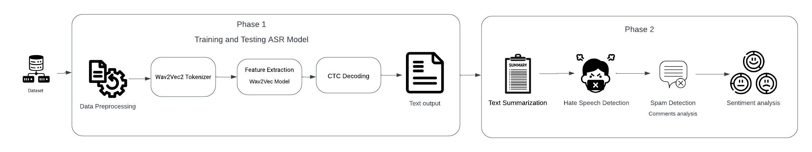
Proposed Methodology

Slide 15
Explanation of Algorithms/Techniques
ASR with wav2vec: A fine-tuned version of the wav2vec model converts speech into text.Wav2vec is known for its self-supervised learning approach, capturing nuanced features in audio data.
Hate Speech Detection: Utilizes NLP and machine learning techniques (as found in the GitHub repositories) to classify text into hate speech or non-hate speech categories.
Spam Detection: Employs machine learning algorithms like naive bayes, SVM, or logistic regression for classifying comments as spam or non-spam.
Sentiment Analysis: Uses techniques like Logistic Regression, Naive Bayes, or Neural Networks to analyze the sentiment of comments, categorizing them into positive, negative, or neutral.

Slide 16
Automatic Speech Recognition
Library Installation:
Installed necessary tools and libraries for handling data, model training, and evaluation.
Data Preparation:
Loaded and preprocessed a speech dataset from YouTube.
Cleaned and organized data for effective model training.
Tokenization and Vocabulary Creation:
Created a tool to convert speech to text using advanced tokenization techniques.
Built a vocabulary for the model to understand and process the speech data.
Feature Extraction:
Developed a feature extraction mechanism to prepare audio data for the model.

Slide 17
Model Training Setup:
Configured a powerful pre-trained model for training on our specific task.
Set up training parameters, such as batch size, learning rate, and evaluation strategy.
Initial Model Training:
Initiated the training process to teach the model how to convert speech to text.
Model Testing:
Integration of modules for hate speech detection, spam filtering, and sentiment analysis.
System testing and evaluation to ensure effectiveness.

Slide 18
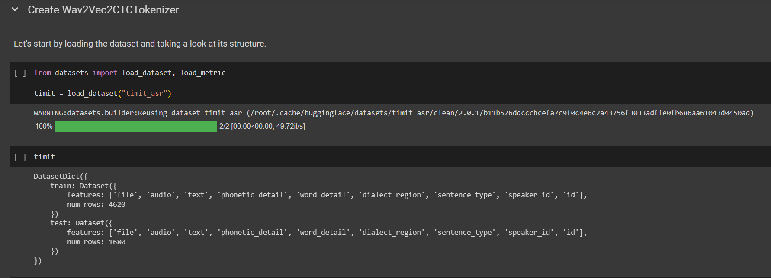
Implementation of ASR

Slide 19
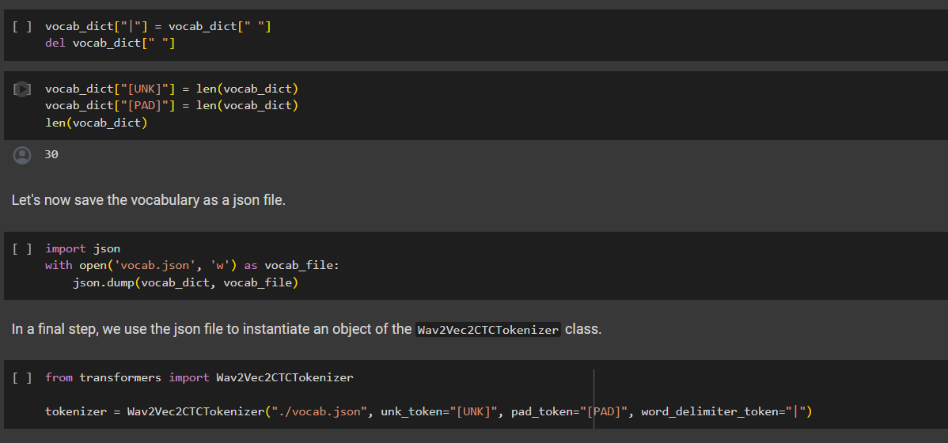
Tokenizer

Slide 20
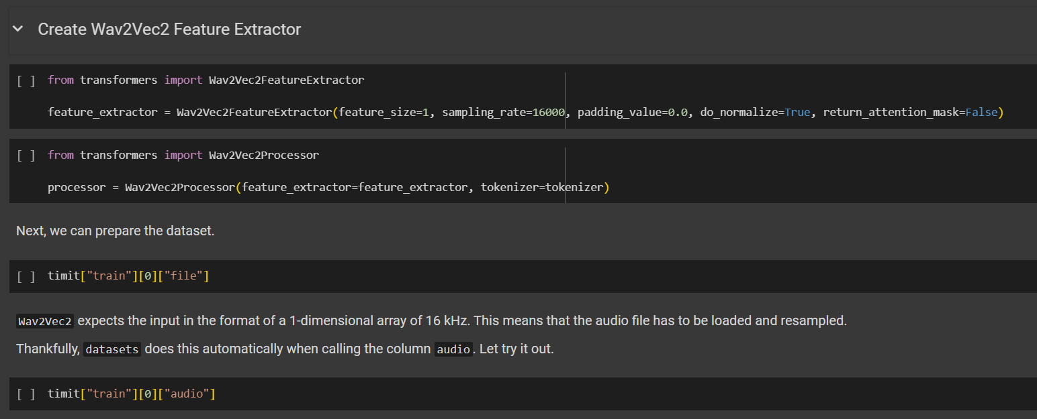

Slide 21
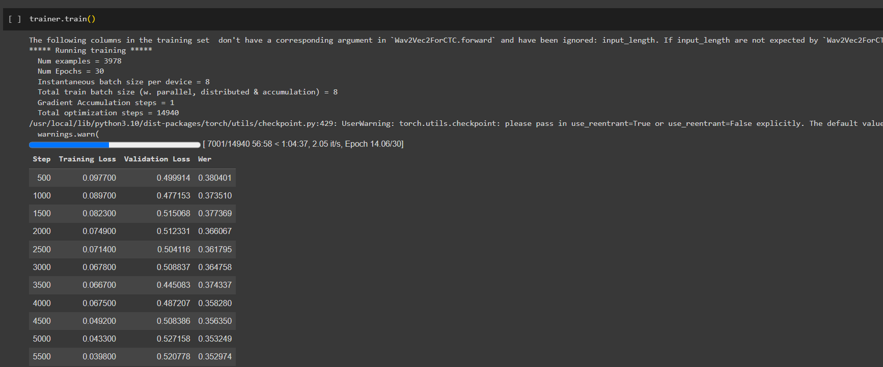
Training results

Slide 22
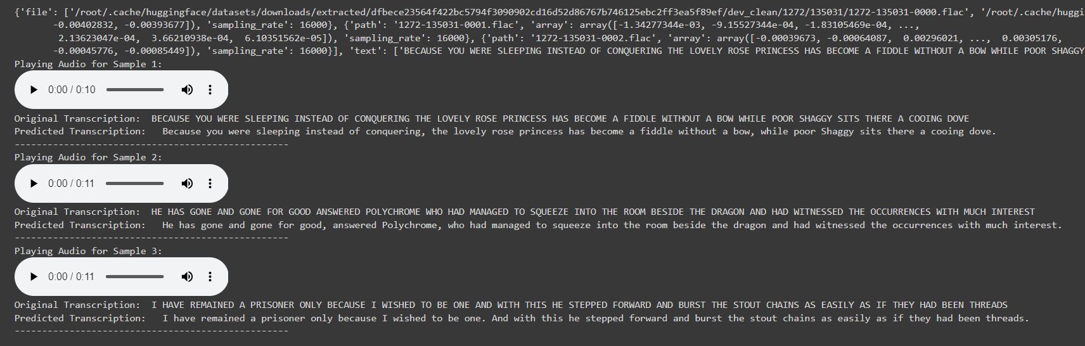
Testing results

Slide 23
Hate Speech Detection
The hate speech multi-label classification model utilizes a BERT-based architecture to classify text into multiple hate speech categories simultaneously.
Trained on a hate speech dataset, the model can detect various forms of hate speech, including race, religion, origin, gender, sexuality, age, and disability.
Through preprocessing, tokenization, model setup, optimization, training, and evaluation, the model achieves high accuracy and F1 score on test data.
This enables it to effectively identify hate speech in new text samples, making it valuable for real-world applications in content moderation and social media monitoring.

Slide 24
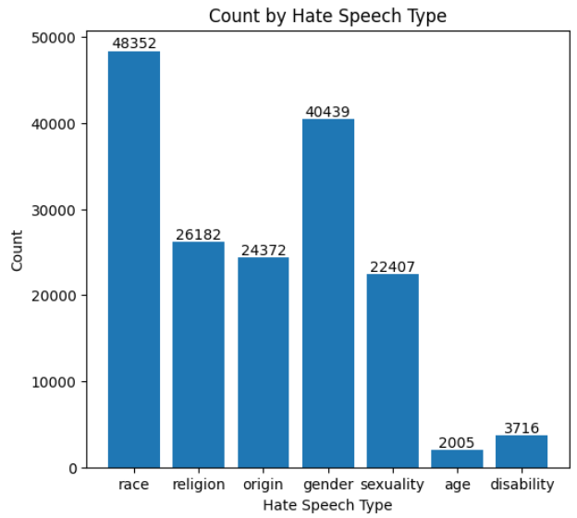
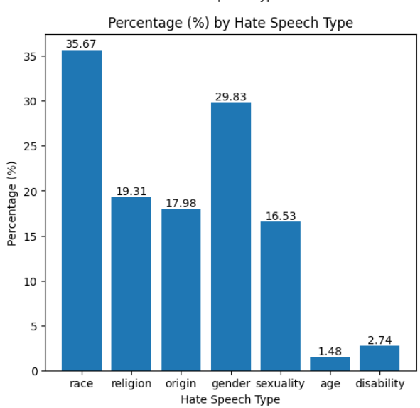
Dataset
The model is trained using a hate speech dataset obtained from the UC Berkeley D-Lab repository, where text samples are labeled with multiple hate speech types including race, religion, origin, gender, sexuality, age, and disability.

Slide 25
Algorithms used
The hate speech detection model described employs BERT, a transformer-based architecture renowned for natural language processing tasks.
Fine-tuned on a multi-label hate speech classification dataset, it categorizes hate speech across various dimensions simultaneously.
Using BERT's contextual understanding, the model predicts hate speech presence in categories like race, religion, and gender.
Evaluation metrics such as accuracy and F1 score validate its effectiveness.
Overall, leveraging BERT's capabilities, the model achieves robust detection of hate speech across diverse contexts.

Slide 26
Setup and Preprocessing
This part includes importing necessary libraries, loading the dataset, cleaning target labels, exploring the dataset, and preparing it for model training.
It involves tasks like installing required libraries, loading the dataset, removing unnecessary columns, renaming columns, exploring dataset statistics, and creating labels for model training.

Slide 27
Model Training Setup
This part involves setting up the model architecture, optimizer, scheduler, training metrics, and evaluation scripts.
It includes tasks like setting up the BERT architecture, defining optimizer and scheduler, setting up training and evaluation scripts, defining metrics like accuracy and F1 score, and preparing the model for training.

Slide 28
Model Training
This part involves training the model using the prepared dataset and evaluation on validation data after each epoch.
It includes tasks like iterating through training data, computing predictions, backpropagation, updating parameters, evaluating on validation data, and monitoring training progress.

Slide 29
Model Evaluation and Deployment
This part involves evaluating the trained model on the test dataset and deploying it for inference using a pipeline.
It includes tasks like evaluating model performance on the test dataset, setting up a pipeline for inference, and testing the model on sample hate speech texts.

Slide 30
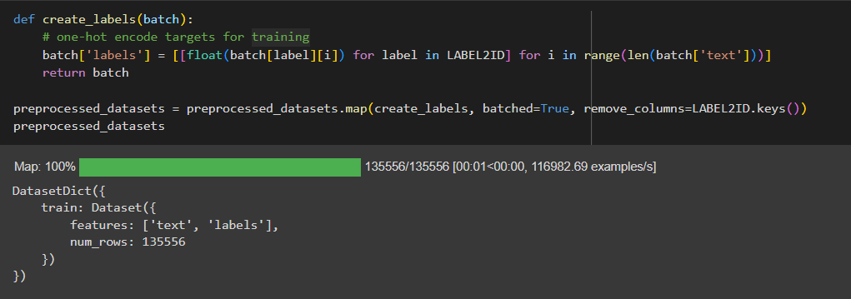
Implementation of the Model
One hot encoding the text to its corresponding labels

Slide 31
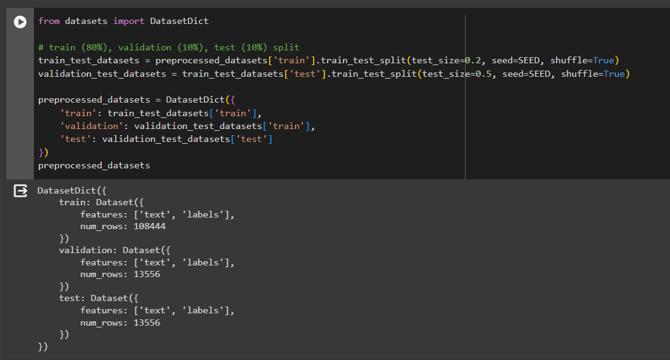
Dataset split up

Slide 32
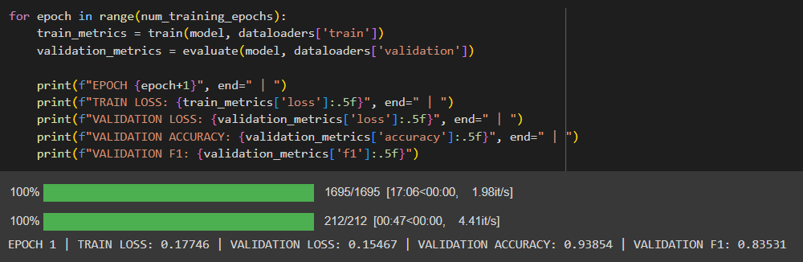
Training the model

Slide 33
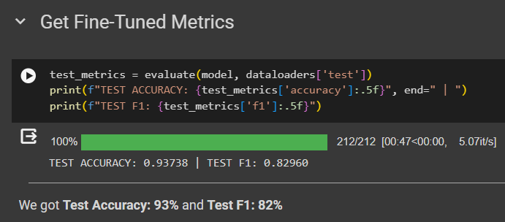
Test Accuracy

Slide 34
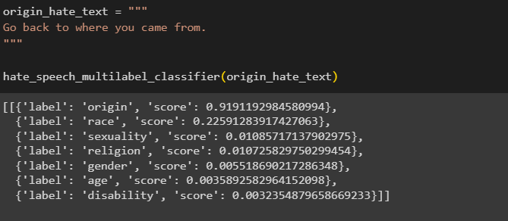
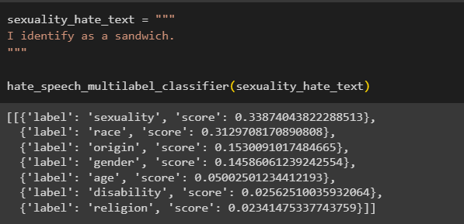
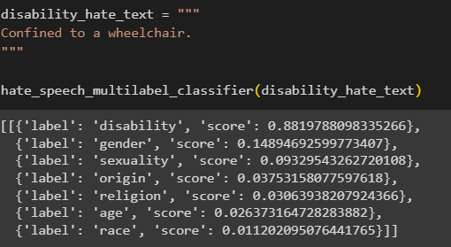
Results

Slide 35
Corrections done after last review
Took a video and predicted the hate speech percentage in that video.
Made an application for video analysis and comment analysis.
Made sure time taken for hate speech detection is reduced

Slide 36
Flask Application for YouTube Video Analysis
The purpose of this application is to analyze YouTube videos using natural language processing (NLP) techniques to identify hate speech, sentiment, and spam within the video content and associated comments.
The Flask application leverages a combination of Python libraries and APIs to perform advanced text analysis on YouTube video content.
It uses Flask as the web framework for handling HTTP requests and responses. Key technologies include PyTube for video extraction, Transformers library for NLP tasks, and the YouTube Data API for accessing video metadata and comments.

Slide 37
Automatic Speech Recognition in App
Audio Extraction: The app extracts audio from a YouTube video using PyTube, allowing further processing of the audio content.
Transcription: The extracted audio is transcribed into text using the AutoModelForSpeechSeq2Seq model from the Transformers library. This model converts spoken words into written text.

Slide 38
Text Analysis Modules
Hate Speech Detection:
The hate speech detection pipeline (pipe_hateSpeech) categorizes text into hate speech categories such as disability, race, gender, etc.
Sentiment Analysis:
The sentiment analysis pipeline (pipe_sentiment) determines the sentiment (positive, neutral, negative) of the text.
Text Summarization:
The text summarization pipeline (pipe_summarizer) generates a concise summary of the transcribed text.
Spam Detection:
The spam detection pipeline (pipe_spam) identifies spam or non-spam content in text, providing insights into comment quality.

Slide 39
YouTube Video Analysis
The app extracts metadata (title, description, views, likes, channel) using the YouTube Data API.
It fetches comments associated with the video and analyzes them for sentiment, hate speech, and spam.

Slide 40
Web Interface and API Endpoints
User Interface (index.html): Users input a YouTube video URL via the web interface to initiate the analysis process.
API Endpoints: The Flask app provides multiple endpoints (/convert, /analysis, /hate_speech, /sentiment, /summarize, /spam_detection, /analysis-comments) to handle specific text analysis tasks based on user input and data processing requirements.

Slide 41
Workflow and Data Flow
Input: Users provide a YouTube video URL via the web interface.
Processing:
Audio extraction and transcription using PyTube and Transformers library.
Text analysis (hate speech detection, sentiment analysis, text summarization, spam detection).
Output:
Transcribed text from the video's audio content.
Analysis results (sentiment, hate speech categories, spam classification) for the video and its associated comments.

Slide 42
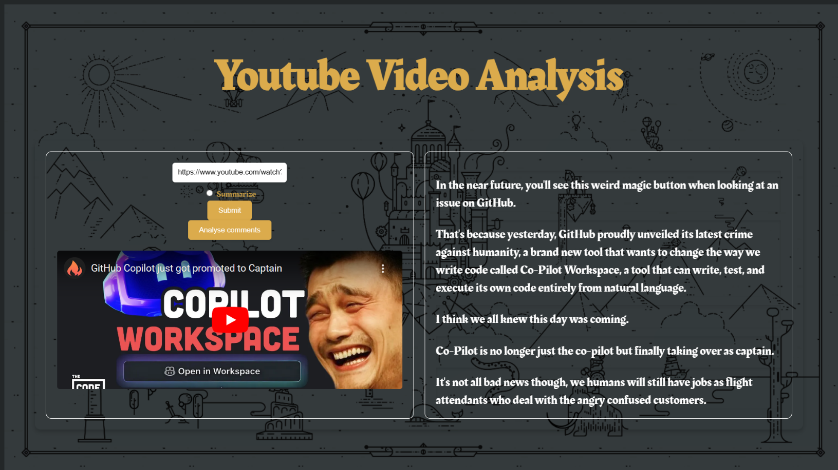
Webpage

Slide 43
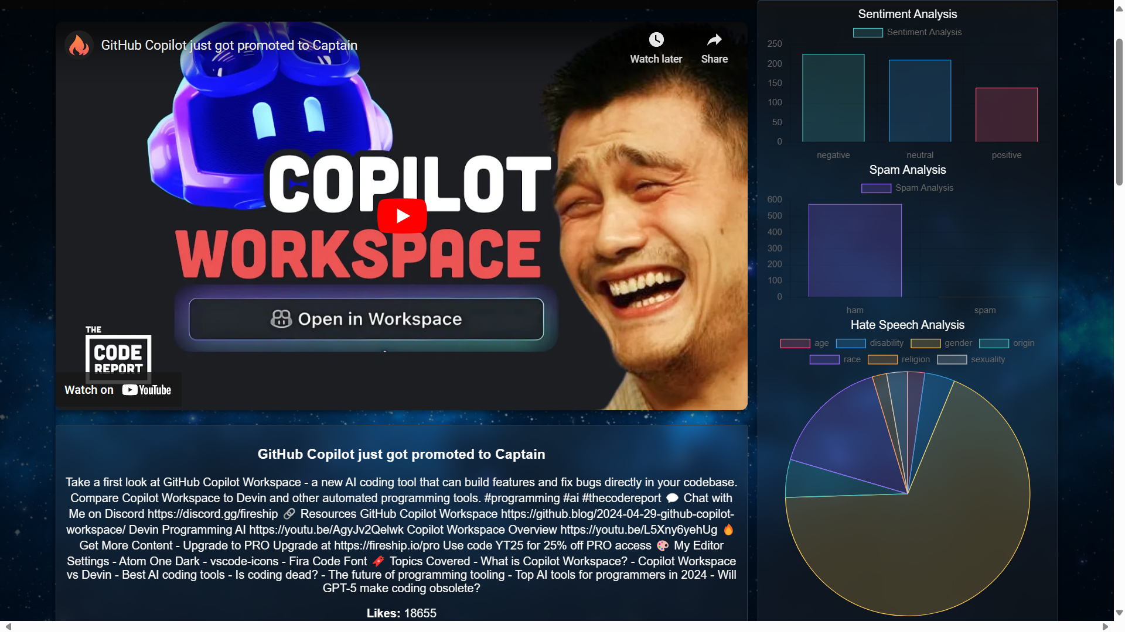
Video Analysis Statistics

Slide 44
Spam detection
The spam detection module applies machine learning to automatically categorize text messages as spam or ham (non-spam).
Through natural language processing (NLP) techniques, the module processes and transforms text data into numerical features.
These features are then used to train a classifier, such as Multinomial Naive Bayes, enabling the system to identify and filter unwanted messages effectively.
By automating spam identification, this module enhances communication security and user experience.

Slide 45
Implementation
The module begins by loading SMS data from a CSV file and performs initial data cleaning tasks such as handling missing values and renaming columns.
Utilizes CountVectorizer to convert the preprocessed text into a document-term matrix, capturing the frequency of each word present in the dataset.
Applies TF-IDF (Term Frequency-Inverse Document Frequency) transformation to the document-term matrix, emphasizing words that are important in specific messages while downweighting common words.

Slide 46
Model Training and Evaluation
Trains a machine learning model, specifically Multinomial Naive Bayes (MultinomialNB), on the transformed data to learn patterns and associations between text features and message labels (spam or ham).
Evaluates the model's performance using various metrics including accuracy, confusion matrix, and ROC AUC score to assess its effectiveness in distinguishing between spam and ham messages.
Implements a pipeline (Pipeline) that combines feature extraction (CountVectorizer), feature scaling (TfidfTransformer), and classification (MultinomialNB) into a single entity, enabling seamless and efficient text classification.

Slide 47
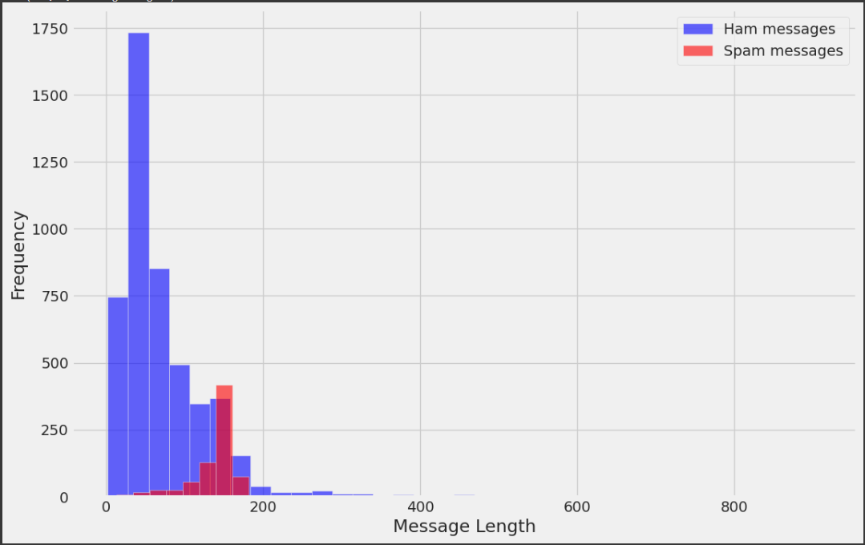
Dataset

Slide 48
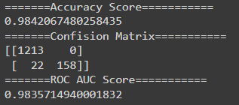
Accuracy

Slide 49
Sentimental Analysis
Sentiment analysis refers to the process of examining text to determine the feeling or attitude being demonstrated by an author, such as in social media posts .
This method aims to determine and remove subjective information from text data. Additionally, sentiment analysis generally falls into three categories: whether the sentiment is positive, negative, or neutral .
The primary reason for conducting sentiment analysis is to determine the primary feeling or general mood expressed in a body of textual contents.

Slide 50
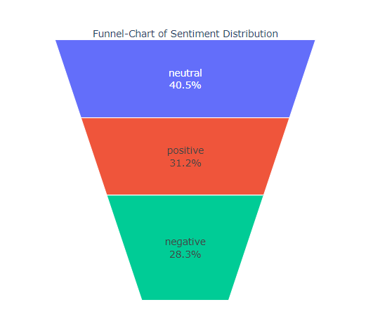
Data Loading and Preprocessing
Reads CSV files containing training and test data.
Does simple data cleaning jobs like discarding HTML tags, links, punctuation and non alphanumeric signs.
Conducts exploratory data analysis (EDA) to understand the distribution of sentiments in the dataset.

Slide 51
Text processing and feature engineering
Functions that define Jaccard similarity between text and selected_text.
Word counts and meta-features, namely words in text and selected_text.
The distributions of the word count as well as the differences in word count for different sentiments are plotted.
Most frequent words in selected_text and text after just removing stopwords.
Bar charts and treemaps are used for the identification of the most frequent words.

Slide 52
Model Training and Model Predictions
Functions that define how to train a NER model using spaCy.
In addition, the preparation of the training data features ensures that the training is done in the format.
Defines a function to get a prediction for entities (in this case selected_text) from the NER model that was trained.
Predicts selected_text for test data based on sentiment using trained models.
Saves the predicted selected_text to a CSV file (submission.csv) for submission.

Slide 53
Text Summarizer
The presented text summarizer module leverages a combination of natural language processing techniques to automatically summarize articles.
The process begins with extensive text preprocessing, including lowercase conversion, HTML tag removal, URL and email address extraction, contraction expansion, and punctuation elimination.

Slide 54
Word Frequency Normalization
Word Tokenization:
The text is tokenized into words.
Word Frequency Calculation:
For each sentence, word frequencies are computed and stored in dictionaries.
Normalization:
Word frequencies within each sentence are normalized by dividing each word's count by the maximum frequency in that sentence.

Slide 55
Sentence Tokenization and Scoring
Sentence Tokenization:
Sentences are tokenized using sent_tokenize function.
Scoring Method:
Sentence scores are calculated based on the sum of normalized word frequencies within each sentence.
Summary Generation
Selection of Top Sentences:
The top 25% (configurable) sentences with the highest scores are selected to form the summary.
Joining Sentences:
Selected sentences are concatenated to form the final summary text.

Slide 56
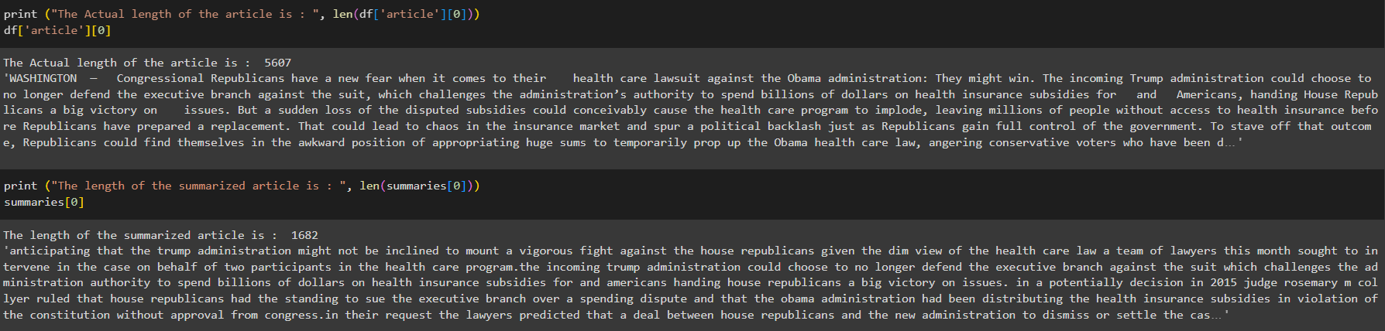
Test result

Slide 57
Results and Discussion
Detects sentiment issues and hate speech in video/audio content and comments.
Utilizes ASR technology, benchmarked against systems like Mozilla's DeepSpeech.
Implements Spam Detection using machine learning (e.g., Naïve Bayes) with 98% true positive rate.
Employs Sentiment Analysis (SA) using models like Logistic Regression to categorize responses.
Outperforms benchmarks like Jigsaw Toxic Comment Classifier in hate speech detection (93% accuracy).

Slide 58
Conclusion
Our system significantly improves YouTube by addressing critical issues like accessibility.
It leverages advanced technologies such as Wav2Vec for Automated Speech Recognition (ASR), BERT for hate speech detection using Natural Language Processing (NLP), and machine learning algorithms for spam detection.
This integrated approach promotes a safer, more inclusive online space, fostering respectful interactions and empowering content creators and moderators to better understand audience sentiments.
The system's modular architecture, combined with comparisons to established models, ensures reliability, scalability, and adaptability to evolving digital demands.

Slide 59
Work Split
Individual Contributions:
Roll No | Name | Contribution
CB.EN.U4CSE20626 | Karishram B | Spam detection and Sentimental Analysis
CB.EN.U4CSE2016 | Dineshsuriya D | Flask App and ASR Model
CB.EN.U4CSE20642 | Nishaanth K N | Hate Speech Detection
CB.EN.U4CSE20650 | Rajkumar M | Text Summarizer and Documentation

Slide 60
References
[1] A. J. Nair, V. G., and A. Vinayak, "Comparative Study of Twitter Sentiment On COVID-19 Tweets," in IEEE, [Online]. Available: https://ieeexplore.ieee.org/document/9418320
[2] A. Krouska, C. Troussas, and M. Virvou, "The Effect of Preprocessing Techniques on Twitter Sentiment Analysis," in IEEE, [Online]. Available: https://ieeexplore.ieee.org/document/7785373
[3] Y. Wang, G. Huang, J. Li, H. Li, Y. Zhou, and H. Jiang, "Refined Global Word Embeddings Based on Sentiment Concept for Sentiment Analysis," in IEEE, [Online]. Available: https://ieeexplore.ieee.org/document/9366882
[4] N. Aslam, F. Rustam, E. Lee, P. B. Washington, and I. Ashraf, "Sentiment Analysis and Emotion Detection on Cryptocurrency Related Tweets Using Ensemble LSTM-GRU Model," in IEEE, [Online]. Available: https://ieeexplore.ieee.org/document/9751065
[5] S. Ghodratnama, A. Beheshti, M. Zakershahrak, and F. Sobhanmanesh, "Extractive Document Summarization Based on Dynamic Feature Space Mapping," in IEEE, [Online]. Available: https://ieeexplore.ieee.org/document/9151114
[6] K. Yao, L. Zhang, D. Du, T. Luo, L. Tao, and Y. Wu, "Dual Encoding for Abstractive Text Summarization," in IEEE, [Online]. Available: https://ieeexplore.ieee.org/document/8520903

Slide 61
[7] J. Jiang, H. Zhang, C. Dai, Q. Zhao, H. Feng, Z. Ji, and I. Ganchev, "Enhancements of Attention-Based Bidirectional LSTM for Hybrid Automatic Text Summarization," in IEEE, [Online]. Available: https://ieeexplore.ieee.org/document/9528391
[8] J. M. Pérez, F. M. Luque, D. Zayat, M. Kondratzky, and A. Moro, "Assessing the Impact of Contextual Information in Hate Speech Detection," in IEEE, [Online]. Available: https://ieeexplore.ieee.org/document/10076443
[9] P. K. Roy, A. K. Tripathy, T. K. Das, and X.-Z. Gao, "A Framework for Hate Speech Detection Using Deep Convolutional Neural Network," in IEEE, [Online]. Available: https://ieeexplore.ieee.org/document/9253658
[10] H. S. Alatawi, A. M. Alhothali, and K. M. Moria, "Detecting White Supremacist Hate Speech Using Domain Specific Word Embedding With Deep Learning and BERT," in IEEE, [Online]. Available: https://ieeexplore.ieee.org/document/9497095
[11] S. Alharbi, M. Alrazgan, A. Alrashed, T. Alnomasi, R. Almojel, and R. Alharbi, "Automatic Speech Recognition: Systematic Literature Review," in IEEE, [Online]. Available: https://ieeexplore.ieee.org/document/9536732
[12] J. Oruh, S. Viriri, and A. Adegun, "Long Short-Term Memory Recurrent Neural Network for Automatic Speech Recognition," in IEEE, [Online]. Available: https://ieeexplore.ieee.org/document/9733937
[13] J. Jorge, A. Giménez, J. A. Silvestre-Cerdà, J. Civera, A. Sanchis, and A. Juan, "Live Streaming Speech Recognition Using Deep Bidirectional LSTM Acoustic Models and Interpolated Language Models," in IEEE, [Online]. Available: https://ieeexplore.ieee.org/document/9645238

Slide 62
THANK YOU

