Slide 1
Speeding up LSM compaction with Learned Indexes in LevelDB
CS 6530 Final Project
Medha, Susmitha, Yuvaraj

Slide 2
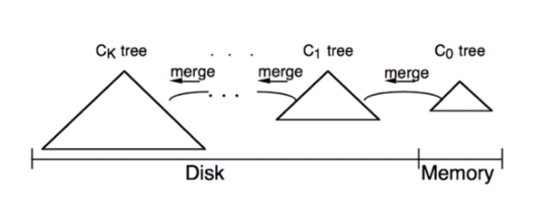
Problem Overview - LSM Tree
Notes:
LSM trees are composed of multiple levels with increasing size. Newer data is pushed to lower levels, eventually lower levels are merged into higher levels to save space by removing redundancy. Each tree is either a single SSTable or split across multiple SSTables. SSTable is a immutable record of sorted rows.

Slide 3
Problem Overview - Compaction
Compaction is CPU bound on comparisons
To merge m iterators with n items - roughly O(n*m²) comparisons
I1 -> 1, 2, 3, 8, 9
I2 -> 4, 5, 6, 12
I3 -> 10, 11
I1 -> 1, 2, 3, 8, 9
I2 -> 4, 5, 6, 12
I3 -> 10, 11
2 comps
I1 -> 1, 2, 3, 8, 9
I2 -> 4, 5, 6, 12
I3 -> 10, 11
2 comps
I1 -> 1, 2, 3, 8, 9
I2 -> 4, 5, 6, 12
I3 -> 10, 11
And so on…
Notes:
the items are removed in order to be compacted
Time spent in compaction is dominated by comparisons
a1 a2 a3 a4 -> m * (n-1)
b1 b2 b3 b4 -> m * (n-1)
c1 c2 c3 c4 -> m * (n-1)
d1 d2 d3 d4 -> m * (n-1)
O (m * (n-1) * (n))
O (m * n^2)
Iterator 1 -> 1, 2, 3, 8, 9
Iterator 2 -> 4, 5, 6, 12
Iterator 3 -> 10, 11
If we find the position of say 4 in iterator 1, then we can avoid the 3 comparisons of 4 and 1, 4 and 2 , 4 and 3.

Slide 4
Existing solutions and Relevant work
Use Learned Indexes to skip comparisons
Bourbon
It is a fork of levelDB.
Skips comparisons in lookup using learned indexes
The Case for Learned Sorting
Speeds up sorting for arrays using learned indexes(Uses RMI)
Claims to be faster than C++ sort.
Our project: utilize learned indexes to reduce comparisons in compactions
Notes:
Pebbles DB
RMI
BOURBON employs greedy piecewise linear regression to learn key distributions which enables fast lookup.
We try to use the same greedy piecewise linear regression model to optimise compactions in LSM trees.

Slide 5
Our approach
I1 -> 1, 2, 3, 8, 9
I2 -> 4, 5, 6, 12
I3 -> 10, 11
I1 -> 1, 2, 3, 8, 9
I2 -> 4, 5, 6, 12
I3 -> 10, 11
Train a model for each iterator
I1 -> 1, 2, 3, 8, 9
I2 -> 4, 5, 6, 12
I3 -> 10, 11
I1 -> 1, 2, 3, 8, 9
I2 -> 4, 5, 6, 12
I3 -> 10, 11
I1 -> 1, 2, 3, 8, 9
I2 -> 4, 5, 6, 12
I3 -> 10, 11
Find the two smallest iterator heads
Query for the second smallest using model of the smallest iterator
Now return from smallest till that limit. (Saved 6 comparisons)
Notes:
It 1 -> 1, 2, 3, 8, 9
It 2 -> 4, 5, 6, 12
It 3 -> 10, 11
Assumption: Real world data is generally skewed.
Some keys appear more often than other,
Those keys will appear in an SSTable more number of times
In the above example,
Iterator 1 contains the smallest key.
The second smallest key across all iterator heads is 4.
We call GuessPositionFromPLR(4) on Iterator 1 which returns the approx position of 4 in iterator 1.

Slide 6
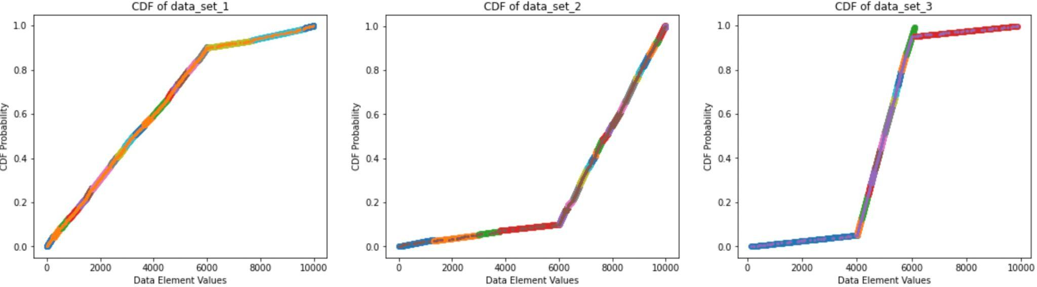
Implementation : Python prototype
Model built using Piecewise-Linear-Regression(PLR)
Position(X) = N * CDF_FROM_PLR_MODEL(X)
N = 3000, 3 lists
Standard comparison : ~6000
Learned comparison + error : ~ 2500 + ~2000
Notes:
X axis : Data elements
Y axis : CDF probability
We used Greedy PLR model used in Bourbon for our guess position objective.
A sample implementation of the Greedy PLR model and using it for merging data is done in the Python prototype.
We measure the comparison count in standard merge and merge with PLR and put out some stats as below.

Slide 7
Implementation: LevelDB
LevelDB compaction path
db/db_impl.cc: DoCompactionWork()
table/version_set.cc: MakeInputIterator()
table/merger.cc: NewMergedIterator (....) -> Iterator interface
Our changes
mod/learned_merger.cc: NewLearnedMergerIterator(...) -> Iterator interface
mod/learned_shadow_merger: NewShadowLearnedMergerIterator(....) Iterator interface
ShadowMerger to assure correctness using assertions
Notes:
GuessPosition
Implemented as linear scan
Make unit tests pass
BloomFilter test
Implemented as shadow iterator
Counters

Slide 8
Implementation: GuessPosition
Scan all keys from iterator and load into memory
Train GreedyPLR CDF function from keys in memory
forked Bourbon’s PLR implementation
Use the CDF per iterator to get approx position
Adjust for error
Log these as extra comparisons

Slide 9
Correctness Verification and Test Benchmark
Test Benchmark (5M keys, Universe of keys: (0, 1B))
Random distribution
Zipfian Distribution (Frequency of key inverse to rank^k)
Metrics:
Number of comparisons
Error correction comparisons
Correctness
ShadowMerger compares items from default implementation
Assertions inside LevelDB code
Notes:
Zipfian - frequency of an item is inversely proportional to exponent of rank

Slide 10
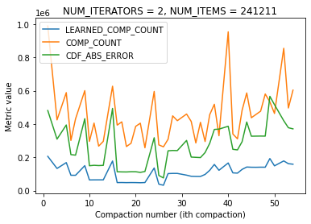
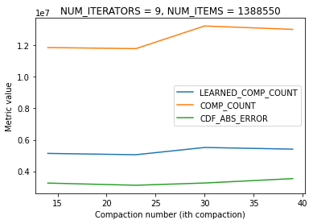
Results - Random Data
Avg comp : 449829
Avg learned comp 109564
Avg error 270471
Avg learned comp + error: 380034
15.515 % reduction in comparisons
Avg comp : 12472910
Avg learned comp 5278190
Avg error 3290664
Avg learned comp + error: 8568854
31.3 % reduction in comparisons
Notes:
Datasets
Zipfian
Random
We generate performance metrics : CompactionSize,
LearnedMergerComparisons, CDFError, DefaultComparisons
and IteratorCount and write it to a csv file for plotting graphs.

Slide 11
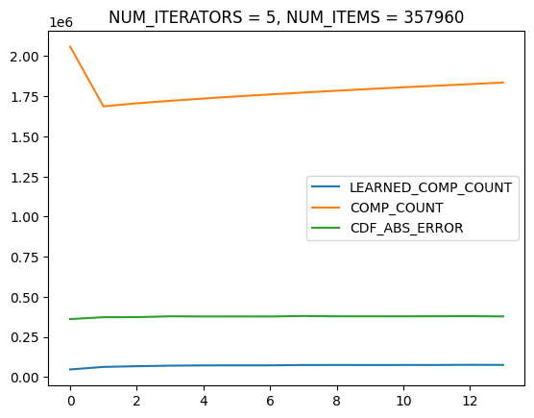
Results - Zipf Distribution
Metric value
Compaction number (ith compaction)
Avg comp : 1789683
Avg learned comp 70452
Avg error 375956
Avg learned comp + error: 446408 75% reduction in comparisons

Slide 12
But… runtime suffers
Implementation | Random Dist | Zipf Dist
Standard | ~55 sec | ~55sec
Learned Merger | ~4m | ~53sec
Our implementation can be better
Lots of conversions from Strings to Integers
Loading all keys to a vector in memory - more RAM + full scan
Need more finer metrics: Time spent in training, adjusting for error
Engineering: Block copy given ranges? Multithreading?

Slide 13
Problems & Further work
Engineering improvements
Finer metrics to help drive engineering improvements
Model improvement
Optimal Gamma - Plot CDF error against PLR Gamma
Try other models (PGM, RMI, RadixSpline, Neural Networks… )
Decision about whether to train or use standard approach

Slide 14
Conclusion
Implemented an approach to reduce the number of comparisons using learned indexes
Far from complete - needs more engineering improvements
Personal Learnings
Unit tests and Documentation are really helpful
Make small changes behind interfaces
Early feedback (office hours) helped a lot

Slide 15
THANK YOU

