Slide 1
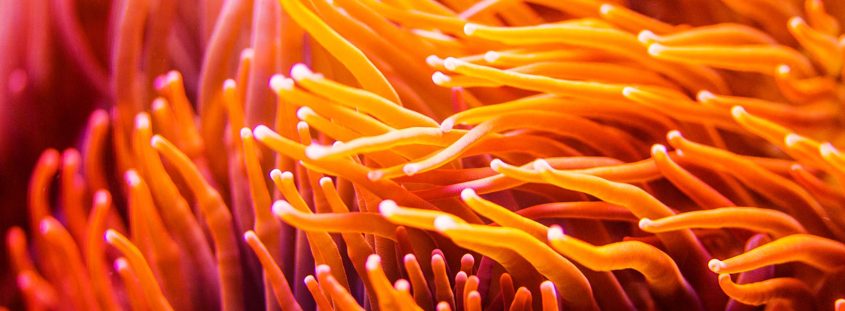
Innovation Research Project
Droidsharks’24

Slide 2
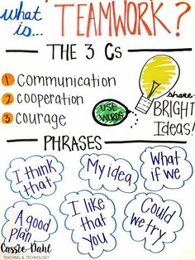
"Alone we can do so little; together we can do so much."

Slide 3
Focus Areas for Innovation
Problem Statement:
Design an autonomous self-powered underwater vehicle with sensors/instruments to address the following challenges:
Power: Power supplies can be unreliable, insufficient, or expensive. How can we solve this ?
https://seatrec.com/technology/
https://www.irena.org
https://theliquidgrid.com/powering-deep-sea-situ-generation/
Communication: How can we relay sensor information back to control center back on land ? Data transmission in aquatic environments can be technically challenging.
https://www.northropgrumman.com/what-we-do/sea/mission-unlimited-inventing-autonomous-recharging-of-unmanned-underwater-vehicles
https://www.media.mit.edu/publications/towards-battery-free-machine-learning-and-inference-in-underwater-environments/
https://www.media.mit.edu/publications/enabling-long-range-underwater-backscatter-via-van-atta-acoustic-networks/
Sensors: What are the sensors we want to mount on the AUV ? (Sonar, PH concentration, Thermal variation detection, can we predict volcanoes, earthquakes and Tsunamis better or map the sea floor or search for minerals etc ?)
Any additional instruments we can add to the UAV to help in cleanup, pollution measurements or detection/classification of marine life forms ?
Which areas in the ocean can we explore: https://www.sciencefocus.com/planet-earth/10-of-the-most-mysterious-places-in-the-oceans ?

Slide 4
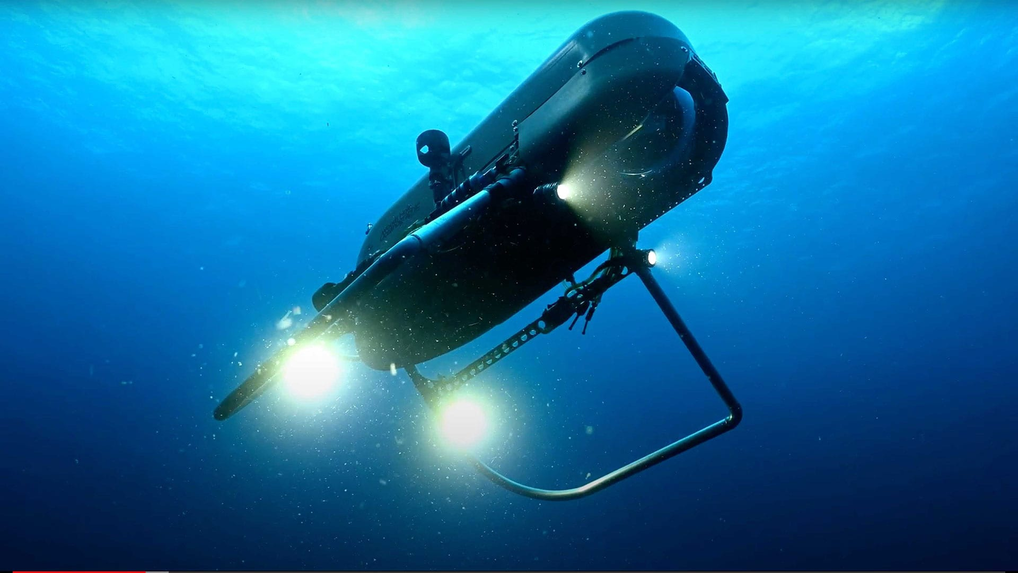
Overview: Autonomous Underwater vehicles (AUV)
Vehicles that perform underwater tasks without a tether or line to a surface ship
Carry instruments & sensors to monitor or inspect or perform activities (sample collection, cleaning etc) in underwater environments
UAV reading:
https://github.com/droidsharks2024/ResearchProject/blob/main/UAV/UAV_Basics.pdf
Example: Orpheus, i2MAP (MBARI):
Orpheus: https://www.whoi.edu/what-we-do/explore/underwater-vehicles/auvs/orpheus/
i2MAP: https://www.mbari.org/technology/i2map/

Slide 5
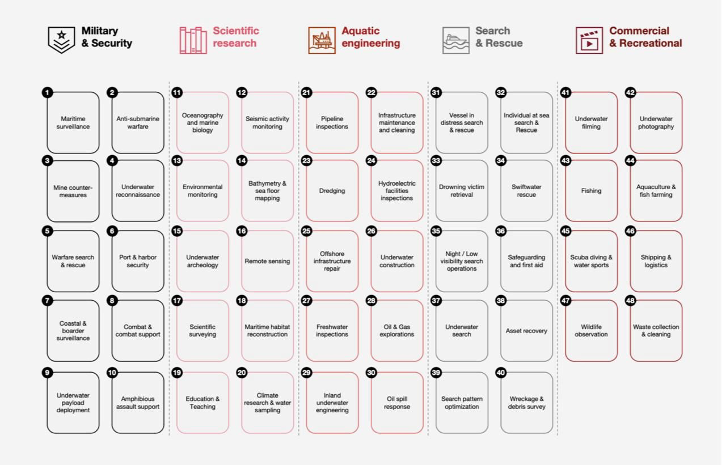
Focus Areas for Sensors & Instruments

Slide 6
Financial and Commercial Feasibility
Reference:
https://github.com/droidsharks2024/ResearchProject/blob/main/UAV/PWC-sea-drones-report.pdf

Slide 7
References
Droidsharks git: https://github.com/droidsharks2024/ResearchProject/tree/main/UAV
Good starting point (Monterey Bay): https://www.mbari.org/education/more-resources/science-at-home/
MBARI events: https://www.mbari.org/about/events/
https://www.sciencefocus.com/planet-earth/10-of-the-most-mysterious-places-in-the-oceans
https://www.asme.org/topics-resources/content/the-design-challenges-of-deep-ocean-engineering
https://www.asme.org/topics-resources/content/advances-in-underwater-robots
ROV JSON: https://ndsf.whoi.edu/data/data-deliverables-summary-for-rov-jason/

Slide 8
Project Completion Tasks
Problem Statement
Project Plan: Research and design
Create: Build a prototype or architectural design
Iterate: Discuss and refine design/prototype
Communicate: What is the final goal of the project ? What is the impact on others/world ?
“TeamWork” “TeamWork” “TeamWork”

