Slide 1
Chapter 10 Characters, C-Strings, and More about the string class
Starting Out with C++ from Control Structures through Objects, Tony Gaddis, 9th Edition
ENGR 1400 – Dr. Michael E. Olson

Slide 2
10.1
Character Testing

Slide 3
Character Testing
Requires cctype header file
FUNCTION | MEANING
isalpha | true if arg. is a letter, false otherwise
isalnum | true if arg. is a letter or digit, false otherwise
isdigit | true if arg. is a digit 0-9, false otherwise
islower | true if arg. is lowercase letter, false otherwise
isprint | true if arg. is a printable character, false otherwise
ispunct | true if arg. is a punctuation character, false otherwise
isupper | true if arg. is an uppercase letter, false otherwise
isspace | true if arg. is a whitespace character, false otherwise
Pr10-1.cpp
Pr10-2.cpp

Slide 4
10.2
Character Case Conversion

Slide 5
Character Case Conversion
Require cctype header file
Functions:
toupper: if char argument is lowercase letter, return uppercase equivalent; otherwise, return input unchanged
char ch1 = 'H'; char ch2 = 'e'; char ch3 = '!';
cout << toupper(ch1); // displays 'H'
cout << toupper(ch2); // displays 'E'
cout << toupper(ch3); // displays '!'

Slide 6
Character Case Conversion
Functions:
tolower: if char argument is uppercase letter, return lowercase equivalent; otherwise, return input unchanged
char ch1 = 'H'; char ch2 = 'e'; char ch3 = '!';
cout << tolower(ch1); // displays 'h'
cout << tolower(ch2); // displays 'e'
cout << tolower(ch3); // displays '!'
Pr10-3.cpp

Slide 7
10.3
C-Strings

Slide 8
C-Strings
C-string: sequence of characters stored in adjacent memory locations and terminated by NULL character
String literal (string constant): sequence of characters enclosed in double quotes " " : "Hi there!"
H
i
t
h
e
r
e
!
\0

Slide 9
C-Strings
Array of chars can be used to define storage for string: const int SIZE = 20; char city[SIZE];
Leave room for NULL at end
Can enter a value using cin or >>
Input is whitespace-terminated
No check to see if enough space
For input containing whitespace, and to control amount of input, use cin.getline()
Pr10-5.cpp

Slide 10
10.4
Library Functions for Working with C-Strings

Slide 11
Library Functions for Working with C-Strings
Require the cstring header file
Functions take one or more C-strings as arguments. Can use:
C-string name
pointer to C-string
literal string

Slide 12
Library Functions for Working with C-Strings
Functions:
strlen(str): returns length of C-string str
char city[SIZE] = "Missoula";
cout << strlen(city); // prints 8
strcat(str1, str2): appends str2 to the end of str1
char location[SIZE] = "Missoula, ";
char state[3] = "MT";
strcat(location, state);
// location now has "Missoula, MT"

Slide 13
Library Functions for Working with C-Strings
Functions:
strcpy(str1, str2): copies str2 to str1 const int SIZE = 20; char fname[SIZE] = "Maureen", name[SIZE]; strcpy(name, fname);
Note: strcat and strcpy perform no bounds checking to determine if there is enough space in receiving character array to hold the string it is being assigned.

Slide 14
C-string Inside a C-string
Function:
strstr(str1, str2): finds the first occurrence of str2 in str1. Returns a pointer to match, or NULL if no match.
char river[] = "Wabash";
char word[] = "aba";
cout << strstr(state, word);
// displays "abash"

Slide 15
Comparing two C-strings
Function:
strcmp(str1, str2): if the two strings are the same, then it returns 0.
char first[] = “Snow College";
char second[] = “Snow College";
if(strcmp(first, second) == 0)
cout << “Yup! They are the same!” << endl;
Since a true comparison returns 0, we can use the ! operator.
if( !strcmp(first, second) )
cout << “Yup! They are the same!” << endl;

Slide 16
10.5
C-String/Numeric Conversion Functions

Slide 17
C-String/Numeric Conversion Functions
Requires <cstdlib> header file
FUNCTION | PARAMETER | ACTION
atoi | C-string | converts C-string to an int value, returns the value
atol | C-string | converts C-string to a long value, returns the value
atof | C-string | converts C-string to a double value, returns the value
itoa | int,C-string, int | converts 1st int parameter to a C-string, stores it in 2nd parameter. 3rd parameter is base of converted value

Slide 18
C-String/Numeric Conversion Functions
int iNum;
long lNum;
double dNum;
char intChar[10];
iNum = atoi("1234"); // puts 1234 in iNum
lNum = atol("5678"); // puts 5678 in lNum
dNum = atof("35.7"); // puts 35.7 in dNum
itoa(iNum, intChar, 8); // puts the string
// "2322" (base 8 for 1234₁₀) in intChar

Slide 19
C-String/Numeric Conversion Functions - Notes
if C-string contains non-digits, results are undefined
function may return result up to non-digit
function may return 0
itoa does no bounds checking – make sure there is enough space to store the result

Slide 20
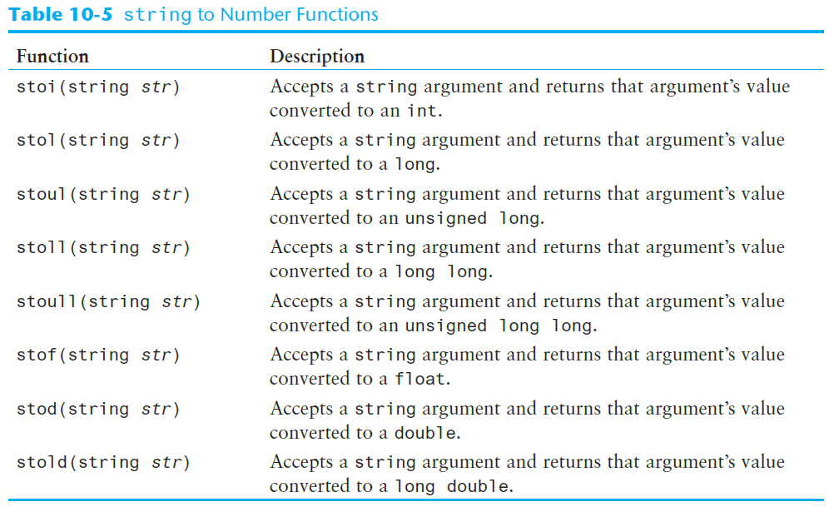
string to Number Conversion

Slide 21
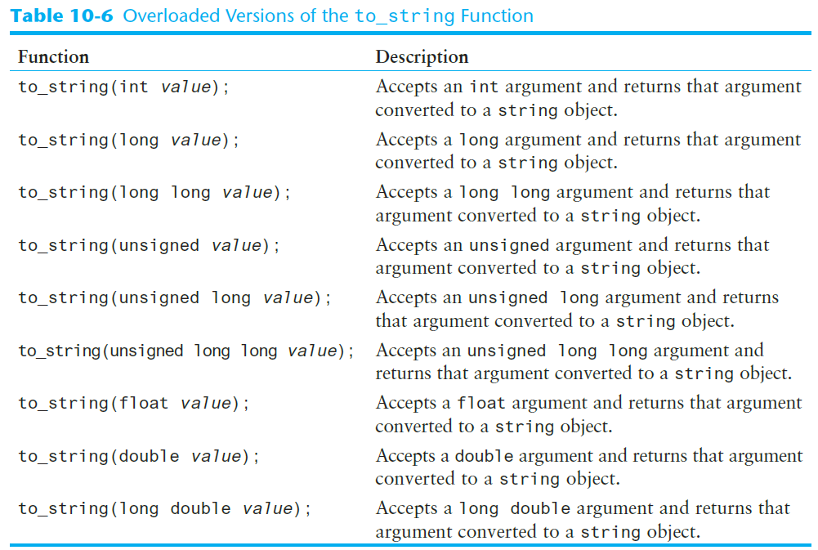
The to_string Function

Slide 22
10.6
Writing Your Own C-String Handling Functions

Slide 23
Writing Your Own C-String Handling Functions
Designing C-String Handling Functions
can pass arrays or pointers to char arrays
Can perform bounds checking to ensure enough space for results
Can anticipate unexpected user input
Can pass C-Strings to a function as arrays or as pointers
Pr10-12.cpp
Pr10-13.cpp

Slide 24
10.7
More About the C++ string Class

Slide 25
The C++ string Class
Special (abstract) data type supports working with strings
#include <string>
Can define string variables in programs:
string firstName, lastName;
Can receive values with assignment operator:
firstName = "George";
lastName = "Washington";
Can be displayed via cout
cout << firstName << " " << lastName;
Pr10-15.cpp

Slide 26
Input into a string Object
Use cin >> to read an item into a string:
string firstName;
cout << "Enter your first name: ";
cin >> firstName;
Pr10-16.cpp

Slide 27
Input into a string Object
Use getline function to put a line of input, possibly including spaces, into a string:
string address;
cout << "Enter your address: ";
getline(cin,address);

Slide 28
string Comparison
Can use relational operators directly to compare string objects:
string str1 = "George",
str2 = "Georgia";
if (str1 < str2)
cout << str1 << " is less than "
<< str2;
Comparison is performed similar to strcmp function. Result is true or false
Pr10-18.cpp

Slide 29
Other Definitions of C++ strings
Definition | Meaning
string name; | defines an empty string object
string myname("Chris"); | defines a string and initializes it
string yourname(myname); | defines a string and initializes it
string aname(myname, 3); | defines a string and initializes it with first 3 characters of myname
string verb(myname,3,2); | defines a string and initializes it with 2 characters from myname starting at position 3
string noname('A', 5); | defines string and initializes it to 5 'A's

Slide 30
Using auto To Define a string Object
The following statement does not define a string object: auto str = "Hello World";
This statement defines str as either const char * or const char[12]

Slide 31
Using auto To Define a string Object
When using the auto key word to define a string object, append the s suffix to the string literal: auto str = "Hello World"s;
This statement defines str as a string object

Slide 32
string Operators
OPERATOR | MEANING
>> | extracts characters from stream up to whitespace, insert into string
<< | inserts string into stream
= | assigns string on right to string object on left
+= | appends string on right to end of contents on left
+ | concatenates two strings
[] | references character in string using array notation
>, >=, <, <=, ==, != | relational operators for string comparison. Return true or false

Slide 33
string Operators
string word1, phrase;
string word2 = " Dog";
cin >> word1; // user enters "Hot Tamale"
// word1 has "Hot"
phrase = word1 + word2; // phrase has
// "Hot Dog"
phrase += " on a bun";
for (int i = 0; i < 16; i++)
cout << phrase[i]; // displays
// "Hot Dog on a bun"
Pr10-20.cpp

Slide 34
string Member Functions
Are behind many overloaded operators
Categories:
assignment: assign, copy, data
modification: append, clear, erase, insert, replace, swap
space management: capacity, empty, length, resize, size
substrings: find, front, back, at, substr
comparison: compare
See Table 10-9 (p. 598) for a list of functions.

Slide 35
string Member Functions
string word1, word2, phrase;
cin >> word1; // word1 is "Hot"
word2.assign(" Dog");
phrase.append(word1);
phrase.append(word2); // phrase has "Hot Dog"
phrase.append(" with mustard relish", 13);
// phrase has "Hot Dog with mustard"
phrase.insert(8, "on a bun ");
cout << phrase << endl; // displays
// "Hot Dog on a bun with mustard"
Pr10-21.cpp

