Slide 1
OMNIKON NATIONAL HACKATHON 2026
VERIFRAME
Verify what you see. Trust what you share.
PROBLEM Omni_CyberTech_4 — Detecting Deepfake and Manipulated Media
THEME Cybersecurity, Blockchain & Digital Trust
Team codeX Dronadri Poornanda Chalam (Team Lead) · Prapul Kumar
Shipped this phase: a real forensic detection engine, JWT + bcrypt auth, a data layer, a FastAPI model service, Docker, CI, and 20 passing tests.
Notes:
We are Team codeX. VERIFRAME is our answer to Omni_CyberTech_4 — detecting deepfake and manipulated media. For Phase 2 we shipped a complete analyst platform plus a real forensic detection engine — Error Level Analysis, EXIF and C2PA checks — running behind a model-agnostic seam. There is no trained ML model yet; that is the last drop-in, and this deck is honest about exactly where that line sits.

Slide 2
01 · PROBLEM STATEMENT
The trust gap in synthetic media
Manipulated media outpaces review — Face swaps, cloned voice and edited video erode public trust faster than anyone can verify by hand.
WHAT ANALYSTS
ACTUALLY NEED
Reviewers work across scattered tools — Fact-checkers and newsrooms lack one forensic workspace for images, video and audio.
Explainable evidence
not an opaque score
Heatmap · EXIF C2PA · audit trail
A human-override
path on every verdict
Detectors decay — New GANs, diffusion models and voice cloners keep appearing; any fixed model goes stale.
Provenance rarely reaches humans — Signals like C2PA exist but are not surfaced where an analyst makes the call.
VERIFRAME · Phase 2 Progress · Team codeX
02 / 13
Notes:
Manipulated media spreads faster than anyone can manually check it, and the people doing that work across scattered tools. Any single detection model also goes stale as generators evolve, so the platform around the model matters as much as the model. VERIFRAME is an explainable review workspace: every verdict traces back to a concrete computation on the file, and the provenance panel surfaces a real C2PA probe result.

Slide 3
02 · PROGRESS MADE
The platform is built and running
17-page React 18 + TypeScript + Vite + Tailwind SPA, fully routed
SOC dashboard shell: Navbar, Sidebar, Footer, recharts analytics
Express 4 TypeScript REST API — ~18 endpoints across 6 route groups
Interactive forensic viewers: anomaly heatmap, video timeline, audio waveform
8-table PostgreSQL schema wired via db/migrate.ts + a PgStore backend
Runs with zero external services — local API + in-memory store, no GPU
WHAT SHIPPED, BY COUNT
Pages
17
UI components
10
API endpoints
18
DB tables
8
Passing tests
20
VERIFRAME · Phase 2 Progress · Team codeX
03 / 13
Notes:
The product surface is done and independently verifiable: 17 routed pages, a dashboard shell, a REST API, and interactive evidence viewers. The eight-table Postgres schema is now wired through a migration runner and a PgStore backend, used whenever DATABASE_URL is set, with the in-memory store as the zero-config default. The demo needs only the local Express API, the forensic analyzer, and the in-memory store — no database, no GPU.

Slide 4
03 · PROGRESS MADE
A real forensic engine behind one seam
One MediaAnalyzer interface isolates the whole engine
analyze(input) → Promise<AnalysisCase> — one env-selected injection point
Default engine reads bytes: ELA heatmap · noise stats · EXIF · C2PA probe
Real signal, no ML model — output labelled modelVersion "forensic-v1-noml"
Weighted aggregation → verdict, authenticity score, manipulation probability
Switching to the model service is one env flip: ANALYZER=pytorch
analyzeController → build(ANALYZER)
MediaAnalyzer · analyze() → AnalysisCase
Forensic
(default)
PyTorch
→ FastAPI
Mock
(demo only)
Forensic engine computes signal from the file itself — no model is trained, loaded, or called. A trained model is the third plug.
VERIFRAME · Phase 2 Progress · Team codeX
04 / 13
Notes:
This is the technical centrepiece. All detection logic sits behind one TypeScript interface with three interchangeable implementations chosen by a single environment variable. The default, ForensicMediaAnalyzer, reads the media bytes and computes real signal: an Error Level Analysis residual heatmap via sharp, EXIF inconsistency and generative-tool flags via exifr, and a C2PA manifest probe — combined with explicit weighted arithmetic into a manipulation probability and verdict. It trains, loads and invokes no model; the code labels its own output forensic-v1-noml. The filename mock still exists, but only as ANALYZER=mock.

Slide 5
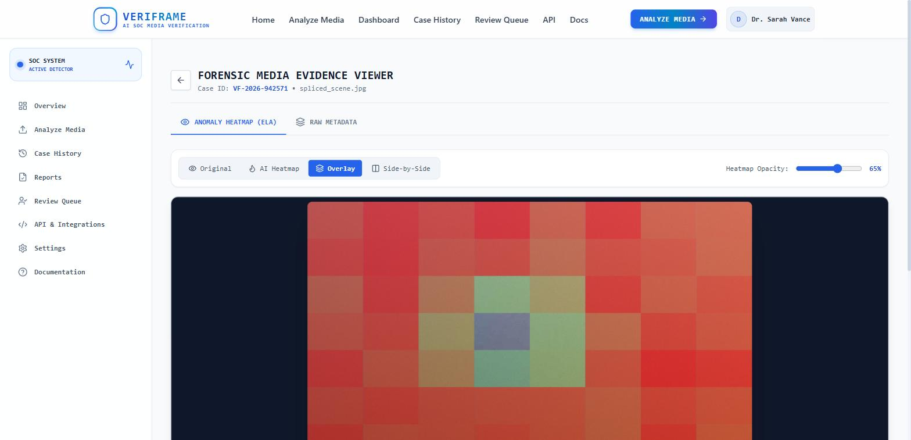
04 · FEATURES IMPLEMENTED
Frontend surface — 17 pages
Landing, Login, Register, Dashboard, Analyze, Processing, Results
Evidence viewer, Case History, Case Detail, Provenance, Reports
Human Review Queue, API Docs, Settings, Help & Learn, 404
Drag-drop upload or URL input, plus three one-click demo samples
Recharts dashboard: KPI cards, 7-day trend, verdict-distribution donut
Heatmap canvas: original / heatmap / overlay / split + opacity slider
Evidence viewer — real 8×8 ELA residual grid over the uploaded file
Heatmap is computed from pixels by sharp — not model gradients. Video/audio viewers are real UI, single anomaly marker pending the model service.
VERIFRAME · Phase 2 Progress · Team codeX
05 / 13
Notes:
The frontend is a complete 17-page SPA with client-side routing and a dashboard-shell layout. The heatmap canvas has four view modes and an opacity slider; for images it now renders a real 8x8 Error Level Analysis residual grid computed from the pixels by sharp, not model gradients. The video timeline and audio waveform viewers are real UI but currently show a single container/metadata anomaly marker pending the model service.

Slide 6
05 · FEATURES IMPLEMENTED
API, auth & working end-to-end flows
🔒 Upload / URL
Processing
Results
Evidence
Provenance
Report
Human Review
reviewer override propagates onto the parent case verdict
~18 endpoints: auth · analyze · cases · reviews · reports · stats · keys · health
helmet · CORS origin allowlist · global + per-route rate limits · zod on every body
Multer in-memory uploads capped at MAX_UPLOAD_MB (default 50) + mime allowlist
analyze and every mutation require a Bearer token; read paths use optional auth
Store interface: MemoryStore by default, PgStore when DATABASE_URL is set
VERIFRAME · Phase 2 Progress · Team codeX
06 / 13
Notes:
The Express API exposes roughly 18 endpoints and is hardened: helmet, a CORS origin allowlist, x-powered-by disabled, a 1 MB JSON cap, a global rate limit plus a stricter one on the auth routes, and zod validation on every body. Uploads run through multer with a 50 MB default cap and a media mime allowlist. The end-to-end flow works: analyze media, walk evidence and provenance, send to review, override the verdict and see it reflected on the parent case. State is in-memory by default and resets on restart; set DATABASE_URL and the same Store interface runs on Postgres via the migration runner.

Slide 7
06 · TECHNICAL ARCHITECTURE
Stack & data layer
React SPA — 17 pages, server-authoritative
Vite 5 dev :3000 · Bearer token · slim offline fallback on read views only
READ THIS AS
The product surface, forensic engine and data layer are real.
Still genuinely absent: ffmpeg, and any trained model weights.
Express REST API :5000
helmet · rate-limit · zod · jsonwebtoken · bcryptjs · x-powered-by off
Forensic engine
sharp (ELA) + exifr (EXIF) + C2PA probe · no PyTorch / ONNX in Node
Store interface
MemoryStore (default, resets) | PgStore when DATABASE_URL set
PostgreSQL · schema.sql + migrations
applied by db/migrate.ts, backs PgStore · 8 tables
FastAPI ai-engine :8000
freq-heuristic-v1 today · trained torch/timm backend = MODEL_WEIGHTS drop-in
VERIFRAME · Phase 2 Progress · Team codeX
07 / 13
Notes:
The Node backend now carries real dependencies: bcryptjs and jsonwebtoken for auth, helmet and express-rate-limit for hardening, zod for validation, sharp and exifr for the forensic engine, and pg for the optional Postgres store. There is no PyTorch or ONNX in the Node process by design; inference lives in a separate Python service. The schema and its migrations are applied by a migration runner and back the PgStore. What is still genuinely absent is ffmpeg and any trained model weights.

Slide 8
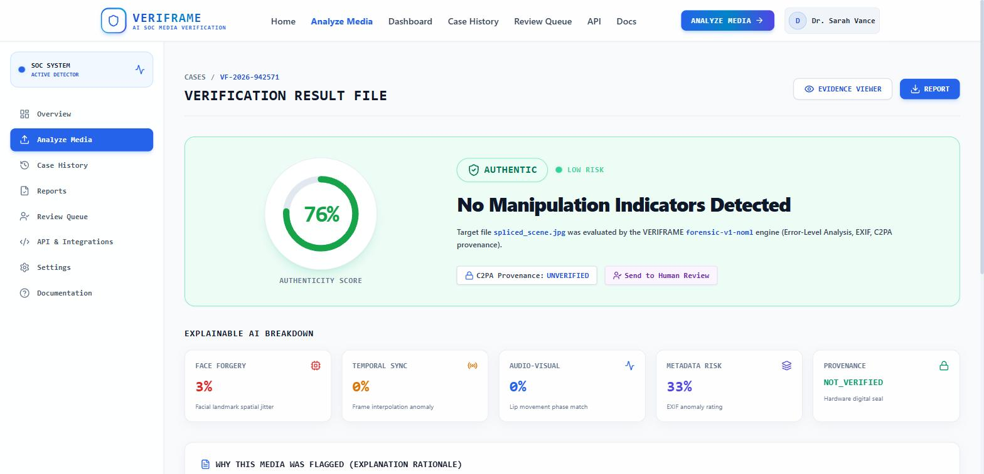
07 · TECHNICAL ARCHITECTURE
The model seam & inference service
services/analysisEngine/index.ts build() switches on ANALYZER
ForensicMediaAnalyzer default — ELA, noise stats, EXIF, C2PA byte-marker probe
C2PA: optional c2pa-node does crypto verify; default is a JUMBF marker scan
PyTorchMediaAnalyzer built — POSTs to FastAPI, falls back to forensic on failure
FastAPI ai-engine runs today: freq-heuristic-v1, a 2-D power-spectrum check
Trained torch/timm backend is a MODEL_WEIGHTS drop-in — no weights in repo
Live forensic verdict — engine tag "forensic-v1-noml", C2PA UNVERIFIED
Every score on this page traces to a computation on the uploaded file.
VERIFRAME · Phase 2 Progress · Team codeX
08 / 13
Notes:
The single coupling point is a build() switch on one environment variable. The default forensic engine reads bytes and computes real signal; for C2PA it tries an optional native library for cryptographic manifest validation and otherwise scans container bytes for the JUMBF marker, reporting 'present but not verified' honestly. The PyTorch client is already written: it calls a FastAPI service and transparently falls back to the forensic engine if that service is down. The service runs today with freq-heuristic-v1, a deliberately conservative 2-D power-spectrum heuristic — real signal with no training. A trained EfficientNet backend loads automatically once MODEL_WEIGHTS points to a checkpoint; none ships in the repo.

Slide 9
08 · CHALLENGES FACED
Build challenges & deliberate trade-offs
Scope
Scoping 17 SOC-grade pages + bespoke forensic viewers in hackathon time
Contract
One analyzer contract covering image, video & audio before any model existed
No-ML engine
Writing a real forensic engine that fills the same contract a model will
Client
Making the client server-authoritative while read views stay resilient offline
Deferred
Trained face-forgery / voice models + ffmpeg frame & audio extraction
The core problem: defining the AnalysisCase contract for all three modalities before a model existed, then writing a real engine to fill it.
VERIFRAME · Phase 2 Progress · Team codeX
09 / 13
Notes:
The hardest build problem was defining the AnalysisCase contract well enough to cover all three modalities before we had a model to shape it — then writing a real forensic engine that fills that same contract. Moving the client to be server-authoritative, with a Bearer token and one request helper, while keeping read-only views resilient to a missing API, took care. What we consciously left for later is narrow: trained models, and ffmpeg-based video-frame and audio extraction.

Slide 10
09 · CHALLENGES FACED
Domain risk we design around
Model staleness
New GANs & voice cloners outpace any fixed detector
MITIGATION Continual retraining loop from reviewer overrides
Compute cost
Real-time video inference is GPU-heavy vs. latency goals
MITIGATION Lightweight edge triage pass before deep model
False positives
Flagging authentic media is reputationally costly
MITIGATION Ensemble + provenance; review-required thresholds
Language bias
Lip-sync & synthetic-voice cues carry dialect bias
MITIGATION Human-in-the-loop queue for borderline calls
Heuristic recall
Forensic heuristic, not ML — bounded on high-quality fakes
MITIGATION Trained model behind the same seam (Phase 3)
VERIFRAME · Phase 2 Progress · Team codeX
10 / 13
Notes:
Beyond the build, deepfake detection carries structural risks we designed around. Detectors decay, so we need a retraining loop; full-video inference is expensive, so we plan an edge triage pass; and false positives erode trust, which is why the human review queue and review-required thresholds exist. We are also clear-eyed that the current engine is a deliberately conservative forensic heuristic, so recall on high-quality generative fakes is bounded until a trained model lands.

Slide 11
10 · FUTURE ROADMAP
Fill the model slot — the seam is already wired
1
Train & serve real model weights behind the existing FastAPI service
2
Face-forgery CNNs + synthetic-voice models; keep the forensic fallback
3
Bundle c2pa-node for default crypto C2PA; add ffmpeg frame & audio extraction
4
Model-gradient heatmaps + real per-frame / per-timestamp anomaly scores
5
Persist users & API keys in Postgres — bcrypt + JWT are already live
6
Feed Human Review Queue overrides into a continual retraining dataset
Every handoff point already exists: FastAPI running, PyTorch client built, ANALYZER=pytorch flip ready.
VERIFRAME · Phase 2 Progress · Team codeX
11 / 13
Notes:
The roadmap is concrete because it is anchored to code that already exists. The Python service, the PyTorch client and the ANALYZER=pytorch flip are all built; step one is training and serving real weights behind that service, evaluated on FaceForensics++, DFDC and Celeb-DF with published precision and recall. From there: bundle the C2PA native library by default, add ffmpeg extraction so video and audio get real per-frame analysis, add gradient-based heatmaps, persist the currently in-memory user store to Postgres, and close a retraining loop fed by reviewer overrides.

Slide 12
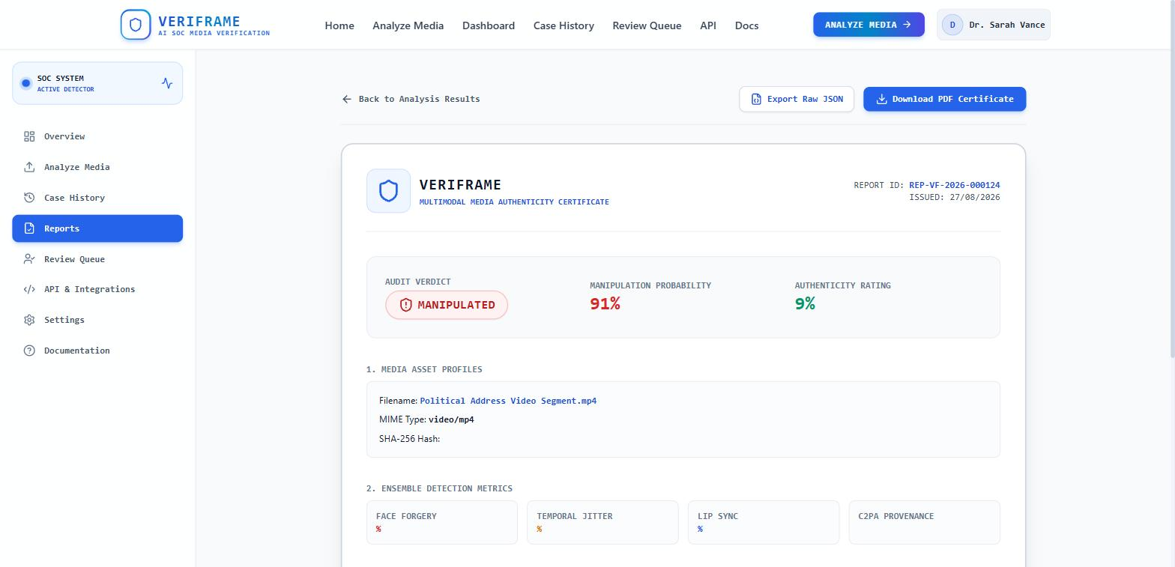
11 · SCREENSHOTS & LIVE DEMO
A fresh upload returns a real verdict
Results — real forensic verdict + breakdown
Evidence — real 8×8 ELA heatmap
Report — export JSON / print PDF
Demo runs on the local Express API — ANALYZER=forensic, in-memory store, no GPU
Landing → Analyze → 7-stage processing → Results verdict banner
A fresh file upload returns a real score from ELA, noise stats, EXIF, C2PA probe
Provenance panel is driven by a real C2PA probe + EXIF on the uploaded file
Review queue + Reports: verdict override, export JSON, print PDF
The three 1-click samples + dashboard KPIs are fixtures — flagged on screen
VERIFRAME · Phase 2 Progress · Team codeX
12 / 13
Notes:
For the live demo we run the local Express API with the forensic analyzer and in-memory store — no GPU, no database. The three one-click samples open seeded fixture cases, so those keep their fixed numbers, but a fresh file upload now returns a real forensic score and verdict from ELA, noise statistics, EXIF and the C2PA probe. We walk the seven-stage processing animation, open the evidence viewer and toggle the heatmap modes, check the provenance panel, override a verdict in the review queue, and export a report. The dashboard KPI tiles remain placeholder fixtures and we call that out on screen.

Slide 13
WHERE VERIFRAME STANDS
The platform, the forensic engine and the model seam all work today.
Default analyzer is real forensic signal — ELA, noise, EXIF, C2PA — no ML.
Trained model is the last drop-in; nothing above the seam changes.
Handoff is live-wired: FastAPI running, PyTorch client built, env flip ready.
Hardened: JWT/bcrypt auth, rate limiting, data layer, Docker, CI, 20 tests.
No accuracy figures claimed — benchmarking on FF++ / DFDC / Celeb-DF is Phase 3.
TRAINED
WEIGHTS
DROP IN
HERE
VERIFRAME · Team codeX · Omnikon National Hackathon 2026 · Omni_CyberTech_4
Notes:
The Phase 2 message is straightforward. We have a working forensic-analysis and case-management platform: every number an analyst sees traces to a concrete computation on the file itself, and the UI surfaces that reasoning chain instead of a black-box score. All detection logic sits behind one interface with an env-selected implementation, so a trained model drops in without touching the API, client, storage or review workflow — the integration cost is already paid. The honest gaps are stated in the product's own output: no trained model in the default engine, video and audio limited to metadata and provenance, and no accuracy figures claimed. Phase 3 is training and evaluating that model against public benchmarks — against a platform already built to receive it.

