Slide 1



Emotional AI: ChatGPT vs Gemini Empathic
Google unveiled “Gemini” a competition to ChatGPT AI

Slide 2
Content
Introduction
Research Questions
Research Goals
Problem Statement
Data Collection
Research Design
Statistical Analysis
Exploratory Data Analysis
Approach
Comparative Study
Limitations
Conclusion

Slide 3

Introduction
1. Comprehending Emotional Intelligence:
Two cutting-edge AI models that are well known for their ability to interpret natural language are ChatGPT and Gemini. Their capacity to comprehend and express emotions, however, is still unknown.
2. Assessing Expression of Emotions:
The challenge of emotional comprehension inside AI systems is addressed by a comparison of ChatGPT and Gemini to reword neutral sentences to six distinct emotional categories: joy, fear, love, sadness, and surprise. The purpose of this study is to analyze both models' ability to generate strong emotional responses and to measure how empathic they are.
3. The Consequences for AI's Emotional Understanding:
This comparative investigation provides insights into the state-of-the-art in AI emotional comprehension and has important implications for the development of empathetic AI technology. The study intends to further the discussion on artificial intelligence's emotional intelligence and pave the way for the development of more sympathetic and perceptive AI systems.

Slide 4

Research Questions
Key Questions
The project aims to address critical topics like how much ChatGPT and Gemini classify neutral comments into distinct emotional categories and how these two AI models differ in their ability to express emotions. The study also intends to investigate the consequences of AI's comprehension of emotions in human-computer and other domain interactions.
Advancing AI Emotional Comprehension
By investigating these problems, the study intends to further the discussion on artificial intelligence's emotional intelligence and pave the way for the development of more sympathetic and perceptive AI systems..

Slide 5

Research Goals
The study attempts to evaluate ChatGPT and Gemini's empathetic reaction and emotion recognition accuracy. To analyze the overall empathy capacities of Gemini and ChatGPT, it also focuses on assessing empathy metrics, parallel emotional responding, and empathy comparison analysis.

Slide 6

Problem Statement
Emotional Recognition and Reaction
Main Issue :
The study aims to figure out how effectively each chatbot, ChatGPT and Gemini, can recognize and react to six different categories of emotions that users may express in their inquiries. The recognized emotions include joy, sorrow, surprise, fear, rage, and disgust.
Assessing Empathic Qualities :
The main issue is to gauge how empathic ChatGPT and Gemini are in recognizing and reacting to these feelings.

Slide 7
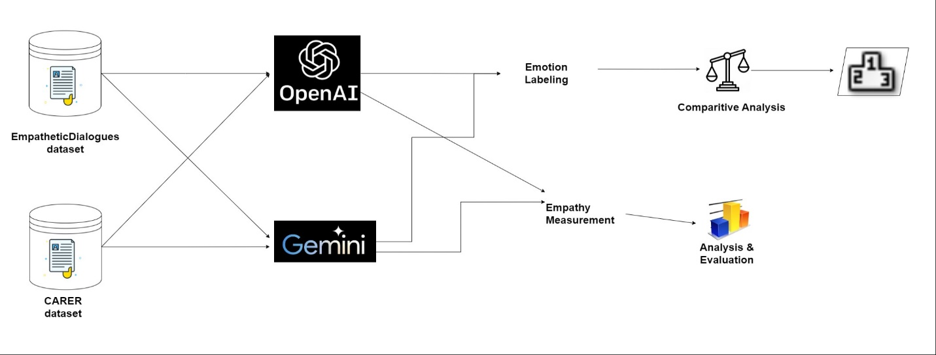
Research Design
Fig: Overall workflow

Slide 8
Data Collection
Dataset :
Empathetic Dialogues: https://paperswithcode.com/dataset/empatheticdialogues
Size of the data : (14725, 8)
After removing duplicates: 3386 rows x 8 columns
CARER (Contextualized Affect Representation for Emotion Recognition) : https://paperswithcode.com/dataset/emotion
Size of the data : (16000, 2)
After removing duplicates: 15933 rows x 2 columns

Slide 9
Statistical Analysis
Empathetic Dialogues:
The mean word count of the text data is approximately 7.62 words per sentence.
The maximum word count in a sentence is 40 words.
The most common words in the text data are: 'got', 'going', 'really', 'get', 'happy', 'last', 'dog', 'time', 'work', 'day’. These words appear frequently in the text data, indicating their importance or relevance.
CARER:
The mean word count of the text data is approximately 9.42 words per sentence.
The maximum word count in a sentence is 37 words.
The most common words in the text data are: ‘feel', ‘feeling', ‘like’, ‘im', ‘really’, know', ‘time', ‘little', ‘get', ‘people’. These words appear frequently in the text data, indicating their importance or relevance.

Slide 10
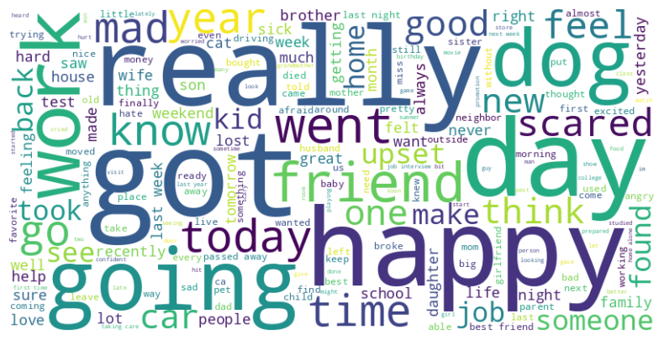
Exploratory DATA ANALYSIS
The word cloud paints a picture of a person navigating the complexities of life, experiencing a range of emotions, cherishing relationships, and reflecting on personal experiences. It suggests a journey with both challenges and joys, losses and hopes, ultimately revealing the richness and depth of human experience.
Fig: Empathetic Dialogues Data Word Cloud
Cont..

Slide 11
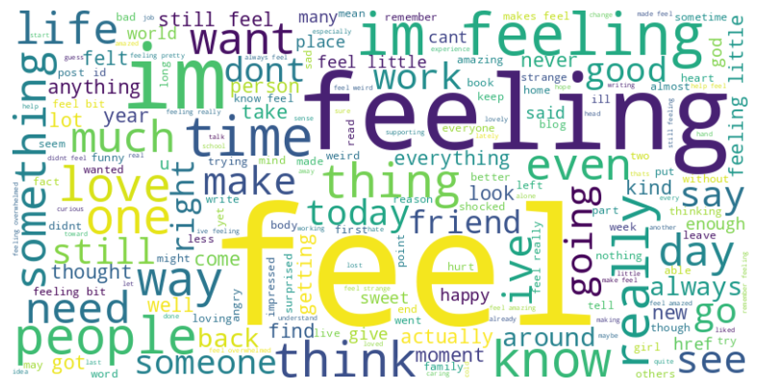
Exploratory DATA ANALYSIS
The word cloud portrays an individual on a journey of self-discovery and emotional exploration. They are navigating a complex world of feelings, seeking connection with others, and striving to understand themselves better. The emphasis on communication and expression suggests a desire to share their experiences and connect with others on a deeper level.
Fig: CARER Data Word Cloud
Cont..

Slide 12

Approach
Randomly select 15 samples from each of the six emotional categories to form 90 records for each iteration, then train and evaluate state-of-the-art AI models like ChatGPT and Gemini to classify neutral statements into these emotional categories iteratively.
Persona Pattern :
To use this pattern, your prompt should make the following fundamental contextual statements:
Act as Persona X
Perform task Y
Ex: Act as a computer that has been the victim of a cyber attack. Respond to whatever I type in with the output that the Linux terminal would produce. Ask me for the first command.

Slide 13
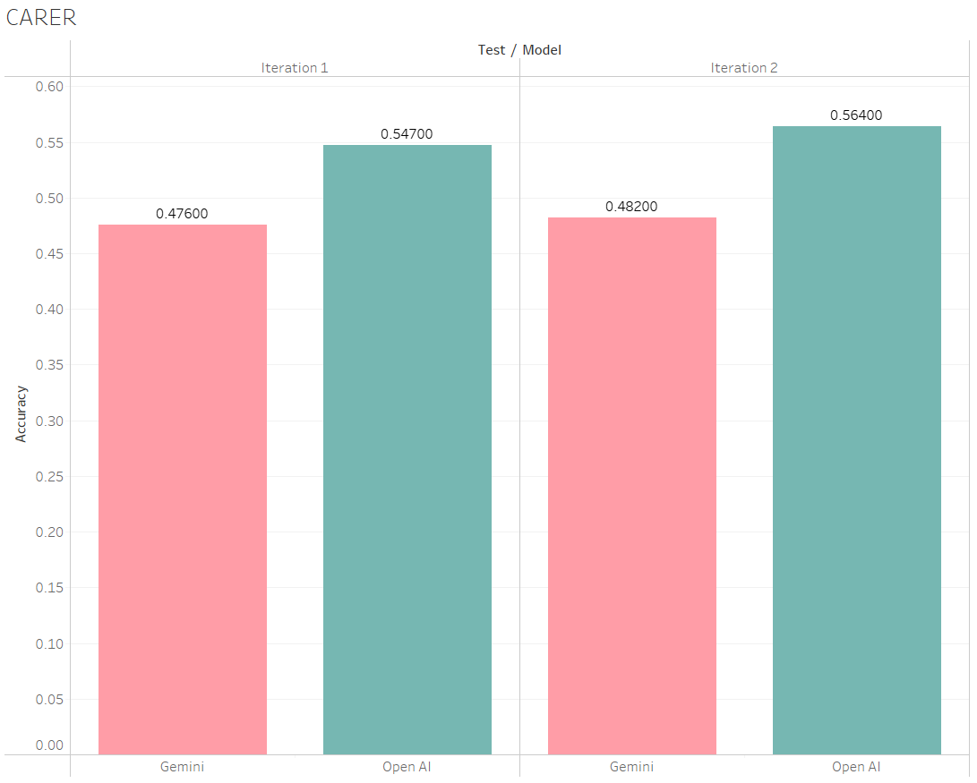

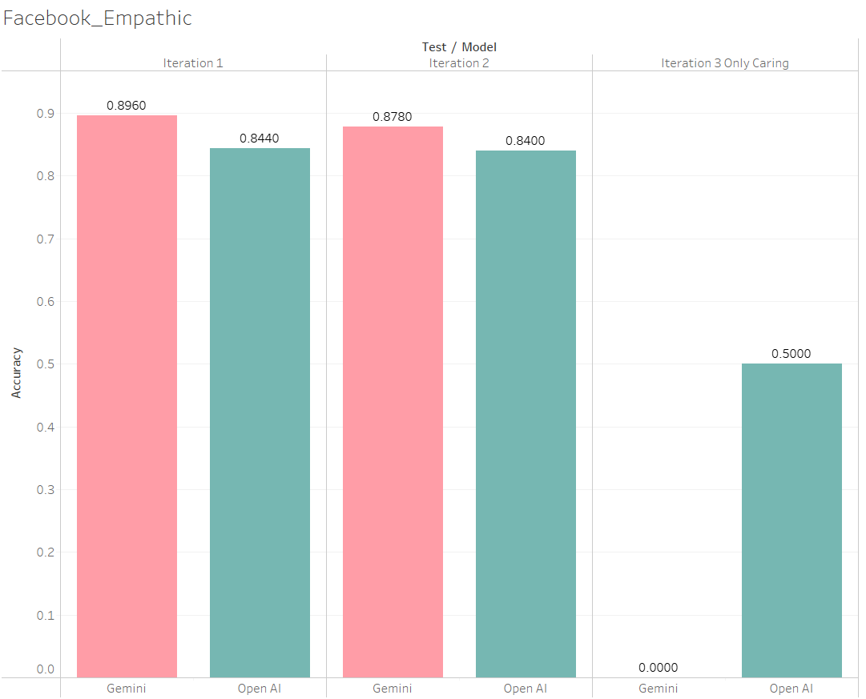
Comparative Study
Fig: Overall CARER Data Accuracy
Fig: Overall Facebook empathic data accuracy

Slide 14

Who WON ? ? GEMINI or CHAT GPT ?

Slide 15
GEMINI VS CHAT GPT: Score Card
 | Chat GPT | GEMINI
Empathetic Dialogues | Accuracy: 0.84 | Accuracy: 0.88
CARER | Accuracy : 0.55 | Accuracy: 0.47

Slide 16

ConfusEd Which one to Pick?

Slide 17
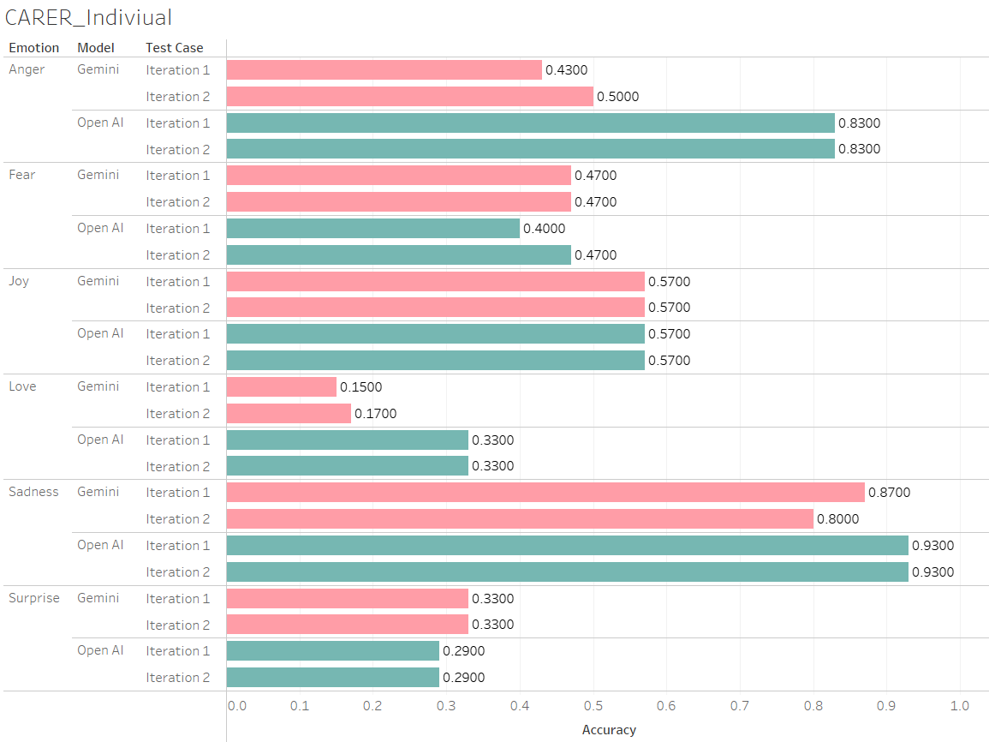
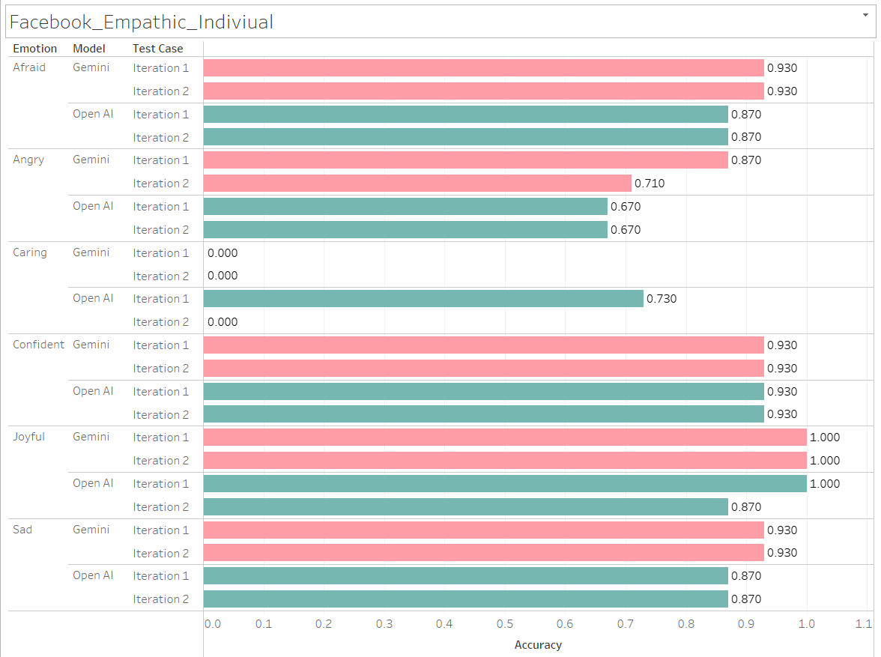
COMPARATIVE STUDY
Fig: Individual Accuracy for emotions Anger, Fear, Joy, Love, Sadness, and Surprise in CARER data.
Fig: Individual Accuracy for emotions Afraid, Angry, Caring, Confident, Joyful, and Sad in Facebook empathic data.

Slide 18
WhICH EMOTIION IS GOOD for GEMINI or CHAT GPT ?

Slide 19

GEMINI VS CHAT GPT: Emotions Score Card
 | Emotions | Chat GPT | Gemini
Empathetic Dialogues | Afraid | 0.87 | 0.93
 | Angry | 0.67 | 0.79
 | Caring | 0.73 | 0
 | Confident | 0.93 | 0.93
 | Joyful | 0.93 | 1
 | Sad | 0.87 | 0.93
CARER | Anger | 0.83 | 0.46
 | Fear | 0.43 | 0.47
 | Joy | 0.57 | 0.57
 | Love | 0.33 | 0.16
 | Sadness | 0.93 | 0.83
 | Surprise | 0.29 | 0.33

Slide 20
Limitations
Open AI Rate Limit Error
Rate Limit Error underscores the importance of understanding and managing the constraints imposed on usage
Gemini limitation with safety ratings
This error indicates that the AI model's response was flagged and blocked due to potential safety concerns.
API Call wait time
Adhering to the 30-second limitation imposed by the Gemini API and OpenAI API is essential for ensuring smooth and uninterrupted access to these valuable resources.

Slide 21
CONCLUSION
The research successfully trained and evaluated ChatGPT and Gemini models on classifying neutral statements into six emotional categories, shedding light on their emotional comprehension capabilities.
Both models showed promising performance, indicating their potential for applications in human-computer interaction.
FUTURE SCOPE
Further refinement of the training process and augmentation of the dataset could enhance the models' accuracy and generalization to diverse emotional expressions.
Extending the research to investigate real-time emotional interaction with users and integrating feedback mechanisms could pave the way for more adaptive and empathetic AI systems in various domains.

Slide 22

Thank You!

