Slide 1
Storage Services for AR Applications
Presented by:
Alex | Sandeep | Venkat | Vikram

Slide 2
Agenda
Background on RTabMap
Bottlenecks and Assumptions
Design and Approach
More on design
Progress
Further work
Demo
Questions?

Slide 3
Background on RTabMap
RTabMap Summary
RGB-D , LIDAR, Graph based SLAM
Loop-closure detection by bag of words
<Have to add more>

Slide 4
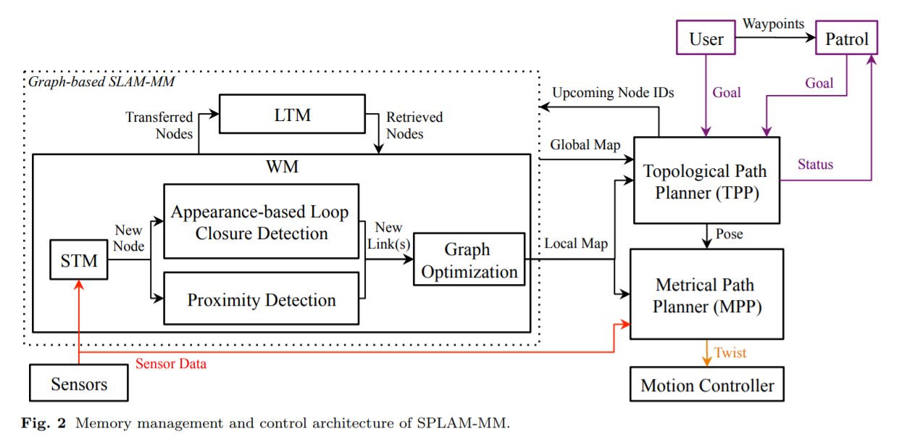
RTabMap: Memory Management

Slide 5
Bottlenecks and Assumptions
Bottlenecks:
Larger captures will result in large db files -> harder to use on thin-clients.
Thin clients cant localize since they cant load large db-files.
Assumptions :
Localization
Localization is done, ie we have co-ordinates of the client position
Client
Has connectivity to the server.
Try to use the Server for compute and storage.
Server
Has enough memory to store the point cloud on memory (or) can store on storage and fetch it back by taking a small hit on performance.
Serves the requests by clients in a state-less fashion.
Notes:
RTabMap:
RGB-D, LIDAR, Graph based SLAM, incremental appearance-based loop closure detector

Slide 6
Design - Approach
We try to solve the solution by a client-server approach
Fetching the Map ( Storage Service):
Client requests the server for a portion of the map and gets it from the point-cloud cache and displays it to the user.
Localization on the Map (Localization Service)
Client requests the server with a set of images and requests the server to localize.
db file
RGB-D Sensors
Ply Viewer
Ply Cache
Db File Cache
RtabMap
Client
Server

Slide 7
Design - Approach
Image
db file
RGB-D Sensors
Ply Viewer
Ply Cache
Db File Cache
1,1,2.ply
Image
1,1,2.ply
RtabMap
Image
1,1,2.ply
Client
Server
Image
Image
Image
1,1,2.ply
1,1,2.ply

Slide 8
More on design
Server Thread on RTabMap
Process the request made by client.
Select the point-cloud of interest from the point cloud cache and send it over to the client.
Point-cloud Cache
Stores the point-cloud of the map in memory for faster lookup.
Client
Performs a request to the Server and fetches the point-cloud.
Can perform a level of caching for better network usage and performance.
db file
Ply Cache
Db File Cache
RtabMap
Server Thread

Slide 9
Progress so far
Server Thread
Server – RTabMap interface.
Server Client interaction.
RTabMap
Export db-file to point-cloud into memory.
Send part of point cloud file to client based on client-position.
Client process
Client - Server interaction.
Client - point cloud viewer integration.

Slide 10
Further work
Aggressive Caching on Client based on client storage/memory.
Opportunistic fetching of areas of interest from the Server.
Compress/Decompress the transmitted ply file to better use the Network (Experiment if this would really improve).

Slide 11
Demo

Slide 12
Questions?

