Slide 1
Storage Services for AR Applications
Presented by:
Alex | Sandeep | Venkat | Vikram

Slide 2
Agenda
Background on RTabMap
Bottlenecks and Assumptions
Design and Approach
More on design
Progress
Further work
Demo
Questions?

Slide 3
Background on RTabMap
RTabMap Summary
Limited on-board capabilities -> robots limit the size of map
Sensor memory, Short-term memory, Working memory, Long-term memory
Contents moved between Working memory and Long-term memory
Loop-closure detection based on bag of words approach
RGB-D , LIDAR, Graph based SLAM
Notes:
A high level overview of RTabMap
RGB-D, LIDAR, Graph based SLAM, incremental appearance-based loop closure detector

Slide 4
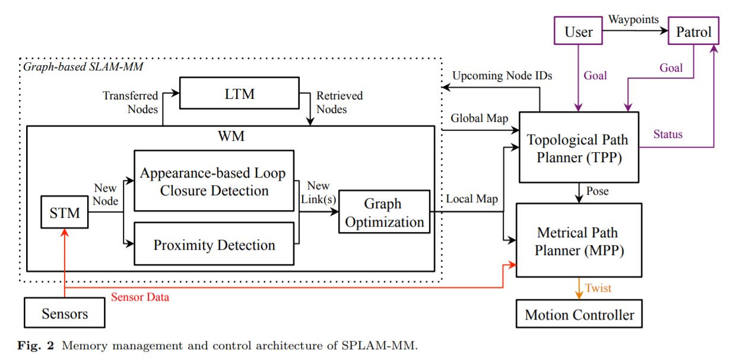
RTabMap: Memory Management
Notes:
Go over STM, WM, LTM to give the picture that we cant have everything on RAM

Slide 5
Bottlenecks and Assumptions
Bottlenecks:
Larger captures will result in large db files -> harder to use on thin-clients.
Thin clients cant localize since they cant load large db-files
Notes:
RTabMap:
RGB-D, LIDAR, Graph based SLAM, incremental appearance-based loop closure detector

Slide 6
Design - Approach
We try to solve the solution by a client-server approach
Fetching the Map (Storage Service):
Client makes a request to the server for a portion of the map, gets it from the point-cloud cache and displays it to the user.
Localization on the Map (Localization Service)
Client requests the server with a set of images and requests the server to localize.
db file
RGB-D Sensors
PLY Viewer
RtabMap
Db File Cache
Client
Server
PCL Cache

Slide 7
Design - Approach
db file
Image
RGB-D Sensors
Ply Viewer
RtabMap
Db File Cache
Image
1,1,2.ply
Image
Client
Server
PCL Cache
Image
Image
Image
x, y
x, y
1,1,2.ply
1,1,2.ply
PCL portion

Slide 8
More on design
Server Thread on RTabMap
Process the request made by client.
Select the point-cloud of interest from the point cloud cache and send it over to the client.
Point-cloud Cache
Stores the point-cloud of the map in memory for faster lookup.
Client
Performs a request to the Server and fetches the point-cloud.
Can perform a level of caching for better network usage and performance.
db file
RtabMap
Db File Cache
Server
PCL Cache

Slide 9
Assumptions
Localization
Localization is done, ie. we have co-ordinates of the client position
Client
Has connectivity to the server.
Try to use the Server for localization and storage.
Server
Has enough memory to store the point cloud on memory (or) can store on storage and fetch it back by taking a small hit on performance.
Serves the requests by clients in a state-less fashion.

Slide 10
Progress so far
RTabMap
Build the main point cloud based on the information from the map DB.
Server Thread
Server – RTabMap interface.
Server Client interaction. Server accepts a request of the form (x, y, radius) from a client and returns portion of the map as point cloud in a binary format.
Client process
Client – Server interaction.
Client – point cloud viewer integration.

Slide 11
Further work
Aggressive Caching on Client based on client storage/memory.
Opportunistic fetching of areas of interest from the Server.
Compress/Decompress the transmitted ply file to better use the Network (Experiment if this would really improve).

Slide 12
Demo

Slide 13
Questions?

