Slide 1


LLM Risk Rankers and Agentic Scaffolding
A case study for Liver Disease Survival Modeling
Dr. Ronny Polle
AI Researcher
GAIN Monthly Webinar
Notes:
HOOK, before the slide: This talk is for you, not about me.
Thank you for having me. Some of you treat patients. Some of you build models. Some of you do both, and some of you do neither. Whichever you are, you will leave with one check that catches a model reading the answers instead of the patient. [PAUSE - 2s] Our story focuses on MASLD—metabolic dysfunction-associated steatotic liver disease. You can think of it as a condition where excess fat builds up in the liver, often linked to diabetes or weight challenges. Our clinical goal was simple to state, but tough to solve: predict which patients will suffer a severe liver event or death. The catch? Patients don't visit the clinic on a neat schedule. Their records are like a book with missing chapters—uneven visits, long gaps, and tests taken at irregular times.
TIME: about 80 s
CHECK BEFORE PRESENTING: Any personal greeting or thanks to the GAIN hosts. If the host can share the rough registrant mix, name it here in place of the four groups.

Slide 2
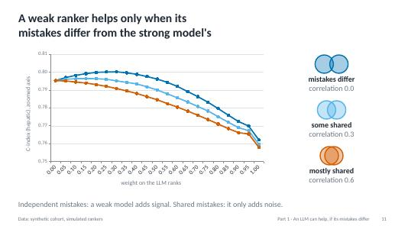
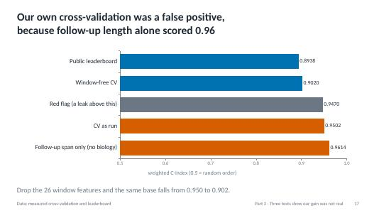
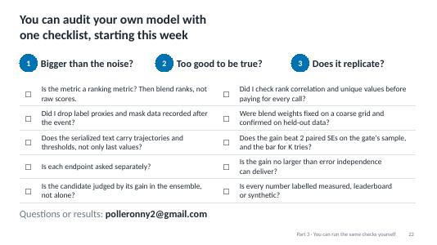
Three questions: can an LLM help,
did ours, and how would you check?
An LLM can help, if its mistakes differ
1
Three tests show our gain was not real
2
You can run the same checks yourself
3
Notes:
HOOK, before the slide: Here is the road we will take.
Three questions today, one per row. First: can a weak language model help a strong one at all? Yes, if its mistakes differ. Second: did ours? Three tests say no. Third: how would you check your own work? That part is yours to take home. [PAUSE - 2s] I will tell you where we are as we go.
TIME: about 40 s

Slide 3


An LLM ranks patients worse alone,
yet seemed to improve our strong model
Tree models
strong ranker
Rank blend
Seemed to improve
Patient record
LLM
weak, but different mistakes
The LLM ranks worse alone, but its errors differ from the tree models'.
Schematic
Notes:
HOOK, before the slide: If you remember one sentence from the opening, make it this one.
The whole talk in one picture, left to right. The tree models read the table of measurements and rank patients well. The LLM reads the same record as text. It ranks worse, but its mistakes differ. Blend the two, and the leaderboard score seemed to improve. [PAUSE - 2s] I will show you why that was plausible, and how a careful repeat of the test overturned it.
TIME: about 45 s

Slide 4
On the leaderboard, a weak LLM
seemed to lift our pipeline to 0.904
Blended at a small rank weight, GPT-OSS gave the pipeline's best public score.
Data: our leaderboard milestones
Notes:
HOOK, before the slide: Here is the number that looked like a win.
The score on this chart is the C-index: 1 means every patient is in the right order, and 0.5 means random order. Blue bars are models alone. Orange bars are blends. Our tabular base alone scored 0.894. GPT-OSS, an open LLM with 120 billion parameters, scored 0.792 alone, far below it. Now look at the last orange bar. Blended in at a small weight, GPT-OSS gave this pipeline's best public score, 0.904. [PAUSE - 2s] A gap of 0.01 looks like progress, even on an axis that starts at random order. That is how it looked to us. Before I go on, a question for the chat. If a colleague showed you this result, what is the first thing you would ask? One line is enough. Type it in the Meet chat now, and I will come back to your answers shortly.
TIME: about 110 s (+30 s for the chat)
CHECK BEFORE PRESENTING: Ask a GAIN host or co-host to watch the Meet chat and read out two or three answers, so you can keep presenting. The chart is drawn from leaderboard.csv, and its title says "leaderboard". Add a personal anecdote here only if it is true.

Slide 5
Because the metric only sees order, we blend ranks, not raw scores
Averaging raw scores lets the wider scale win. Averaging ranks weighs both fairly.
Data: synthetic cohort
Notes:
HOOK, before the slide: The scoring rule decides the method.
The challenge score is 0.7 times the C-index for liver events, plus 0.3 times the C-index for death. The C-index asks of every pair of patients we can compare: did the one with the earlier event get the higher risk? Like a race result, only the finishing order counts, not the times. Four bars, in two pairs. First: a score, and the same score stretched, give the same C-index, 0.7926. Second: average the raw scores, and the LLM's wider scale takes over, 0.7606. Average the ranks instead, and both models count: 0.7884. [PAUSE - 2s] So when the metric only sees order, blend ranks.
TIME: about 60 s

Slide 6
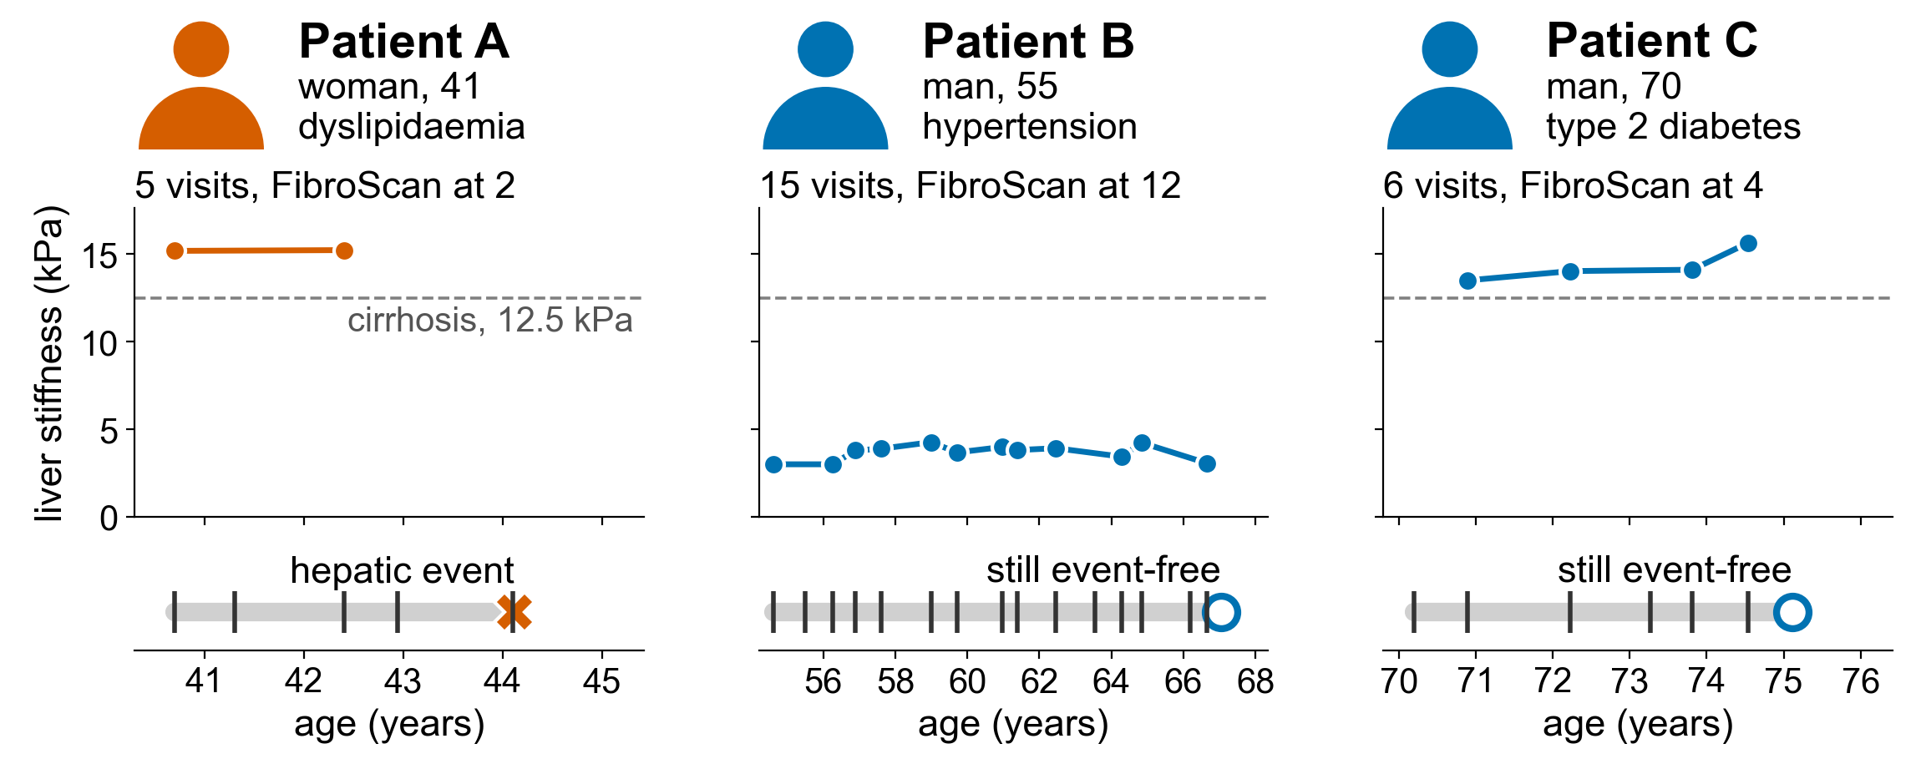
Each patient's record has its own length, gaps and ending
Visits: 5, 15 and 6. FibroScan at 2, 12 and 4 of them. One event.
Data: synthetic patients
Notes:
HOOK, before the slide: Before any model, meet three patients.
Each patient is one row, with up to 22 visits, each with blood tests and liver stiffness, measured by FibroScan. Three synthetic patients, left to right, with the same columns as the real records. Patient A is a woman of 41. She has five visits, and FibroScan at only two of them. Both readings are above the cirrhosis line, where the liver is badly scarred. Then her record ends, because she has a hepatic event, a major liver event. [PAUSE - 2s] Patient B is a man of 55, with fifteen visits over about twelve years and low FibroScan readings at twelve of them. He is still event-free when follow-up ends. Patient C is a man of 70 with six visits. FibroScan at four, all above the cirrhosis line. He is also still event-free at his last visit, and we do not know what happens next. That is right censoring. Patient A's record is the shortest, because the event ended it. So what could a model learn from the length of a record alone? Hold that thought.
TIME: about 100 s

Slide 7
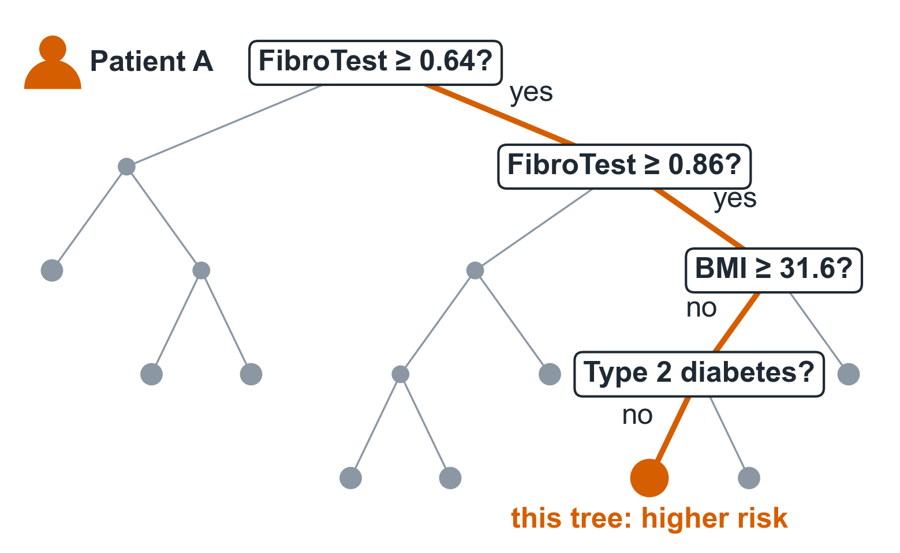

Our tree models read Patient A's record
as hundreds of small yes/no flowcharts
XGBoost
250 trees
CatBoost
250 trees
Rank blend
99%
of 600 test patients rank below Patient A
Each tree asks a few yes/no questions. Added up, hundreds of them rank the patients.
Data: synthetic cohort; the first of 250 XGBoost trees, first-visit features
Notes:
HOOK, before the slide: Before any LLM, see how our strong model reads Patient A.
Our strong model is two boosted tree models, XGBoost and CatBoost. A tree is a flowchart of yes/no questions. Here is the first tree, with Patient A's path. Is her FibroTest above 0.64? Yes. Above 0.86? Yes. Two more questions, and this tree says higher risk. Grey dots are questions she never meets. [PAUSE - 2s] One tree is a weak guess. Boosting adds 250, each correcting the ones before it. CatBoost grows 250 more, and we blend the two by rank. Together, they rank Patient A above 99% of the test patients. This model sees only her first visit. What if it also saw how long her record runs?
TIME: about 65 s
IF YOU RUN LONG: If you run long, skip the CatBoost sentence.

Slide 8
Follow-up stops at the event, so
record length can leak the outcome
A score that sees the whole follow-up window beats the true risk, so it reads the outcome.
Data: synthetic cohort
Notes:
HOOK, before the slide: Patient A's record was short for a reason.
Now the whole synthetic cohort. Two charts. On the left, the number of visits per patient. The orange bars are patients with a hepatic event, and they have fewer visits, because follow-up ends at the event. That is Patient A's story, many times over. So, to my question: the number of visits, and the length of follow-up, quietly encode the outcome. On the right, the same tree models. In synthetic data we know each patient's true risk, and ranking by it scores 0.825. That is the ceiling. The trees you just saw, limited to the first visit, score 0.798, just below it, as an honest model should. A model that sees the whole follow-up window scores 0.920, above the ceiling. A model that beats the truth is reading the answer. In Ghana we have a word for this: apor, the leaked exam paper. [PAUSE - 2s] I am telling you this now because we fell into this trap ourselves, and I will show you how we found out.
TIME: about 95 s
CHECK BEFORE PRESENTING: Keep the apor line only if it suits the room. Listeners from outside Ghana get its meaning from "the leaked exam paper".

Slide 9
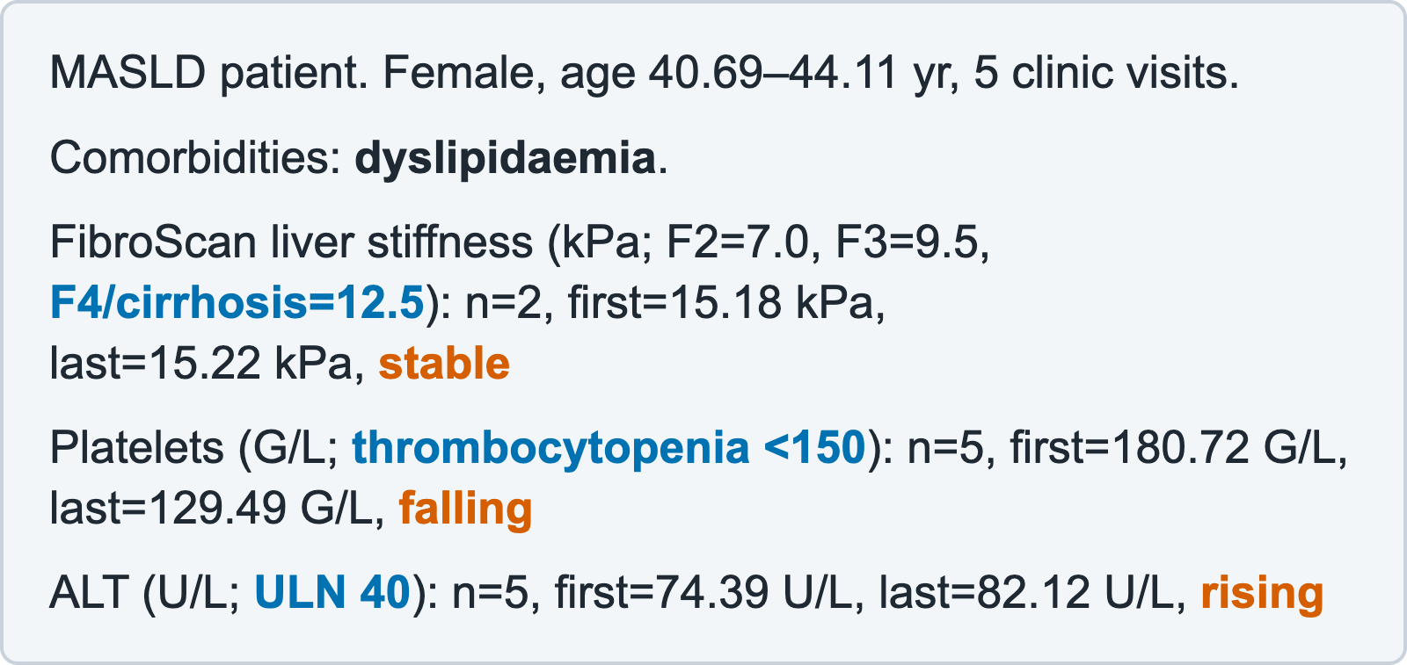
We turn each patient into a clinical
note and ask one question per endpoint
Patient A, as the LLM reads her record
Hepatic prompt
0–100 score
Death prompt
0–100 score
HeLM idea: a language model reads the record as text and returns a risk ranking.
Data: synthetic patient
Notes:
HOOK, before the slide: The model never sees the spreadsheet. It reads a clinical note.
HeLM is a simple idea: give a language model a patient's record as text, and read a risk out of it. It comes from Belyaeva, Cosentino and colleagues, in 2023. On the left is Patient A again, as the model sees her: not a spreadsheet, but a short clinical note. FibroScan reads 15.18, then 15.22: stable. Platelets are falling, and the last value is below the 150 threshold. The note adds direction words, like rising and falling, normal ranges, and her other conditions. On the right, two prompts: one question per endpoint, meaning per outcome. Liver events are driven by fibrosis, the scarring of the liver. Death is driven mostly by age, and by heart and metabolic disease. One combined prompt blurs the two, so each outcome gets its own prompt and its own score from 0 to 100. [PAUSE - 2s] We treat those scores as rankings, never as probabilities. A C-index needs nothing more.
TIME: about 90 s

Slide 10
A fixed harness, not an autonomous
agent, decides what the model may see
Leak guard
Prompt builder
Model call
Retry and rate limits
Score log
Drops follow-up length
One prompt per endpoint
One prompt in, one JSON out
Survives free-tier limits
Saves every score
If the guard were a prompt line:
Prompt: “ignore follow-up length”
Model
still reaches the model
follow-up length
The model picks no tools and no next steps.
Schematic of the harness
Notes:
HOOK, before the slide: Everything except the model call is plain code we wrote.
Follow the top row: guard, prompt, one model call, retry, log. Only the blue box is the model. It sees one prompt and returns one JSON object. The rest is the harness. It decides what the model may see, keeps a long run alive on free API tiers, and saves every score, so a crash costs nothing. It is a fixed pipeline, not an autonomous agent: the model picks no tools and no next steps. [PAUSE - 2s] So put the guards in the harness, not in the prompt. Look at the dashed row: a prompt that says "ignore follow-up length" still contains it. That is like telling a jury to disregard what it just heard. It cannot unhear it. In the top row, the guard drops it before the prompt is written, so the model never sees it. One note on privacy: GPT-OSS ran on Ollama's cloud, so that text left the machine. The data here is synthetic; with real records, that matters.
TIME: about 90 s

Slide 11
A weak ranker helps only when its
mistakes differ from the strong model's
mistakes differ
correlation 0.0
some shared
correlation 0.3
mostly shared
correlation 0.6
Independent mistakes: a weak model adds signal. Shared mistakes: it only adds noise.
Data: synthetic cohort, simulated rankers
Notes:
HOOK, before the slide: A weak model can still earn its place.
Think of a second opinion. It helps only if the second doctor can catch what the first one missed. A ranker is any model that puts patients in order of risk. Take two simulated rankers of the same true risk: a strong tabular one, and a weaker LLM one with about 20 distinct scores, like real LLM scores. We turn one knob: how often they make the same mistakes. Each line is one setting, with its overlap drawn beside it. When the mistakes differ, the line climbs above the base as the LLM gets more weight. When they are shared, it only falls. A second opinion only helps if its mistakes differ. [PAUSE - 2s] So judge a new model by what it adds to the blend, not by its score alone. Judged alone, our LLM would have been thrown away.
TIME: about 80 s

Slide 12
Two cheap checks show early whether
a new ranker is worth its API calls
Lower rank correlation means more new information.
Data: synthetic cohort, simulated rankers
Notes:
HOOK, before the slide: Measure before you spend.
Scoring every patient costs two LLM calls, so test cheaply first. Start with a smoke test on Patients A, B and C: does the prompt run, does the JSON parse, do the scores differ? Then two checks, one per chart. On the left, the Spearman rank correlation: how closely the second opinion agrees with the first. The higher it is, the less the blend gains. On the right, count the distinct scores. Five score levels give only six distinct values, and a ranker with a handful of scores ties most pairs.
TIME: about 55 s
CHECK BEFORE PRESENTING: Decided: score three patients first. Three patients are a smoke test, not an estimate: a Spearman correlation on three patients can only be 1, 0.5, -0.5 or -1. Say "the correlation needs a bigger first batch" if someone asks. In the synthetic demo, score granularity cost little (LLM alone 0.743 at 5 levels, 0.752 at 100), so correlation is the bigger lever.

Slide 13

We submitted the LLM inside a
two-stage rank blend, at a small weight
0.075
EfficientNet-B0
image + tabular
Stage 1
50/50 rank blend
effective weight of the LLM, close to the 0.07 we replicated
GPT-OSS
split-endpoint scores
0.15
Stage 2
rank blend
Final score
Tabular base
10 seeds
0.85
Schematic of the submitted blend
Notes:
HOOK, before the slide: This is what we actually submitted.
This is what we submitted: GPT-OSS blended with an image model, then into our tabular base, by rank both times. So the LLM's effective weight was about 0.075. Small.
TIME: about 25 s

Slide 14
Part 1 recap: why an LLM could help
MASLD prediction starts with irregular records that end at different times.
1
MASLD prediction starts with irregular records that end at different times.
1
When follow-up stops at an event, record length can reveal the outcome.
2
When follow-up stops at an event, record length can reveal the outcome.
2
The harness removes leaked time information before any model sees it.
3
The harness removes leaked time information before any model sees it.
3
A weaker LLM can help only when its ranking errors differ.
4
A weaker LLM can help only when its ranking errors differ.
4
Notes:
HOOK, before the slide: Before we test the apparent win, pause on what Part 1 established.
MASLD records are irregular, and events can shorten them. That makes follow-up length a leak unless the harness removes it before prompting. A weak LLM can still help, but only when its ranking errors differ. Together, this evidence made the small-weight blend plausible. Part 2 tests whether the apparent gain was real.
TIME: about 25 s

Slide 15
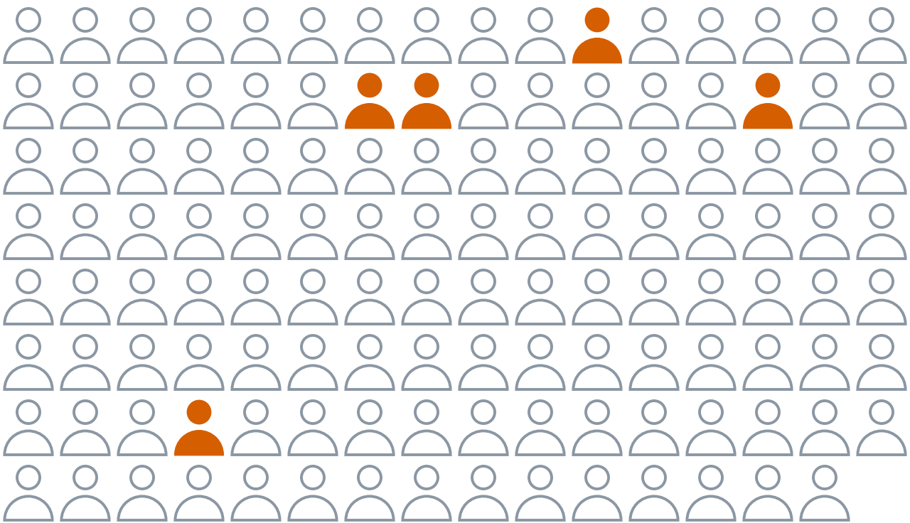
A 127-patient public leaderboard
cannot tell a gain of 0.0056 from noise
Public board: 127 patients
about 5 liver events, expected at the 4% rate
Our gain was one standard error. A credible gain needed two.
Data: simulated from measured event rates; our leaderboard gain
Notes:
HOOK, before the slide: So was the 0.904 real? Let me go back to your question.
Earlier I asked what you would ask first. If you wrote "how big was the test set?" or "how many times did you try?", you were already running test one. If you wrote "was there a leak?", that is test two, and for us it mattered most. We held every change to three tests. Test one: is the gain bigger than the noise? On the left, the public leaderboard: 127 patients, and only about five liver events. Seventy percent of the score rests on how those five are ranked. No one would approve a drug on a trial with five events. On the right, our gain against the gain you would need on each sample. A standard error is the size of a typical chance swing, and a credible gain is two of them, about 0.011 here. Our gain from adding GPT-OSS is the short bar: 0.0056, one standard error. [PAUSE - 2s] Even on the 296 private patients, you would need 0.0059.
TIME: about 105 s (+15 s if you read out chat answers)
NOTE: Why 70%: the score is 0.7 times the hepatic C-index plus 0.3 times the death C-index, and every hepatic pair the C-index can compare includes one of the patients with an event. Five is expected, not observed: 127 times the training rate of 47 in 1,253 is just under five. The public split's own count is hidden.

Slide 16
With 272 tries on one sample, the
best result looks good by chance alone
The best of many tries looks good by construction.
Data: simulated; our leaderboard gain
Notes:
HOOK, before the slide: Noise also grows with how many times you look.
Test one has a second part: how many times did we look? Flip 272 fair coins ten times each. The luckiest coin will almost always land heads at least nine times. It is not a magic coin. It is the best of 272. Leaderboards work the same way. Four bars: our gain on the left, then the best gain that chance alone gives you, as the number of tries goes up. With five tries, it is 0.0100. With thirty, 0.0145. With 272, our scored uploads, it is 0.0186. [PAUSE - 2s] Our gain sits below all three. A benchmark win below the noise floor is not a win.
TIME: about 65 s
NOTE: The coin line: one coin shows 9 or more heads in 10 flips with chance 11 in 1,024, so all 272 miss with chance (1 - 11/1024)^272, about 5%. Submission seven (best public score) moved from the script to the likely questions. data/CHALLENGE_SUBS.md lists 280 uploads, of which 272 were scored (8 scoring errors). Say "scored uploads", not "uploads". The deck line was corrected to match. Submission seven is not the LLM blend, whose final upload scored 0.904 (leaderboard.csv). data/CHALLENGE_SUBS.md gives it the same listed score, 0.93081, as submission_cv_0, uploaded the same day, and no file in the repo says which pipeline made either. If asked, say "a different pipeline, not the LLM blend".

Slide 17
Our gain was bigger than even fully
independent mistakes could deliver
When reality beats the best case, suspect the measurement, not the model.
Data: simulation, and leaderboard gains against the model's prediction
Notes:
HOOK, before the slide: Some gains are too good for the mechanism.
Test two: is the gain too good to be true? Start with the mechanism: how much can a second model add at most? Two charts. On the left, a simulation: with independent mistakes, the best blend gain is about 0.006. At an error correlation of 0.3, about 0.002. At 0.6, nothing. On the right, our two blends. Adding GPT-OSS at weight 0.07, even with fully independent mistakes, should give about 0.0037. We saw 0.0056. [PAUSE - 2s] When reality beats the best case, suspect the measurement, not the model. A score above what is possible is a leak, not a win. Before I show you ours, a prediction for the chat. Picture a model that sees only one thing per patient: the gap between the first and the last visit. No blood tests, no scans. Will it rank patients worse than our whole model, about the same, or better? Type worse, same or better.
TIME: about 110 s (+20 s: wait for the guesses, and have the host read two or three before you click. The next headline gives the answer away)

Slide 18
Our own cross-validation was a false positive,
because follow-up length alone scored 0.96
Drop the 26 window features and the same base falls from 0.950 to 0.902.
Data: measured cross-validation and leaderboard
Notes:
HOOK, before the slide: The leak was not only on the leaderboard. It was in our own CV.
If you typed better, you just found the leak in our pipeline. If you typed worse, that is the sensible guess, and it is wrong. Look at the bottom bar: the gap between the first and last visit, with no biology at all, scored 0.9614. [PAUSE - 2s] That beats our whole model. A model that reads follow-up duration isn't predicting disease. It's reading the label. Patient A's short record is exactly what it reads. How did we get here? Cross-validation, or CV, tests a model on patients it did not train on: split the training data into ten folds, hold one out, train on the rest, and repeat. Our tabular base scored 0.9502 in CV, but 0.8938 on the leaderboard. And 0.9502 is above our red flag, 0.947, the score above which we suspect a leak. So we ran the probe you just predicted. This was our own pipeline and our own mistake. We dropped every feature computed over the follow-up window, 26 in all. The same base, now leak-free, scores 0.9020, below the red flag and within 0.008 of the leaderboard.
TIME: about 100 s

Slide 19
Adding GPT-OSS slightly lowers the leak-free
cross-validation score, so the gain does not replicate
Weight 0.07, fixed in advance: the blend loses in most folds. A synthetic cohort with real signal wins 9.
Data: measured window-free 10-fold CV; synthetic contrast
Notes:
HOOK, before the slide: Test three is replication, and this is the replication that mattered.
Test three, replication: does the gain show up on data the leaderboard never saw? GPT-OSS scored all 1,253 training patients zero-shot, with no examples in the prompt. It saw only what the leak-free base sees: no follow-up length, no visits after the event. The blend weight is 0.07, the one we submitted, fixed in advance. Two charts. On the left, the leak-free CV: base 0.9020, base plus GPT-OSS 0.8999. On the right, the folds. The blend beat the base in just one hepatic fold and two death folds. For contrast, in a synthetic cohort where an LLM does add real signal, the same weight wins nine of ten. A gain you can't replicate isn't a gain. [PAUSE - 2s] One caveat: this is not an exact replay of the leaderboard run. The inputs are stricter, and the base is the tabular model.
TIME: about 80 s

Slide 20
No model or prompt clears the noise,
and the LLMs agree with each other
GPT-OSS, split
Nemotron, joint, reasoning
+0.0010
MedGemma, split
MedGemma, joint
-0.008
-0.004
0
+0.004
blend gain
The LLMs agree with each other: rank correlation about 0.8.
Data: measured window-free 10-fold CV; whiskers span two standard errors
Notes:
HOOK, before the slide: Maybe a better prompt or a stronger model would change the answer.
Four rows, one per model and prompt. Split means one prompt per outcome; joint, one for both. Each dot is what that LLM adds to our base, and each bar spans two standard errors, our bar for a credible gain. The dashed line is zero, and every bar crosses it. [PAUSE - 2s] Reasoning helps the LLM alone: Nemotron 3 Super, which works step by step before it answers, is the strongest, at 0.789. Its dot is the only one right of zero, but its bar still crosses it. And the LLMs agree with each other, at a rank correlation of about 0.8: second opinions from doctors trained in the same school. Swapping one for another changes little. The weak-ranker idea is real. Here, the LLM's mistakes were too close to the base's for it to help.
TIME: about 80 s

Slide 21
Part 2 recap: why the gain did not hold
The 0.0056 public gain was one standard error. With 272 scored uploads, chance mattered more.
1
The 0.0056 public gain was one standard error. With 272 scored uploads, chance mattered more.
1
The observed lift exceeded the best case predicted at the submitted weight.
2
The observed lift exceeded the best case predicted at the submitted weight.
2
Follow-up span alone scored 0.9614, exposing leakage in cross-validation.
3
Follow-up span alone scored 0.9614, exposing leakage in cross-validation.
3
Leak-free CV favored the base: 0.9020 versus 0.8999 for the blend.
4
Leak-free CV favored the base: 0.9020 versus 0.8999 for the blend.
4
Notes:
HOOK, before the slide: The audit changed the conclusion.
The public gain was within noise after many tries. It was larger than the mechanism predicted, follow-up span exposed the leak, and the leak-free blend scored below the base. The apparent win did not hold. The audit changed the conclusion, so Part 3 converts the findings into practical habits.
TIME: about 25 s

Slide 22
The limits mean we report rankings, not
risks, and quote the leak-free 0.902
Limit | What it means
Rankings, not risks | The scores rank patients. They are not risks.
Cost and drift | Two calls per patient. Store raw scores and the model tag.
Quote the leak-free 0.902, not the leaky 0.950.
Data: measured cross-validation and leaderboard
Notes:
HOOK, before the slide: Here is what this result does not show.
Two limits in the table, one in the chart. First, the LLM scores rank patients. They are not risks, and we never report them as risks. Second, two calls per patient cost money, and a hosted model can change under you, so store the raw scores and the model tag with every run. Third, in the chart: our own CV read follow-up length and scored 0.950. The number to quote is the leak-free one, 0.902. [PAUSE - 2s] None of this says LLMs are useless here. It says that here, this one did not help.
TIME: about 60 s

Slide 23
Cheap habits, not big budgets, make
clinical AI results trustworthy
1
Start local
2
Test cheaply
3
Hunt for leaks
35 min
1,253 patients, on a laptop
Three patients first
Span alone beat the whole model
Data: measured run time; synthetic rankers; measured CV
Notes:
HOOK, before the slide: Take one of these home.
One habit per column, each with its evidence beneath it. One: start with a model you can run yourself, and know where your data goes. MedGemma scored all 1,253 patients on a laptop in about 35 minutes, and no record left the machine. To be fair, it ranked poorly here, 0.59 alone, so I am saying it is feasible, not that it is good. Cloud and free endpoints may log prompts, so check the data terms before you send patient records. Two: test cheaply before you pay. Score three patients, then check the rank correlation and the number of distinct scores. Three: look for leaks in your own features first. The gap between the first and last visit alone scored 0.96, above the whole model. Before I click, one question for you: what were the three tests? [PAUSE - 2s]
TIME: about 80 s
CHECK BEFORE PRESENTING: Recheck the 35 minutes before you present. The free-tier quota (about 1,000 requests a day) moved to the likely questions; recheck it too.

Slide 24
You can audit your own model with
one checklist, starting this week
1
Bigger than the noise?
2
Too good to be true?
3
Does it replicate?
☐ | Is the metric a ranking metric? Then blend ranks, not raw scores. | ☐ | Did I check rank correlation and unique values before paying for every call?
☐ | Did I drop label proxies and mask data recorded after the event? | ☐ | Were blend weights fixed on a coarse grid and confirmed on held-out data?
☐ | Does the serialized text carry trajectories and thresholds, not only last values? | ☐ | Does the gain beat 2 paired SEs on the gate's sample, and the bar for K tries?
☐ | Is each endpoint asked separately? | ☐ | Is the gain no larger than error independence can deliver?
☐ | Is the candidate judged by its gain in the ensemble, not alone? | ☐ | Is every number labelled measured, leaderboard or synthetic?
Questions or results: polleronny2@gmail.com
Notes:
HOOK, before the slide: Here are the three tests, and the checklist behind them.
Is the gain bigger than the noise? Is it too good to be true? Does it replicate? You already ask these in your own work. The 120-billion-parameter model gave us the gain that did not replicate. A better check beats a bigger model. [PAUSE - 2s] So, one action each. If you treat patients, ask whoever built the model: what does it score with the dates alone? If you build models, run that probe this week. If you do neither, ask the three questions of the next AI headline you read. Whichever you choose: if the result survives, you have earned the right to trust it. If it does not, you have caught something before it reached a paper or a patient. If you try it, I would love to hear what you find. My email is polleronny2 at gmail dot com, and it is on the slide. I will paste the link to the repo, with the code and the checklist, in the chat. Thank you. I will take your questions.
TIME: about 95 s
NOTE: Keep this slide up during the questions.
CHECK BEFORE PRESENTING: Paste the repo link into the Meet chat as you close. The deck has a hidden placeholder for the link: add it after you push, if you also want it on the slide.

Slide 25
Without the leak, XGBoost alone looks better
than the 50/50 blend, but not credibly
Fold mean +0.0155 ± 0.0056 (2.8 SE) clears the bar. The patient bootstrap +0.0103 ± 0.0070 (1.5 SE) does not.
Data: measured cross-validation
Notes:
BACKUP, for Q&A. The leaky CV approved the 50/50 XGBoost and CatBoost blend on a margin of 0.0008. Window-free, XGBoost alone looks better: fold mean +0.0155 ± 0.0056 (2.8 SE), patient bootstrap +0.0103 ± 0.0070 (1.5 SE), and XGBoost beats the blend in 6 of 10 hepatic and 5 of 10 death folds. We chose the comparison after seeing the scores. Suggestive, not credible.

Slide 26
The same checks apply wherever a strong
base meets a weaker candidate ranker
Setting | Strong base | Candidate ranker | Combine by
Clinical survival (this talk) | gradient-boosted AFT | LLM reading a clinical summary | rank blend
Credit or churn risk | boosted trees on tabular data | LLM over notes or transcripts | rank blend
Search and retrieval | a learned ranker | an LLM relevance judge | reciprocal rank fusion
Triage and alerting | rules and thresholds | an LLM reading free-text reports | ordered escalation
Schematic
Notes:
BACKUP, for Q&A. The same pattern in credit risk, search, and triage: strong base, candidate ranker, rank blend, reciprocal rank fusion, or ordered escalation.

