Slide 1
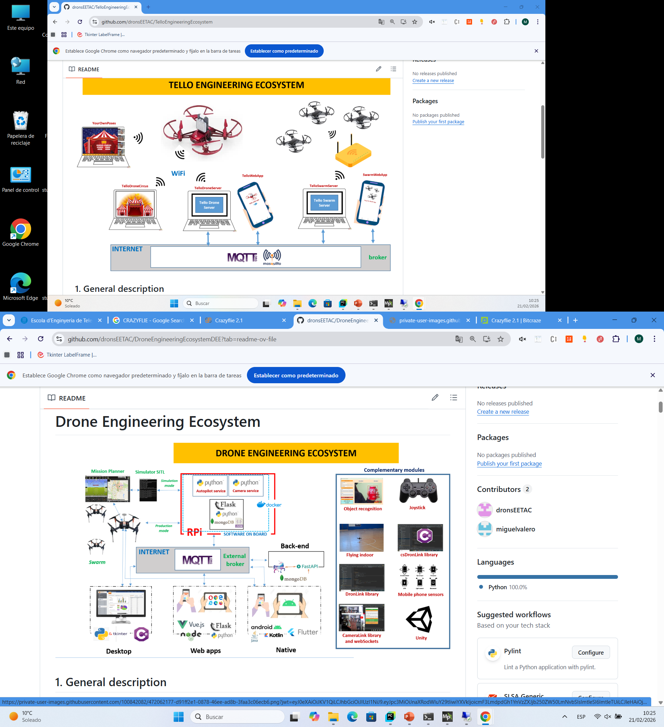

Slide 2
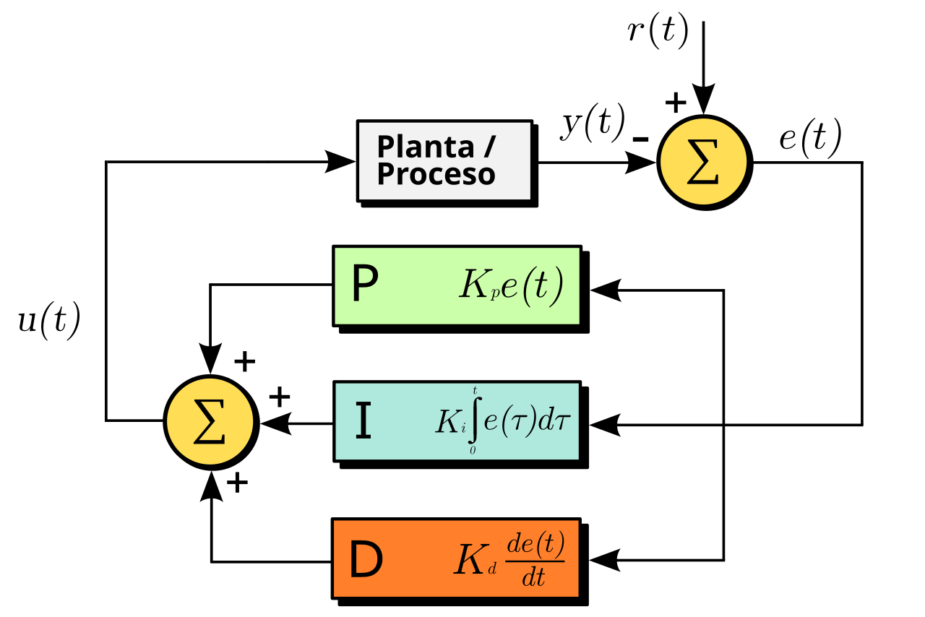
Complementary modules
PID

Slide 3
Complementary modules
PID

