Slide 1
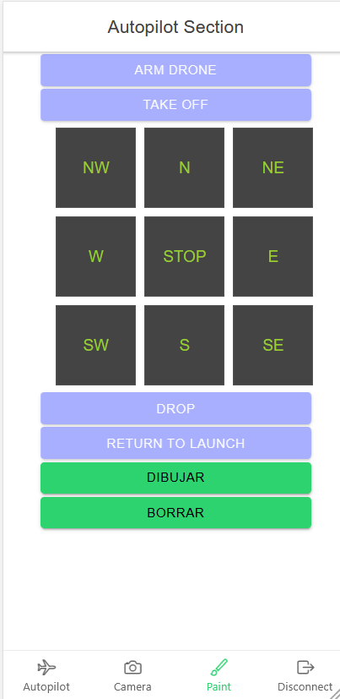

http://dronseetac.upc.edu:8103

Slide 2
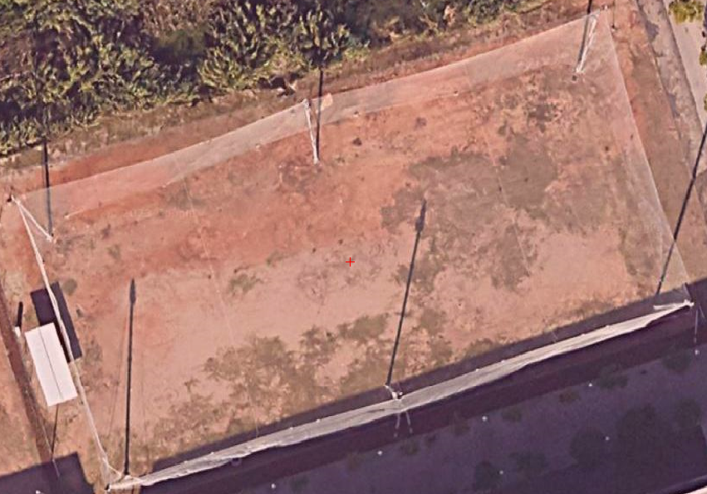


Slide 3
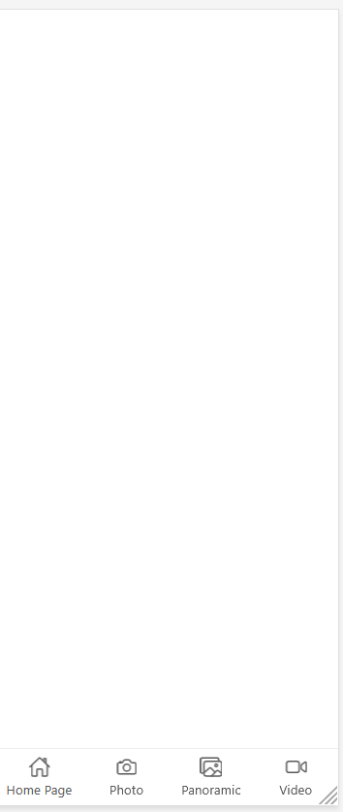
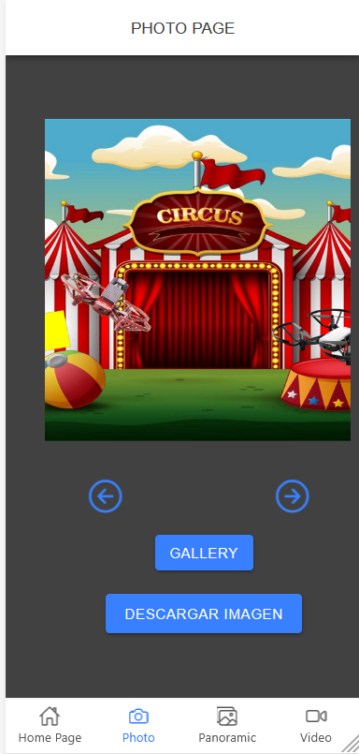

http://dronseetac.upc.edu:8100

Slide 4
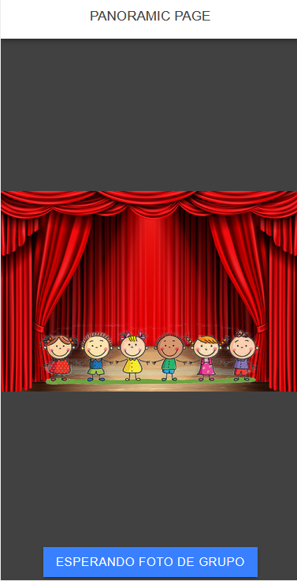
http://dronseetac.upc.edu:8100

